Slide 1

LUA & Corona SDK
Jesse Warden
Boston Corona SDK Meetup 2012

Slide 2

Who?
Jesse Warden
Web App Solution
ExtJS/Sencha Touch/Flex/Java/BlazeDS Consulting

Slide 3


What?
Mobile Gaming
Corona SDK by Ansca Mobile
Lua

Slide 4
Corona SDK: Specifics
Value Proposition
API’s Overview
Physics & Collisions
  Bodies
  Joints
  Forces

Slide 5
Lua: SPecifics
Syntax
OOP
Design Patterns
Frameworks
Components

Slide 6
What is Corona SDK?
Ansca Mobile
SDK for writing Android & iOS Games
http://anscamobile.com
http://developer.anscamobile.com/resources/apis

Slide 7
Corona
Simulator
Builds on the Server

Slide 8
Why Corona?
Box2D is Native
3rd Party API’s are easy
Game network partnerships
Lua is quick to iterate in

Slide 9





Integrations
Facebook
Google Maps
OpenFeint
PapayaMobile

Slide 10
Integrations
iOS Micro Payments (Android coming)
Virtual Currency via SuperRewards
InMobi
App Advertising

Slide 11

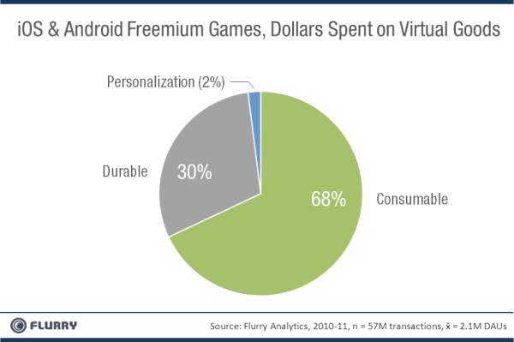
Freemium
Micropayments

Slide 12
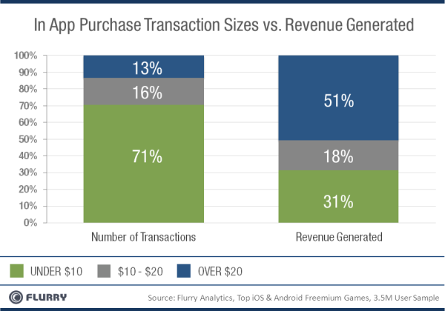
Freemium
Micropayments

Slide 13
Integrations
Metrics

Slide 14
COrona SDK API’s
developer.anscamobile.com/resources/apis

Slide 15
Tools
Corona SDK
IDE
  TextMate
  IntelliJ
  PC: LuaEdit

Slide 16
BOX2D
Physics Engine
Native
Bodies, Joints, and Forces
Every Corona DisplayObject can be a Body

Slide 17

Angry Birds
Box2d Bodies

Slide 18
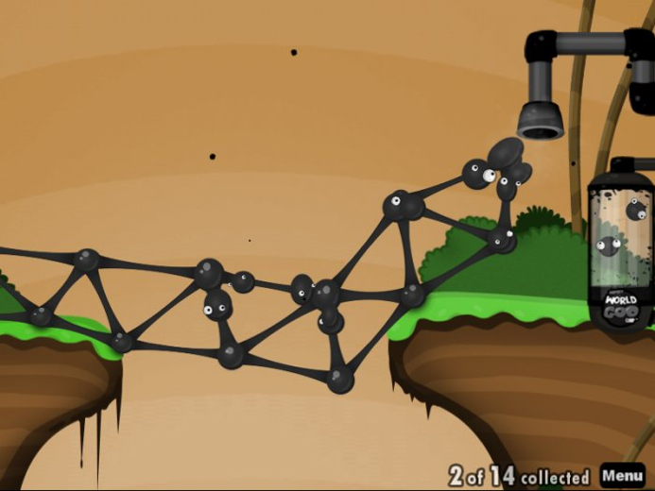
World of Goo
Box2d Joints

Slide 19
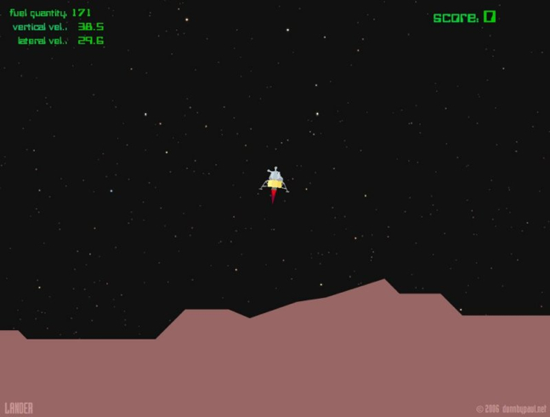
Moon Lander
Box2d Forces

Slide 20
Lua
lightweight, embeddable scripting language
used in robotics, AI, and hardware integration
Adobe Edge/Lightroom GUI built with Lua
20,000 lines of C, 240kb compressed

Slide 21
Lua: MOOAARR INFO
variants
like JavaScript, except
  block scope
  no prototype (has metatables)
  multiple global scopes

Slide 22
Lua Notes
no strong-typing
no classes (wish Squirrel would output Lua...)
packages! w00t

Slide 23
Lua Lessons
[Mr. Body Massage Machine..... GO!]

Slide 24
Corona Resources
http://developer.anscamobile.com/resources/apis
http://learningcorona.com/
http://www.lua.org/

Slide 25
Inspiration
http://flashgameart.com/
http://www.deviantart.com/
http://www.newgrounds.com/
http://www.albinoblacksheep.com/

Slide 26
Game Knowledge
http://gamasutra.com/
http://kotaku.com/

Slide 27
Thank you! Questions?
Jesse Warden
Email: jessew@webappsolution.com
Twitter: @jesterxl
Blog: jessewarden.com
G+: Jesse Warden

