Slide 1

Mobile Game: Corona & Adobe AIR
Jesse Warden

Slide 2
Tools You Need
TextMate
http://macromates.com/
Corona_x000b_https://developer.anscamobile.com/downloads/coronasdk
TextMate Corona Bundle_x000b_https://github.com/osadchuk/Corona-SDK.tmbundle/downloads
TextMate Corona Bundle Installation Instructions_x000b_http://www.ludicroussoftware.com/corona-textmate-bundle/index.html

Slide 3
Tools You Need
Flash Builder
https://www.adobe.com/cfusion/tdrc/index.cfm?product=flash_builder&promoid=FDUMD
Fireworks
http://www.adobe.com/cfusion/tdrc/index.cfm?product=fireworks&promoid=DJDUQ

Slide 4

Who?
Jesse Warden
Web App Solution
Flex/Java/BlazeDS Consulting

Slide 5


What?
Mobile Gaming
Corona SDK by Ansca Mobile
Adobe AIR for Mobile

Slide 6

What You’ll Learn
  Lua

Slide 7
What You’ll Learn
Corona
  Physics & Collisions
  SpriteSheets
  Touch Events
  Achievements & Scores via OpenFeint

Slide 8
What You’ll Learn
Adobe AIR
  3 ways to do blitting
  Touch Events
  DisplayObject nesting
  Adobe Tooling

Slide 9
Corona SDK
Ansca Mobile
SDK for writing Android & iOS Games
http://anscamobile.com
http://developer.anscamobile.com/resources/apis

Slide 10
Corona
Simulator
Builds on the Server

Slide 11
Why Corona?
Box2D is Native
3rd Party API’s are easy
Game network partnerships

Slide 12





Integrations
Facebook
Google Maps
OpenFeint
PapayaMobile

Slide 13
Integrations
iOS Micro Payments (Android coming)
Virtual Currency via SuperRewards
InMobi
App Advertising

Slide 14

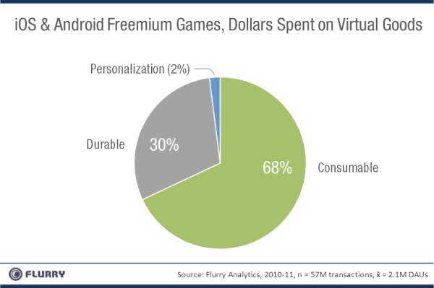
Freemium
Micropayments

Slide 15
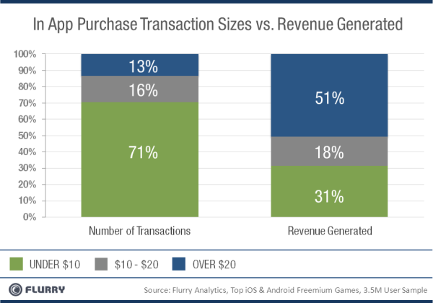
Freemium
Micropayments

Slide 16
Integrations
Metrics

Slide 17
COrona Lessons
Lesson 1: Tools
Lesson 2: Lua
Lesson 3: DisplayObjects
Lesson 4: Events & Timers
Lesson 5: Box2D
Lesson 6: SpriteSheets
Lesson 7: OpenFeint

Slide 18
Lesson 1: Tools
Corona SDK
TextMate
IntelliJ
PC: LuaEdit

Slide 19
Lesson 2: Lua
print
-- and --[[ ]]--
_G
foo = “bar”
nil
bar = nil
variants
types: string, number, function, table, boolean, nil
if then else elseif
concatenation
tables

Slide 20
Lesson 2: Lua
< > <= >= == ~=
and, or, not
type
multiple return types
local vs. global
while / pairs / ipairs, for start,end,optionalIncrment
functions
arg
scope

Slide 21
Lesson 2: Lua
static
self
classes
packages
errors, pcall, assert, error
debug
unit testing: TestMOre

Slide 22
Lesson 3: DisplayObjects
Image: Plane
Image: Bullet
Image: Enemy

Slide 23
Lesson 4: Events & Timers
Move Plane on Touch
Create Enemies via Timer
Move Enemies via enterFrame
Create Bullets and move via enterFrame

Slide 24
Lesson 5: Box2D
Turn it on, set gravity to 0, add Plane
add Enemy
add Bullet
collision events
Collision Filters chart
kill t3h objects

Slide 25
Lesson 6: SpriteSheets
Flash Design
Fireworks Design
Player SpriteSheet
Creation upon death

Slide 26
Lesson 7: OpenFeint
website
  Create Leaderboard
  Create Achievements
require it
init it
on kill, add points
on 10 kills, unlock achievement
make a menu
button for seeing scores
button for seeing achievements

Slide 27
Adobe AIR Lessons
Lesson 1: Tools
Lesson 2: ActionScript
Lesson 3: Bitmaps
Lesson 4: Sprites

Slide 28
Lesson 1: Tools
Flash Builder
IntelliJ
Android SDK
iOS Stack

Slide 29
Lesson 2: ActionScript
trace
// and /* */
; optional, but everyone uses them
var foo = “bar”;
null/undefined/NaN
Number, int, uint, String, Boolean, Array, Vector, Object, ByteArray, Dictionary
if, else, else if, switch
concatenation
Object & * vs. Strict Types

Slide 30
Lesson 2: ActionScript
< > <= >= == != !
functions
typeof
instanceof
classes
packages
access: private, protected, public
scope: local, member, anon/closures, classes
static
local variables

Slide 31
Lesson 3: Bitmaps
Bitmap & BitmapData
copyPixels
scrollRect
scrollRect move
copyPixels

Slide 32
Lesson 4: Sprites
Character: Sprite / SpriteSheet
Move Character
Animated SpriteSheet

Slide 33



Design
Photoshop
Fireworks
Flash

Slide 34
Sprites n’ Assets
[Photoshop: Freeman Script]
[Fireworks: My Script]
[Flash: Onion Skinning]

Slide 35

Adobe AIR
Tooling
Strongly Typed
Runtime Exceptions
Debugging

Slide 36
Adobe AIR
GUI Components
Flex
MinimalComps

Slide 37
Adobe AIR
Libraries
Low-Level Access
Blitting

Slide 38
Adobe AIR
[simple blitting]

Slide 39
Corona Resources
http://developer.anscamobile.com/resources/apis
http://learningcorona.com/
http://www.lua.org/

Slide 40
Adobe AIR Resources
http://help.adobe.com/en_US/FlashPlatform/reference/actionscript/3/index.html
Twitter
G+
http://tech.groups.yahoo.com/group/flexcoders/

Slide 41
Inspiriation
http://flashgameart.com/
http://www.deviantart.com/
http://www.newgrounds.com/
http://www.albinoblacksheep.com/

Slide 42
Game Knowledge
http://gamasutra.com/
http://kotaku.com/

Slide 43
Thank you! Questions?
Jesse Warden
Email: jessew@webappsolution.com
Twitter: @jesterxl
Blog: jessewarden.com

