Slide 1
Refactoring
Jesse Warden

Slide 2
Who?
Jesse Warden
Web App Solution
Flex, Java, and BlazeDS Consulting

Slide 3
What?
Basic Refactoring
Priority Pyramid
Stories
Leadership

Slide 4
Why?
Coding is more fun
People like working with you
Grow in your career
Better Software

Slide 5
No seriously...
I loathe it
People have said articles helped them
Mentor Leadership / Stewardship

Slide 6
Basics
Exceptions
Architecture
Refactoring Paths

Slide 7
Exceptions
Synchronous: 100%
Asynchronous: 99%
Null Pointers

Slide 8
Synchronous
throw new Error(“b00m”);
try/catch
“Road to hell is paved with good intentions.”

Slide 9
Asynchronous
dispatchEvent(new ErrorEvent(“b00m”));
addEventListener(“b00m”, onHandle);
Same as before, don’t swallow.

Slide 10
Uncaught
loaderInfo.uncaughtErrorEvents
won’t always get a stack trace

Slide 11
Uncatchable
Error #2044: Unhandled IOErrorEvent:. text=Error #2036: Load Never Completed.

Slide 12
Null Pointers
Sir Charles Antony Richard Hoare
British Computer Scientist
"I call it my billion-dollar mistake"
Programmer Enemy #1

Slide 13
Null Pointers
Loose Typing
External Data

Slide 14
ExternalInterface
Marshall Exceptions
set to true

Slide 15
Exceptions
Crashes
Unexpected/Unrelated Errors
Breed Insecurity
Cause Fire Drills

Slide 16
Exceptions
Best Defense is a Good Offense
Broken Windows

Slide 17
Fighting Back
try/catch
log the catch
log uncaughtErrors
Code Review

Slide 18
Loose Typing
Object
Dictionary
*
Dynamic
Interfaces

Slide 19
Object
Protoyping
JSON
Teaching
delete slots

Slide 20
Object Solution
Don’t Use Object
Ensure casts aren’t null
Same for Dynamic & Interface

Slide 21
Dictionary
Easier lookups vs. ByteArray
Strict Equality on Keys

Slide 22
Dictionary Solution
Wrap

Slide 23
Star
*

Slide 24
Star Solution
Don’t Use It
Log It
Ensure Consumers Guard

Slide 25
External Data
Factories
Value Object / Data Transfer Object
Parsing

Slide 26
Parsing
Poison Entire System
When in doubt, return null
Proactive: throw meaningful error
Uber Proactive: Unit Test

Slide 27
Parsing
Holy S$*(%&: Null Pattern

Slide 28
Architecture
Encapsulation
Testability

Slide 29
Encapsulation
Black Box
Manages its own internal state

Slide 30
Bad Encapsulation
Global Variables / Singletons
No Accessors/API for Data Models
No API so you dig

Slide 31
Testability
Easy to test
not welded together
not spaghetti code

Slide 32
Services
Service Inside the Proxy
Not a service, just a loader
No centralized error reporting

Slide 33
Service Solutions
Create a base class
log all errors
create an integration suite

Slide 34
Big Ole’ Commands
switch

Slide 35
Refactoring Paths
What do you build now?
What do you change to later?
When?
Not Architecting

Slide 36
Refactoring Path
Ability to code now, satisfy non-programmers for trust earning, with assurance you haven’t coded yourself into a corner.

Slide 37
Marriage
Compromise

Slide 38
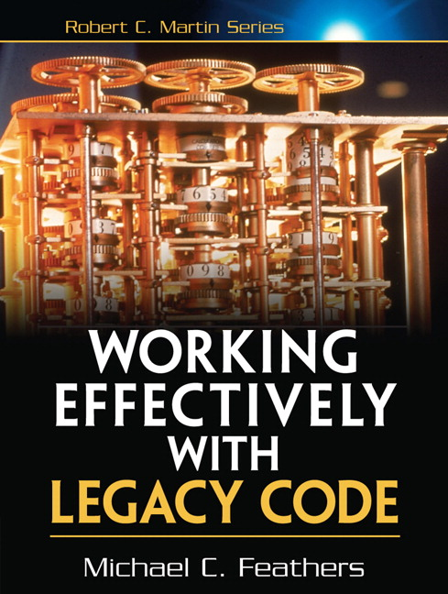
Good Book

Slide 39
It’s Ok. It’ll Be Ok.
Lose some battles...
...as long as you win the war.

Slide 40
Detractors
Don’t have their Poetic License
Fear
Understand the Rules & Ramifications

Slide 41
Detractors
Ivory Zealots
Scars
Don’t Believe in their Refactoring Ability
or Yours

Slide 42
Refactoring Paths
Refactoring is Temporal
Architecture is not
Architecture is Plan
Refactoring is a Strategy

Slide 43
Refactoring Path
Know the rule(s) ur breaking
do it
document what needs to change
when you have time, fix it

Slide 44
Refactoring Paths
Use a *
Cast It

Slide 45
Refactoring Paths
Make an Object
Make a ValueObject

Slide 46
Refactoring Path
Event with public var data:*;

Slide 47
Refactoring Path
Scouting
Bear Bait
Intentional Parsing Throws
Intentional Grenades

Slide 48
Refactoring Path
if if if if if if
then then then then
badger badger badger badger
make a switch
make functions

Slide 49
Refactoring Paths
<s:Component> vs Item Renderer
Passive

Slide 50
Priority Pyramid
Report
Understanding
Trust
Lead

Slide 51
Priority Pyramid
Build
Explosions
Diagnostics
Architecture
Workflow

Slide 52
Pyramid: Report
Who is my boss?
What will make you happy when I leave?

Slide 53
Pyramid: Understanding
Listen
What’s the True Goal?
What are the problems?
What are the challenges?

Slide 54
Pyramid: Understanding
Explore & Document
  Learn Data Model
  Learn Framework
  Understanding the Story

Slide 55
Pyramid: Understanding
  Looking for Red Flags
  Looking for Mines
  Looking for Validation

Slide 56
Pyramid: Understanding
  Dissect People
  What makes them tick?
  Who listens to who?

Slide 57
Pyramid: Trust
Make Friends
Provide Immediate Value

Slide 58
Pyramid: Trust
Check in code into source control 1st week
fix a problem
Only get 1 change at 1st impression
Under Promise, Over Deliver

Slide 59
Pyramid: Trust
Stop Fire Drills
Empower Through Diagnostic Tools
Easy to use, visible logger
Easy to use, visible environment info

Slide 60
Pyramid: Trust
Update on Direction
Provide Transparency
What, why, and when
Plan A, Plan B

Slide 61
Pyramid: Lead
Be Positive
Short Term Goals
Long Term Goals

Slide 62
Pyramid: Lead
Plan
1 thing at a time
Assess Problems
Document

Slide 63
Pyramid: Lead
Re-prioritize as needed

Slide 64
Pyramid: Lead
Delegate
Help
Divide & Conquer
Short Term Branches: 3 days

Slide 65
Experiences

Slide 66
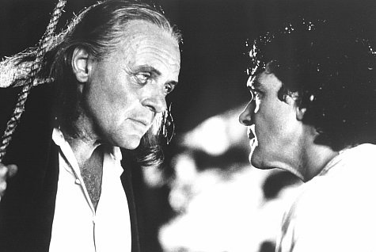
Hearts & Minds

Slide 67
Fight Only to Win

Slide 68
People on Pedestals

Slide 69
Idle Hands

Slide 70
Winston Wolfe
[show video]
[dissect]

Slide 71
Conclusions
Exceptions: Catch & Log
Refactoring: Remember The Paths
Listen, Build Trust, and Lead

Slide 72
Thank You! Questions?
Jesse Warden
webappsolution.com
jessewarden.com
@jesterxl

