Slide 1
Redux, ngRedux, & Sagas
A Gentle Introduction for Angular Developers
Jesse Warden | NationJS | September 16th, 2016

Slide 2
Who
Jesse Warden
I do JavaScript, Little Bit of Node

Slide 3
What We’ll Cover
What & Why of Redux
Redux
ngRedux

Slide 4
2 Things
Pure Functions
Redux Solves the Bubbling Problem

Slide 5
What & Why of Redux
What: Predictable State Container
Why: helps create consistent & predictable applications, easier to test

Slide 6
Er… wat
Er, What: who’s changing my data, when, and where in a predictable fashion

Slide 7
Er… Why?
Er, Why: more hints as to where the defect are… and code you write is easier to unit test

Slide 8
Predictable How
comes from Functional Programming
pure functions / avoiding see effects
examples of pure functions

Slide 10
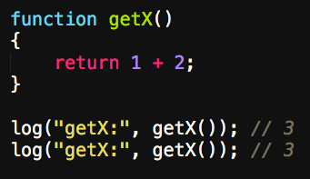

Slide 11
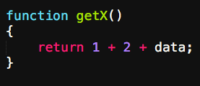

Slide 12
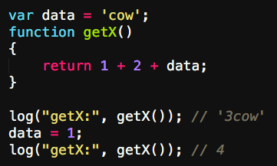

Slide 13
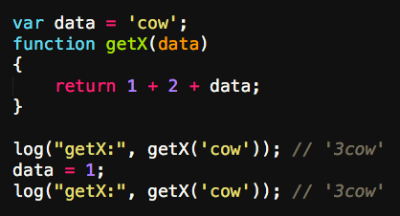

Slide 14
State Waaaat
"Who is the logged in user right now?"

Slide 15
State
the data your front-end application shows and edits
Where you put things
Often called mutable state

Slide 16
Examples of State
window state

Slide 17
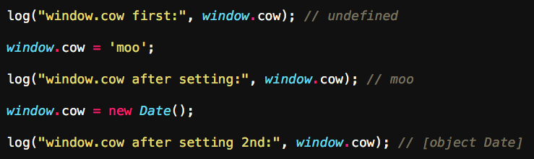

Slide 18
Examples of State
Angular Factory state

Slide 19
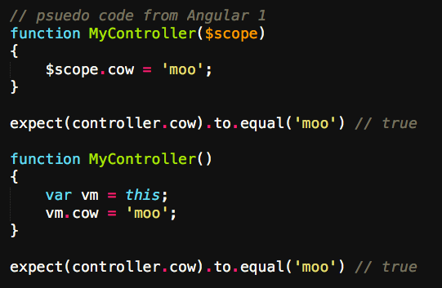

Slide 20
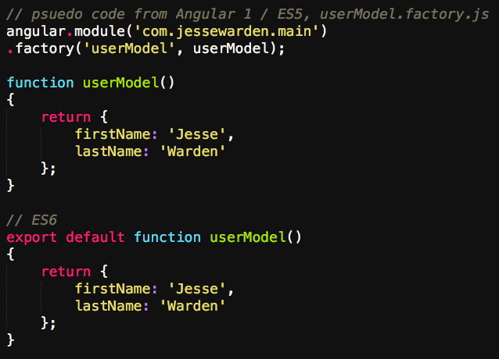

Slide 21
Examples of Changing State
set a variable
have a function do it
Object.assign

Slide 22
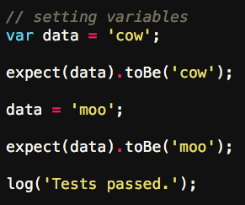

Slide 23
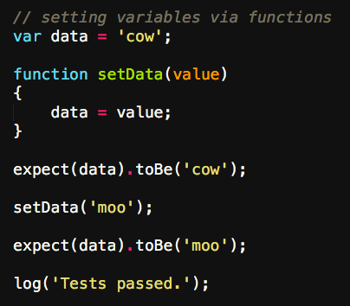

Slide 24
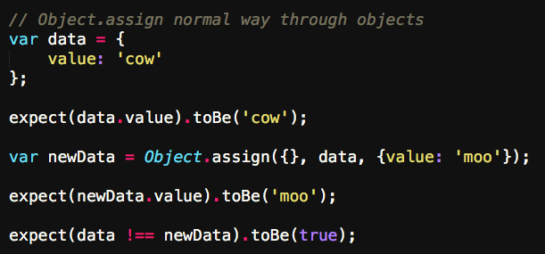

Slide 25
Ok, we get predictable state
predictable: pure functions
state: my data in t3h RAM

Slide 26
The Bubble Problem
When you start refactoring imperative code to use pure functions, you run into the bubble problem: mutable state bubbles up and out state.
Someone, SOMEWHERE, has to eventually store the state by using a var vs. const.
If you abstract it into a safe container, you’ve created Redux.

Slide 27
The Bubble Problem
Imagine you can’t ever use var, only const

Slide 28
Refactor Imperative

Slide 29
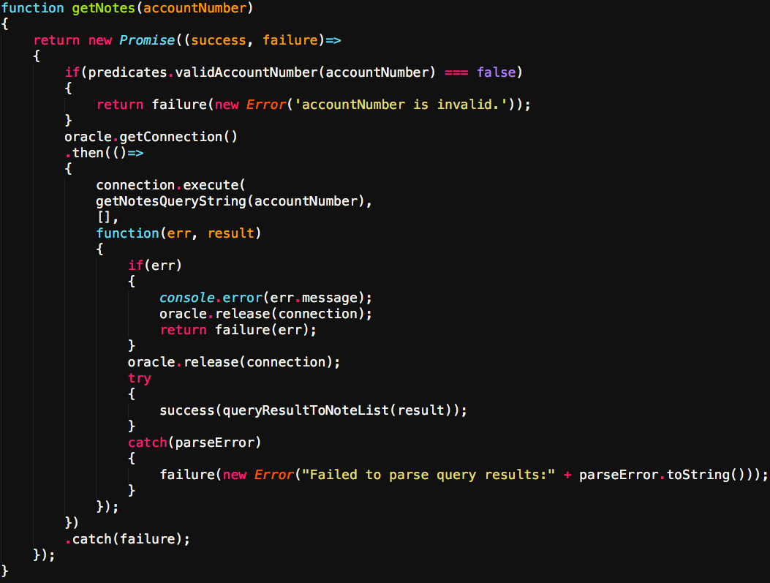

Slide 30
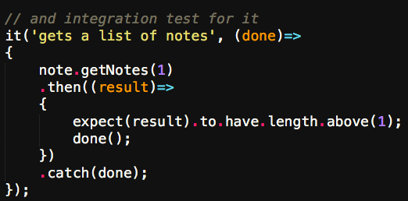

Slide 31
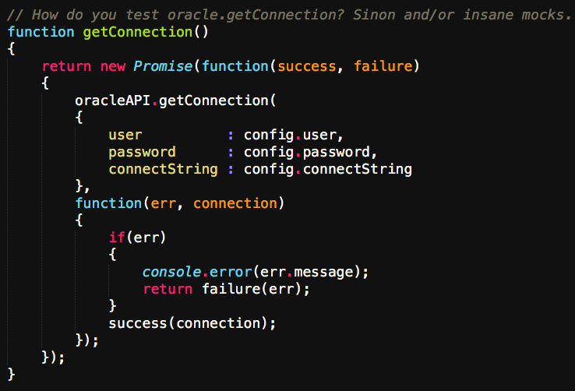

Slide 32
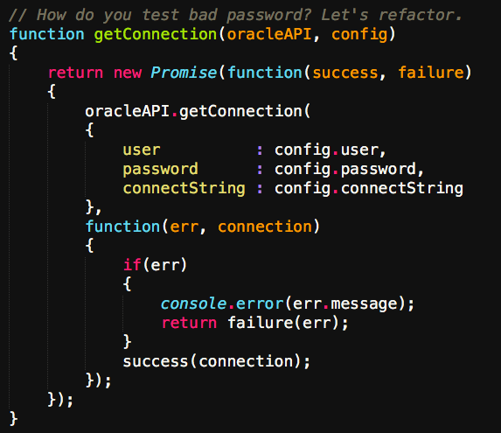

Slide 33
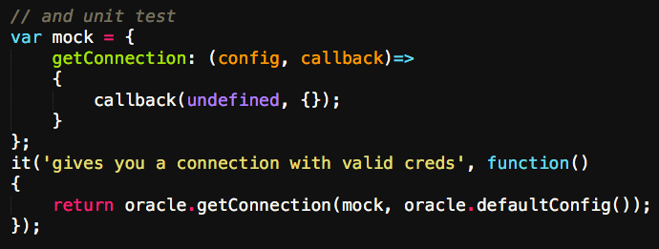

Slide 34
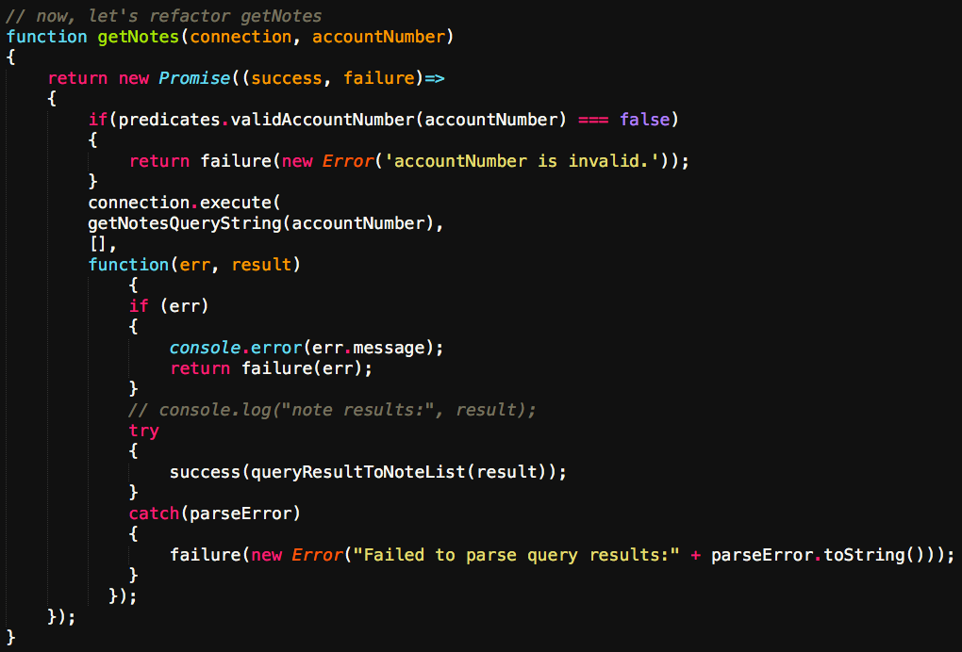

Slide 35
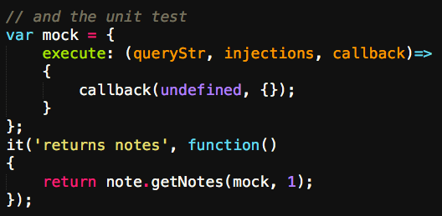

Slide 36
Redux
Data for entire app in a single object. You only change it by dispatching actions with your new value. To actually change the data, you use pure functions.
Data for entire app spread out over multiple classes. You change through method calls. To change data, you'd use getter/setters, or $watchers.

Slide 37
Initial State
data right now
our data model
starts as a basic domain
eventually tree gets pretty big and specialized
show default Object

Slide 38
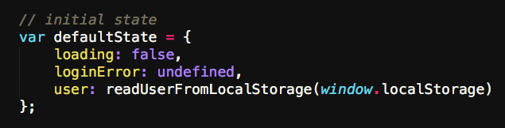

Slide 39
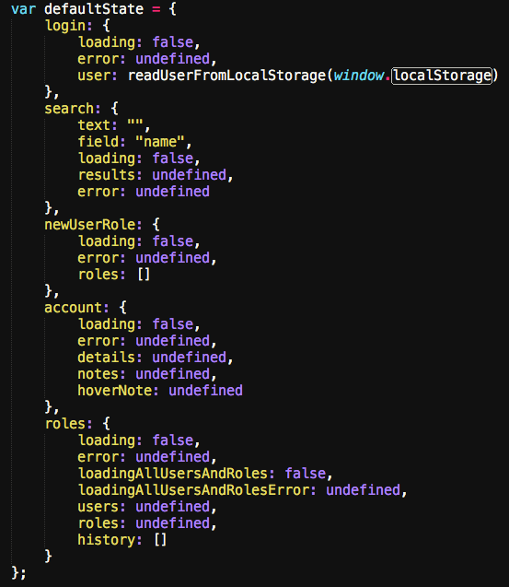

Slide 40
Actions
what happened / what do you want to change?
show basic action
show different types
show WHY action creators (pure functions)

Slide 41
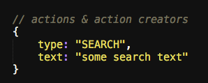

Slide 42
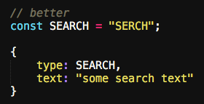

Slide 43
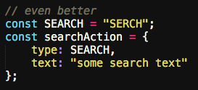

Slide 44
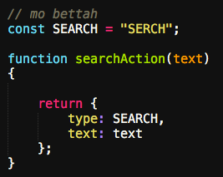

Slide 45
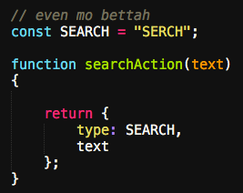

Slide 46
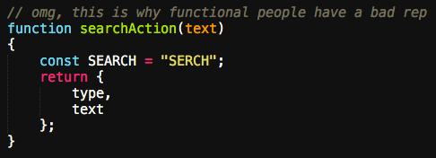

Slide 47
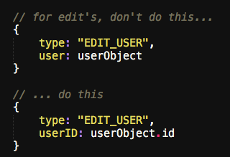

Slide 48
Reducers
change your data in response to what happened
pure as possible
like Array.reduce
_.reduce

Slide 49
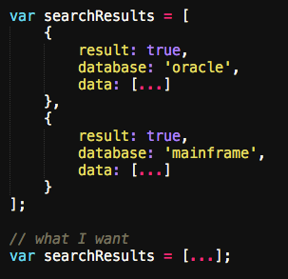

Slide 50
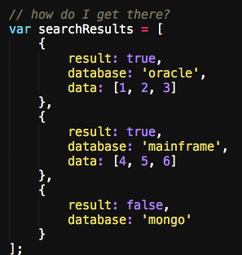

Slide 51
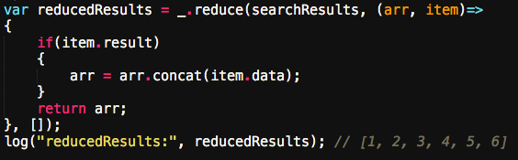

Slide 52
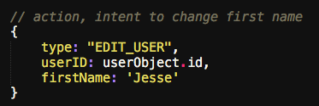

Slide 53
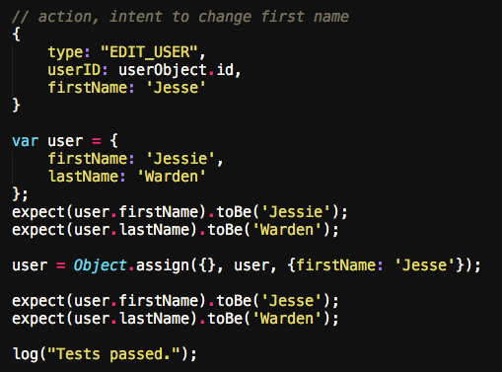

Slide 54
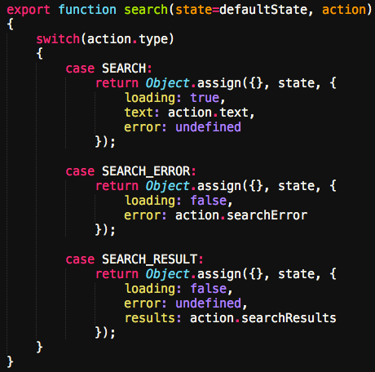

Slide 55
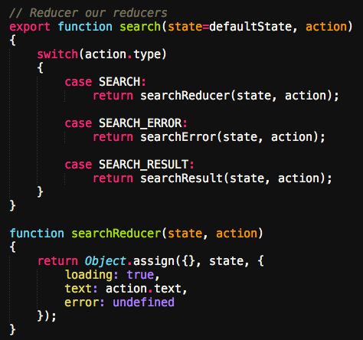

Slide 56
Reducers
talk about initial state again
both in switch default
and in ES6 default
combineReducers shrinks size, not a requirement

Slide 57
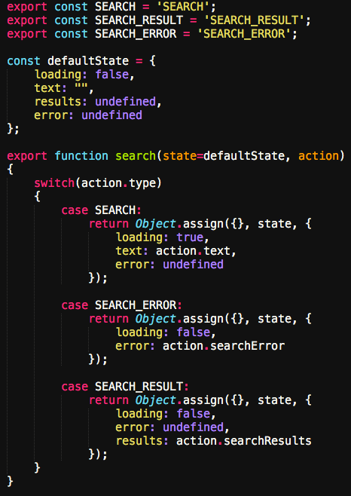

Slide 59
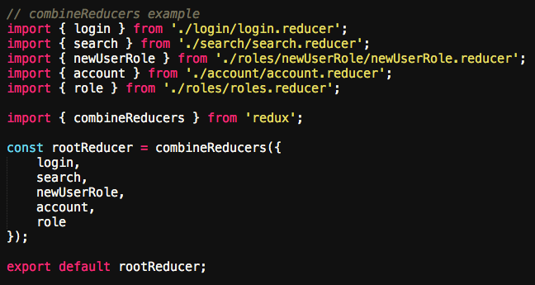

Slide 60
Store
holds your state. There is only 1.
you access it through getState
update state via dispatch(action)
for views/GUI, listen via subscribe(listener)
can set default state via 2nd param of createStore

Slide 61


Slide 62
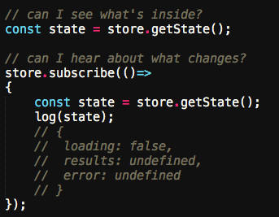

Slide 63
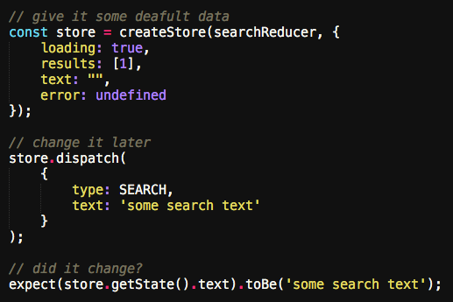

Slide 64
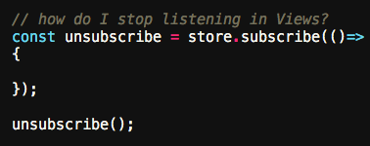

Slide 65
Data Flow
store.dispatch(action)
reducer handles change request
new state tree, saves it
new state of your app via store.subscribe(listener)

Slide 66
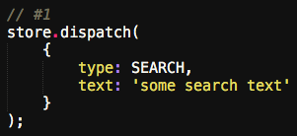

Slide 67
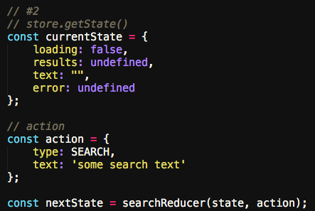

Slide 68
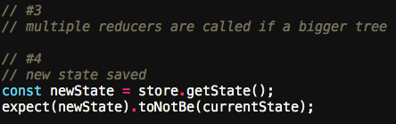

Slide 69
Async
show the 3 states
Thunks: easy to learn, basically promises
Sagas: harder to learn, easier to read & test

Slide 70
Sagas
handling async through pure generator functions

Slide 71
ngRedux
$ngReduxProvider (setup)
$ngRedux (connect)
$onDestroy (unsubscribe)
mapStateToThis

Slide 72
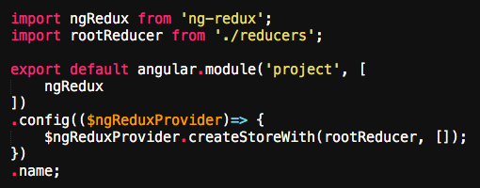

Slide 73
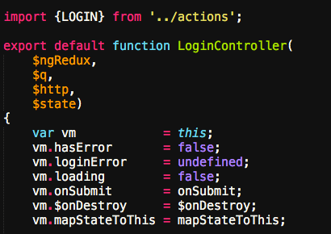

Slide 74
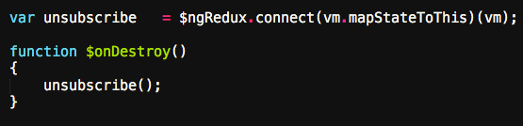

Slide 75
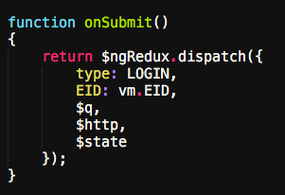

Slide 76
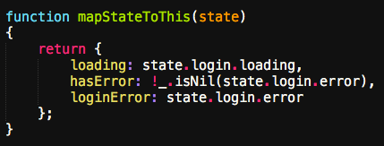

Slide 77
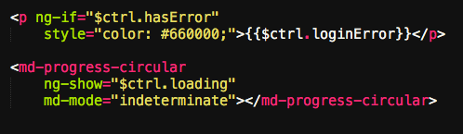

Slide 78
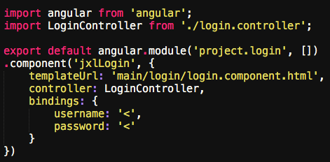

Slide 79
File Organization
Node module to ES6 Module
sock drawer vs. features
http://cliffmeyers.com/blog/2013/4/21/code-organization-angularjs-javascript
reducer(s) & saga(s) per feature

Slide 80
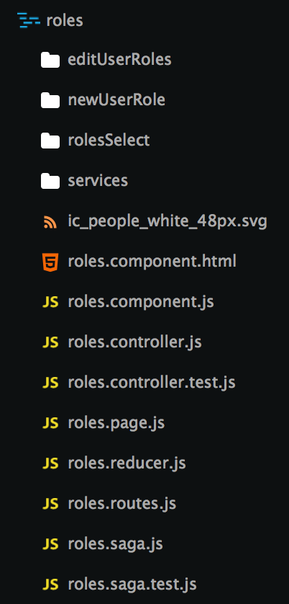

Slide 81
Conclusions
Redux gives you a 2kb functional programming framework that ensures your data is kept as pure as possible.
clear flow of data (action > reducer > store > subscribe)
single data store, scale to multiple functions & class files

Slide 82
Resources
Eric Elliot on What a Pure Function Is https://medium.com/javascript-scene/master-the-javascript-interview-what-is-a-pure-function-d1c076bec976
Learn Array Comprehensions http://reactivex.io/learnrx/
Jesse Warden’s Beginner’s Guide to Functional Programming http://jessewarden.com/2016/08/beginners-guide-to-functional-programming-part-1.html
Lodash https://lodash.com/docs
Dan Abramov teaches Redux on egghead.io https://egghead.io/lessons/javascript-redux-the-single-immutable-state-tree
Redux Documentation http://redux.js.org/docs/api/
Redux Saga Documentation http://yelouafi.github.io/redux-saga/

Slide 83
Questions?
Jesse Warden
jesse@jessewarden.com
@jesterxl on Twitter

