Slide 1
Redux, ngRedux, & Sagas
A Gentle Introduction for Angular Developers
Jesse Warden | NationJS | September 16th, 2016

Slide 2
Who
Jesse Warden
I do JavaScript, Little Bit of Node

Slide 3
What We’ll Cover
What & Why of Redux
Redux
ngRedux

Slide 4
2 Things
Pure Functions
Redux Solves the Bubbling Problem

Slide 5
What & Why of Redux
What: Predictable State Container
Why: helps create consistent & predictable applications, easier to test

Slide 6
Er… wat
Er, What: who’s changing my data, when, and where in a predictable fashion

Slide 7
Er… Why?
Er, Why: more hints as to where the defect are… and code you write is easier to unit test, easier to reason about in a codebase you didn’t write

Slide 8
Predictable How
comes from Functional Programming
pure functions / avoiding side effects

Slide 9
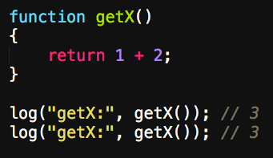

Slide 10
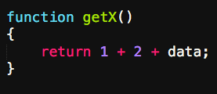

Slide 11
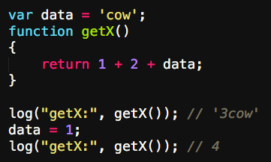

Slide 12
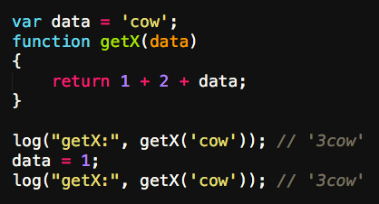

Slide 13
State Waaaat
"Who is the logged in user right now?"

Slide 14
State
the data your front-end application shows and edits
Where you put things
Often called mutable state; you can change something
you can’t change 1
1 is 1, yo

Slide 15
Examples of State
window state

Slide 16
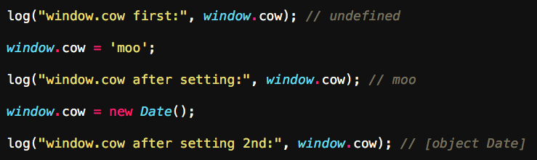

Slide 17
Examples of State
Angular Factory state

Slide 18
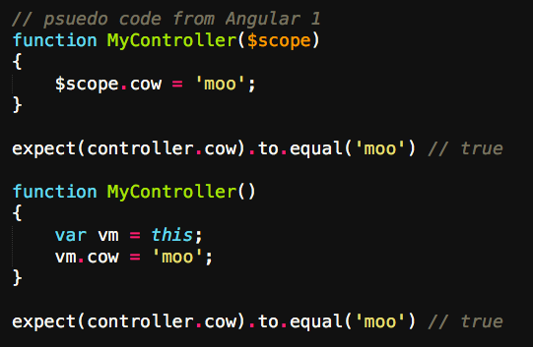

Slide 19
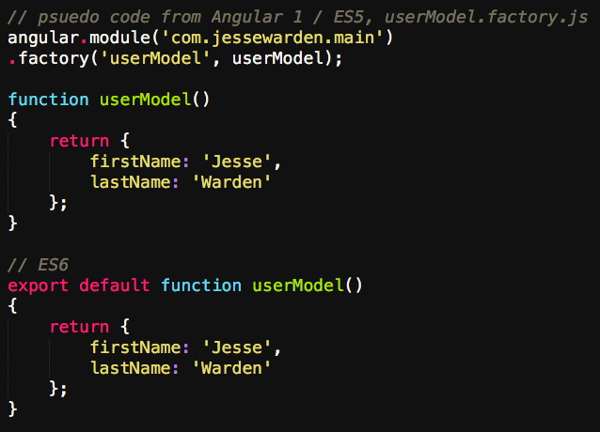

Slide 20
Examples of Changing State
set a variable
have a function do it
Object.assign

Slide 21
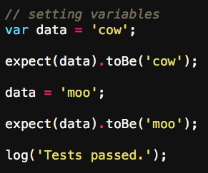

Slide 22
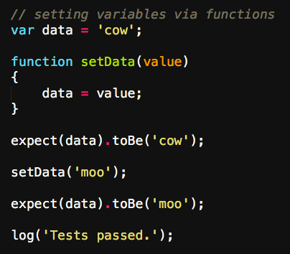

Slide 23
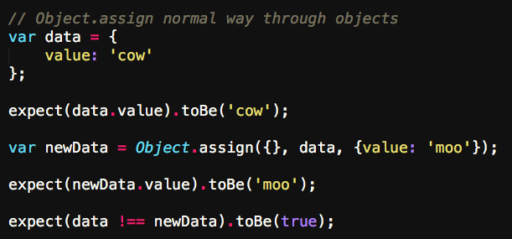

Slide 24
Ok, we get predictable state
predictable: pure functions
state: my data in t3h RAM

Slide 25
The Bubble Problem
When you start refactoring imperative code to use pure functions, you run into the bubble problem: mutable state bubbles up and out state.
Someone, SOMEWHERE, has to eventually store the state by using a var vs. const.
If you abstract it into a safe container, you’ve created Redux.

Slide 26
The Bubble Problem
Imagine you can’t ever use var, only const

Slide 27
Refactor Imperative

Slide 28
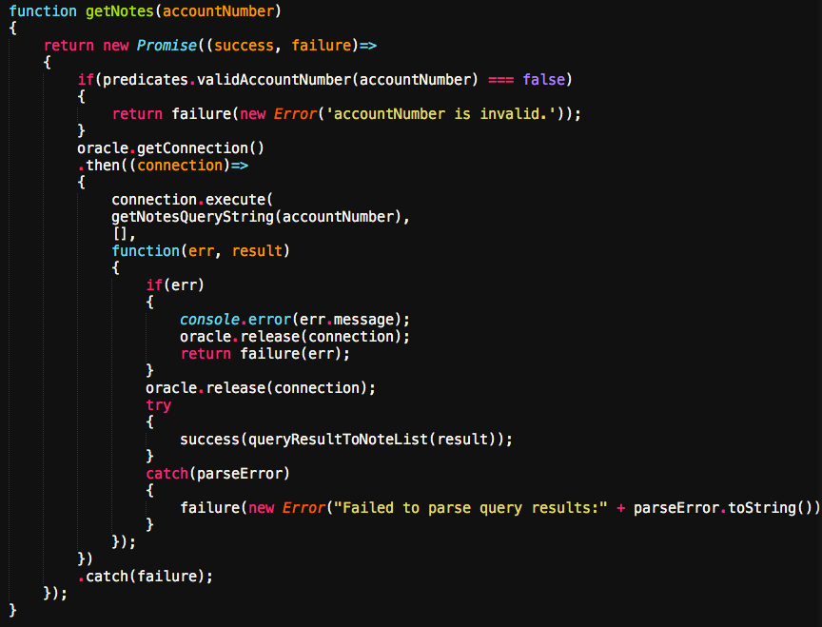

Slide 29
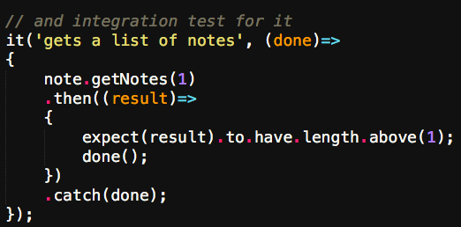

Slide 30
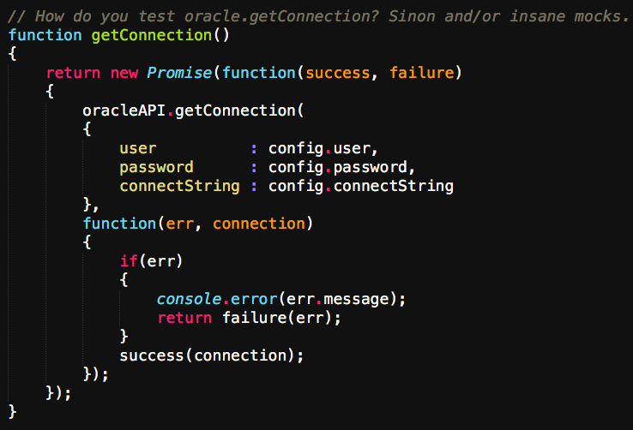

Slide 31
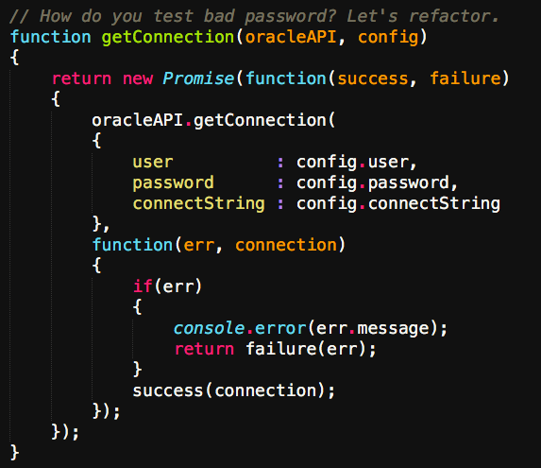

Slide 32
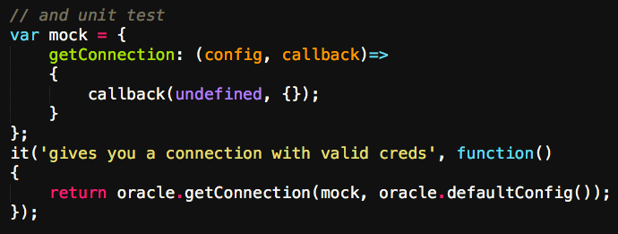

Slide 33
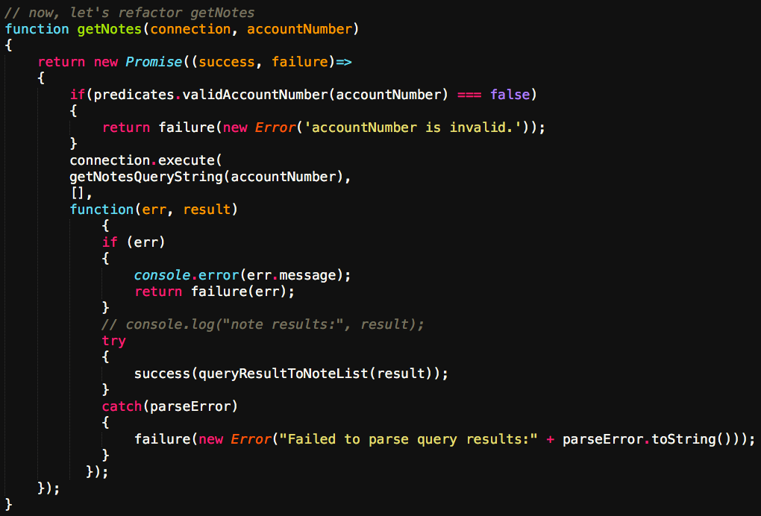

Slide 34
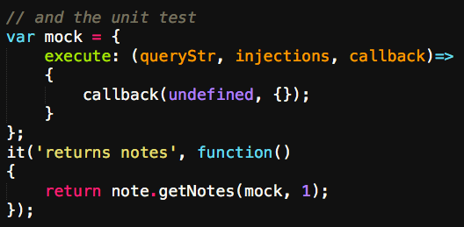

Slide 35
Redux
Data for entire app in a single object. You only change it by dispatching actions with your new value. To actually change the data, you use pure functions.
Data for entire app spread out over multiple classes. You change through method calls. To change data, you'd use getter/setters, or $watchers.
Made by Facebook & Dan Abramov
@dan_abramov on Twitter

Slide 36
Initial State
our data "right now"
our data or domain model
starts as a basic Object…
eventually tree gets pretty big and specialized

Slide 37
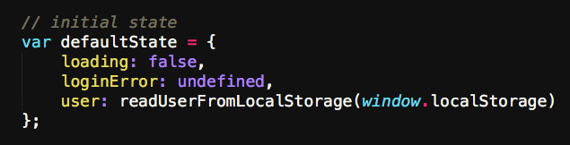

Slide 38
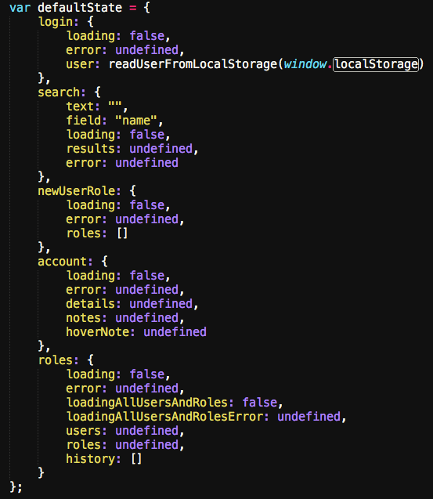

Slide 39
Actions
what happened / what do you want to change?
Either an object…
… or a pure function that makes an Object

Slide 40
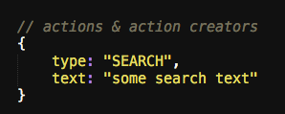

Slide 41
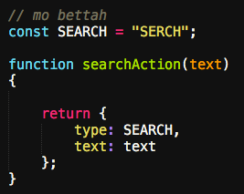

Slide 42
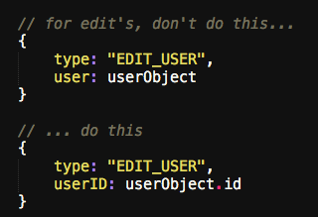

Slide 43
Reducers
change your data in response to what happened
pure as possible
like Array.reduce
_.reduce

Slide 44
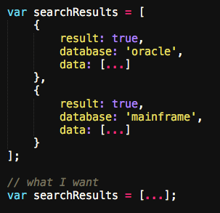

Slide 45
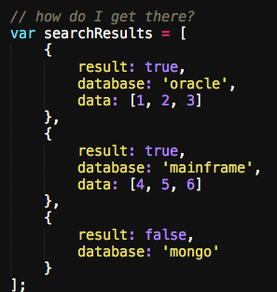

Slide 46
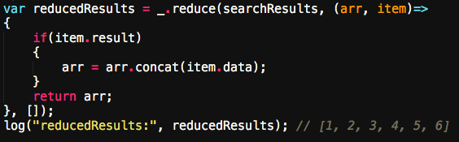

Slide 47
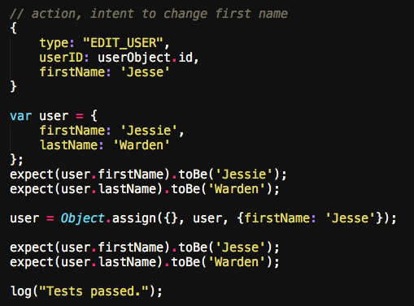

Slide 48
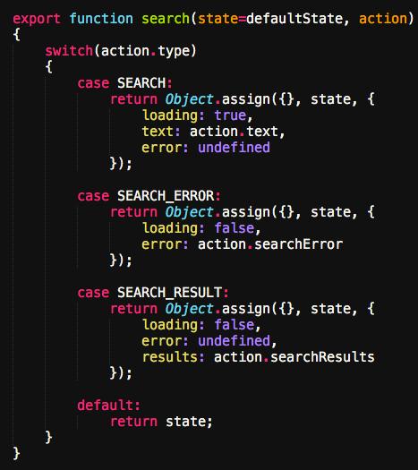

Slide 49
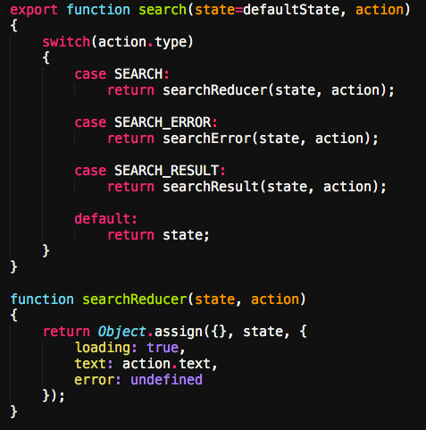

Slide 50
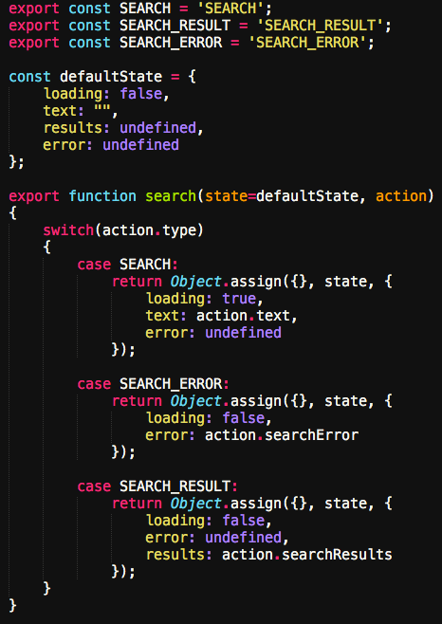

Slide 52
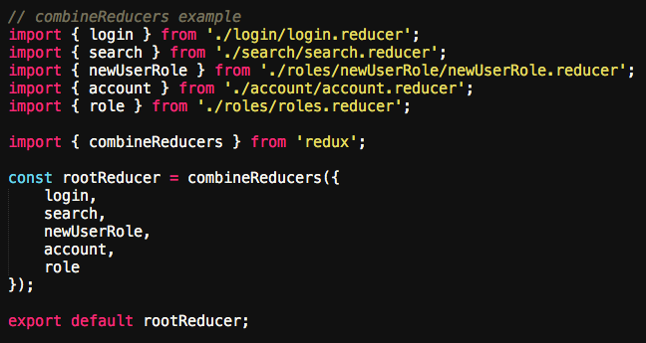

Slide 54
Store
holds your state. There is only 1.
you access it through getState (kinda pure)
update state via dispatch(action)
for views/GUI, listen via subscribe(listener)
can set default state via 2nd param of createStore

Slide 55


Slide 56
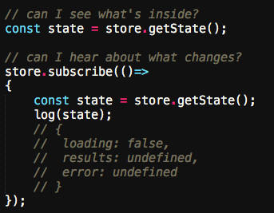

Slide 57
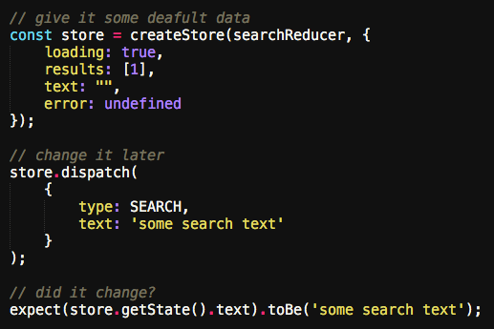

Slide 58
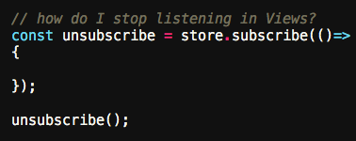

Slide 59
Data Flow
store.dispatch(action)
reducer handles change request
new state tree, saves it
new state of your app via store.subscribe(listener)

Slide 60
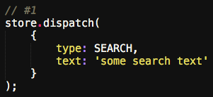

Slide 61
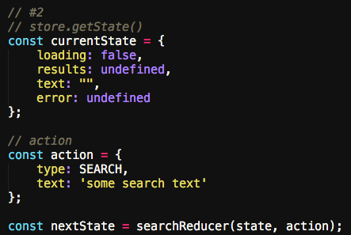

Slide 62
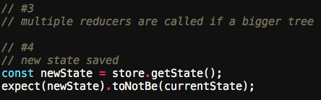

Slide 63
Async
THUNKS MEH
SAGAS GOOD
WELCOME TO AMURRRRICA, MAX

Slide 64
ngRedux
$ngReduxProvider (setup)
$ngRedux (connect)
$onDestroy (unsubscribe)
mapStateToThis

Slide 65
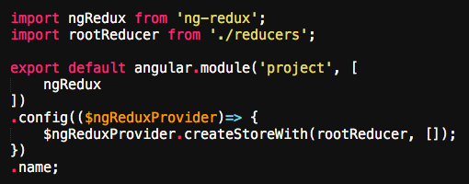

Slide 66
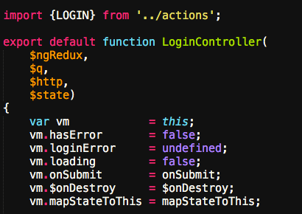
Angular 2
ngOnDestroy

Slide 67
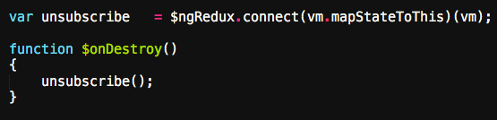

Slide 68
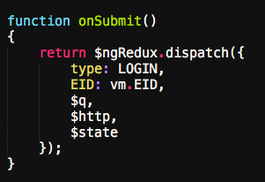

Slide 69
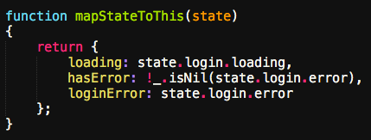

Slide 70
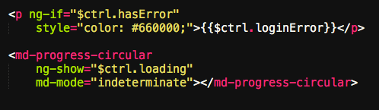

Slide 71
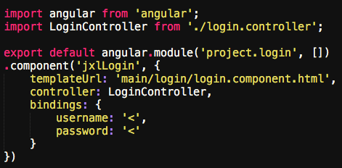

Slide 72
File Organization
Node module to ES6 Module
sock drawer vs. features
http://cliffmeyers.com/blog/2013/4/21/code-organization-angularjs-javascript
reducer(s) & saga(s) per feature

Slide 73
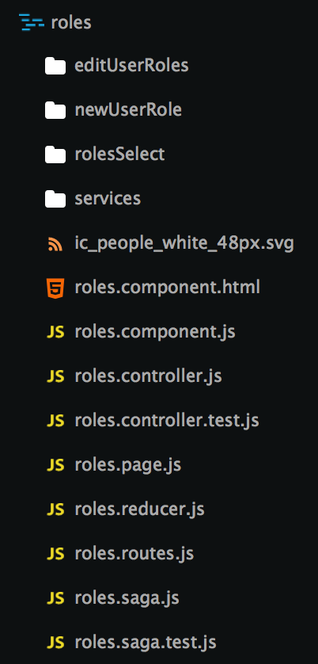

Slide 74
Conclusions
Redux gives you a 2kb functional programming framework that ensures your data is kept as pure as possible.
clear flow of data (action > reducer > store > subscribe)
single data store, scale to multiple functions & class files
solves the functional bubble problem via pure functions

Slide 75
Resources
Eric Elliot on What a Pure Function Is https://medium.com/javascript-scene/master-the-javascript-interview-what-is-a-pure-function-d1c076bec976
Learn Array Comprehensions http://reactivex.io/learnrx/
Jesse Warden’s Beginner’s Guide to Functional Programming http://jessewarden.com/2016/08/beginners-guide-to-functional-programming-part-1.html
Lodash https://lodash.com/docs
Dan Abramov teaches Redux on egghead.io https://egghead.io/lessons/javascript-redux-the-single-immutable-state-tree
Redux Documentation http://redux.js.org/docs/api/
Redux Saga Documentation http://yelouafi.github.io/redux-saga/
John Papa Angular Style Guide https://github.com/johnpapa/angular-styleguide

Slide 76
Questions?
Jesse Warden
jesse@jessewarden.com
@jesterxl on Twitter

