Slide 1
SYstem, WebPack, & JSPM
Jesse Warden | RVA.js | Nov 3 2015

Slide 2
What?
Text
DevOps & Lean Engineering
Brief on Angular/React/Backbone & Node Workflow
Deep Dive in JavaScript Modules

Slide 3
DevOps & Lean Engineering
Lean Engineering Process v02

Slide 4
Angular & Node WOrkflow
Angular and Node in AOWP v3

Slide 5
Angular 2
Angular 2 Overview

Slide 6
JavaScript
Modules

Slide 7
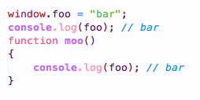
Global
window
In the beginning… there was window

Slide 8
Global Bad
No Scale
global variables: they fast…
… but no clue who’s setting them, access control
global state
no control

Slide 9
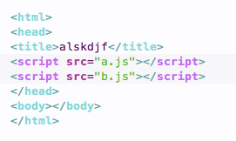
External Files
<script src>
load via block
parse
"run"
Notes:
Show External code on desktop

Slide 10
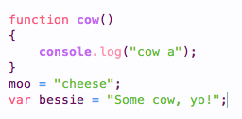
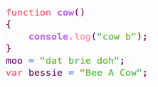
a.js vs. B.js
External

Slide 11
Script Problems
You shouldn’t write ‘em
order issue
flat dependency != tree
Notes:
Show A vs. B load order if you haven’t

Slide 12
CommonJS
Node
Encapsulation / Global Safe (unless you r t3h l@m3 and use global)
Module system
Version Safe (via local node_modules)
synchronous
dependent loading
Node (server or build system)

Slide 13
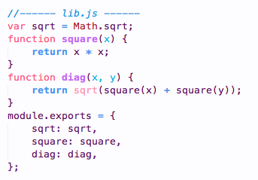
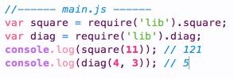
CommonJS
Node

Slide 14
Require.js
Browser
asynchronous
different than <script defer>
back when "pages" vs. "views" or "components" nomenclature
CDN hosted libs
"load on the fly"
minor dependency injection
build via r.js

Slide 15
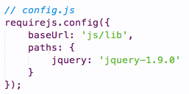
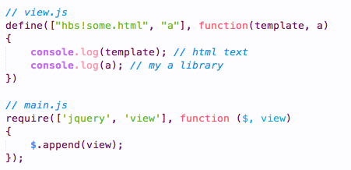
Require.js
Example

Slide 16
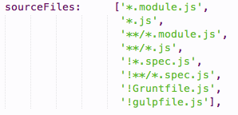
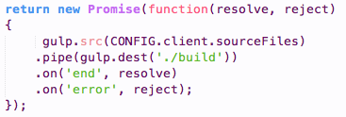
Grunt / Gulp
Build
Angular (ok)
Manual Dependency Ordering (insane, no scale)

Slide 17
Browserify
Require in the Browser
"work everywhere"
Node rocks with CommonJS, let’s use it
"universal JavaScript"
i.e. lodash
build system, not runtime
supports bundles (atomify, cssify, tsify)
https://github.com/substack/browserify-handbook

Slide 18
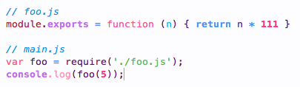
Browserify
Require in the Browser

Slide 19

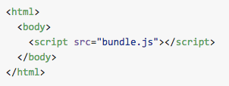
Browserify
Require in the Browser

Slide 20
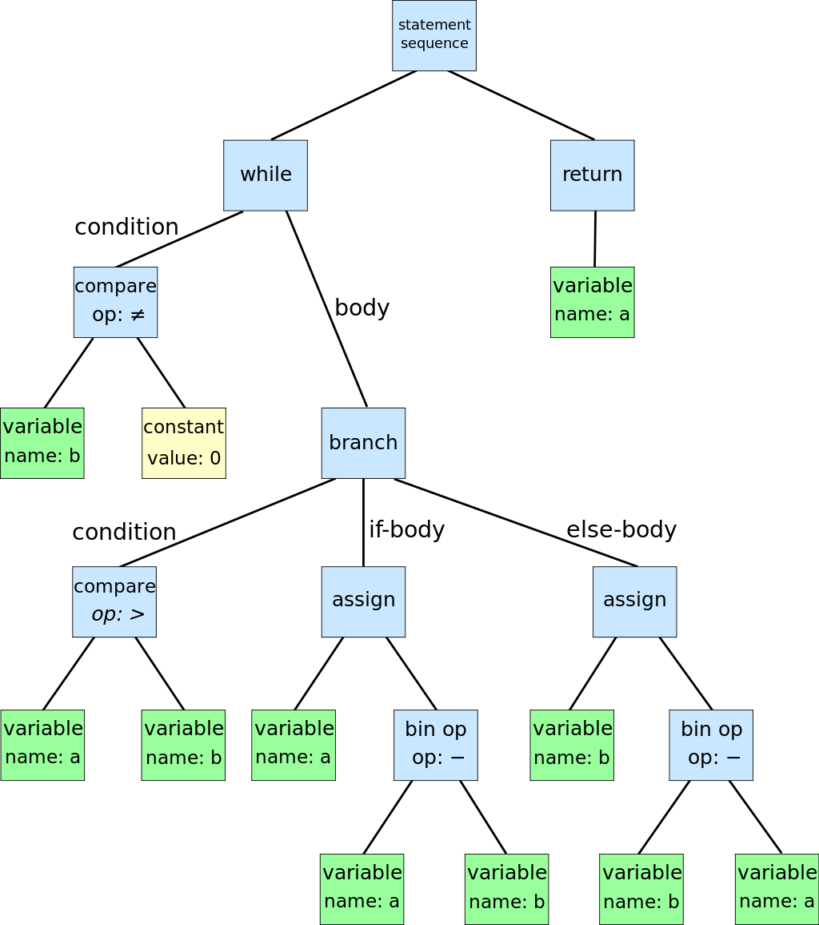
Browserify
Require in the Browser
static analysis (uses detective)
creates Abstract Syntax Tree (AST)

Slide 21
Browserify
Require in the Browser
injectable
hot replace
via beefy, wzrd, browserify-middleware, etc.

Slide 22
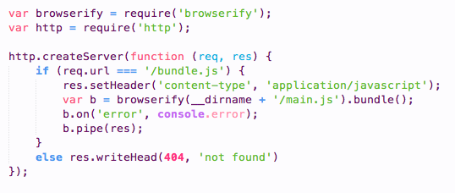
Browserify
Require in the Browser

Slide 23
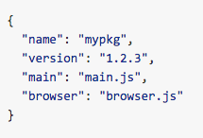
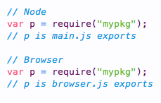
Browserify
Require in the Browser
built in classes for Node in the browser
transforms (CoffeeScript, TypeScript, CSS, images, etc)
customizable browser fallback

Slide 24
ES6
New JS
ECMAScript 2015
No one calls it that except for standards people
OOP: Yay, classes!
Functional: Yay, new features!
DevOps: Yay, static dependency tree!
http://exploringjs.com/es6/ch_modules.html

Slide 25
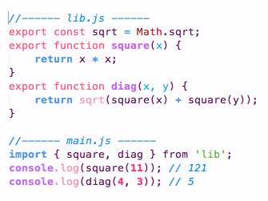

ES6
Example

Slide 26
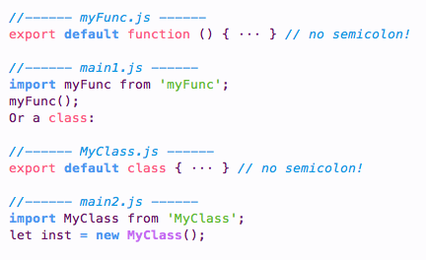
ES6
Example

Slide 27
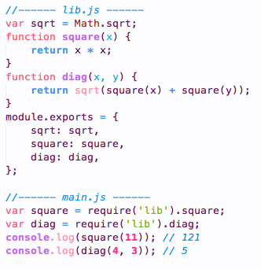
ES6
Example

Slide 28
ES6
Example
 | Scripts | Modules
HTML | <script> | <script type="module">
Top-Level variables are | global | local to module
Value of this at top level | window | undefined
Executed | sync | async
import statement | no | yes
Promise-based API | yes | yes
File extension | .js | .js

Slide 29
ES6
Other benefits
better cyclic dependencies
module renaming on consumer
import { name1 as localName1, name2 } from ‘src/my_lib';
static initializer
import 'src/my_lib';

Slide 30
Webpack
Loader of Everything
better Require.js
more features / API’s than Browserify
built in vs. plugins/3rd party
does that matter…?
… only for ES6
… AND RUNTIME
https://webpack.github.io/

Slide 31
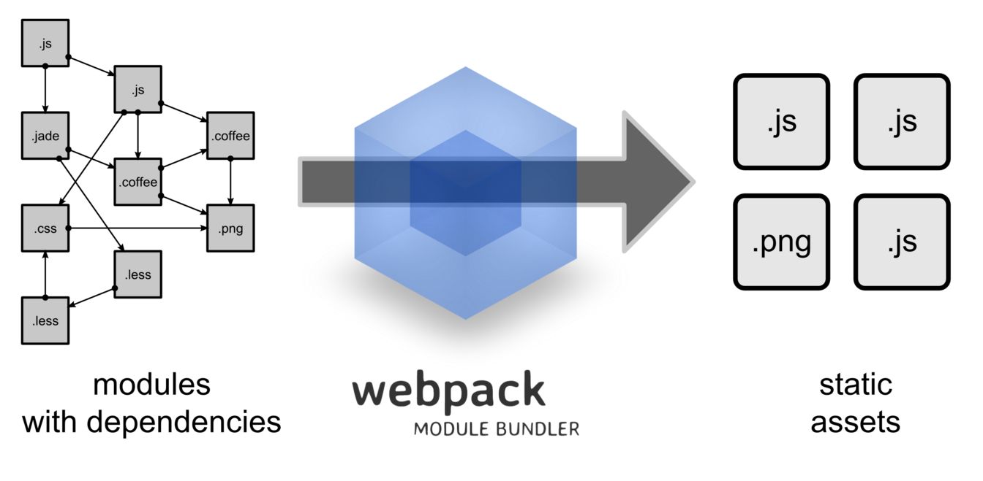
Webpack
Loader of Everything

Slide 32
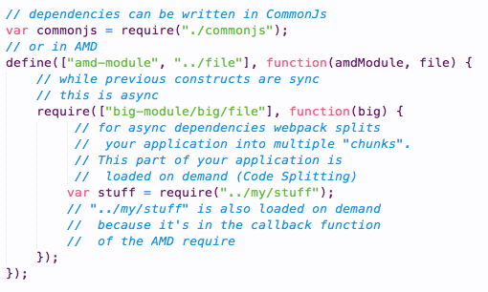
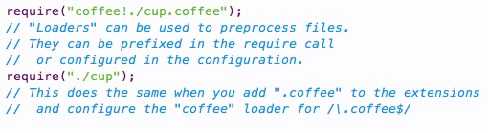
Webpack
Loader of Everything

Slide 33

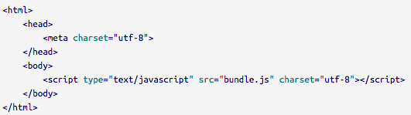
Webpack
Loader of Everything
bundle it

Slide 34
Webpack
Loader of Everything
npm install webpack-dev-server -g
webpack-dev-server —progress —colors
Code Splitting: http://webpack.github.io/docs/code-splitting.html

Slide 35
ES6-Module-Loader
Level 1: Boilerplate
programmatically work with modules
configure module loading
Loader: NOT part of the standard
System: NOT part of the standard
… both are expected to be
https://github.com/ModuleLoader/es6-module-loader

Slide 36
ES6-Module-Loader
Specifics
Provides System.import
Runtime, not build time
Assumes Traceur, Babel, or TypeScript
ES6 circular refs
paths
[show basic]

Slide 37
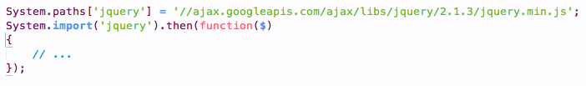
ES6-Module-Loader
Specifics

Slide 38
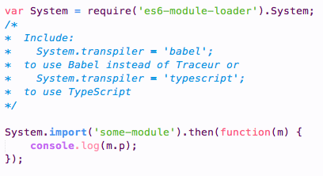
ES6-Module-Loader
Specifics

Slide 39
SystemJS
Level 2: For Usage
Built on ES6-Module-Loader
loads any module format (CommonJS, AMD, ES5, ES6, None)
Supports RequireJS-style maps, paths, shims, etc.
Loader plugin works with CSS, JSON, and Images
Browser + Node
Gallons of plugins like Browserify & Webpack have

Slide 40
SystemJS
Level 2: For Usage
Zebra Striping
Modules
Standalone

Slide 41
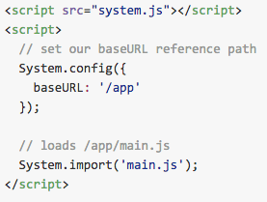
SystemJS
Level 2: Browser

Slide 42
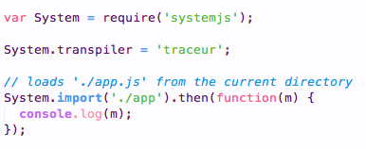
SystemJS
Level 2: Node

Slide 43
JSPM
Level 3: All you Need
package manager for SystemJS
called ES6 module loader (but you know better)
loads from npm and Github
dev == load, prod == standalone (or load)
CLI for installing; use jspm instead of npm
global registry
http://jspm.io/

Slide 44

JSPM
Level 3: All you Need
npm should work out of the box
NodeJS libs for Browser are same as Browserify
GitHub version is semvar
package.json by default, or overridden by you
flattens dependencies

Slide 45
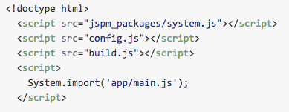
JSPM
Level 3: All you Need
improves package.js with new tags
Notes:
Show bottom of jspm.io

Slide 46

JSPM
Level 3: All you Need
standalone (production)

Slide 47
COnclusions
Done.
JSPM should be all you need
Will probably be standard
Runtime + Build time
All 3 libraries built-on top of each other
supports 3 languages and all module formats

Slide 48
Jesse Warden
Thanks!
@jesterxl
jesse@jessewarden.com
https://www.youtube.com/user/jesterxl
http://jessewarden.com/blog/

