Slide 1
Logical Equivalence
Topic #1.1 – Propositional Logic: Equivalences
Compound propositions p and q are logically equivalent to each other IFF p and q contain the same truth values as each other in all rows of their truth tables.
Notes:
Discrete Math - Module #1 - Logic
114/01/03
(c)2001-2002, Michael P. Frank

Slide 2
Proving Equivalence via Truth Tables
Topic #1.1 – Propositional Logic: Equivalences
Ex. Prove that p∨q ⇔ ¬(¬p ∧ ¬q).
F
T
T
T
F
T
T
F
F
T
T
F
T
F
T
T
F
F
F
T
Notes:
Discrete Math - Module #1 - Logic
114/01/03
(c)2001-2002, Michael P. Frank

Slide 3
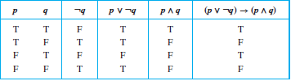
Truth Table Construction
Construct the truth table of the compound proposition
(p ∨ ¬ q) → (p ∧ q)

Slide 4
Equivalence Laws
Topic #1.1 – Propositional Logic: Equivalences
These are similar to the arithmetic identities you may have learned in algebra, but for propositional equivalences instead.
Two compound propositions that always have the same truth value are called logically equivalent (denoted ≡).
Notes:
Discrete Math - Module #1 - Logic
114/01/03
(c)2001-2002, Michael P. Frank

Slide 5
Equivalence Laws
Topic #1.1 – Propositional Logic: Equivalences
Identity: p∧T ⇔ p p∨F ⇔ p
Domination: p∨T ⇔ T p∧F ⇔ F
Idempotent: p∨p ⇔ p p∧p ⇔ p
Double negation: ¬¬p ⇔ p
Commutative: p∨q ⇔ q∨p p∧q ⇔ q∧p
Associative: (p∨q)∨r ⇔ p∨(q∨r)
(p∧q)∧r ⇔ p∧(q∧r)
Notes:
Discrete Math - Module #1 - Logic
114/01/03
(c)2001-2002, Michael P. Frank

Slide 6
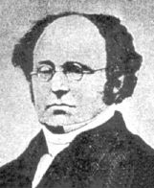
More Equivalence Laws
Topic #1.1 – Propositional Logic: Equivalences
Distributive: p∨(q∧r) ⇔ (p∨q)∧(p∨r)
p∧(q∨r) ⇔ (p∧q)∨(p∧r)
De Morgan’s:
¬(p∧q) ⇔ ¬p ∨ ¬q
¬(p∨q) ⇔ ¬p ∧ ¬q
Trivial tautology/contradiction: (Negation)
p ∨ ¬p ⇔ T p ∧ ¬p ⇔ F
Absorption: p∧(p∨q) ⇔ p and p∨(p∧q) ⇔ p
Augustus
De Morgan
(1806-1871)
Notes:
Discrete Math - Module #1 - Logic
114/01/03
(c)2001-2002, Michael P. Frank

Slide 7
Defining Operators via Equivalences
Topic #1.1 – Propositional Logic: Equivalences
Using equivalences, we can define operators in terms of other operators.
Exclusive or: p⊕q ⇔ (p∨q)∧¬(p∧q)
p⊕q ⇔ (p∧¬q)∨(q∧¬p)
Implies: p→q ⇔ ¬p ∨ q
Biconditional: p↔q ⇔ (p→q) ∧ (q→p)
p↔q ⇔ ¬(p⊕q)
Notes:
Discrete Math - Module #1 - Logic
114/01/03
(c)2001-2002, Michael P. Frank

Slide 8

Constructing New Logical Equivalences

Slide 9
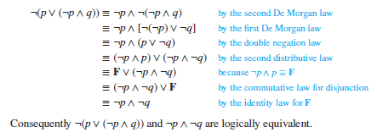
Constructing New Logical Equivalences

Slide 10
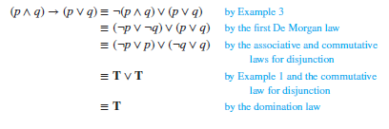
Constructing New Logical Equivalences

