Slide 1
Translating English Sentence into Logical Expressions
Using propositional variables and logical connectives, we can translate English sentences into logical expressions.
E.g., You can access the Internet from campus only if you are a computer science major or you are not a freshman.
Solution:

Slide 2

System Specification
(Consistent/Inconsistent)
Translating English sentence into logical expressions is an essential part of specifying both hardware and software systems.
To check Consistent/Inconsistent

Slide 3

System Specification
(Consistent/Inconsistent)
Problem
What will happen if I add the following statement
“The diagnostic message is not retransmitted”
Still Consistent?

Slide 4
Predicates and Quantifiers

Slide 5
Predicates and Quantifiers
Predicate : It is a property that is affirmed or denied.
i.e., part of sentence that attributes a property to the subject.
Here subject refers a variable.
Used to express the meaning of a wide range of statements in mathematics and computer science in ways that permit us to reason and explore relationships between objects.

Slide 6
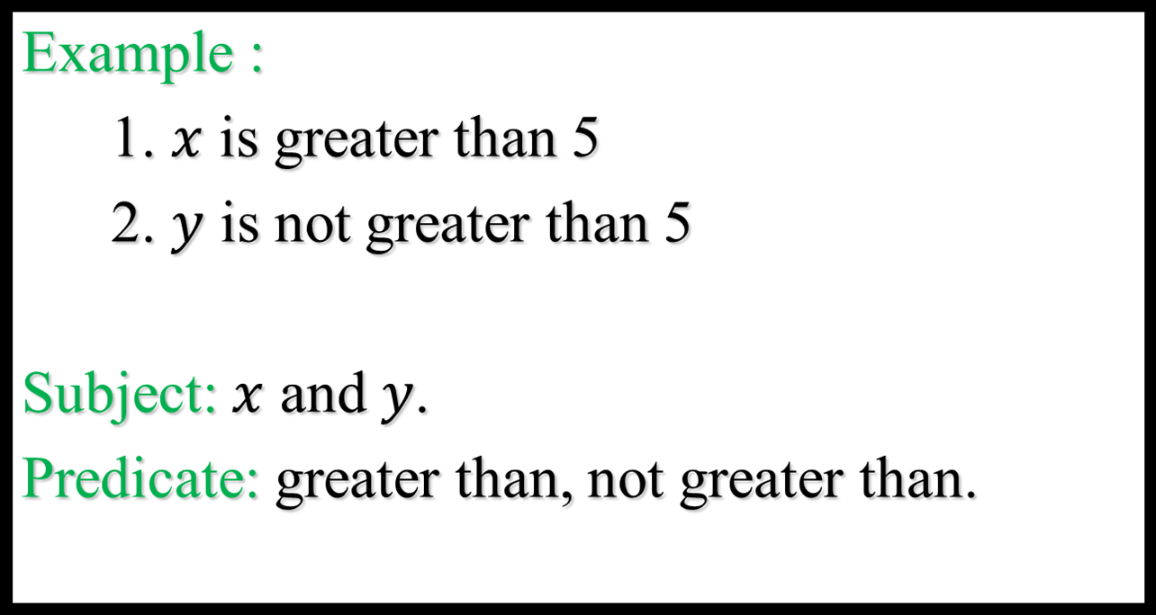
Predicates

Slide 7
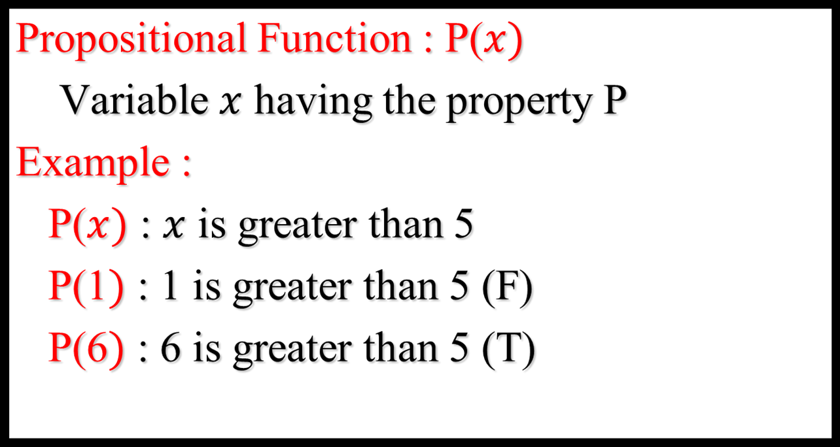
Predicates

Slide 8

Predicates
Example

Slide 9

Quantification

Slide 10
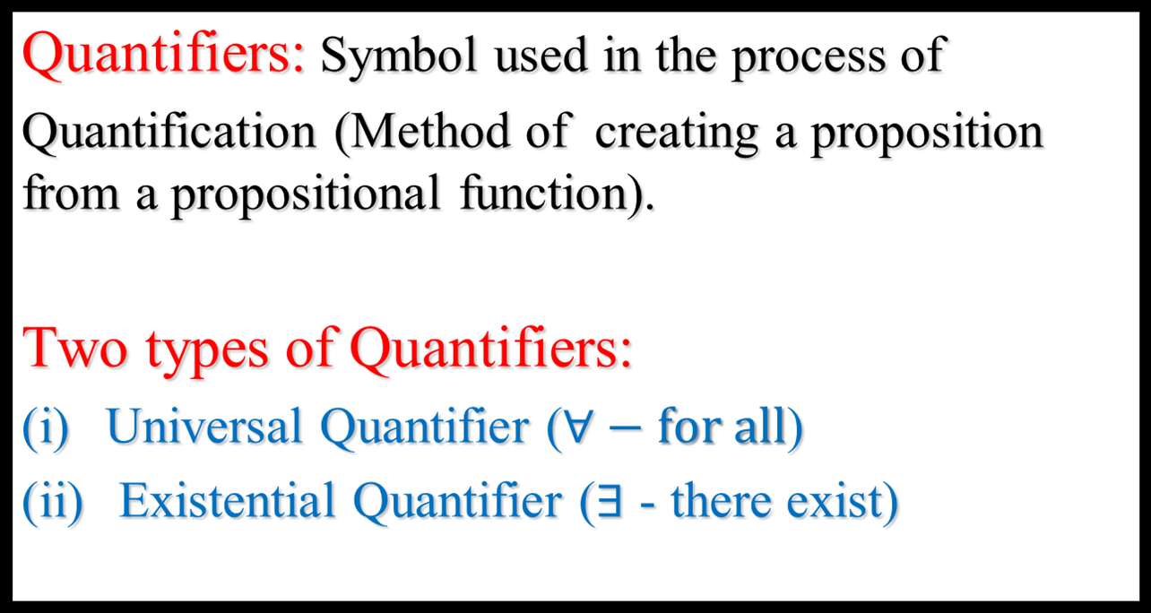
Quantifiers

Slide 11
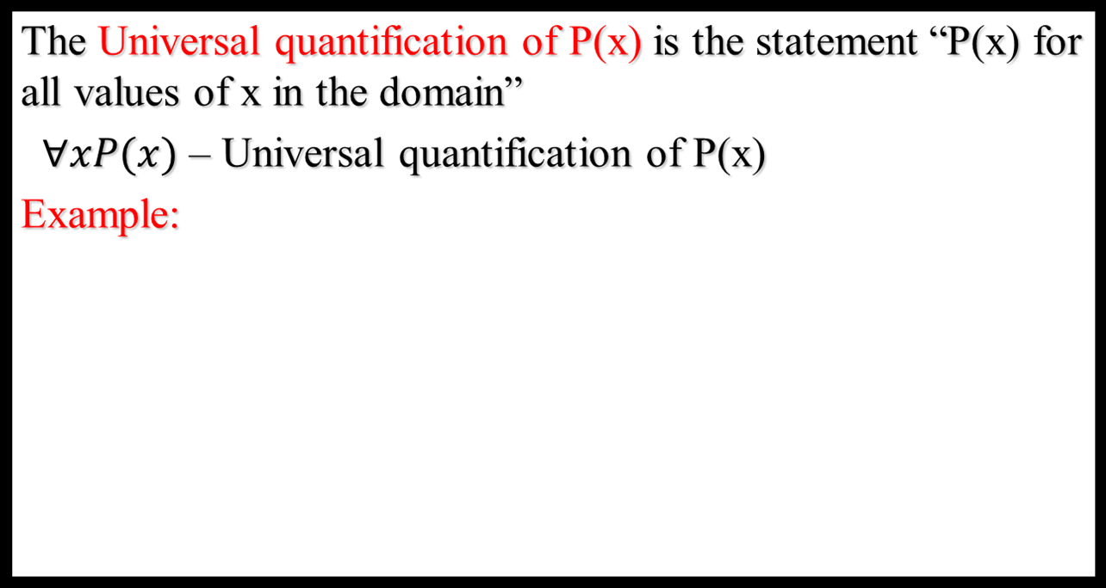
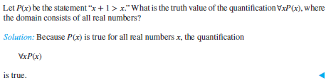
Quantification

Slide 12
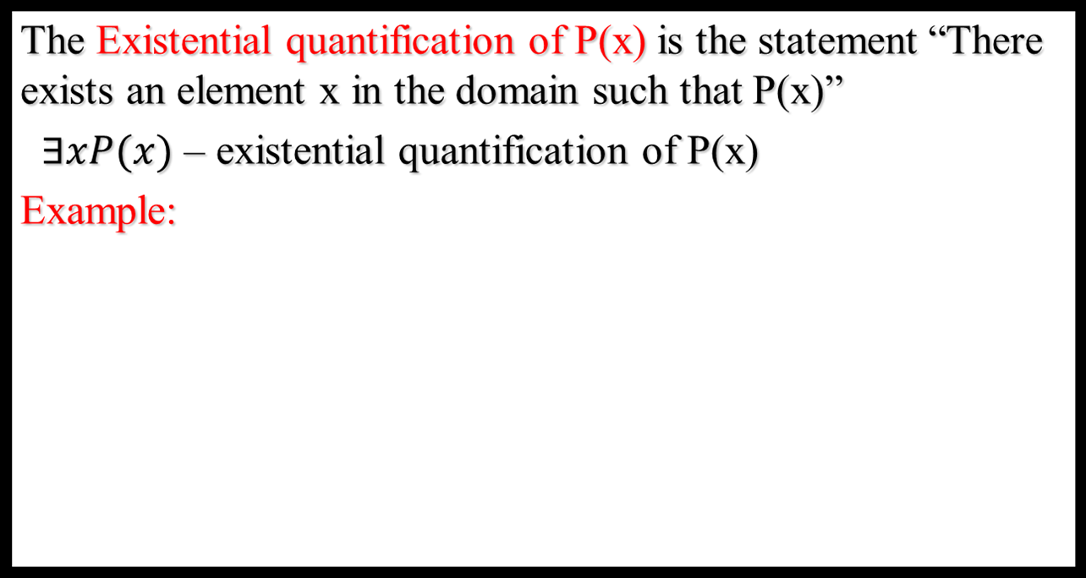

Quantification

Slide 13
Negation of the Quantified Statement

Slide 14
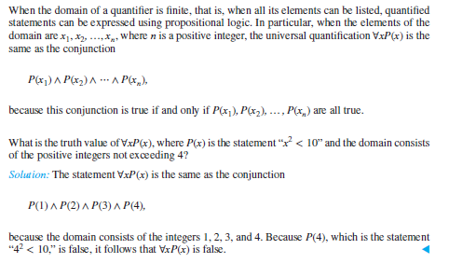
Quantifiers over finite domains

Slide 15
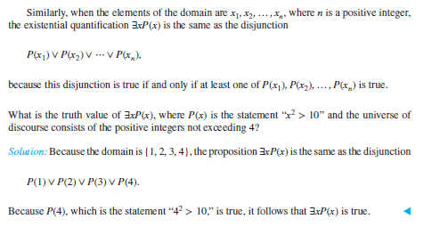
Quantifiers over finite domains

Slide 16
Problems
Express each of the following statements using Quantifiers. Form the negation of the statement and express the negation in English sentence.
1. All students are having laptops.

Slide 18
Problems
2. All dogs have fleas

Slide 19
Problems
3. Every Koala can climb

Slide 20
Problems
4. There is a rabbit that knows calculus

Slide 21
Problems
5. No monkey can speak English.

Slide 22
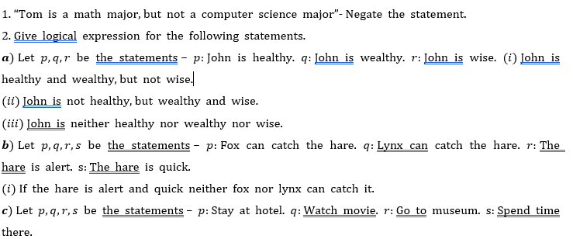
Practice Problems

Slide 23
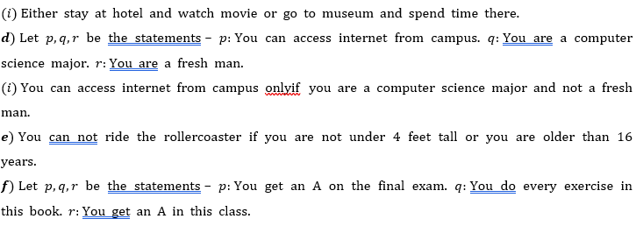
Practice Problems

Slide 24
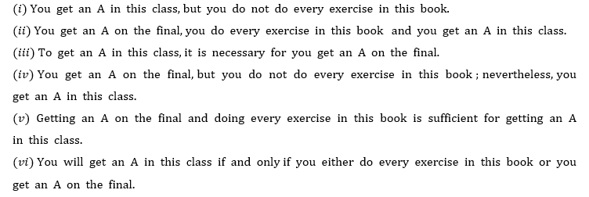
Practice Problems

Slide 25
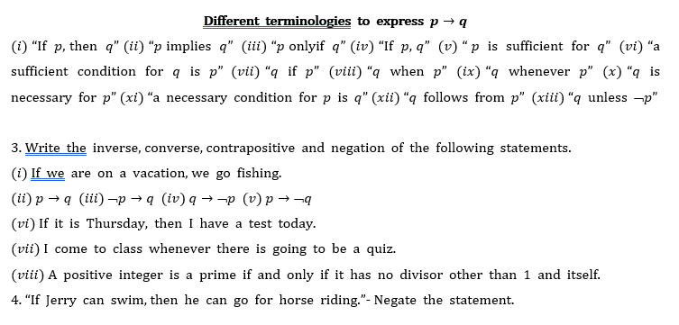
Practice Problems

Slide 26
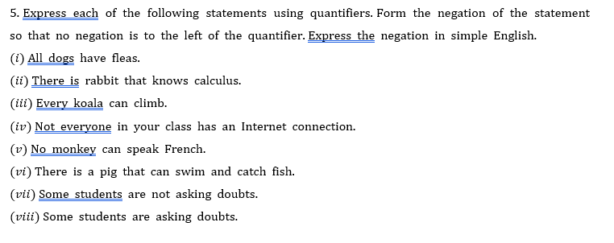
Practice Problems

Slide 27
Problems
Check whether the following system specifications are consistent
“The router can send packets to the edge system only if it supports the new address space. For the router to support new address space it is necessary that the latest software release be installed. The router can send packets to the edge system if the latest software release is installed. The router does not support the new address space”.

Slide 28
Problems
2. Without using truth tables, prove that
[(¬p∨q) ∧(p∧(p∧q))] ⇔ p ∧ q.
3. Let p, q, and r be the propositions
p: You get an A on the final exam.
q: You do every exercise in this book.
r: You get an A in this class.
Write this proposition using p, q, and r and logical connectives: To get an A in this class, it is necessary for you to get an A on the final exam.

