Slide 1

Personalized Study-Time Planner
By Jestin George

Slide 2
Introduction
Students often struggle with managing their study time effectively using traditional, fixed schedules that do not account for topic difficulty, personal pace, or performance. This leads to poor time utilization, incomplete preparation, and reduced motivation.

Slide 3

Traditional Approach
The traditional study approach typically involves creating a fixed timetable where equal time is allocated to subjects or chapters, regardless of their difficulty or the learner’s familiarity. It follows a linear pattern, lacks personalization, and doesn't adapt to changes in the learner’s schedule or performance. Without real-time feedback, progress tracking, or intelligent adjustments, it often leads to inefficiency, missed revisions, and reduced motivation.

Slide 4

Why traditional approach Fails
treat all topics as equal in time and difficulty
ignore the learner's strengths, weaknesses, and learning pace
often underestimate or overestimate the time needed per topic.
No Progress Tracking

Slide 5
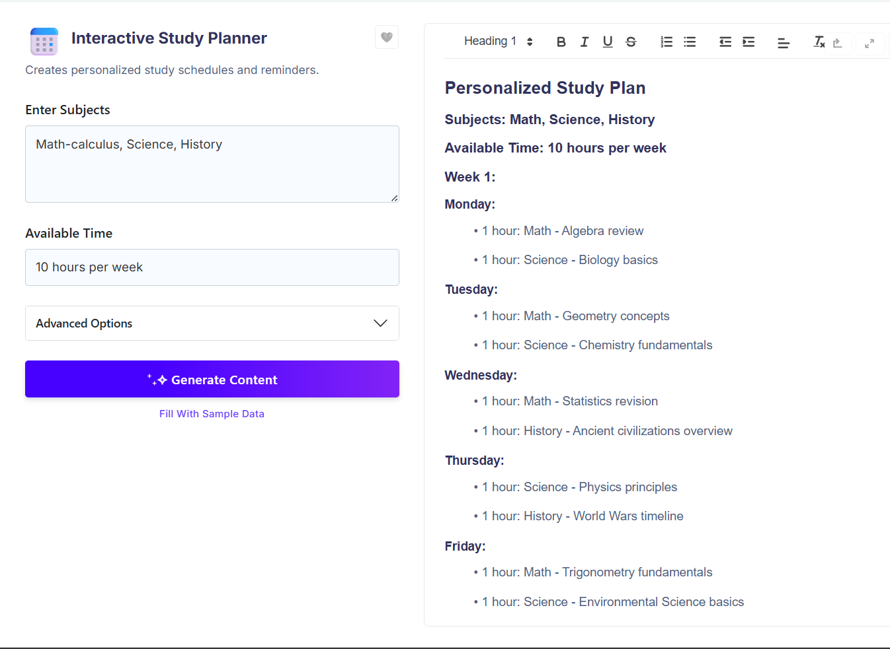
Existing system
Basic
Do not contain personalization
Gives equal weightage for all topics

Slide 6
Solution
A system which is capable of :
Identifiing learner's strengths, weaknesses, and learning pace
treat all topics with a weightage
Tracking progress

Slide 7
Proposed system
The Personalized Study Time Planner is an AI-powered web application that allows
students to upload their study materials and input available time. It extracts topics, estimates difficulty, and generates a customized, adaptive timetable.
The system enables users to study, mark completion, unlock quizzes, track progress, and receive smart reminders—offering a dynamic, efficient, and personalized learning experience.

Slide 8
Modules
1) Admin module
2) User module
3) Topic Extraction & Difficulty Analysis Module
4) Quiz module
5) Timetable Generation Module
6) Report generation module
7) Notification module
8) Support and feedback

Slide 9
Databases
1 users
Attributes | Dt | Key
Userid | Serial | Pk
Name | integer
Email | varchar | unique
Password hash | varchar
Role | varchar
Created at | Timestamp
2 study materials
Attributes | Dt | Key
Materiel id | Serial | Pk
Collection id | Integer | fk
Subject | varchar
Pdfpath | varchar
Uploaded time | timestamp
3 collections
Attributes | Dt | Key
Collection id | Serial | Pk
User id | Varchar
Created at | timestamp
Created by | integer | fk

Slide 10
4 topics
Attributes | Dt | Key
Topic id | Serial | Pk
Material id | int | fk
Title | varchar
Difficulty level | int
Estimated time | timestamp
Sequence no | integer
5 time table
Attributes | Dt | Key
Planid | Serial | Pk
Userid | Varchar | fk
Startdate | date
End date | date
Available min | time
Created on | Timestamp
6 timetable entries
Attributes | Dt | Key
Entry id | Serial | Pk
Plan id | Int | fk
Topic | int | fk
Scheduled date | date
Allocated min | time
Is completed | boolean
Completed on | Timestamp

Slide 11
7 quizes
Attributes | Dt | Key
Attempt id | Serial | Pk
Quiz id | Int | fk
User id | int | fk
Selected answer | varchar
Is correct | Boolean
Attempt time | Timestamp
8 quiz attempts
Attributes | Dt | Key
Quiz id | Serial | Pk
Topic id | Var
Question text
Options
Collect answer
Created on | Timestamp
9 notifications
Attributes | Dt | Key
Notification id | Serial | Pk
User id | Var
Message
Is read
Created at | Timestamp

Slide 12
10 user activity
Attributes | Dt | Key
Activity id | Serial | Pk
User id | Var
Topic id
Time spend
Session start
Session End | Timestamp
11 performance
Attributes | Dt | Key
Tracking id | Serial | Pk
User id | Var
Topic id
Interaction time
Last accessed | Timestamp
12 admin_actions
Attributes | Dt | Key
Action id | Serial | Pk
Admin id | Var
Action type
Target user id
Time | Timestamp

Slide 13

Future enhancements
Add RAG (Retrieval Augmanted Generation)model to make I more effective
Multiple study time support
Use more custom models

Slide 14

Thank you

