Slide 1




Phish & Chips
Cooking Up AI to Fry Phishers!
Github Repo:

Slide 2

The Recipe (Data & Features)
Phishing Websites Dataset – From UC Irvine Machine Learning Repository (DOI: 10.24432/C51W2X)
With 250 K URLs
30 Features
200 top trusted websites – from Similarweb (based on visits)
Features used
URL Length
Domain Length
Subdomain Length
Number of special characters
Number of dots
Is it trusted site?
Is it https?

Slide 3
Cooking the Model (ML Training & Optimization)
Random Forrest was picked as it didn’t burn the meal, and it wasn’t too bland

Slide 4
Serving It Hot (Deployment & DevOps)
TechStack
Python
TensorFlow
Chrome Extensions
Flask API
JavaScript

Slide 5
Let’s start cooking….. (Demo)

Slide 6
Appendix

Slide 7
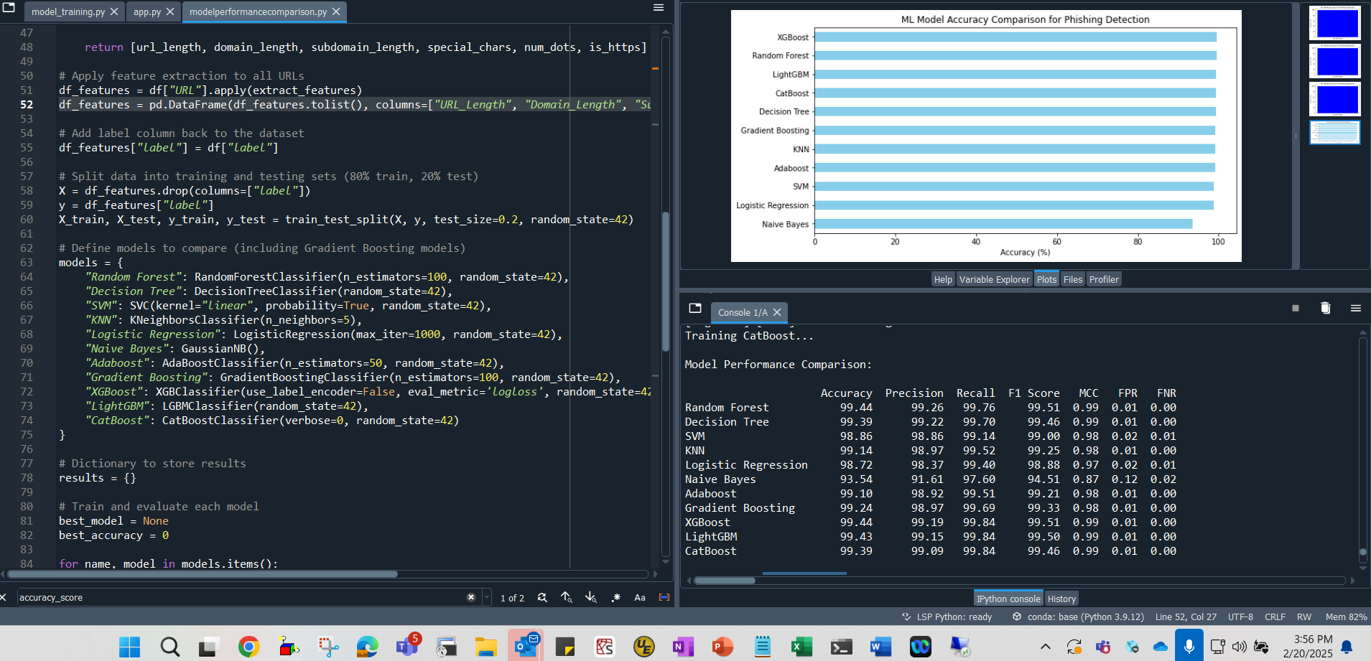

Slide 8
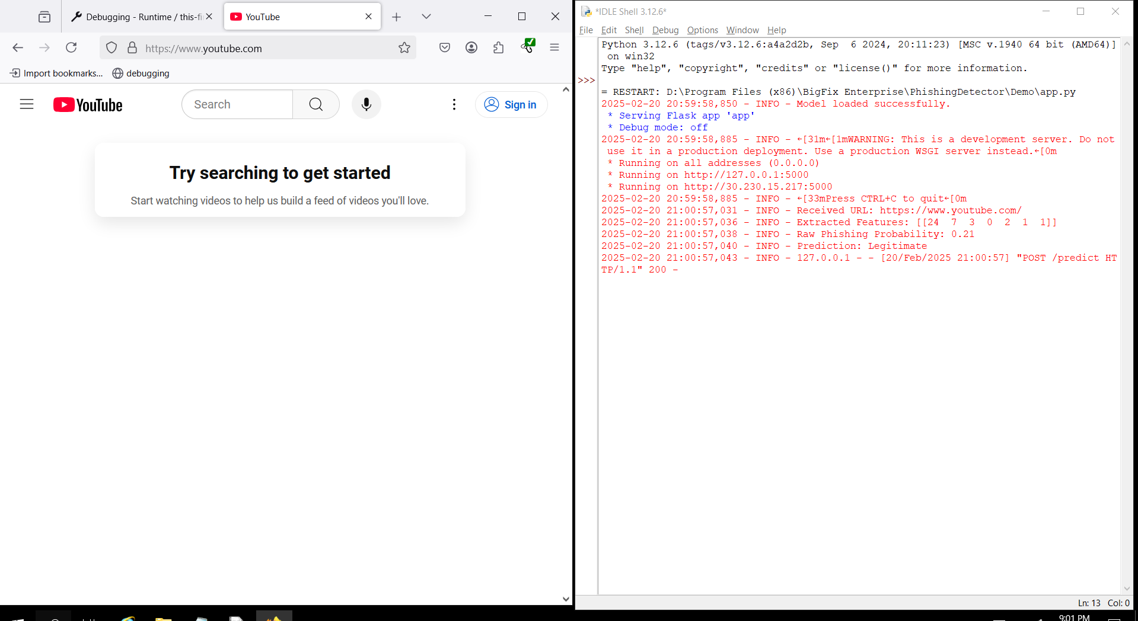
Plugin
and its status
Legitimate site

Slide 9
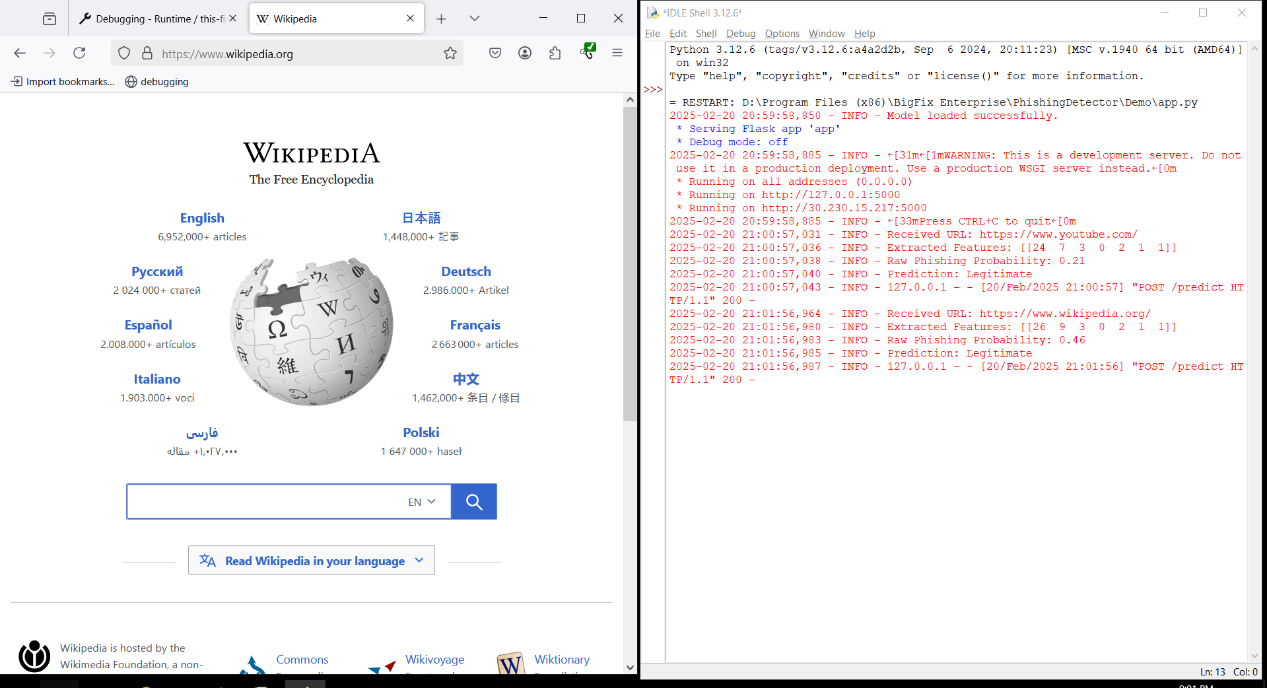
Plugin
and its status
Legitimate site

Slide 10
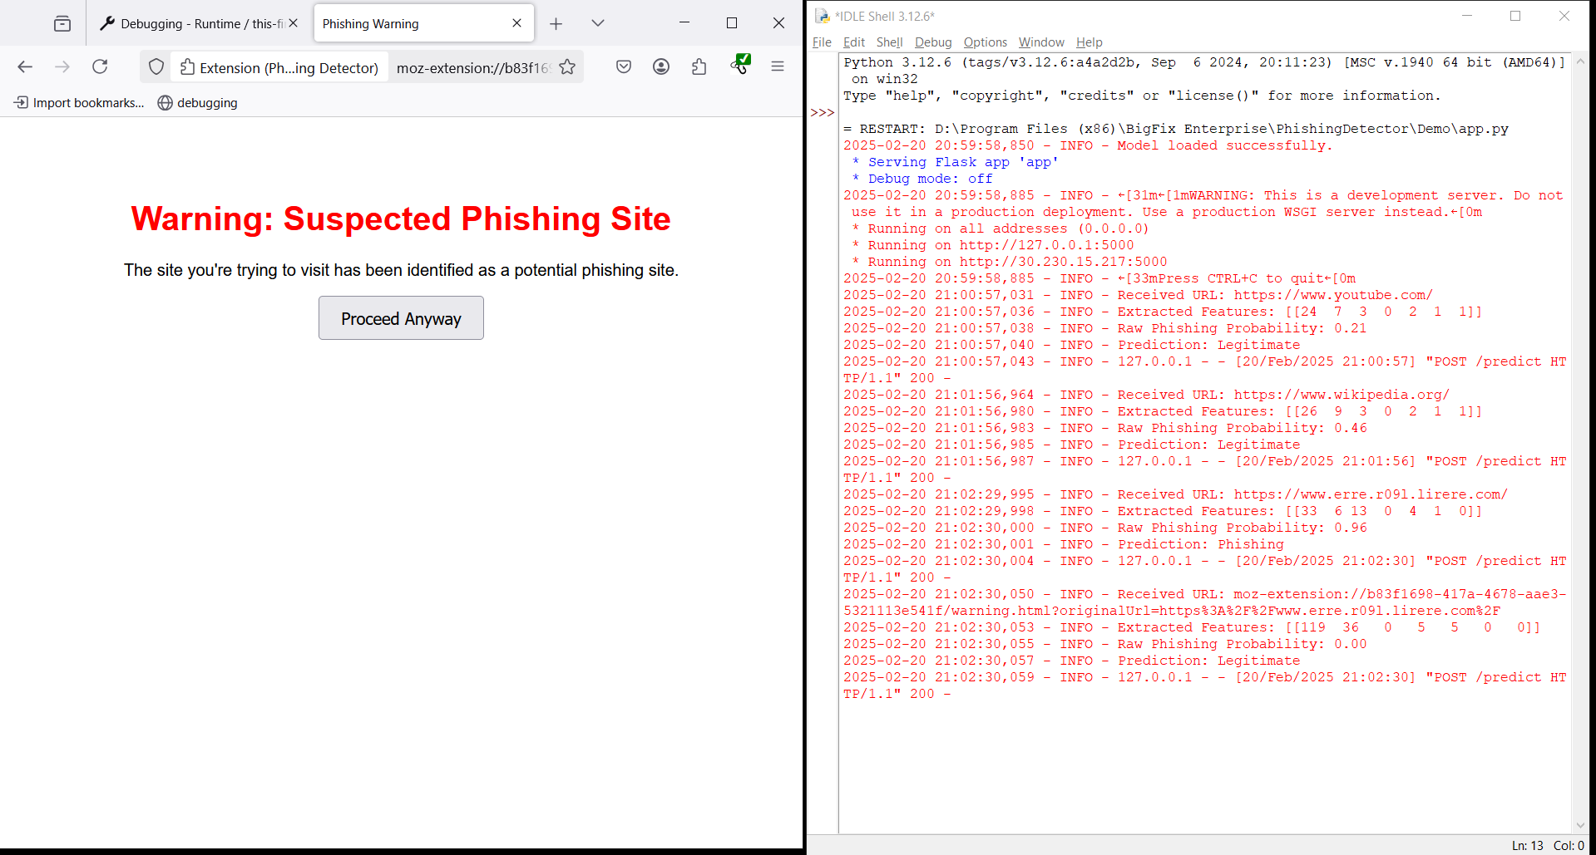
Plugin
and its status
Phishing site
URL is redirected to safety (plugin)

Slide 11
Bon Appétit

