Slide 1
SCHub
A Web service for learning institutions data management
www.schub.me
by
For ALX Portfolio Project
Cohort 10
July 2023
Aina Jesulayomi Michael
Samuel Iwelumo

Slide 2
TEAM
Aina Jesulayomi Michael
Project Outline
API Routes (app)
Servers setup and launch
Samuel Iwelumo
Models
API Authentication (auth)
React application

Slide 3
Inspiration
This project was inspired by our experiences in schools in Nigeria. It is noted that smaller schools have poor digital records for students (like excel spreadsheets) or no digital record at all (They use manual recording of information in files). These are at high risk for data loss, and very difficult to scale to a larger population.
Our solution is a webservice that stores this useful information in a database and uses an API to retrieve, update and post data to a simple and easy to use webpage, this is accessible to students, teachers and school administrators.

Slide 4








Architecture
Single API backend
HTTP Request to app.schub.me
Balanced requests
API / AUTH response
Weighted Round Robin
Client
HTTP/S Request to www.SCHub.me
App and Web Server 1
Client
Load Balancer
API / AUTH response
Web Server 2

Slide 5
Technologies
Domain Name System – Namecheap
Servers – Digital Ocean Containers
Load balancing – Haproxy
Web server – Nginx
SSL – Certbot
Reverse-Proxy using Private IP address
Monitoring using digital ocean

Slide 6
Technologies
Environment – Linux Ubuntu 20.04
Configurations - Bash
Application
Models – Python
Database – MySQL
API and Authentication – Flask, Gunicorn
Frontend – React js

Slide 7
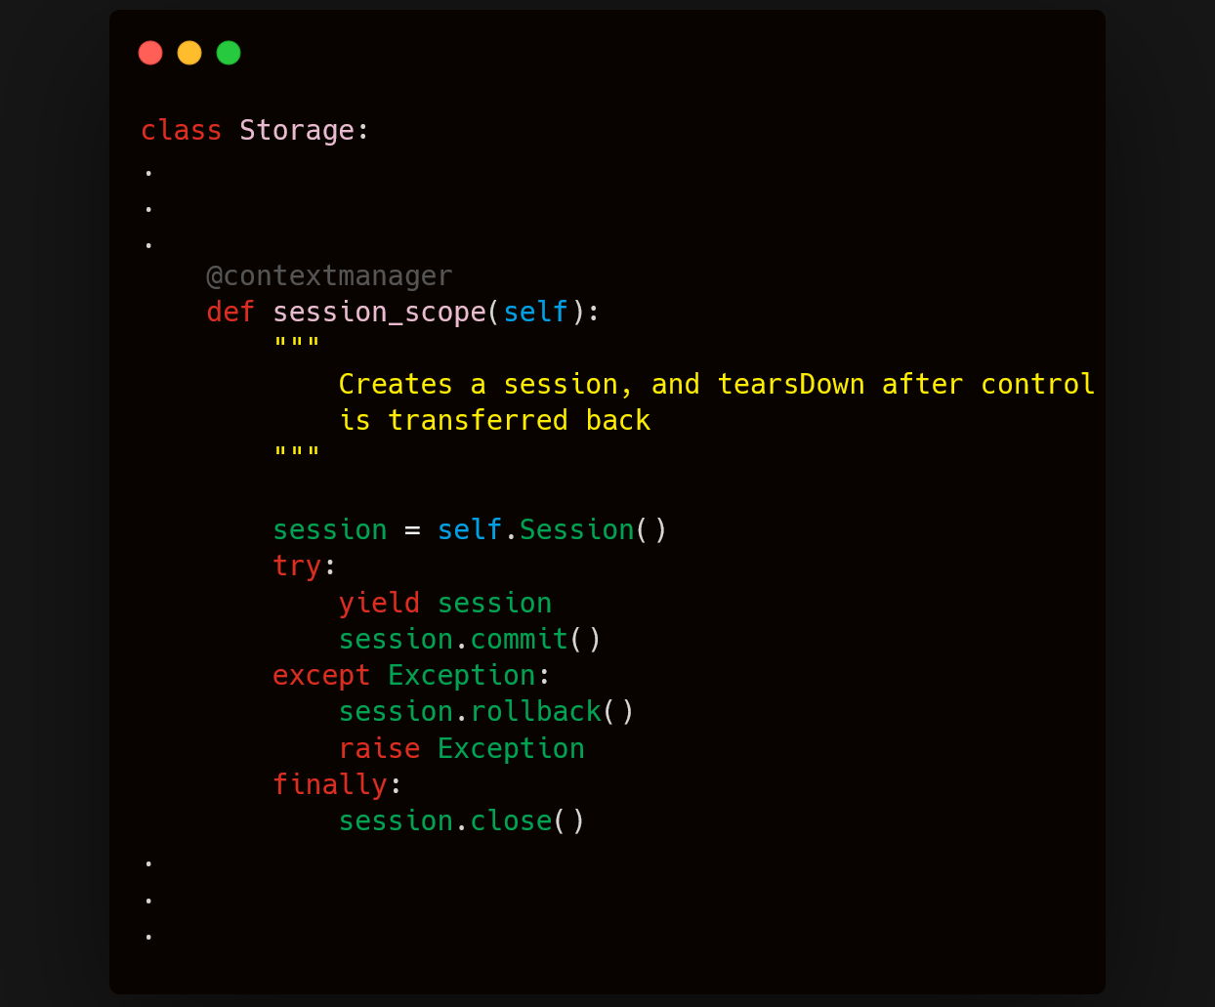
Code Snippets
Scoped Sessions

Slide 8
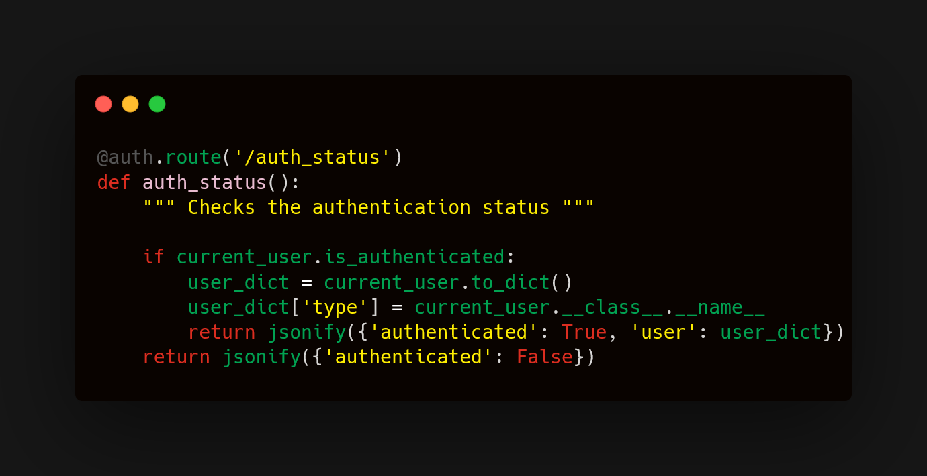
Code Snippets
API Authentication status

Slide 9
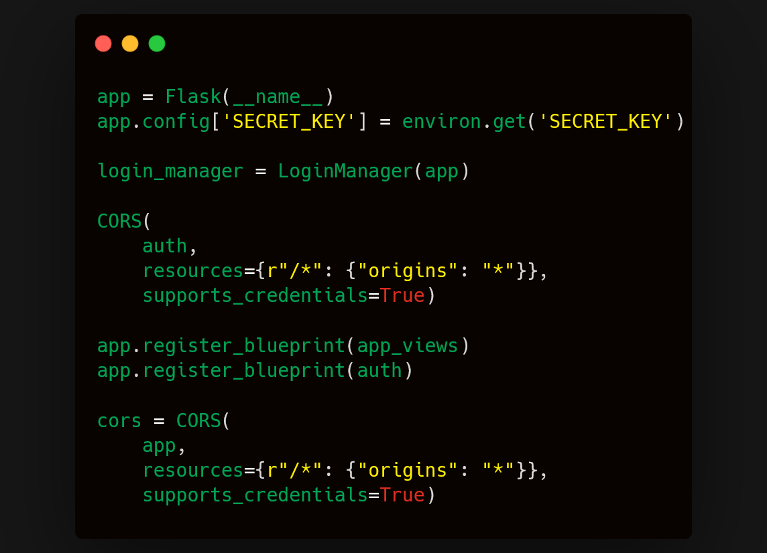
Code Snippets
CORS and Blueprints

Slide 10
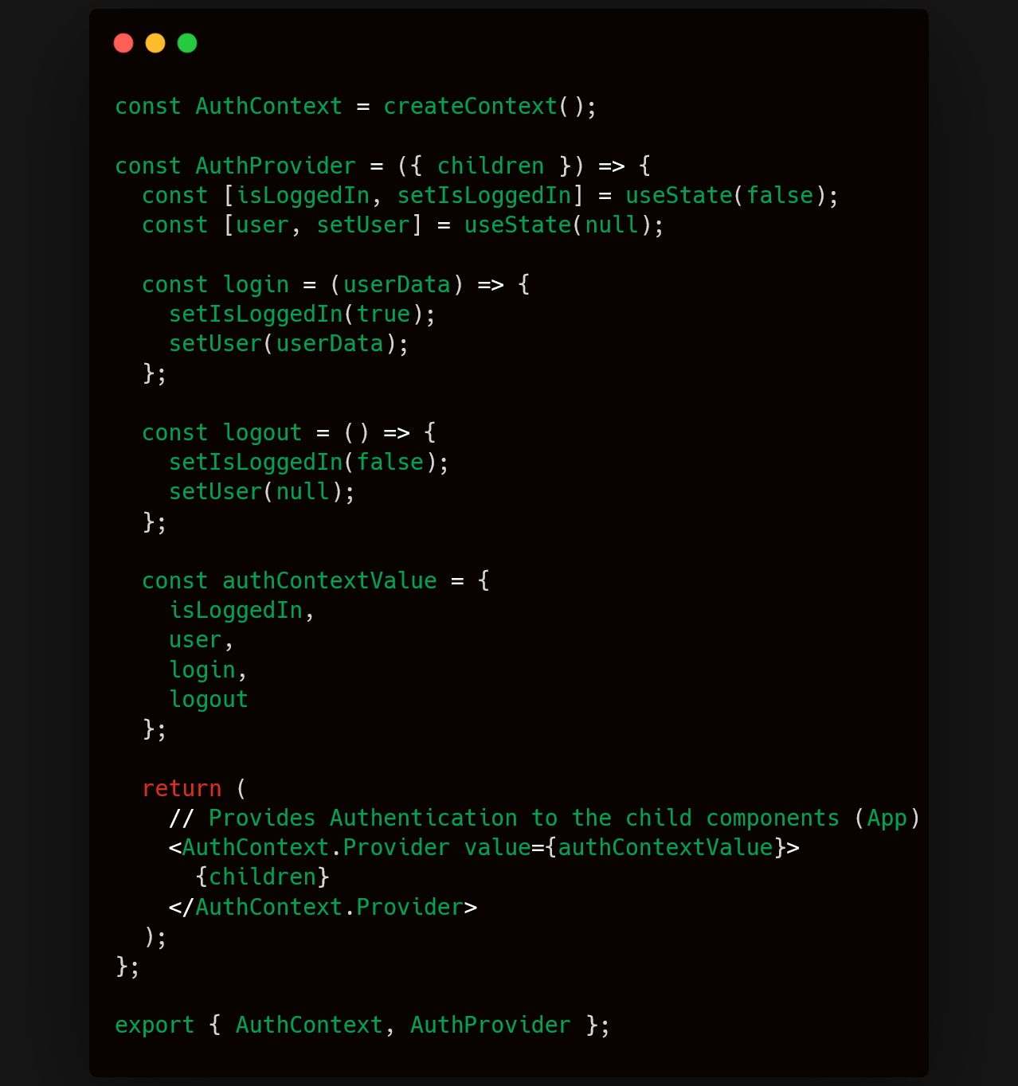
Code Snippets
Authentication context and provider

Slide 11
Collaboration
Process
Github
Trunk-based development
Manual code reviews
Trello
Progress Boards
Feature cards
Due dates
Week One: 16-22/06/2023
Build models and Database Storage
Write various API endpoints with Flask
Generate sample data for API calls
Test models and api (unittests)

Slide 12
Collaboration
Process
Github
Trunk-based development
Manual code reviews
Trello
Progress Boards
Feature cards
Due dates
Week Two: 23-29/06/2023
Build application using react
Home page
Login page
Student, Teacher, Administrator Dashboard
Management Pages
Manage authentication with flask_login and jwt
Test application functions locally with browser

Slide 13
Collaboration
Process
Github
Trunk-based development
Manual code reviews
Trello
Progress Boards
Feature cards
Due dates
Week Three: 1-7/07/2023
Create react build
Setup Servers, balancing, reverse proxying
Deploy app to servers, automate deployment
Deploy landing page (/explore)
Test website application logic, monitor network

Slide 14
Challenges
Implementing login was particularly challenging during initial setup, this was solved using Flask_login and PyJWT to encode and decode tokens.
Speed of requests was slow due to api requests being sent from the webservers to the load balancer which then sends back the same request to the api server. This was optimized by using a forward to the private IP address of the api server.
Single-threaded communication in SQLalchemy caused simultaneous requests to the api to fail. This was resolved by modifying the storage class to handle multi-threaded communication using scoped sessions.

