Slide 1
Practice 3: Import a New Dataset and Perform an Analysis
Barraza Torres Jesús Daniel

Slide 2
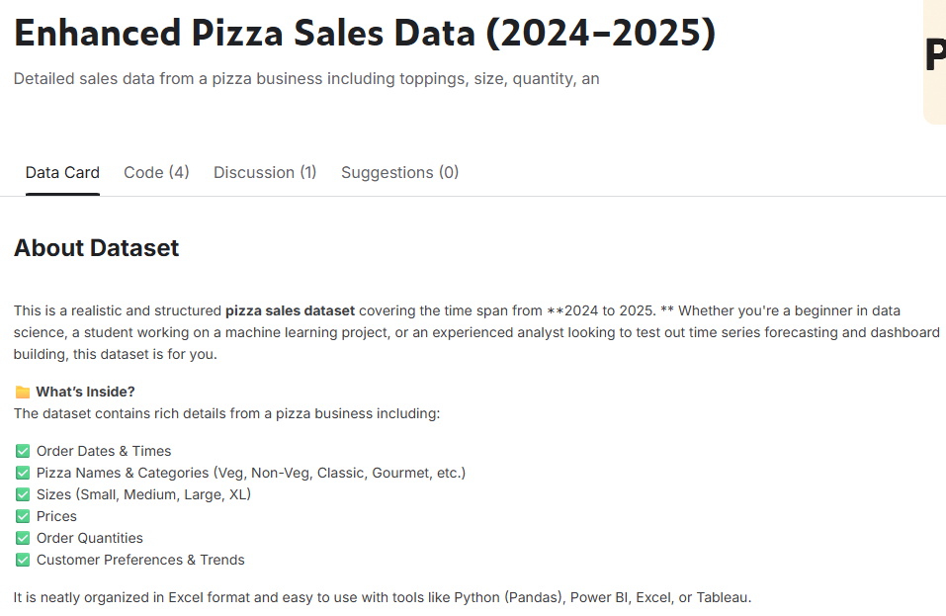
Introduction
For the project to start, I needed to use a database to continue. Just after that it hit me, why shouldn’t I search a database for pizza?

Slide 3
Start of the project
library(readxl) Pizzas <- read_excel("C:/Users/USER/Documents/Enhanced_pizza_sell_data_2024-25.xlsx") View(Pizzas)

Slide 4
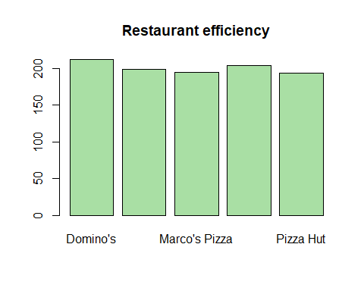
Categorical analysis
## [1] "Number of rows"
## [1] 1004
## [1] "Number of columns"
## [1] 2
## [1] "Some data"
## tibble [1,004 × 2] (S3: tbl_df/tbl/data.frame) ## $ Restaurant_Name : chr [1:1004] "Domino's" "Domino's" "Domino's" "Domino's" ... ## $ Deliver_Efficiency(min/km): num [1:1004] 6 6.67 5 5.56 5.56 ...
## [1] "Table of frequencies"
## Name ## Domino's Little Caesars Marco's Pizza Papa John's Pizza Hut ## 212 199 195 204 194

Slide 5
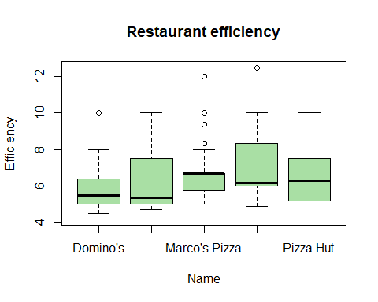
Numerical Analysis
## [1] "Mean"
## [1] 6.397006
## [1] "Median"
## [1] 6
## [1] "Mode"
## Name ## Domino's Little Caesars Marco's Pizza Papa John's Pizza Hut ## 212 199 195 204 194
## [1] "Range"
## [1] 4.166667 12.500000
## [1] "Variance"
## [1] 2.441633
## [1] "Standart deviation"
## [1] 1.562573

Slide 6
Thanks for watching!

