Slide 1
Opening the Black Box
Jesus D. Jimenez Ballestas · Group 25 · IE7374 Generative AI

Slide 2
The problem
A language model is usually a black box: prompt in, text out
When it states a wrong fact, the conventional fixes are retraining or fine-tuning — both change the entire network to correct one thing
This project: treat EleutherAI’s Pythia-160m as a system with parts
Find the parts responsible for three specific behaviors
Use that to change what the model writes by editing one weight matrix
Nothing trained, nothing fine-tuned — one deliberate rank-one update
Runs on a laptop CPU in about a minute
Notes:
Interpretability is not the goal here — control is. If you can find where a fact lives, you can fix it surgically instead of retraining.

Slide 3
Four research questions
RQ1 — which attention heads and MLPs causally drive subject–verb agreement, factual recall, and induction?
RQ2 — when we ablate them, does performance drop selectively?
RQ3 (generative core) — can that localization be used to edit the model so it generates the new fact, with efficacy, generalization, specificity and fluency?
RQ4 — using Pythia’s 154 training checkpoints, when does each behavior appear?
Notes:
RQ3 is what makes this a generative project rather than only an analysis project: the model produces output under the edit, and that output is what gets scored.

Slide 4
Data: minimal pairs, hand-built
Suite | Prompts | Example | Correct | Incorrect
Agreement | 20 | The keys on the table | are | is
Factual recall | 12 | The capital of France is | Paris | London
Induction | 16 | AliceBob Alice | Bob | Carol
Notes:
48 prompts, plus 3 edit targets each with two paraphrases and two neighbourhood facts — Eiffel Tower, Paris to Rome. Every answer is verified single-token so the probability comparison is clean. 48 is small, and that is the project’s main limitation.

Slide 5
Method: measure → localize → edit
Measure — logit difference: logit(correct) − logit(incorrect), one forward pass
Localize
logit lens — where the answer forms (observational)
zero-ablation of every head and MLP — causal contribution
causal tracing — corrupt the subject, restore layer by layer
Edit (ROME-style) — optimize a delta at the subject’s last token, then a closed-form rank-one update to that MLP’s output matrix
Score the generated text — efficacy · generalization · specificity · fluency
Notes:
Two metric families matching the two halves of the project. One command runs all of it: python src/model_runner.py, about 60 seconds on CPU.

Slide 6
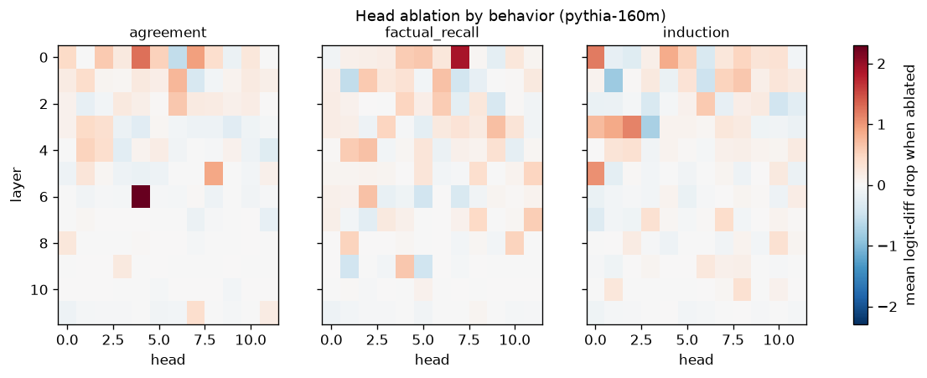
Result 1 — ablating every head, per behavior
Notes:
Each cell is the drop in logit difference when that head is zeroed, averaged over four prompts. One dark cell dominates the agreement panel: layer 6, head 4.

Slide 7
One head owns subject–verb agreement
Behavior | Top head | Own behavior | Other behaviors | Selectivity
Agreement | L6.H4 | +2.29 | −0.02 | 1.00
Induction | L0.H0 | +1.19 | +0.17 | 0.75
Factual recall | L0.H7 | +1.89 | +0.60 | 0.52
Notes:
Selectivity 1.00 means ablating L6.H4 costs 2.29 logits of agreement margin and nothing measurable anywhere else — a dedicated component. Factual recall is diffuse by comparison. Worth noting: the largest single component for all three behaviors is MLP 0, which is shared input processing, not a mechanism. Largest drop and “the mechanism” are different claims.

Slide 8
Result 2 — the edit changes what it writes
Pythia-160m · Mount Everest: Nepal → Canada · one weight matrix differs
before — Mount Everest is located in the country of Nepal. The mountain is located in the Himalayas, and is the highest mountain in the world…
after — Mount Everest is located in the country of Canada. The Mount Everest National Park is located in the country of Canada…
Notes:
Fluency is unchanged — the model keeps writing coherent English about the edited subject, it just says something different. This is RQ3 answered in the affirmative.

Slide 9
The same edit in three models
Model | Efficacy | Generalization | Specificity | Top-1 preserved
gpt2 | 0.00 | 0.00 | 0.33 | 1.00
pythia-160m | 0.67 | 0.00 | 0.33 | 0.83
pythia-410m | 1.00 | 0.50 | 0.50 | 1.00
Notes:
The tidy story: editing works better at scale and not at all on GPT-2. Two slides from now I show that story is wrong — and why testing it was the most valuable thing I did.

Slide 10
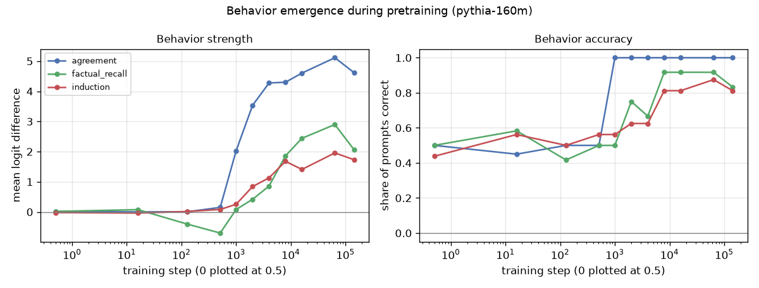
Result 3 — when do behaviors appear?
Notes:
Eleven Pythia checkpoints from random init to fully trained, all 48 prompts at each.

Slide 11
Three behaviors, three shapes
Agreement switches on abruptly — 13× jump between steps 512 and 1 000, done by step 4 000
Induction climbs steadily over an order of magnitude of training
Factual recall is worse than chance at steps 128–512: right answer type, wrong answer — it learns “a city follows this prompt” before it learns which city
Step 64 000 beats the final step 143 000 on two of three behaviors
Notes:
A behavior can get worse on its way to getting better — something a single end-of-training measurement cannot see. This is only possible because Pythia publishes checkpoints.

Slide 12
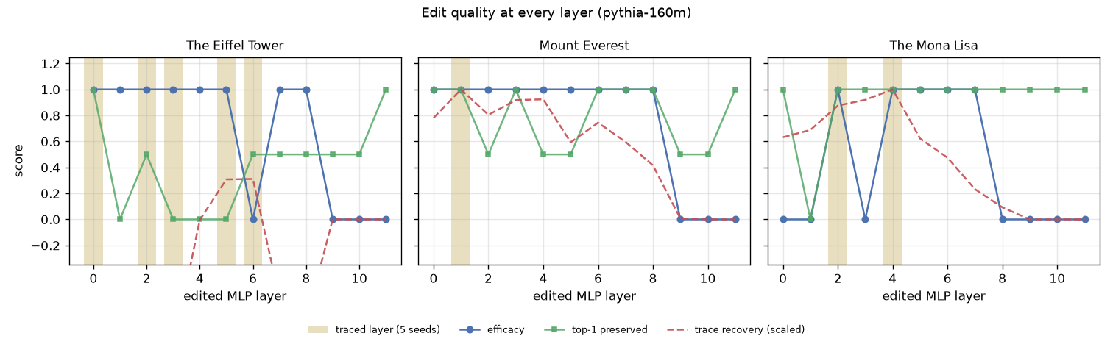
Result 4 — testing our own explanation
Notes:
Earlier milestone claimed: causal tracing picks a bad layer, and the fix is ROME’s multi-layer window. So I edited every target at every layer — 36 rank-one fits — to find out what the rule should have picked.

Slide 13
The proposed fix made it worse
Layer-selection rule | Mean efficacy | Mean top-1 preserved
raw argmax (current default) | 0.933 | 0.800
windowed argmax (w=3) | 0.733 | 0.500
windowed argmax (w=5) | 0.800 | 0.667
Notes:
The raw rule lands on a working layer in 14 of 15 seed-and-target combinations. The windowed rule is implemented but is not the default, and this measurement is why.

Slide 14
Why the layer mattered less than we thought
Most early layers hold the edit — Everest works from 9 of 12 layers
The last three layers never work: by layer 9 the answer is already decided, so the edit arrives too late — exactly what the logit lens showed independently
The original failure was one isolated dead layer, not a depth effect
Notes:
Two independent methods — logit lens and the layer sweep — agreeing on where the decision is made is the strongest evidence in the project after the L6.H4 result.

Slide 15
Result 5 — the GPT-2 mystery
During the fit on GPT-2 the loss increased; ‖δ‖ stalled at 2.76, where Pythia reaches 6–7
The objective penalizes ‖δ‖ in absolute terms — but the δ a model needs scales with its residual-stream norm
Residual norm at the edited layer: gpt2 75.0 · pythia-160m 13.4 · pythia-410m 18.9
GPT-2’s edit was never attempted — it was regularized out of existence
At edit_kl_weight = 0.001, GPT-2 reaches efficacy 1.00
Notes:
This is the finding I am most pleased with, and it came from refusing to accept a plausible explanation. Nothing about GPT-2 resists editing; the hyperparameter was tuned on Pythia.

Slide 16
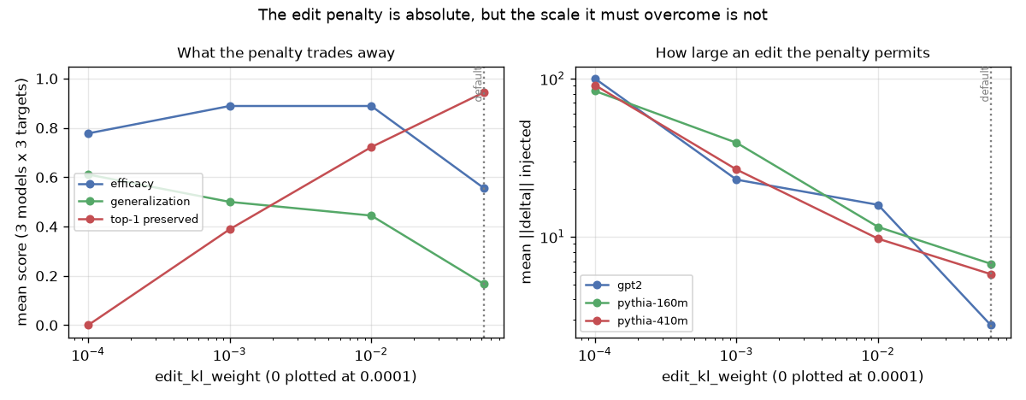
The trade-off that was hidden
Notes:
Left: pooled over three models and three targets, as the penalty falls, efficacy and generalization rise while neighbourhood preservation collapses. Right: the delta size each penalty permits, per model.

Slide 17
“Generalization = 0.00” was a setting, not a property
edit_kl_weight | Mean ‖δ‖ | Efficacy | Generalization | Top-1 preserved
0.0625 (default) | 5.1 | 0.556 | 0.167 | 0.944
0.01 | 12.4 | 0.889 | 0.444 | 0.722
0.001 | 29.6 | 0.889 | 0.500 | 0.389
0 | 91.3 | 0.778 | 0.611 | 0.000
Notes:
The committed default was deliberately not re-tuned to the better-looking setting, so the pipeline still reports the conservative configuration and the trade-off is documented rather than hidden. At 0.01, pythia-410m gets efficacy 1.00, generalization 0.83 and top-1 preserved 0.83 at once.

Slide 18
What I learned
Localization succeeds where behavior is sharp — one head for agreement, diffuse machinery for facts
Editing’s hard part is specificity, not efficacy — most layers and most settings can change a fact; none changed only that fact
Behaviors have training histories — and the last checkpoint is not the best one
Reported failures deserve the scrutiny given to successes — two headline limitations dissolved under one hyperparameter sweep, each with a plausible, well-cited explanation attached
Notes:
The methodological point is the one I would want an audience to leave with: a hyperparameter tuned on one model is a finding about that model, not a property of a method.

Slide 19
Limits and what’s next
Limits — 48 prompts and 3 edit targets, so every edit metric is a mean over 3 binary outcomes; n-gram-entropy fluency; single seed per fit; the Pile itself was never analyzed
Next
Scale to 300–500 prompts / 20–40 targets — error bars, not point estimates
Make the penalty scale-relative — predicted to collapse the three per-model curves onto one, a falsifiable claim
Restore ROME’s covariance term, now that the confound is removed
Denser checkpoints between steps 512 and 8 000
Multi-fact editing (MEMIT)
Notes:
Point 2 comes directly out of the penalty experiment and is testable in an afternoon.

Slide 20
Reproduce everything
git clone https://github.com/Jesus-D-Jimenez/IE7374_Project pip install -r requirements.txt python src/model_runner.py # 10 samples + 3 edits, ~60 s on CPU pytest -q # 38 tests
Every figure in this talk regenerates from scripts/
Committed outputs, run metadata with package versions, Dockerfile, CI
Full tables and numbers: outputs/study/README.md
Questions?
Notes:
Same seed and machine reproduces the committed numbers exactly; the container reproduces every generation across platforms.

