Slide 1





Presented by Jesús G. Hernández
NATURAL LANGUAGE PROCESSING PROJECT
News Classification is it real or fake?

Slide 2


Index
01. Introduction & Objective
02. Dataset Overview
03. Data Preprocessing
04. Text Vectorization (TF-IDF)
05. Models Tested
06. Model Evaluation & Confusion Matrices
07. Hyperparameter Tuning
08. Predictions on Test Dataset
09. Conclusions

Slide 3

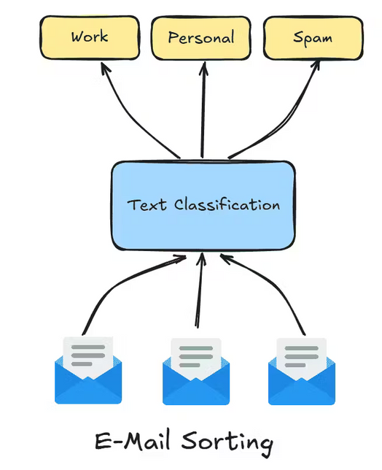

Introduction & Objective
Which should be the final result?
  Build a classifier to distinguish real vs fake news
  Predict labels for a new, unseen dataset (testing_data.csv)
  Goal: accurate predictions for unknown headlines

Slide 4
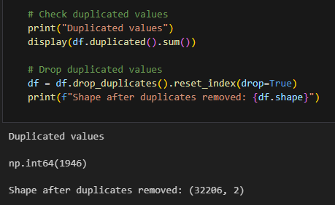


Dataset Overview
NULL AND DUPLICATED VALUES:
COLUMNS:
  Null values: None
  Duplicates: 1,946 rows removed
Label (0 = fake, 1 = real) with headline (text)
HEADLINE CHARACTERISTICS
Headlines contain: punctuation, capitalization, stop words
Note: Data read with sep="\t" to separate the two columns correctly

Slide 5


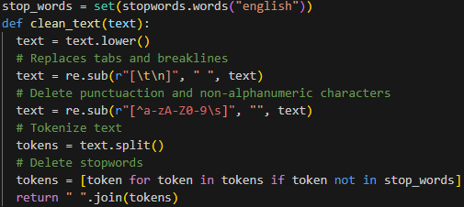
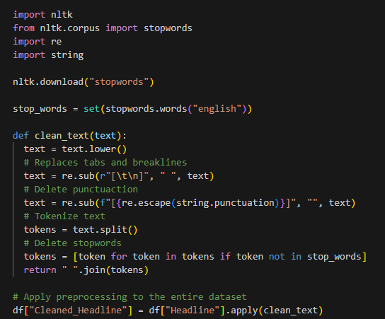
DATA PREPROCESSING
As we said before, capital letters, symbols (!, **, -...) were deleted, this new rows were saved to an auxiliar column
From this document:
To this cleaned document:

Slide 6

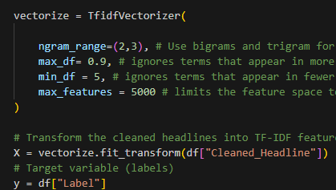


TEXT VECTORIZATION
(TF-IDF)
TF-IDF (Term Frequency – Inverse Document Frequency):
  Convert headlines to numerical vectors
  Keep bigrams & trigrams to preserve context
  Top 5000 features, ignore rare (min_df=5) and frequent (max_df=0.9) words

Slide 7
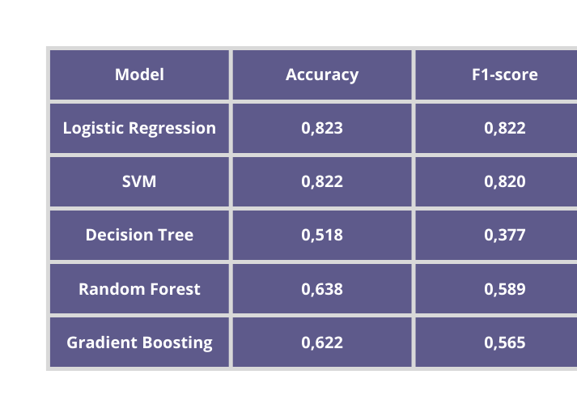


MODELS TESTED
  Logistic Regression → fast, interpretable, good baseline
  SVM → handles complex boundaries
  Trees/Ensembles → more complex, may overfit
LOGISTIC REGRESSION
SVM

Slide 8
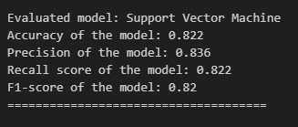
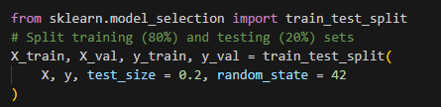
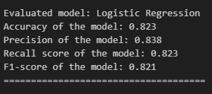

Model Evaluation
  Models evaluated using a validation set (80/20 split)
  Metrics used:
  Accuracy – overall correctness
  Precision – correctness of predicted labels
  Recall – ability to find all true labels
  F1-score – balance between precision and recall
  Confusion Matrix used to analyze prediction errors

Slide 9
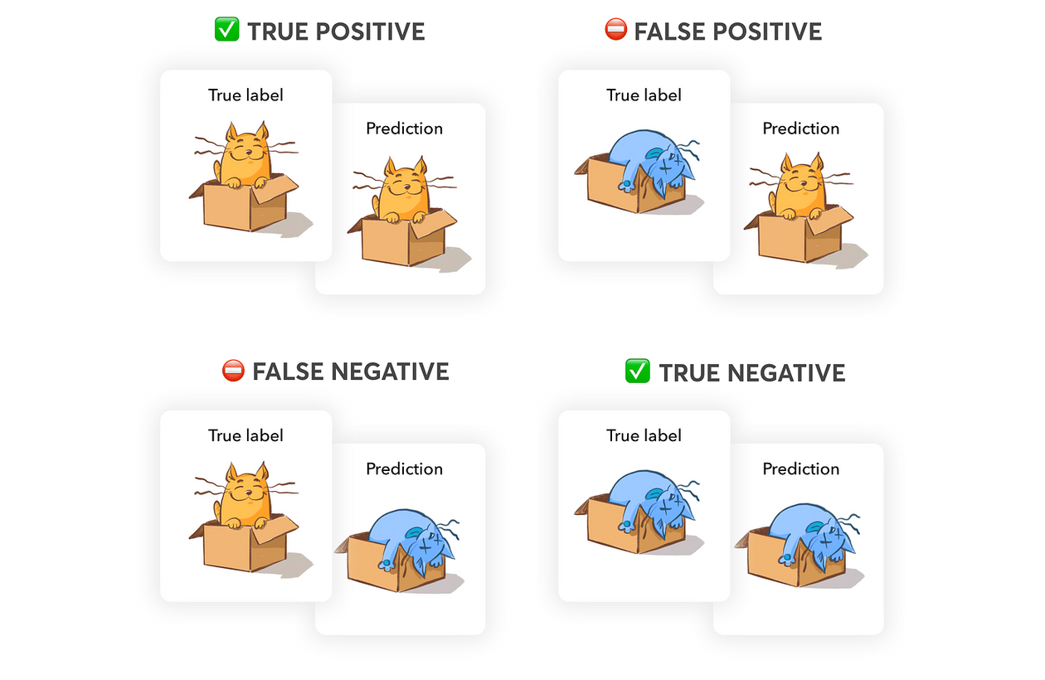
Model Evaluation
  Models evaluated using a validation set (80/20 split)
  Metrics used:
  Accuracy – overall correctness
  Precision – correctness of predicted labels
  Recall – ability to find all true labels
  F1-score – balance between precision and recall
  Confusion Matrix used to analyze prediction errors

Slide 10
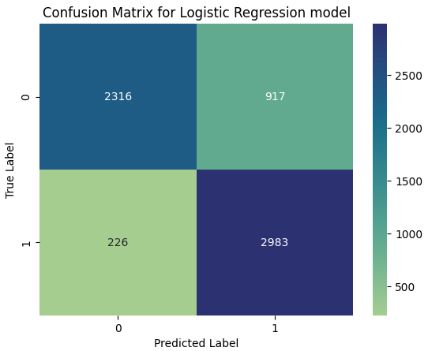
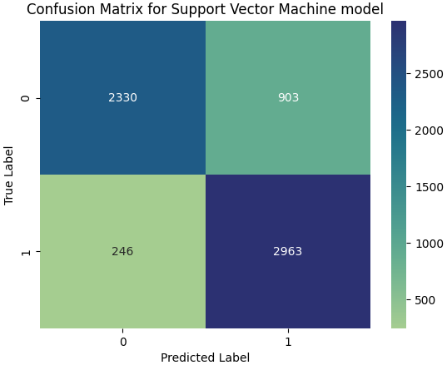
Model
Evaluation
Confusion matrix example (Logistic Regression):
  Most fake (0) and real (1) headlines correctly classified
  Few misclassifications between similar headlines
SVM: Similar performance, slightly more confusion

Slide 11
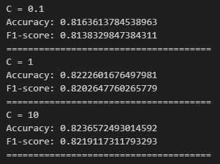

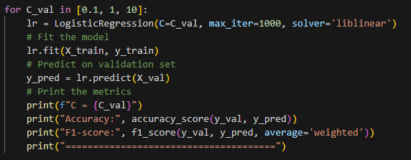

Hyperparameter Tuning
What was tuned?
Accuracy and F1-score
  01
LOGISTIC REGRESSION:
Regularization parameter C

Slide 12
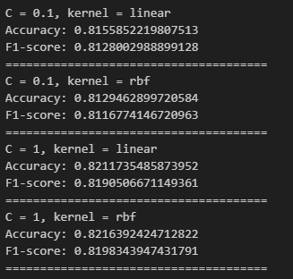
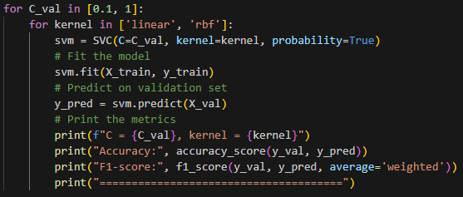
Hyperparameter Tuning
What was tuned?
Accuracy and F1-score
  02
SUPPORT VECTOR MACHINE (SVM):
Regularization parameter C
Kernel type (linear, rbf)

Slide 13

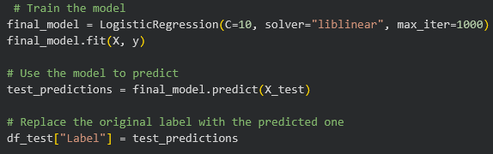
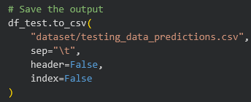
Predictions on Test Dataset
PROCESS
OUTPUT
  Applied same preprocessing & TF-IDF
  Used Logistic Regression to predict labels
  Each headline classified as:
  0 = Fake
  1 = Real
  testing_data_predictions.csv
  Original file format preserved

Slide 14
Conclusion
SLIDE: CONCLUSION
  Final model: Logistic Regression
  Key results:
    High F1-score & accuracy
    Fast training, simpler than SVM
    Successfully classified real vs fake news
    Generalized well to unseen data

Slide 15

Thanks for listening

