Slide 1
My Prescriptions
Tecnologico de Monterrey Coding Bootcamp
Project # 2
Mayra Cuenca – Jesús Colunga – Hugo Moreno

Slide 2
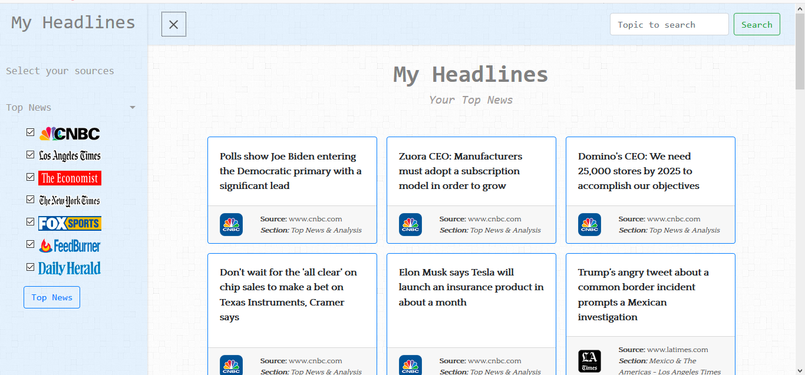

Slide 3
Description
MyPrescriptions is a patient and prescriptions management cloud-based system.
It helps Doctors manage their patient's data, health records, and prescriptions.

Slide 4
Motivation
According to the World Health Organization there are more than 343,700 doctors in Mexico.
We think that a tool like MyPrescriptions help doctors to be more productive and organized, and keep a better record of their appointments and prescriptions and this is transalated in better health for our community.

Slide 5
Results
We presented the Viable Minimum Product for our Project, the following capabilities,
Doctor Registration
Doctor Login
Patient management
Patient Lookup
Prescriptions

Slide 6
Team Efforts
Mayra Cuenca
UX and Bootstrap Specialist
She designed all the responsive and user friendly layout to display information and configure the site.
Jesus Colunga
Integration expert – Routing – Data Base Manager.
He was responsible for the design of the Database Model and for making the integration between the layout and the information that was retrieved by the API code.
Hugo Moreno:
Security – Routing
He made the coding necessary to have a secure login.

Slide 7
Idividual Responsabilities
Mayra: Se was responsible of the design of the UX, style and code of the layout.
Jesus: Responsible of the Design of the Database, the integration of the modules designed to retrieve information from APIS and the Layout.
Hugo: Responsible of finding APIS news and coding to retrieve information.

Slide 8
Improvements
Doctors genda.
Patient medical record storage.
Doctor assistant login.
Patient login to access their medical records.

Slide 9
Technology Used
HTML- CSS -Bootstrap - Javascript - JQuery
Sweet Alert Library
Passport
AJAX
NPM
Node
Handlebars
Heroku
Sequelize
MySQL
GitHub repository

Slide 10
Thank You

