Slide 1
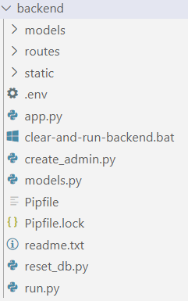
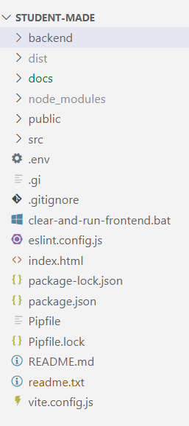
UNCC 4155 - ECOMMERCE PROJECT STRUCTURE
BACKEND API
(PYTHON)
FRONTEND
(VITE + REACT)

