Slide 1
Rockbuster Stealth LLC
Business Analysis & Insights
Tableau Link:
https://public.tableau.com/app/profile/jesus.barcenas/viz/RockBusterStealthcustomerdata/Story1?publish=yes

Slide 2
Project Overview
Who: Rockbuster Stealth LLC is a movie rental company with stores around the world
Motivation: Rockbuster Stealth LLC needs to adapt their current business model to include streaming services in order to compete with online streaming services (Netflix, prime video, etc.)
Objective: Share a view of Rockbuster Stealth’s current business performance and share recommendations for the future.

Slide 3
Statistics on Rockbuster Stealth’s Inventory
Contains a library of 1,000 movies total.
Most common rating: pg 13
 | Rental Rate | Rental Duration | Movie length | Replacement cost
Min | .99 | 1 days | 46 min | 9.99
Max | 4.99 | 7 days | 185 min | 29.99
Avg | 2.98 | 5 days | 115 min | 19.99

Slide 4

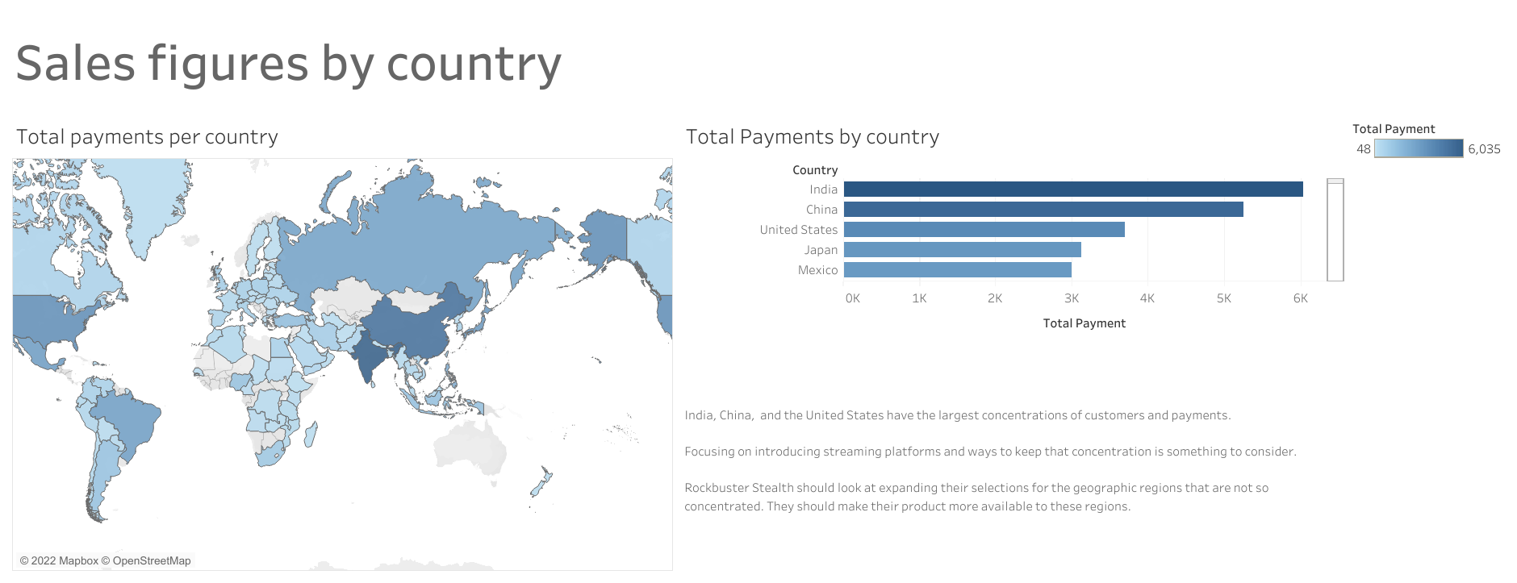

Slide 5
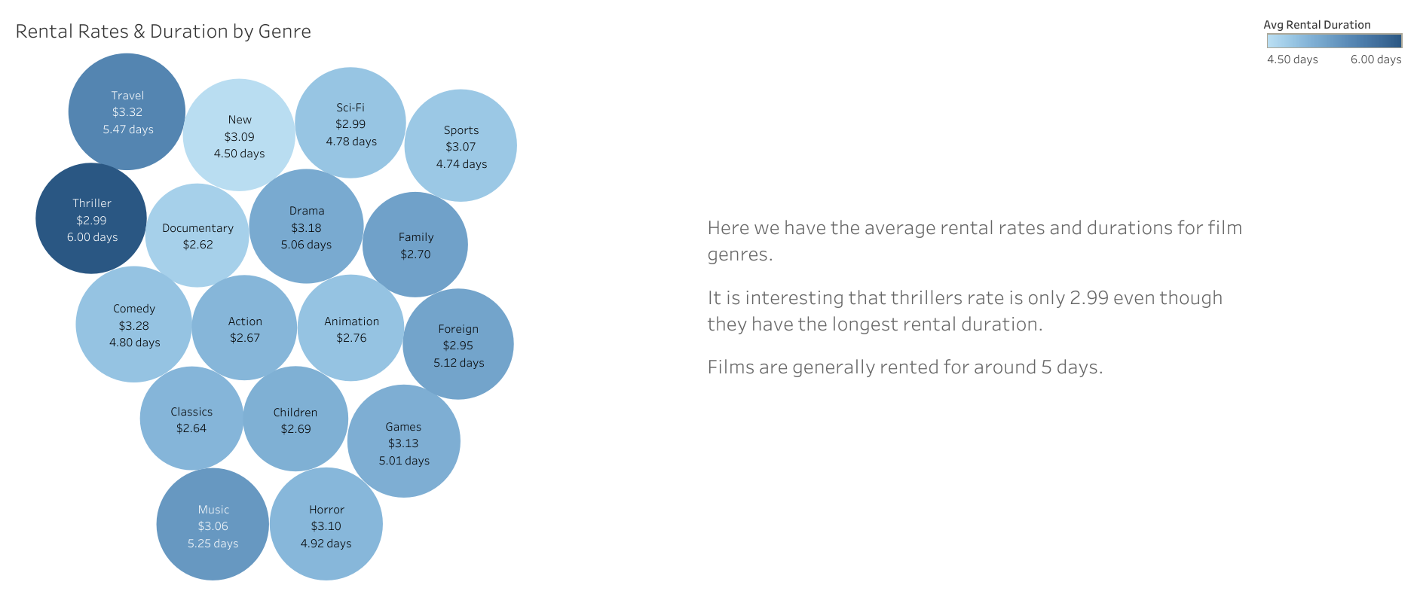

Slide 6
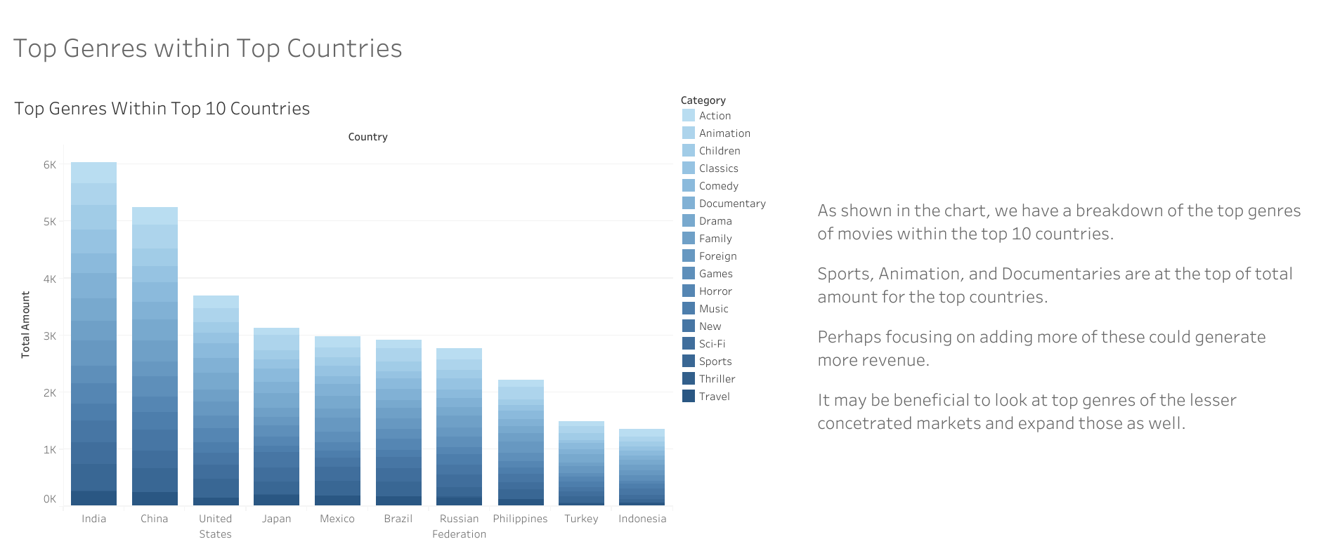

Slide 7
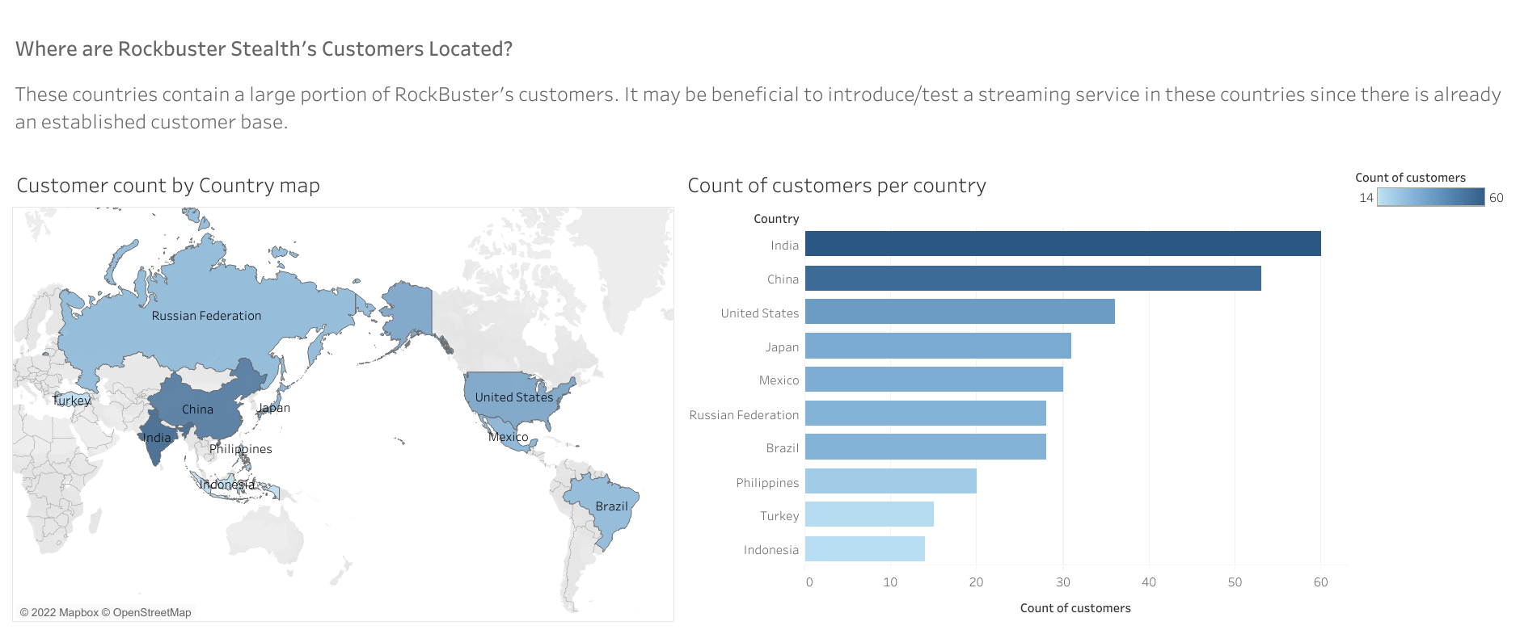

Slide 8
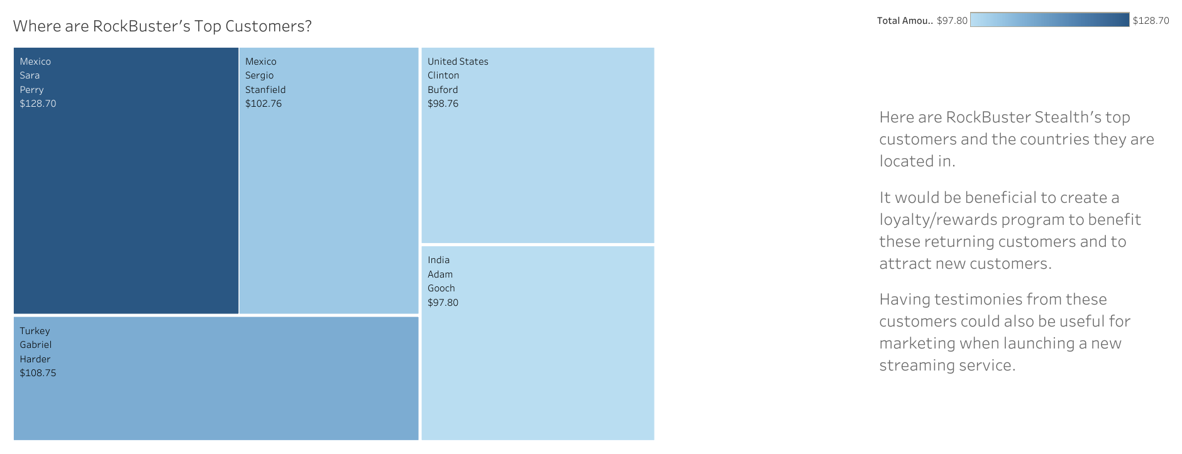

Slide 9
Recommendations
Travel movies average the highest rental rates and duration – add more to the inventory
The 3 biggest markets are India, China, and the U.S focus on implementing streaming service where customer base is established
Sports, Sci-fi, and animation genres are the top 3 genres in payment amount so focus on adding more to inventory/streaming service
Top customers – Incentive/loyalty program could prove beneficial in keeping and attracting new customers. Current customers get discount on streaming service for a limited time
Expand inventory to newer movies.
Streaming will reduce replacement cost

Slide 10
Questions?
Reach out to Jesus Barcenas @ jbarcenas81@yahoo.com

