Slide 1

Power BI Demo Challenge
Jesús D Hernández Londoño

Slide 2
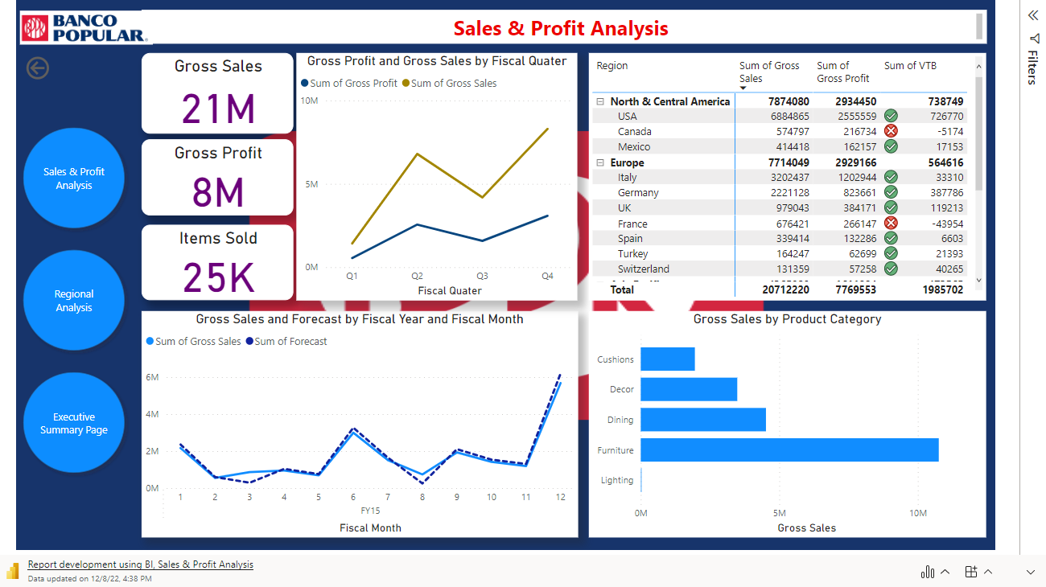

Slide 3
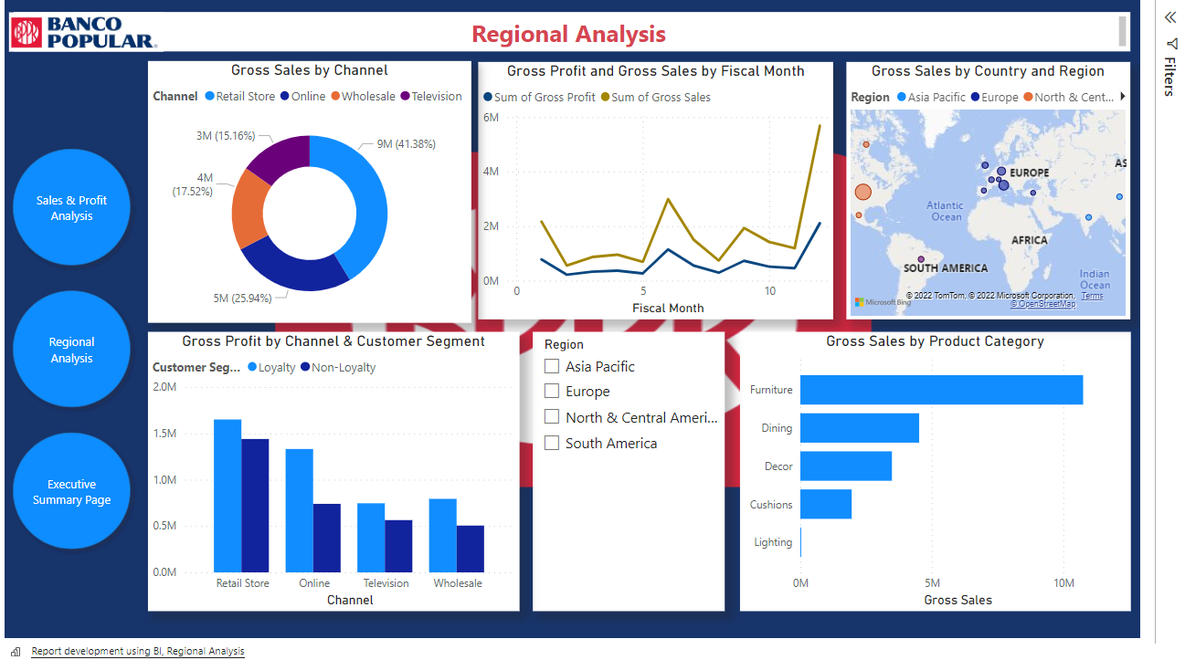

Slide 4
