Slide 1
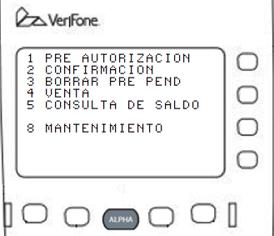

Slide 2
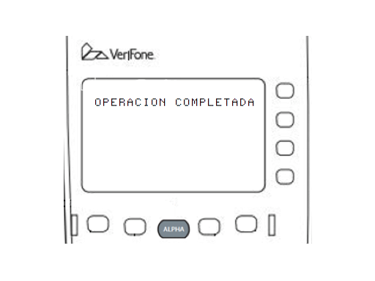
SYSTEM MODE ENTRY
PASSWORD
---------------

Slide 3
SYS MODE MENU 1
EDIT PARAMETERS F2
DOWNLOAD F3
RESTART F4

Slide 4
GROUP SELECT
GROUP ID: _1
APP: EMPTY

Slide 5
SYS MODE EDIT
GROUP 1 PASSWORD
---------------

Slide 6
SYS MODE EDIT G1
FILE CONFIG.SYS_
--------------

