Slide 1
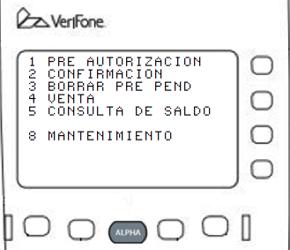

Slide 2
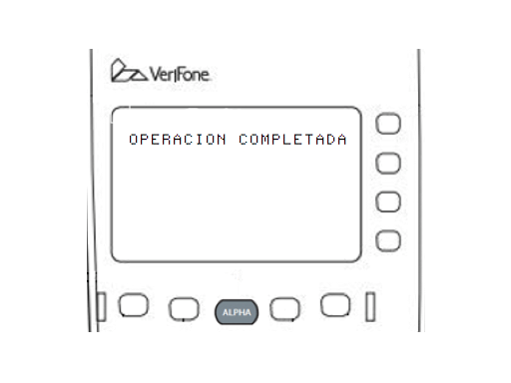
SYSTEM MODE ENTRY
PASSWORD
---------------

Slide 3
SYS MODE MENU 1
EDIT PARAMETERS F2
DOWNLOAD F3
RESTART F4

Slide 4
GROUP SELECT
GROUP ID: _1
APP: EMPTY

Slide 5
SYS MODE EDIT
GROUP 1 PASSWORD
---------------

Slide 6
SYS MODE EDIT G1
FILE CONFIG.SYS_
--------------

Slide 7
1 PRE-AUTHORIZATION
2 COMPLETION
3 CLEAR PENDING PRE
4 SALE
5 BALANCE ENQUIRY
8 MAINTENANCE

Slide 8
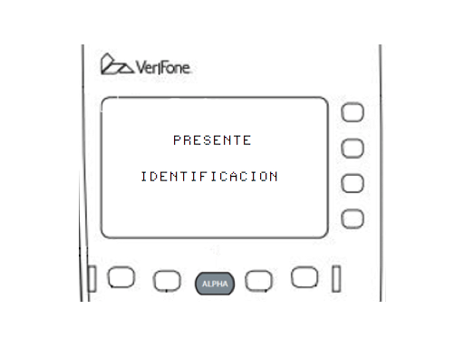
PRESENT
IDENTIFICATION

Slide 9
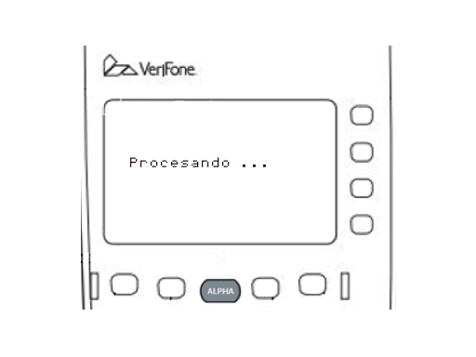
PROCESSING . . .

Slide 10
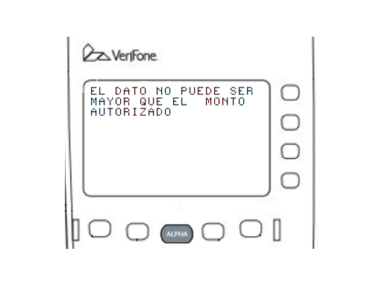
INPUT CAN’T BE GREATER THAN THE AUTHORIZATION QUANTITY

Slide 11
OPERATION COMPLETED

Slide 12
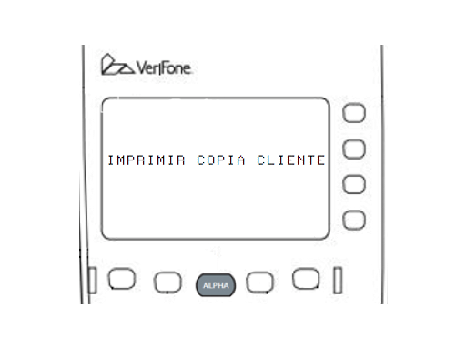
PRINT CUSTOMER COPY ?

Slide 13
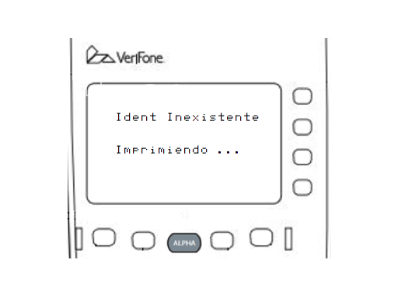
Ident inexistente
PRINTING . . .

Slide 14
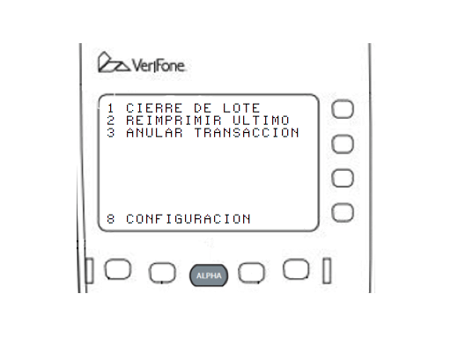
1 BATCH CLOSE
2 REPRINT LAST
3 VOID TRANSACTION
8 CONFIGURATION

Slide 15
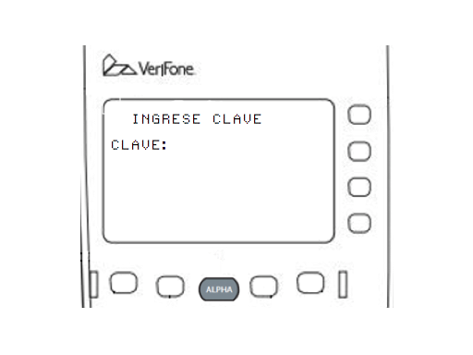
INSERT PASSWORD
PASSWORD:

Slide 16
INSERT NEW PASSWORD
PASSWORD:

Slide 17
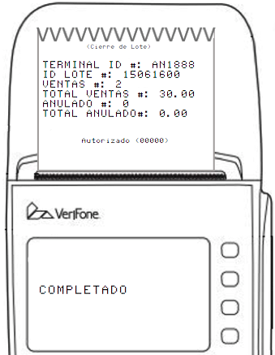
(Batch Close)
TERMINAL ID: AN1888
BATCH ID: 15061600
SALES: 2
TOTAL SALES: 300.00
VOID: 0
TOTAL VOID: 0.00
Authorized (00000)
COMPLETED

Slide 18
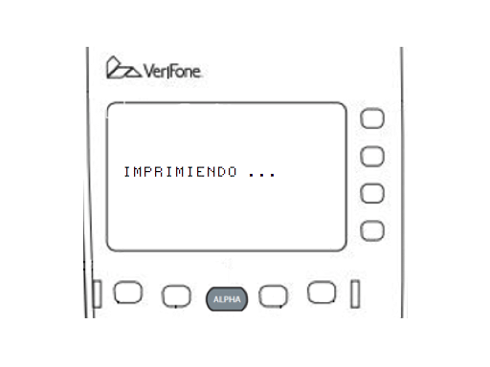
PRINTING . . .

Slide 19

AUTHORIZE CODE:

Slide 20
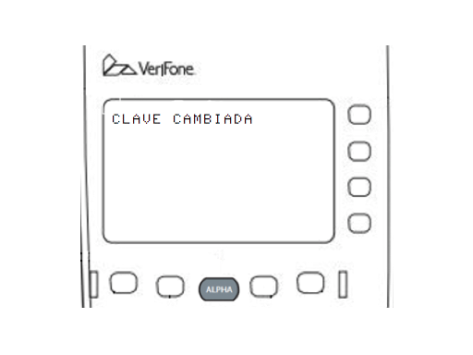
PASSWORD CHANGED

Slide 21
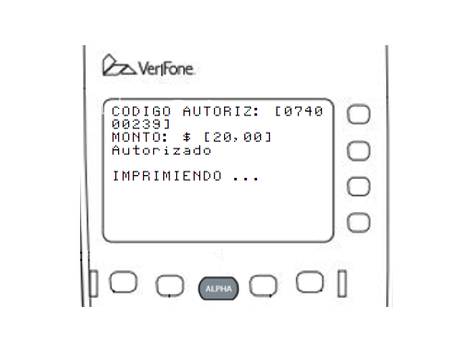
AUTH CODE: [074000239]
AMOUNT: $ [20,00]
Authorized
PRINTING . . .

Slide 22
AMOUNT: $ [20,00]
Authorized
PRINTING . . .

