Slide 1
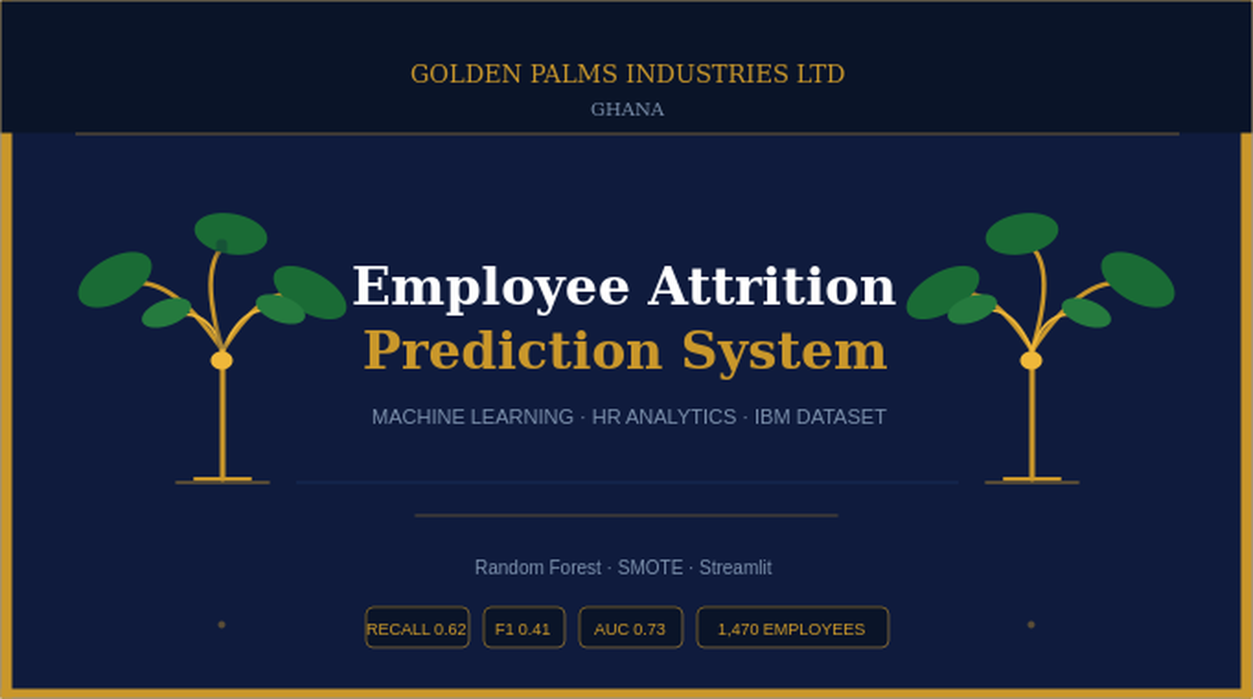

Slide 2
Project Overview
We built a machine learning system that predicts whether an employee is likely to leave a company (attrition). Trained on the IBM HR Analytics dataset, the model was deployed as an interactive Streamlit web app.
Dataset
Records
Algorithm
Deployed As
IBM HR Analytics
1,470 employees
Random Forest
Streamlit App
Tools:
Python · Pandas · NumPy · Scikit-learn · Imbalanced-learn · Matplotlib · Seaborn · Streamlit · Joblib
Employee Attrition Prediction System

Slide 3
Dataset & Exploratory Data Analysis
1,470
6
84%
16%
0
Employees
Features
Stayed
Left
Missing Values
Key Findings
Attrition imbalance confirmed — 84% Stay vs 16% Leave, directly motivating SMOTE
Poor work-life balance (score 1) was disproportionately common among employees who left
Overtime strongly predicts attrition — employees working overtime left at much higher rates
Correlation heatmap showed YearsAtCompany, TotalWorkingYears and Income are inter-linked
Lower monthly income correlated with higher attrition risk across all departments
Employee Attrition Prediction System

Slide 4
Data Preprocessing Pipeline
Drop Columns
1
Removed EmployeeCount, EmployeeNumber, Over18, StandardHours — no predictive value
Encode Target
2
Attrition: Yes → 1 (Leave), No → 0 (Stay)
5
Binary Encoding
3
OverTime mapped to 1 / 0
Employee Attrition Prediction System

Slide 5
Handling Class Imbalance with SMOTE
The Problem
Before vs After SMOTE
Only 16% of employees left. If the model always predicted "Stay" it would be 84% accurate — but useless, catching zero actual leavers. Plain accuracy is misleading here.
Stay (0)
Leave (1)
Before
939
197
After
939
939 ✓
The Fix: SMOTE
SMOTE generates synthetic minority examples by interpolating between existing ones — giving the model balanced training data without just copying records.
Applied only to training data, never the test set.
Recall
F1-Score
How many actual leavers the model catches. Missing a leaver costs more than a false alarm.
Harmonic mean of precision and recall. Balances catching leavers without over-flagging stayers.
Employee Attrition Prediction System

Slide 6
Model Training — Random Forest Classifier
Train / Test Split
Model Configuration
Split:
80% / 20%
Parameter
Value
Reason
Stratified:
Yes
n_estimators
200
More trees = more stable
Train Rows:
1,176
max_depth
10
Prevents overfitting
Test Rows:
294
class_weight
balanced
Guards against imbalance
min_samples_split
5
Avoids tiny splits
5-fold cross-validation performed to confirm the model generalises before final test evaluation.
random_state
42
Reproducible results
Employee Attrition Prediction System

Slide 7
Model Evaluation & Results
Classification Report (threshold = 0.30)
Recall = 0.68
Catches 68% of employees who will leave — up from 23%
Class
Precision
Recall
F1
Support
Stay (0)
0.91
0.64
0.75
247
F1 = 0.38
Leave (1)
0.26
0.68
0.38
47
Balances precision (0.38) and recall — acceptable trade-off
Accuracy
0.65
—
0.65
294
Accuracy = 0.65
ROC-AUC
0.70
—
—
—
Dropped from 0.83 intentionally for better recall
ROC-AUC = 0.70
Threshold lowered from 0.50 → 0.30 to improve recall on leavers
Well above random chance (0.50)
Employee Attrition Prediction System

Slide 8
Streamlit Application
Input Fields
Prediction Output
Saved Files
Monthly income, Distance from Home
Risk verdict — High (red) or Low (green)
attrition_model.pkl
Trained model
Overtime status, Years at company
Probability % of leaving vs staying
scaler.pkl
Input transform
Job Satisfaction, Work-Life Balance
Auto risk flags — overtime, low income etc.
feature_columns.pkl
Column alignment
HR action recommendations
Run: streamlit run app.py
Employee Attrition Prediction System

Slide 9
Project Summary
Dataset:
IBM HR Analytics · 1,470 employees · 35 features
Leave Recall:
0.68 — correctly flags 68% of employees who will leave
Algorithm:
Random Forest · 200 trees · max depth 10
F1-Score:
0.38 — balanced precision-recall for leavers
Imbalance:
SMOTE + class_weight='balanced'
ROC-AUC:
0.70 — strong discriminatory power above chance
Threshold:
0.30 (lowered from 0.50 to improve recall)
Deployment:
Streamlit web app · full interactive HR interface
A practical tool giving HR teams an early warning system to improve employee retention.

