Slide 1
Project guide:
Amyjoy Exson
Submitted By: Areti Siva Satya Raju Jeswanth

Slide 2
PROJECT TITLE:-
UNVEILING TOMORROW’S WEATHER

Slide 3
Content:
Problem statement
Introduction
Existing system
Proposed system
Software requirements & Hardware requirements
Modules Involved in the project
Architecture
Machine Learning models
Testing
output
Conclusion

Slide 4
Problem Statement:-
The goal of this project is to build a machine learning model that can accurately predict the weather for a given location. The model will take into account various features such as historical weather data, current conditions, and user-specified settings.

Slide 5
Introduction:
Weather forecasting can be defined as an attempt to predict the future weather conditions based on previously collected data. Sometimes extreme weather conditions can cause heavy losses. If we can predict the future weather conditions properly such losses can be minimized. Weather forecasting is important to each and every one, whether it is a student who decides to carry an umbrella or not by knowing the weather, or a government organization which helps people to vacate a location by knowing that it is going to rain heavily in that region. Existing systems give information about weather in terms of a wide ranged value.
For example, the temperature is going to be ranging from 21 degrees to 29 degrees Celsius. Such systems are very confusing and are not very helpful to the people.

Slide 6
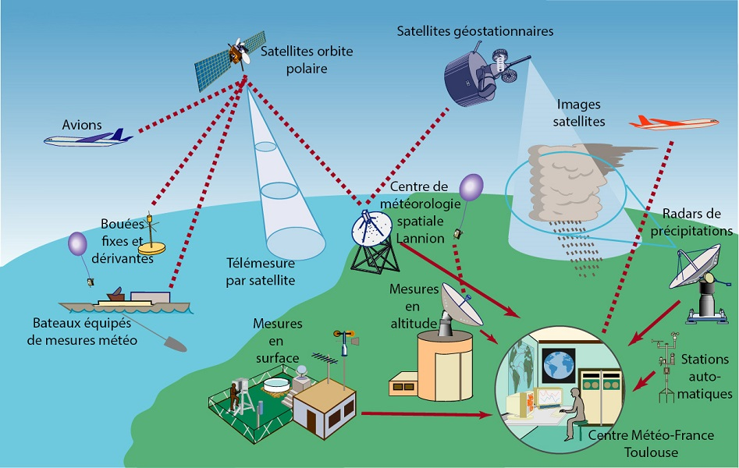
There are various fields which need weather prediction data. People who consume weather prediction results may include farmers, pilots, power generation stations which depend on solar energy and wind energy and many more. There is a need for systems which can predict the weather conditions very accurately at a specific time and location. Machine Learning models can be used to build systems that can predict the weather with high accuracy. The most important part of any machine learning models is the data. The prediction accuracy of a machine learning model is completely dependent on the data that it is trained with.

Slide 7
Existing system:-
The existing systems used to forecast weather require a lot of data about the current state of the weather and based on understanding of the atmospheric weather processes to predict how the weather evolves in the future. Some very sophisticated and complex methods which use satellite for prediction of weather exist.
Other than such systems, other systems which make use of machine learning techniques such as Linear regression and statistical methods also exist. The
systems which have been proposed are having certain limitations-
In some of the models, data of Weather is taken from the surroundings of the target place., More the surrounding data, less the efficiency as target weather does not always depend on its surrounding places.
Over prediction is seen in many models.
The predicted readings are 10% (on average) higher than the original values.
Cost is high when we go for Satellite image processing which indeed gives high accuracy

Slide 8
Proposed System:-
User will enter current temperature; humidity and wind, System will take this parameter and will predict weather from previous data in database. The role of the admin is to add previous weather data in database, so that system will calculate weather based on these data. Weather forecasting system takes parameters such as temperature, humidity, and wind and will forecast weather based on previous record therefore this prediction will prove reliable.
This is not only used to predict the weather conditions for the near future at a specific location with high accuracy and efficiency but also reduce the reliability on expensive instruments and methods presently used to predict the weather. The predicted weather conditions should match the actual weather conditions. And help daily commuters, farmers and other people by informing the weather situations beforehand so that they can plan their schedule accordingly. To overcome the limitations and to reduce complexity, we have proposed machine learning models.

Slide 9
Software requirements:
Operating System: Windows, Linux.
Language: Python
Python IDE: Jupyter Notebook, Python 3.
Python 3.7: Python is an interpreted, high level, general programming language. Its formatting is visually uncluttered, and it often uses English keywords where other languages use punctuation. It provides a vast library for data mining and predictions.
Jupiter Notebook/ Spider/ PyCharm: It is an open-source cross-platform integrated development environment (IDE) for scientific programming in the Python language. Spyder integrates with a number of prominent packages as well as another open-source software.
NumPy: NumPy was used for building the front-end part of the system.
Pandas: Pandas was used for the data preprocessing and statistical analysis of data.
Matplotlib: Matplotlib was used for the graphical representation of our prediction.

Slide 10
Hardware Requirements:
Processor: 64-bit, quad-core, 2.5 GHz minimum per core
Ram: 4 GB or more
Hard disk: 20 GB of available space or more.
Display: Dual XGA (1024 x 768) or higher resolution monitors

Slide 11
Modules:
NumPy:
The NumPy library is a fundamental library for scientific computing in Python. It provides a high-performance multidimensional array object, and tools for working with these arrays.
NumPy is an essential library for machine learning in Python. It provides a powerful array object and tools for working with arrays. NumPy arrays are efficient data structures for working with numerical data. They are also convenient for working with data in various formats, such as images and matrices .

Slide 12
Pandas:
Pandas is a powerful tool for data analysis in Python. It can be used for data cleaning and manipulation, feature engineering, and even machine learning. Pandas is particularly well-suited for machine learning because it provides a number of features that are very useful for working with data:
Pandas can handle missing data gracefully.
Pandas can easily convert data from one format to another (e.g., from a CSV file to a SQL database).
Pandas provides many built-in functions for data analysis, which can be used for preprocessing data for machine learning.
Pandas is fast and efficient, which is important for working with large datasets.
Seaborn:
Seaborn is a Python data visualization library based on matplotlib. It provides a high-level interface for drawing attractive and informative statistical graphics. Seaborn is particularly useful for exploring linear relationships between multiple variables. Some of the most useful functions in Seaborn for machine learning are the pairplot() and jointplot() functions. These functions create scatter plots between pairs of variables, and can be used to quickly visualize relationships between many variables.
The Seaborn library is also great for creating visualizations of categorical data. The countplot() function creates a barplot of counts for each category. This is a useful way to understand the distribution of a categorical variable.

Slide 13
Sklearn:
Sklearn is a library in machine learning that provides a range of tools for data mining and data analysis. It includes tools for preprocessing data, dimensionality reduction, supervised and unsupervised learning, model selection, and evaluation.
Matplotlib:
Matplotlib is often used in machine learning to visualize data. For example, it can be used to plot the data points in a dataset, or to visualize the results of a machine learning algorithm.
Matplotlib.pyplot is a collection of command style functions that make matplotlib work like MATLAB. Each pyplot function makes some change to a figure: e.g., creates a figure, creates a plotting area in a figure, plots some lines in a plotting area, decorates the plot with labels, etc. In matplotlib pyplot various states are preserved across function calls, so that it keeps track of things like the current figure and plotting area, and the plotting functions are directed to the current axes (please note that “axes” here and in most places in the documentation refers to the axes part of a figure and not the strict mathematical term for more than one axis).

Slide 14
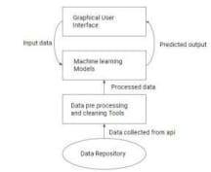
Architecture:
The complete system consists of a Graphical User Interface. The GUI takes the current day’s weather input. These inputs are given to the trained models in order to predict the weather conditions of the near future.
The architecture of the system consists of a data repository consisting of the historical weather data. This data is used for training the models. Then it consists of data preprocessing tools in order to select the required data and to clean the data to get efficient results. On top of that are the machine learning models which take in the preprocessed data and training the model to predict the future weather conditions. And the topmost layer is the Graphical User Interface which helps user to provide inputs for the day and get accurate predictions.

Slide 15
Machine Learning Models
Random Forest Algorithm:
Random forest is a supervised learning algorithm which is used for both classification as well as regression. But however, it is mainly used for classification problems. As we know that a forest is made up of trees and more trees means more robust forest. Similarly, random forest algorithm creates decision trees on data samples and then gets the prediction from each of them and finally selects the best solution by means of voting. The algorithm works by constructing a number of decision trees at training time and outputting the class that is the mode of the classes (classification) or mean prediction (regression) of the individual trees. It is an ensemble method which is better than a single decision tree because it reduces the overfitting by averaging the result.

Slide 16
How does Random Forest algorithm work ?
Random Forest works in two-phase first is to create the random forest by combining N decision tree, and second is to make predictions for each tree created in the first phase.
The Working process can be explained in the below steps and diagram:
Step-1: Select random K data points from the training set.
Step-2: Build the decision trees associated with the selected data points (Subsets).
Step-3: Choose the number N for decision trees that you want to build.
Step-4: Repeat Step 1 & 2.
Step-5: For new data points, find the predictions of each decision tree, and assign the new data points to the category that wins the majority votes.

Slide 17
Applications of Random Forest
There are mainly four sectors where Random forest mostly used:
Banking: Banking sector mostly uses this algorithm for the identification of loan risk.
Medicine: With the help of this algorithm, disease trends and risks of the disease can be identified.
Land Use: We can identify the areas of similar land use by this algorithm.
Marketing: Marketing trends can be identified using this algorithm.

Slide 18
Advantages of Random Forest
Random Forest is capable of performing both Classification and Regression tasks.
It is capable of handling large datasets with high dimensionality.
It enhances the accuracy of the model and prevents the overfitting issue.
Disadvantages of Random Forest
Although random forest can be used for both classification and regression tasks, it is not more suitable for Regression tasks.

Slide 19
Decision Tree Algorithm:
A decision tree is a supervised learning algorithm that can be used for both classification and regression tasks. The goal of a decision tree is to create a model that predicts the value of a target variable based on other variables in the data. Decision trees are created by splitting the data into smaller groups based on an attribute value. The tree is then created by selecting the attribute that results in the largest information gain, which is the difference in entropy before and after the split. The process is then repeated on each of the child nodes, until the tree is complete. Once the tree is complete, it can be used to make predictions by traversing the tree from the root to the leaves. The prediction is made by taking the majority vote of the values at the leaves.

Slide 20
Linear Regression:
Linear regression is a supervised machine learning algorithm that is used to predict a continuous dependent variable given a set of independent variables. It is a linear approach to modeling the relationship between a dependent variable and one or more independent variables. Linear regression is widely used in many different fields, such as economics, finance, and engineering.
Naive Bayes:
Naïve Bayes is a machine learning algorithm that is used for classification tasks. The algorithm is based on the Bayesian theorem, which states that the probability of an event occurring is equal to the product of the prior probability of the event and the likelihood of the event. Naive Bayes is a simple and effective machine learning algorithm that can be used for a variety of tasks, including text classification, spam filtering, and document classification. Naive Bayes is a simple but powerful technique for building predictive models.

Slide 21
Conclusion:-
Random Forest algorithm is best suited for Weather Forecasting with Machine Learning using Python
With the help of more advanced techniques of machine learning, we can only try to forecast the weather conditions. But we are not sure of the results matching exactly the same as the actual values, this is because weather also depend on the increase in the number of buildings and concrete structure, changes in the vegetation, an increase in the number of vehicles and pollution level. But these factors are a machine learning problem in their own domain. Integrating all these factors would be a challenging task. Utilization of machine learning models in prediction of weather conditions in short periods of time can run on less resource-intensive machines.
Prediction of variables such as rainfall possibilities, temperature, humidity etc. Evaluation of the proposed techniques and comparison of several machine learning models in the prediction of future

Slide 22
THANK YOU

