Slide 1
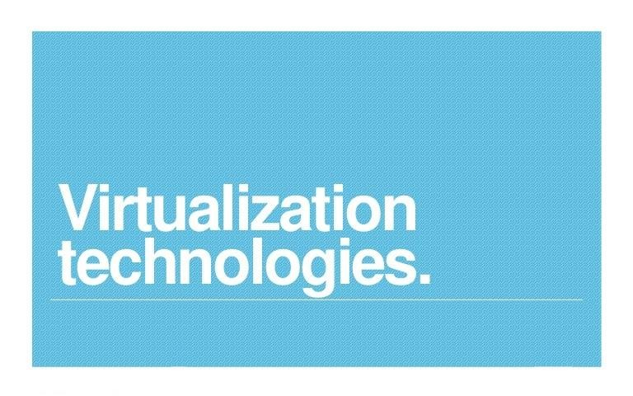
1

Slide 2
Module-2
Using Cloud Computing Platforms
2

Slide 3
In File..
Understanding Abstraction and Virtualization
Capacity Planning
Exploring Platform as a Service
Notes:
Slide Objectives:
Introduce the topics that will be covered in this session
VALUE PROP
Speaking Points:
Notes:

Slide 4
Abstraction and Virtualization
Virtualization Technologies
Load Balancing and Virtualization
Hypervisors
Machine Imaging
Porting Applications

Slide 5
Virtualization technologies
Most cloud-based systems combine their resources into pools that can be assigned on-demand to users. This resource pooling helps to attain efficient utilization, provide reasonable costs to users, and proactively react to demand.
Pooled resources can be accessed using a technique called Virtualization.
5

Slide 6
Virtualization assigns a logical name for a physical resource and then provides a pointer to that physical resource when a request is made.
The mapping of virtual resources to physical resources can be both dynamic and simple; which helps efficient resource management.

Slide 7
Benefits of virtualization
Additional benefits include:
Reduced capital and operating costs.
Minimized or eliminated downtime.
Increased IT productivity, efficiency, agility, and responsiveness.
Faster provisioning of applications and resources.
Greater business continuity and disaster recovery.
Simplified data center management.
7

Slide 8
Virtualized components for cloud computing:
Access: A client can request access to a cloud service from any location.
Application: A cloud has multiple application instances and directs requests to an instance based on conditions.
CPU: Computers can be partitioned into a set of virtual machines with each machine being assigned a workload. Alternatively, systems can be virtualized through load-balancing technologies.
Storage: Data is stored across storage devices and often replicated for redundancy.
8

Slide 9
Virtualization enables the following attributes of cloud computing:
Service-based: A service-based architecture is where clients are abstracted from service providers through service interfaces. Clients are provided services through service interfaces.
Scalable and Elastic: Services can be altered to affect capacity and performance on demand.
Shared Services: Resources are pooled to create greater efficiencies.
Metered Usage: Services are billed on a usage basis.
Internet delivery: The services provided by cloud computing are based on Internet protocols and formats.
9

Slide 10
Load Balancing and Virtualization
Cloud computing provides virtualized network access to a service. No matter where you access the service, you are directed to the available resources.
Cloud Load Balancing is the process of distributing workloads and computing resources in a cloud computing environment.
It allows enterprises to manage application or workload demands by allocating resources among multiple computers, networks, or servers.
Load Balancing can be implemented in hardware or in software.
10

Slide 11

Load balancing is an optimization technique; It can be used to:
Increase Utilization
Reduce Response Time
Avoid System Overload
Increase Throughput (Capacity)
Lower Latency (Delay before processing request)

Slide 12
The following network resources can be load balanced:
Network interfaces and services (such as DNS, FTP, and HTTP).
Connections through intelligent switches.
Processing through computer system assignment.
Storage resources.
Access to application instances.

Slide 13
Load balancing makes a system reliable through managed redirection. It uses various algorithms for traffic routing.
When a request from a client or service requester arrives, the load balancer uses a scheduling algorithm to assign where the request is sent.
Typical scheduling algorithms used are Round Robin, Weighted Round Robin, Fastest Response Time, Least Connections, and Weighted Least Connections.
It also creates a session so that subsequent traffic related to that session is routed to the same resource.

Slide 14
Advanced Load Balancing
Workload managers are more sophisticated load balancers.
In order to assign tasks to each resource, they determine the current utilization of the resources in their pool, the response time, the work queue length, connection latency, capacity, and other factors.
An Application Delivery Controller (ADC) is a combination of the load balancer and an application server. It is placed between a firewall/router and a data center providing the web services.
ADCs are also referred to as a content switch, multilayer switch, or web switch.

Slide 15
An ADC is assigned a virtual IP address (VIP) that it maps to a pool of servers.
An ADC is considered to be an advanced version of a load balancer and lowers the workload of the Web servers.
Services provided by an ADC include data compression, content caching, security, server health monitoring, Secure Sockets Layer[SSL] offload and advanced routing based on current conditions.
An ADC is considered to be an application accelerator, which focus on two areas of technology:
Network optimization
Application/framework optimization.

Slide 16
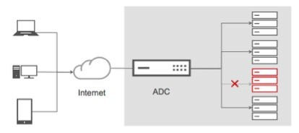
An architectural layer containing ADCs is described as an Application Delivery Network (ADN).
The purpose of an ADN is to distribute content to resources based on application-specific criteria.
ADN provides a caching mechanism to reduce traffic, traffic prioritization and optimization, and other techniques.

Slide 17
Hypervisors
Virtual systems are created out of physical systems. A portion of computer system resources can be set aside to create a virtual machine.
Virtual machine has all the attributes and characteristics of a physical system; but it is a software, that imitates a physical machine.
A system/hardware virtual machine has its own memory address space, processor resource allocation, and device I/O using its own virtual device drivers.

Slide 18
Virtual machines that are designed to run only a single application or process are referred to as Process virtual machines.
Virtual machines provide the capability of running multiple machine instances, each with its own OS.
A Hypervisor or Virtual Machine Monitor (VMM) is a computer software or firmware or hardware that creates and runs virtual machines.
It is a low-level program that allows multiple operating systems to run concurrently on a single host computer.
Hypervisors use a thin layer of code in software or firmware to allocate resources in real time.

Slide 19
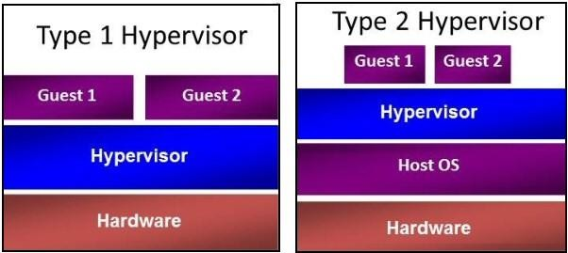
A computer on which a hypervisor runs one or more virtual machines is called a host machine, and each virtual machine is called a guest machine.
Hypervisor/Virtual Machine Types:
Type 1
Type 2

Slide 20
Type 1 Hypervisor
Type 1 hypervisors run directly on the system hardware. They are often referred to as a "native" or "bare metal" or "embedded" hypervisors.
Type 1 VMs have no host operating system because they are installed on a bare system.
Because they run directly on the hardware, Type 1 hypervisors support hardware virtualization.
They provide higher performance, availability, and security.
An OS running on a Type 1 VM is a full virtualization because, it is a complete simulation of the hardware that it is running on.
Eg: Oracle VM, VMware ESX and ESXi

Slide 21
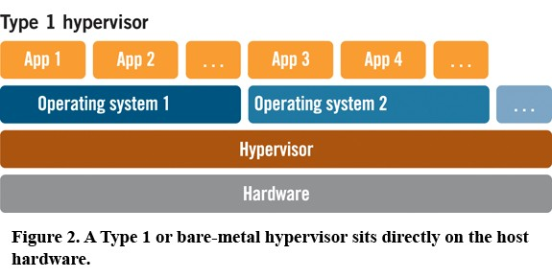

Slide 22
Type 2 Hypervisor
It run on a host operating system.
Because they run as an application on top of an operating system, Type 2 hypervisors perform software virtualization.
A software interface is created that replicates the device to which the system normally interacts.
Additional applications can be installed, executed, and can be monitored; such as browsers, word editors, application software etc.
Eg: Microsoft Hyper V, VMware Workstation 6.0

Slide 23
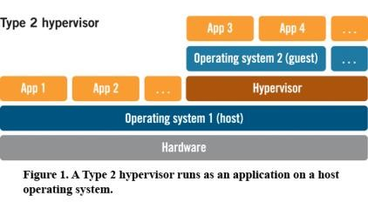

Slide 24
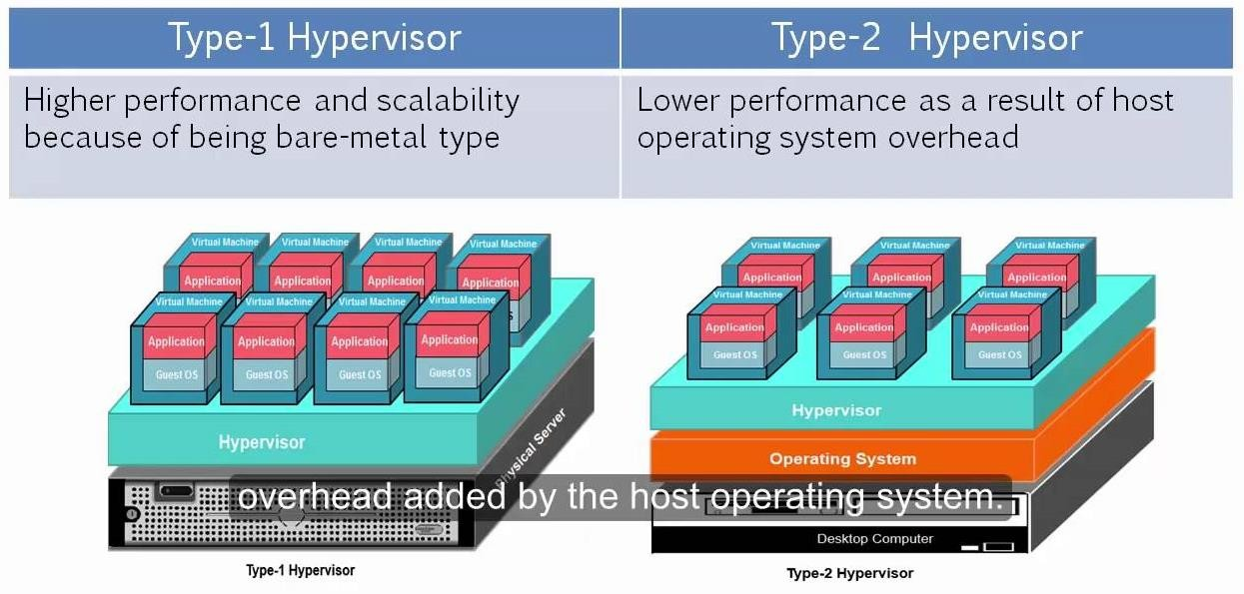

Slide 25
Benefits of hypervisors
There are several benefits to using a hypervisor that hosts multiple virtual machines:
Speed: Hypervisors allow virtual machines to be created instantly, unlike bare-metal servers. This makes it easier to provision resources as needed for dynamic workloads.
Efficiency: Hypervisors that run several virtual machines on one physical machine’s resources also allow for more efficient utilization of one physical server. It is more cost- and energy-efficient to run several virtual machines on one physical machine than to run multiple underutilized physical machines for the same task.
Flexibility: Bare-metal hypervisors allow operating systems and their associated applications to run on a variety of hardware types because the hypervisor separates the OS from the underlying hardware, so the software no longer relies on specific hardware devices or drivers.

Slide 26
Portability: Hypervisors allow multiple operating systems to reside on the same physical server (host machine). Because the virtual machines that the hypervisor runs are independent from the physical machine, they are portable.
IT teams can shift workloads and allocate networking, memory, storage and processing resources across multiple servers as needed, moving from machine to machine or platform to platform.
When an application needs more processing power, the virtualization software
allows it to seamlessly access additional machines.

Slide 27
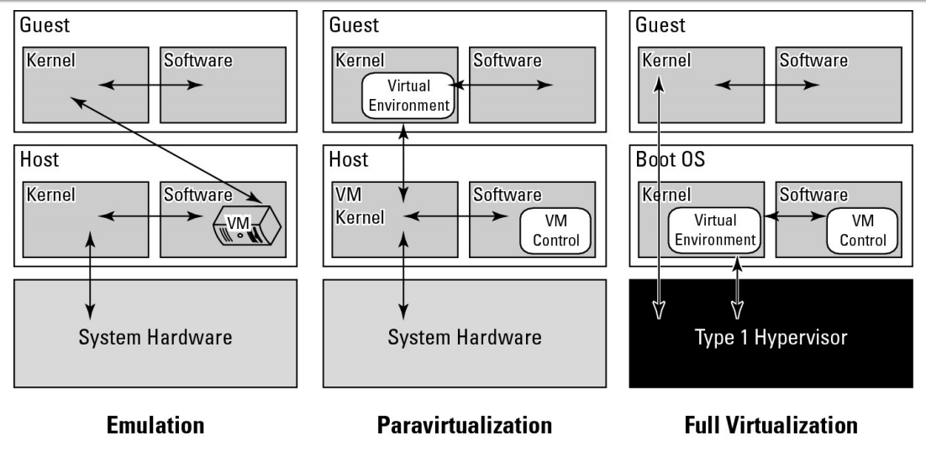

Slide 28
Emulation
In emulation, the virtual machine simulates hardware, so it can be independent of the underlying system hardware.
A guest operating system using emulation does not need to be modified in any way.
Advantages:
Widest hardware compatibility
More portable applications/images
Disadvantages:
Worst user experience. Too much overhead of running customized applications, graphics, etc
Worst performance.

Slide 29
Paravirtualization
It requires the host OS to provide a virtual machine interface for the guest OS. The guest access hardware through that host VM.
An OS running as a guest on a paravirtualization system must be ported/modified to work with the host interface.
Advantages:
Good image portability
Disadvantages:
Complex driver architecture
Compatibility is limited by the vendors

Slide 30
Full Virtualization (Hardware pass-through)
In a full virtualization scheme, the VM is installed as a Type 1 Hypervisor directly onto the hardware.
All OS communicate directly with the VM hypervisor, so guest OS do not require any modification.
Guest operating systems in full virtualization systems are generally faster than other virtualization schemes.
Advantages:
Best user experience
Native performance
Disadvantages:
Hardware-specific images
35

Slide 31
Machine Imaging
A mechanism to provide system portability, instantiate applications and provision and deploy systems in the cloud through storing the state of a systems using a system image.
A system image makes a copy or a clone of the entire computer system inside a single container such as a file.
The system imaging program is used to make this image and can be used later to restore a system image.

Slide 32
Some imaging programs allow you to view the files contained in the image and do partial restores.
Eg: Amazon Machine Image (AMI) used by Amazon Web Services: An AMI is a file system image that contains an operating system, all appropriate device drivers, and any applications and state information that the working virtual machine would have.

Slide 33
Porting Applications
Cloud computing applications have the ability to run on virtual systems and these virtual systems to be moved as needed to respond to demand.
Systems (VMs running applications), storage, and network assets can all be virtualized.
Cloud Developers want the ability to port their applications from one cloud vendor to another. But the major cloud vendors don't have technologies that interoperate with one another.
Some technologies used for porting applications:
The Simple Cloud API by Zend Technologies
Virtual Application Appliance by AppZero

Slide 34
The Simple Cloud API
Porting an application built on the Microsoft Azure platform to AWS or GoogleApps is difficult.
The Simple API for Cloud Application Services is an open-source initiative by Zend Technologies to create a common application program interface that will allow applications to be portable.
Among the founding supporters are IBM, Microsoft, Nivanix, Rackspace, and GoGrid.
Simple Cloud API has common interfaces for:
File Storage Services
Document Storage Services
Simple Queue Services

Slide 35
AppZero Virtual Application Appliance
Virtual Application Appliance (VAA), developed by AppZero company, gives the ability to run an application from whatever platform you want.
It is created as an architectural layer between the Windows or the UNIX OS and the applications. The virtualization layer serves as the mediator for file I/O, memory I/O, and application calls and responses to DLLs.
The running application in AppZero changes none of the registry entries or any of the files on the Windows Server.
VAA creates a container which encapsulates the application and all its dependencies within a set of files; it is an application image for a specific OS.

Slide 36
Dependencies include DLL, service settings, configuration files, registry entries, and machine and network settings.
This container forms an installable server-side application stack that can be run after installation but has no impact on the underlying OS.
VAAs are created using the AppZero Creator wizard, managed with the AppZero Admin tool, and may be installed using the AppZero Director, which creates a VAA runtime application.
AppZero Dissolve removes the VAA virtualization layer from the encapsulated application and installs that application directly into the operating system.

Slide 37


Capacity Planning
Capacity Planning
Defining Baseline and Metrics
Baseline Measurements | System Metrics | Load Testing
Resource Ceiling | Server and Instance Types
Network Capacity
Scaling

Slide 38
Capacity Planning
Capacity planning examines the available systems, measures their performance, and determines patterns in usage that enables the planner to predict demand.
A system uses processor, memory, storage, and network capacity to satisfy cloud computing demands.
Each of these resources has a utilization rate, and these resources reaches a ceiling that limits performance when demand increases.

Slide 39
Resources are provisioned and allocated to meet demand. The goal of capacity planning is to accommodate the workload.
Capacity planning measures the maximum amount of work that can be done using the current technology and then adds resources to do more work as needed.
It is the goal of a capacity planner to identify the critical resource that has a resource ceiling and add more resources to move the bottleneck to higher levels of demand.

Slide 40
Capacity planning steps:
Determine the characteristics of the present system.
Measure the workload for the different resources in the system: CPU, RAM, disk, network, and so forth.
Load the system until it is overloaded, determine when it breaks, and specify what is required to maintain acceptable performance.
Predict the future based on historical trends and other factors.
Deploy or tear down resources to meet your predictions.
Iterate Steps 1 through 5 repeatedly.

Slide 41
Defining Baseline and Metrics
In business, the current system capacity or workload should be determined as a measurable quantity over time.
Many developers create cloud-based applications and Web sites based on a LAMP solution stack.
LAMP stands for:
Linux: the operating system
Apache HTTP Server: the Web server.
MySQL: the database server
PHP [Hypertext Preprocessor]: the scripting language
These four technologies are open source products.

Slide 42
1.Baseline Measurements
Two important overall workload metrics in this LAMP system:
Page views or hits on the Web site, as measured in hits per second.
Transactions completed on the database server, as measured by transactions per second or perhaps by queries per second.
The total workload might be served by a single server instance in the cloud, a number of virtual server instances, or some combination of physical and virtual servers.

Slide 43
Workload characteristics are determined by:
W_{T}: the total workload for the system per unit time.
W_{AVG}: the average workload over multiple units of time.
W_{MAX}: the highest amount of work recorded by the system.
W_{TOT}: the total amount of work done by the system.

Slide 44
2. System Metrics
Capacity planning must measure system-level statistics, determining what each system is capable of, and how the resources of a system affect system-level performance.
A machine instance (physical or virtual) is primarily defined by four essential resources:
CPU
Memory (RAM)
Disk
Network connectivity

Slide 45
In Linux/UNIX, sar command display the level of CPU activity. In Windows, the Task Manager serves this purpose.
Linux performance measurement tool RRDTool (Round Robin Database tool) captures time-dependent performance data from resources such as CPU load, network utilization (bandwidth), and so on and stores the data in a circular buffer. It is commonly used in performance analysis work.
Some LAMP Performance Monitoring Tools are:
Alertra: Web site monitoring service
Collectd: System statistics collection daemon

Slide 46
3. Load Testing
The aim of Load Testing is to check what happens to a system when the load increases.
It is also referred to as performance testing, reliability testing, stress testing, and volume testing.
Upon reaching the maximum load, cloud can create virtual clone of the system to perform tasks.
Examples of load generation tools: HP LodeRunner, IBM Rational Performance Tester, JMeter
Load balancers serves more requests to more powerful systems and fewer requests to less powerful systems.

Slide 47
Load testing seeks to answer the following questions:
What is the maximum load that my current system can support?
Which resource(s) represents the bottleneck in the current system that limits the system’s performance?
Can I alter the configuration of my server in order to increase capacity?
How does a server’s performance relate to other servers that might have different characteristics?

Slide 48
4. Resource Ceiling
Among several components (like the CPU, RAM, Network I/O, and Disk I/O) of a particular server, if any component reaches its maximum utilization while functioning, this factor is the current system resource ceiling.
Usually, in such a scenario, since a particular component reaches its maximum utilization, more utilization of other resources might not be possible even though the system is not fully loaded.

Slide 49
Some common issues and solutions:
Network I/O is often a bottleneck in Web servers, so, Web sites prefer to scale out using many low-powered servers instead of scaling up with fewer but more powerful servers.
Database servers usually exhibit resource ceilings. The solution is to replicate the master MySQL database and create a number of slave MySQL databases. All READ operations are performed on the slave MySQL databases, and all WRITE operations are performed on the master MySQL database.

Slide 50
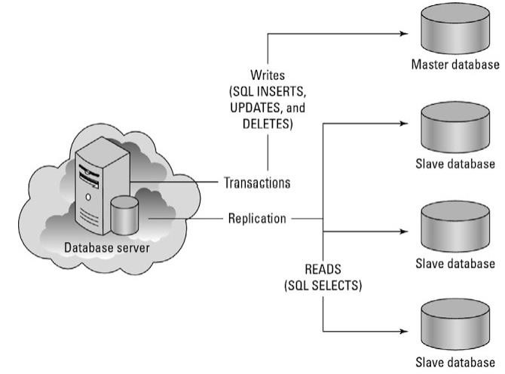
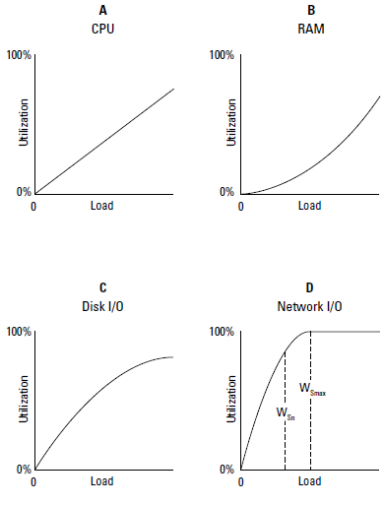
Database Servers Resource Ceiling
Network I/O Resource Ceiling
56

Slide 51
5. Server and Instance Types
Capacity planning makes the growth and shrinkage of capacity predictable.
In cloud computing, you can increase (automatically or manually) capacity on demand quickly and efficiently.
It can be made possible by standardizing on a few hardware types and then well characterizing those platforms.
Assign servers standardized roles and populate those servers with identical services.

Slide 52
A server with the same set of software, system configuration, and hardware should perform similarly if given the same role in infrastructure.
Capacity planning compares the capability of different systems and chooses the solution that is right-sized and provides the service with the best operational parameters at the lowest cost.
Server instances of various sizes are created to perform different kinds of tasks.

Slide 53
An Amazon Machine Instance (AMI) is described as follows:
Micro Instance
633 MB memory, 1 to 2 EC2 Compute Units with either a 32-bit or 64-bit platform.
Small Instance (Default)
1.7 GB memory, 1 EC2 Compute Unit, 160GB instance storage, 32-bitplatform, I/O Performance: Moderate.
High-Memory Quadruple Extra Large Instance
68.4GB of memory, 26 EC2 Compute Units, 1,690GB of instance storage, 64-bit platform, I/O Performance: High.
High-CPU Extra Large Instance
7 GB of memory, 20 EC2 Compute Units, 1,690GB of instance storage, 64-bit platform, I/O Performance: High.

Slide 54
Network Capacity
There are three aspects to assessing network capacity:
Network traffic to and from the network interface at the server, be it a physical or virtual interface or server(Server side network)
Network traffic from the cloud to the network interface (Measurement of WAN traffic)
Network traffic from the cloud through your ISP to your local network interface (your computer)

Slide 55
To measure network traffic at a server's network interface, a network monitor is used, which is a form of packet analyzer.
Eg: Microsoft includes a utility called the Microsoft Network Monitor as part of its server utilities.

Slide 56
Factor 2 is the cloud’s network performance, which is a measurement of WAN traffic. A WAN’s capacity is a function of many factors:
Overall system traffic (competing services)
Routing and switching protocols
Traffic types (transfer protocols)
Network interconnect technologies (wiring)
The amount of bandwidth that the cloud vendor purchased from an Internet backbone provider

Slide 57
Scaling
Scalability is a key feature provided in cloud computing. This is achieved with the help of providing adequate infrastructure.
You can either scale vertically (scale up) or scale horizontally (scale out), and each method is broadly suitable for different types of applications.

Slide 58
Vertical scaling
In this method, we add resources to a system to make it more powerful. Results in a single powerful supercomputer.
Eg: Replacing a dual-processor machine instance equivalence with a quad-processor machine instance equivalence
Vertical scaling allows you to use a virtual system to run more virtual machines (operating system instance), run more daemons on the same machine instance, or take advantage of more RAM (memory) and faster compute times.

Slide 59
Horizontal scaling
It adds capacity to a system by adding more individual nodes.
Eg: In a dual-processor machine instance, you add more dual-processor machines instances.
Scaling out indefinitely leads you to an architecture with a large number of servers, which is the model that many cloud and grid computer networks use.
It allows you to run distributed applications more efficiently and is effective in using hardware more efficiently because it is both easier to pool resources and to partition them.

Slide 60
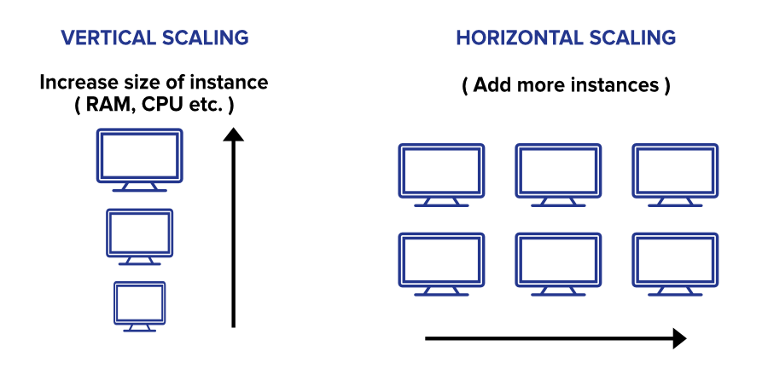

Slide 61
Exploring Platform as a Service
SaaS versus PaaS
Application Development
Using PaaS Application Frameworks
Drupal | Squarespace | Eccentex
LongJump| WaveMaker |Wolf Frameworks

Slide 62
Exploring Platform as a Service
The PaaS model provides the tools and environment that are needed to create applications that can run in a SaaS model.
Applications developed in PaaS systems can be composite business applications, data portals, or mashups with data derived from multiple sources.
Application frameworks are powerful tools for creating cloud computing applications.
Salesforce.com is a Web application suite that is a SaaS.
Force.com is its PaaS platform for building their own services.

Slide 63
PaaS systems provide a toolkit to work with and also a VM to run your software. Using these, the developers design the software and UI that serves the needs.
Eg: Windows Azure Platform, Drupal, Squarespace, Wolf. These tools are very well-developed and require almost no coding.

Slide 64
The services provided by the PAAS model are:
Application development.
Collaboration: allows multiple individuals to work on the same projects.
Data management: Tools are provided for accessing and using data.
Instrumentation, performance, and testing: Tools are available for measuring your applications and optimizing their performance.
Storage: Data can be stored in either the PaaS vendor's service or accessed from a third-party storage service.
Transaction management.

Slide 65
Application Development
Common application types developed using PaaS tools are:
Composite business applications.
Data portals.
Mashups of multiple data sources.
Major Application Development Tools are: Google AppEngine, Microsoft Windows Azure Platform, Eccentex AppBase, LongJump, and Wolf
The vendor provides a full software development stack for the programmer to use; the developer need not go outside of the service to create his application.

Slide 66
All PaaS application development must have lifecycle management. As an application age, it must be upgraded, migrated, grown, and eventually phased out or ported.
Most PaaS vendors offer integrated systems with lifecycle development platforms.
An integrated lifecycle platform includes the following:
The virtual machine and operating system (often offered by an IaaS).
Data design and storage.
A development environment with defined Application Programming Interfaces.
Middleware.
Testing and optimization tools.
Additional tools and services.

Slide 67
Drupal
A full-strength developer tool that is modular and exposes its functionality through a set of published APIs.
The contrib modules can be added to Drupal to replace other modules, enhance capabilities, or provide entirely new features.
Third-party modules include messaging systems, visual editors, a content construction kit (CCK) for database schema extension, views, and panels.

Slide 68
Squarespace
A next-generation website builder and deployment tool.
Presents itself as a blogging tool, social media integration tool, photo gallery, form builder and data collector, item list manager, traffic and site management and analysis tool.
Eccentex
Uses its AppBase architecture to create Cloudware applications.
AppBase includes a set of different tools for building the following applications: Business Objects Build, Presentation Builder, Business Process Designer, Dashboard Designer, Report Builder, Security Roles Management

Slide 69
LongJump
Its development environment is based on Java and uses REST/SOAP APIs.
LongJump's PaaS is based on standard Java/JavaScript, SOAP, and REST.
It creates browser-based Web applications that are database-enabled.
LongJump comes with an Object Model Viewer, forms, reports, layout tools, dashboards, and site management tools.
Access control is based on role-based and rule-based access, and it allows for data-sharing between teams and between tenants.

Slide 70
WaveMaker
An application development environment for creating Java-based Web and cloud Ajax applications.
The software is open-source and offered under the Apache license.
WaveMaker is a drag-and-drop environment that runs inside a browser.
Wolf Frameworks
Wolf Frameworks is an application development framework that is open, standards-based, and portable.
It is a PaaS vendor, that offers a platform, where you can build a SaaS solution that is open and cross-platform.

Slide 71
Wolf Frameworks
Wolf Frameworks is based on: AJAX, asynchronous Java, XML and .NET Framework
Using Wolf, applications can be built without writing technical code.
It also allows application data to be written to the client's database server, and data can be imported or exported from a variety of data formats.
Wolf supports forms, search, business logic and rules, charts, reports, dashboards, and both custom and external Web pages.
After you create entities and assign their properties, you create business rules with a rules designer.
You can automate tasks via business rules.

Slide 72
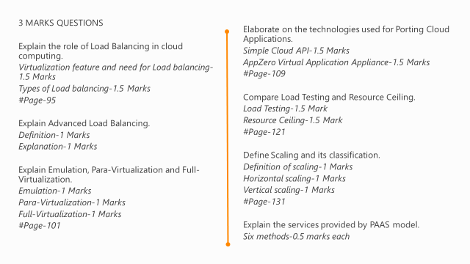

Slide 73
6 MARKS QUESTIONS
Explain Hypervisor and its categories with the help of diagrams.
Definition of Virtual machine and use of Hypervisor-2 Marks
Type 1 Hypervisor with diagram-2 Marks
Type 2 Hypervisor with diagram-2 Marks
#Page-100
Explain the methods used for porting application in cloud.
Porting definition-1 Mark
The Simple Cloud API-2.5 Marks
AppZero Virtual Application Appliance-2.5 Marks
Define capacity planning. Explain the role of capacity planning in Cloud Computing.
or
Explain the parameters and methods used to implement Capacity Planning.
Definition and need of capacity planning.-1 Mark
Baseline Measurements, System Metrics, Load Testing, Resource Ceiling, Server and Instance Types.-5 Mark
Elaborate on the commonly used Application Development frameworks.
Drupal, Squarespace, Eccentex, LongJump, WaveMaker, Wolf Frameworks -1 Marks each

