Slide 1

ElimuMatch
Matching Support to Retention Risk
A data-driven platform for fee support to secondary school students in Kenya
Prepared for Impact Investors, CSR Partners, and Education Foundations
ElimuMatch Analytics | September 2026
jesyldah.github.io/ElimuMatch

Slide 2
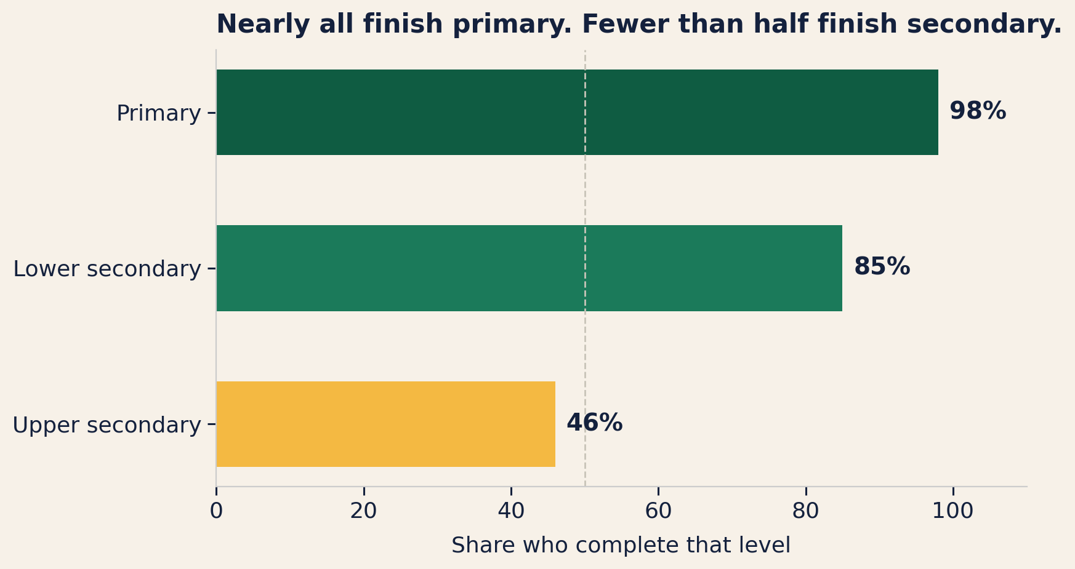
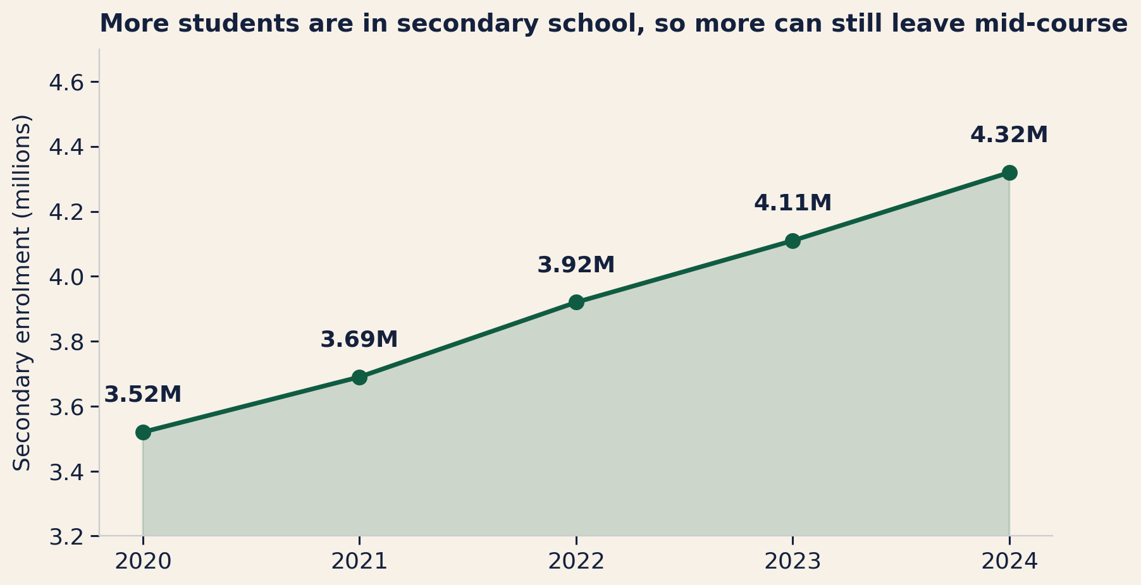
PROBLEM
Kenya expanded access, but nearly half of students still do not finish secondary school
4.32 million students were enrolled by 2024, all vulnerable to fee pressure and income shocks.
People want to help, but support follows personal connections instead of reaching those who need it most.
Sources: UNESCO IICBA (2025) completion estimates; KNBS Economic Survey 2025, secondary enrolment 2020-2024.

Slide 3
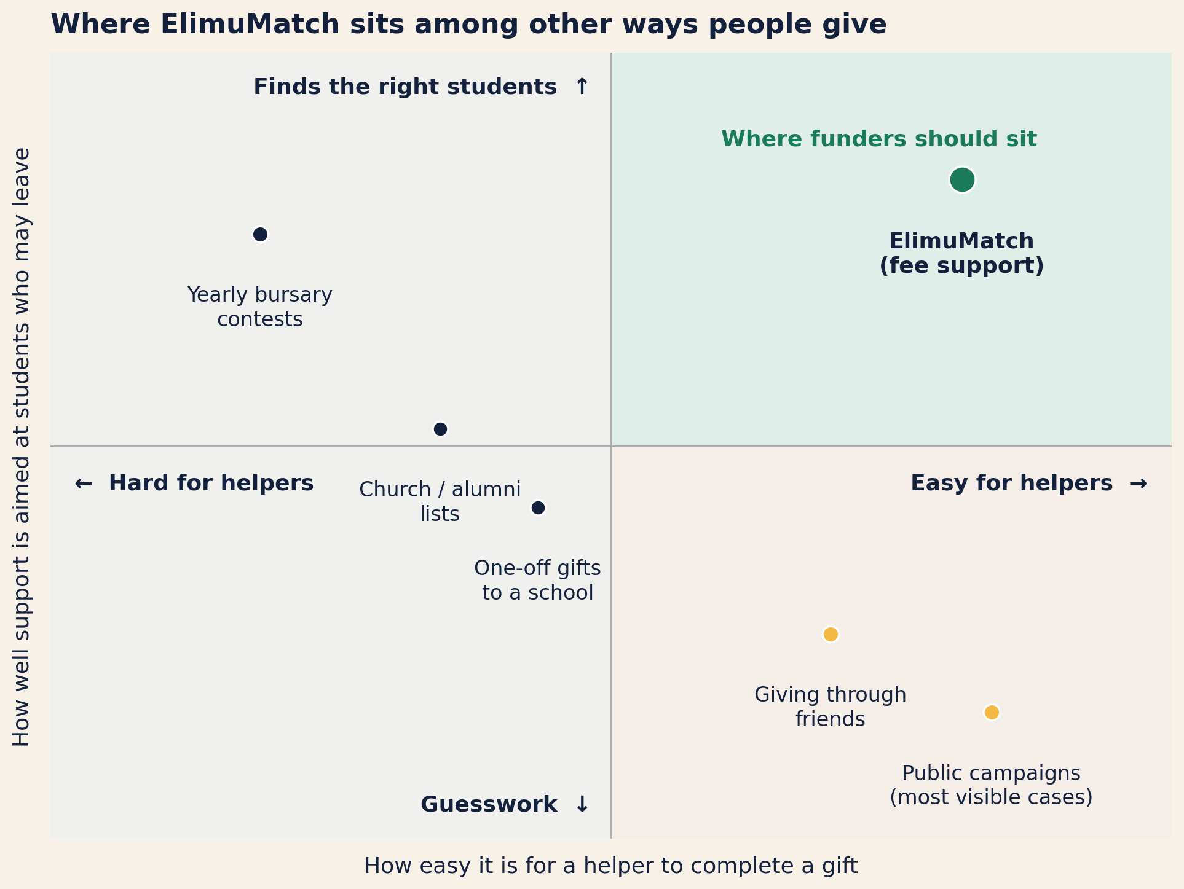
OPPORTUNITY
NGO help often focuses on ASAL, while students elsewhere also face fee pressure and dropout risk
How support is directed today
Geographic concentration: Many NGO programs focus on arid and semi-arid lands (ASAL), while students elsewhere also face fee pressure.
Network reliance: Individual helpers often rely on personal contacts, so students without connections are overlooked.
Bursary friction: Annual contests bring heavy paperwork and long gaps the rest of the year.
Unranked dropout risk: Crowdfunding and school lists rarely prioritize who is most at risk of leaving.
ElimuMatch closes these gaps
Helpers can give in any of Kenya’s 47 counties, to students prioritized by measured dropout risk, through a simple path that settles straight to the school.

Slide 4
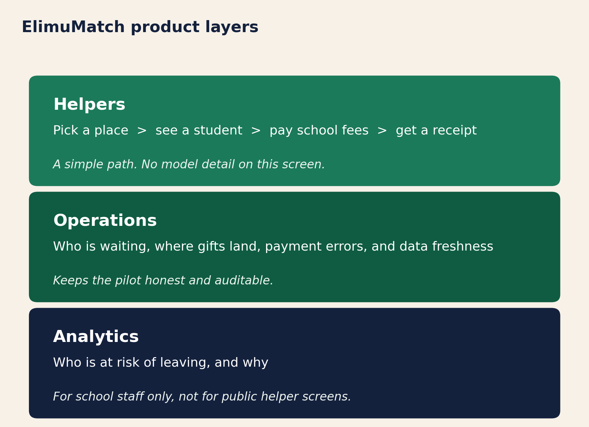
OUR SOLUTION
ElimuMatch identifies at-risk students and lets helpers support them in four simple steps
What helpers experience
They pick a county, choose a school, see a student's fee balance, give, and get a receipt.
What happens behind the scenes
Our system scores each student's risk of dropping out. Only students who need fee help appear.
School staff can see the reasons behind each score.
Every shilling goes directly to the school's fee account. ElimuMatch does not take a cut.

Slide 5
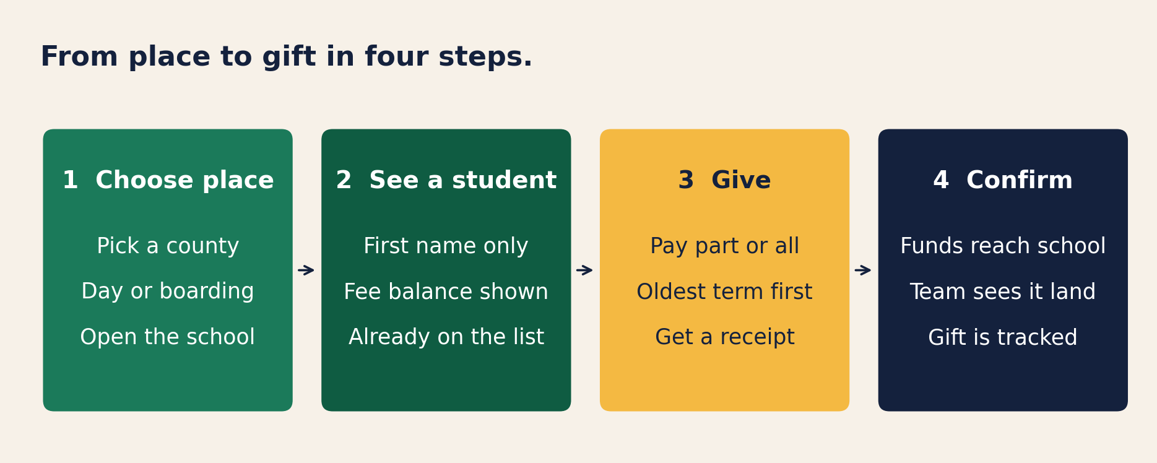
HOW IT WORKS
A helper chooses where to give, pays school fees, and gets a receipt
Every gift goes directly to the school's fee account. Oldest unpaid terms are cleared first.
Overpayments are blocked automatically, and every transaction is tracked and auditable.
Live demo: jesyldah.github.io/ElimuMatch

Slide 6
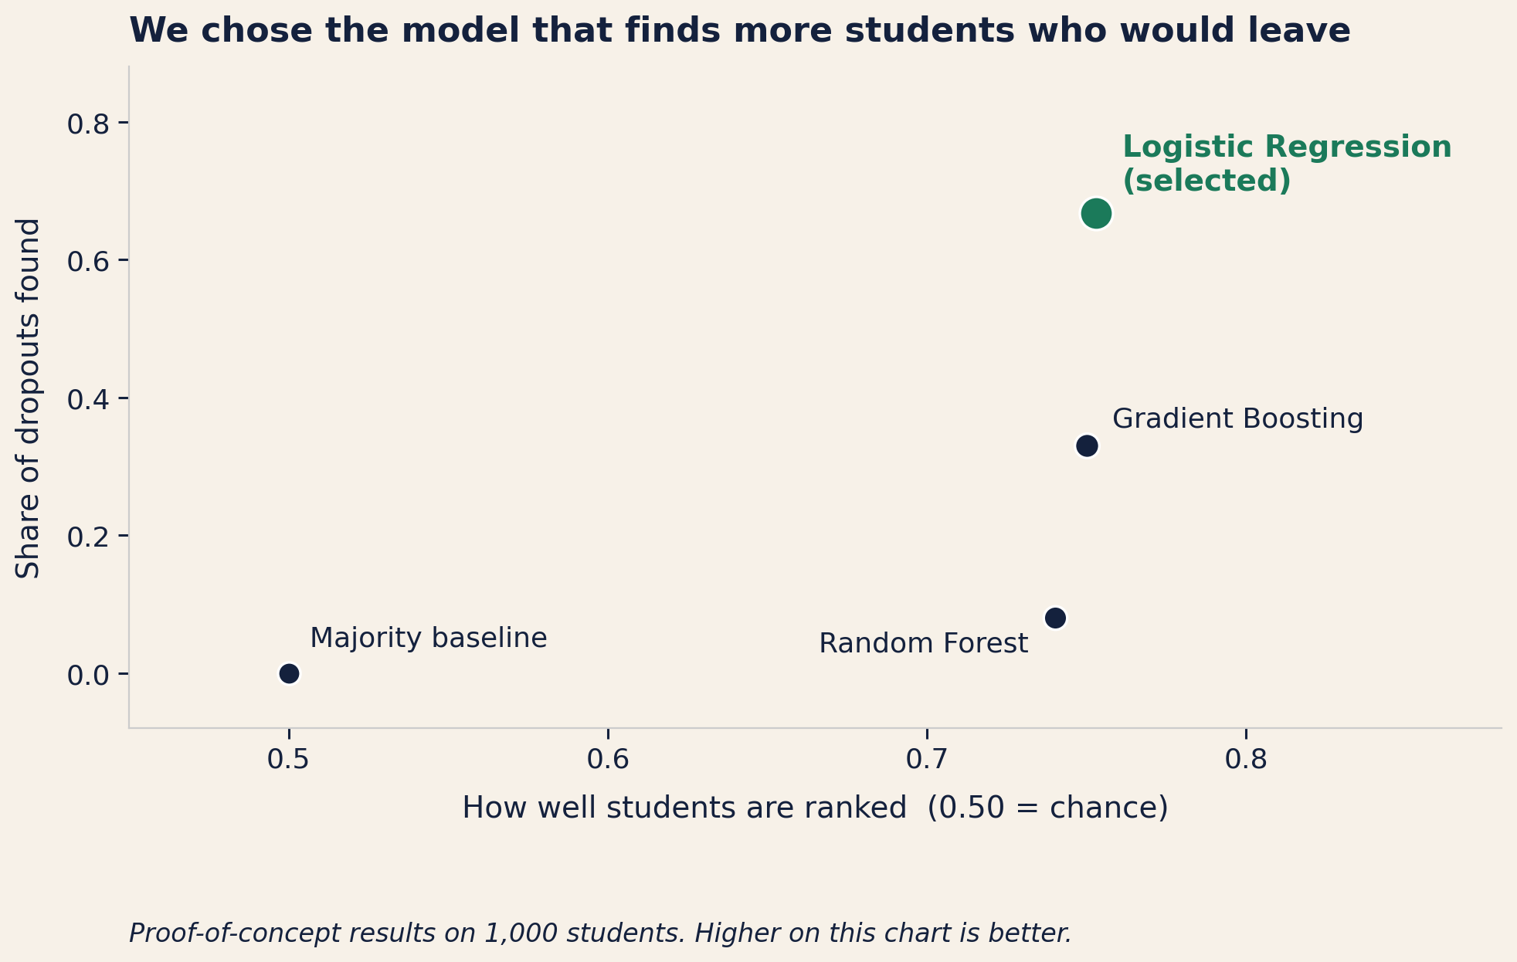
KEY INSIGHT
Our system identifies about two out of three students who would drop out, twice the nearest alternative
We tested four different approaches.
Logistic Regression is the one we selected: it catches about 67% of students who later drop out. Gradient Boosting catches only about 33%.
The strongest warning signs are health problems, family economic pressure, and falling grades.
School staff see why each student is flagged, so they can take informed action. Helpers see only a simple, clear profile.

Slide 7
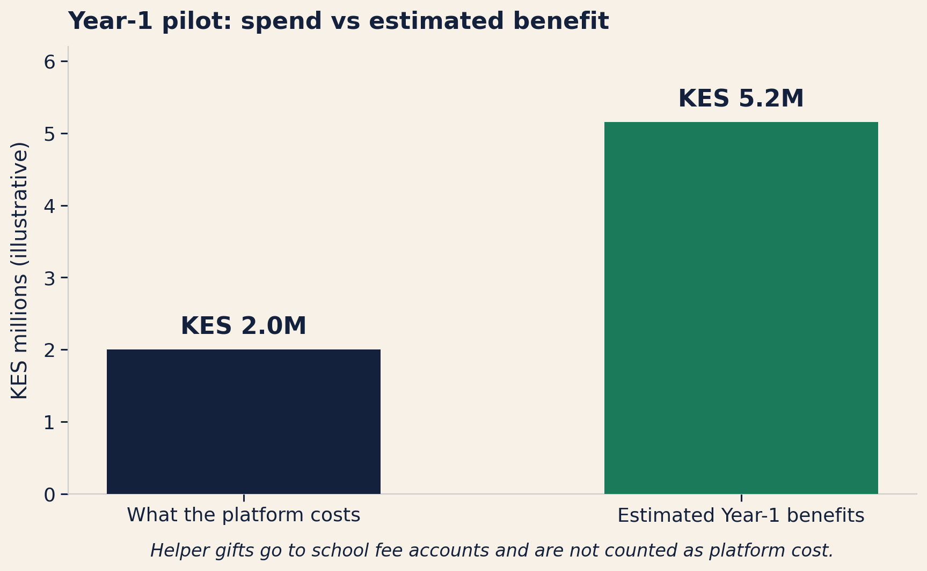
BUSINESS VALUE
An 8-school pilot returns about KES 2.6 for every KES 1 of platform cost
Year-1 pilot: 8 schools, about 1,000 students
It costs about KES 2.0M to set up and run the platform for one year.
Helper gifts of about KES 4.0M pass through to schools separately.
The estimated benefits total about KES 5.2M from better targeting, fewer dropouts, and staff time saved.
Conservative estimate: roughly break-even.
Base case: 2.6x return. Best case: 5.4x.
We measure success by whether priority students actually receive gifts, whether payments land without errors, and whether helped students stay in school.

Slide 8
IMPLEMENTATION ROADMAP
Our pilot runs through six stages and proceeds only if hard results clear
1. Legal Gate
2. Partner Data
3. Soft Pilot
4. Live Giving
5. Measure
6. Scale Decision
Sign agreements with
8 partner schools.
Data protection and
child safeguarding.
Collect school records
under the signed
agreements. Check quality, validate on real extracts, and set a termly refresh.
Rank students on real
data. Review every list
before anything is
made public.
Helpers give through
the platform. Money
goes to school fee
accounts.
Track whether helped
students stay enrolled.
Check payments and
fairness each term.
Add schools or new
support types only if
pilot results justify it.
▶
▶
▶
▶
▶
Months 0-4
Months 1-4
Term 1
Terms 1-2
Each term
End of Year 1
Scale is unlocked only if these three results hold:
The model identifies at least 40% of students who later drop out
Payment error rates stay below 10%
Helped students stay in school longer within two terms

Slide 9
The Ask
Ksh. 2 million to fund an 8-school Year-1 pilot to prove
fee-support matching on real school data
What the funding will unlock:
✓ Platform setup and operations (helper gifts go to schools directly).
✓ A part-time analyst and school liaison to run the pilot.
✓ Access to partner school records under signed agreements.
✓ Live fee giving with human review of every student list before it is published.
✓ A decision to expand (only after pilot results justify it).
We can direct fee support to the students most likely to leave school,
replacing guesswork with transparent, auditable matching.

Slide 10
SOURCES
References
Adhola, F., Ochola, J., & Tikoko, B. (2025). Donor funding and school operations, Nakuru County.
Adelman, C. (2006). The Toolbox Revisited. U.S. Dept. of Education.
Basch, C. E. (2011). Healthier students are better learners. J. School Health, 81(10).
Childress, M. (2015). Dynamics of education in Kenya. The School Fund.
Cortez, P. & Silva, A. (2008). Using data mining to predict student performance.
Cursor. (2026). Auto (Composer) drafting assistance. cursor.com.
Glennerster, R. et al. (2011). Access and quality in Kenyan education. J-PAL / IPA.
Gongera, E. & Okoth, N. (2013). Alternative financing, Kisii County.
Kenya National Bureau of Statistics. (2025). Economic Survey 2025.
Lundberg, S. & Lee, S.-I. (2017). Interpreting model predictions. NeurIPS 30.
Otieno, M. & Ochieng, J. (2020). 100% transition policy, Machakos.
Realinho, V. et al. (2022). Predicting student dropout and success.
RELI Africa. (2020). Status of secondary education in Kenya.
Tinto, V. (1993). Leaving College (2nd ed.). U. of Chicago Press.
UNESCO IICBA. (2025). Kenya education data brief.
Figure sources:
Slide 2: Author charts from UNESCO IICBA (2025) and KNBS (2025)
Slide 3: Illustrative positioning map (author)
Slide 4: Product layer diagram (author)
Slide 5: Gift journey and operations flow (author)
Slide 6: Model comparison from project pipeline on test data
Slide 7: Year-1 economics chart (illustrative, author)
All results are from proof-of-concept data (1,000 students). Not yet validated on live school records.
Live demo: jesyldah.github.io/ElimuMatch | Code: github.com/Jesyldah/ElimuMatch

