Slide 1
ElimuMatch
Matching Support to Retention Risk
A data-driven platform for fee support to secondary school students in Kenya
Prepared for Impact Investors, CSR Partners, and Education Foundations
ElimuMatch Analytics | August 2026
jesyldah.github.io/ElimuMatch

Slide 2
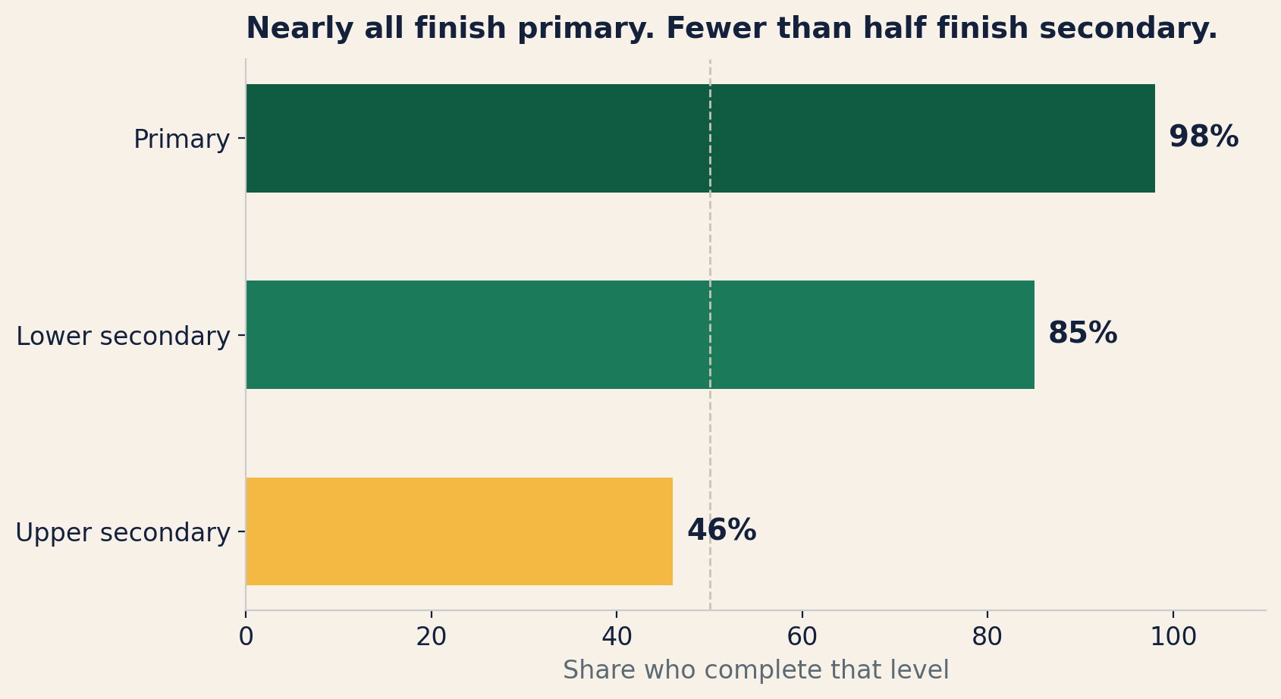
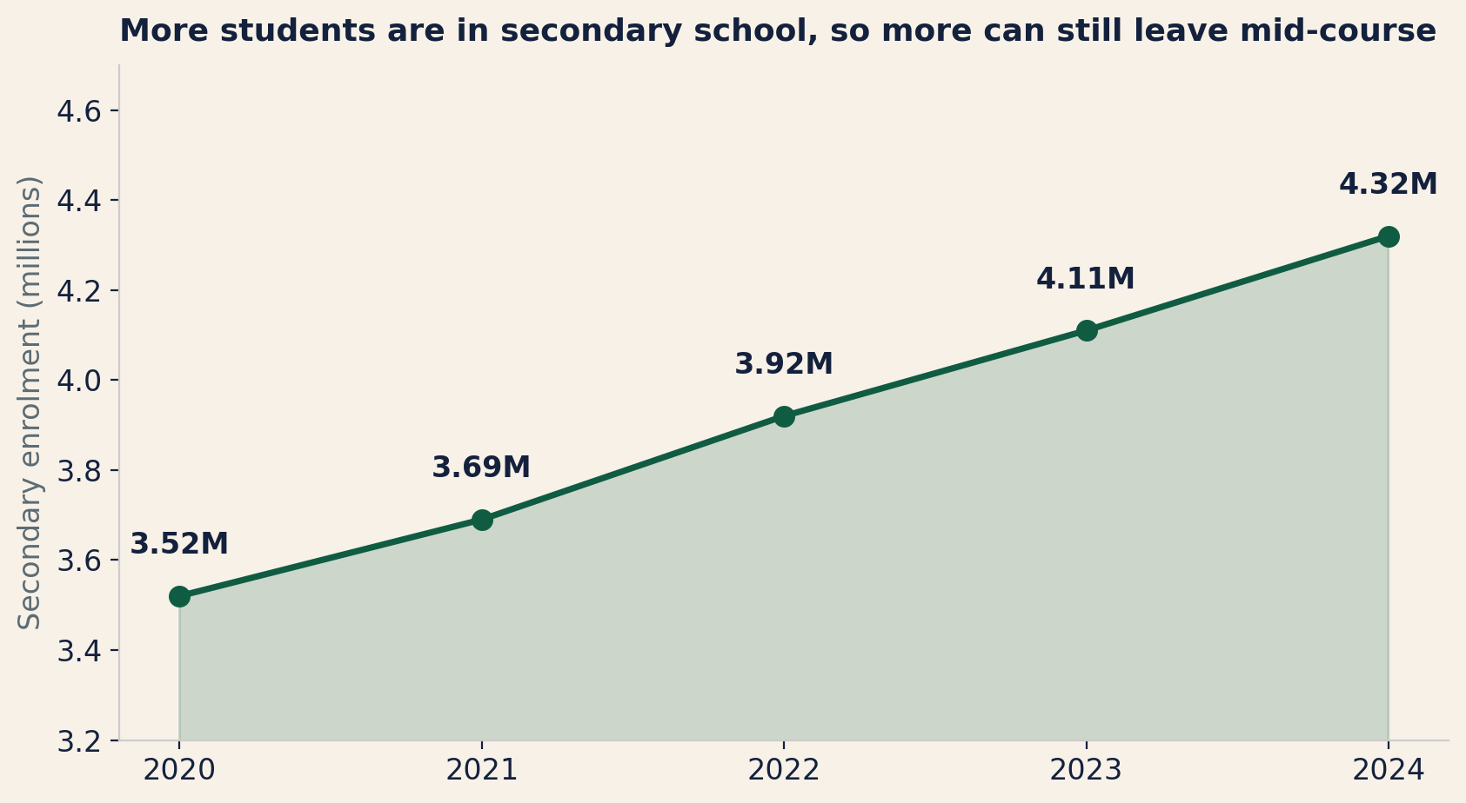
PROBLEM
Kenya has expanded access, but nearly half of students still do not finish secondary school
4.32 million students were enrolled by 2024, all vulnerable to fee pressure and income shocks.
People want to help, but support follows personal connections instead of reaching those who need it most.
Sources: UNESCO IICBA (2025) completion estimates; KNBS Economic Survey 2025, secondary enrolment 2020-2024.

Slide 3
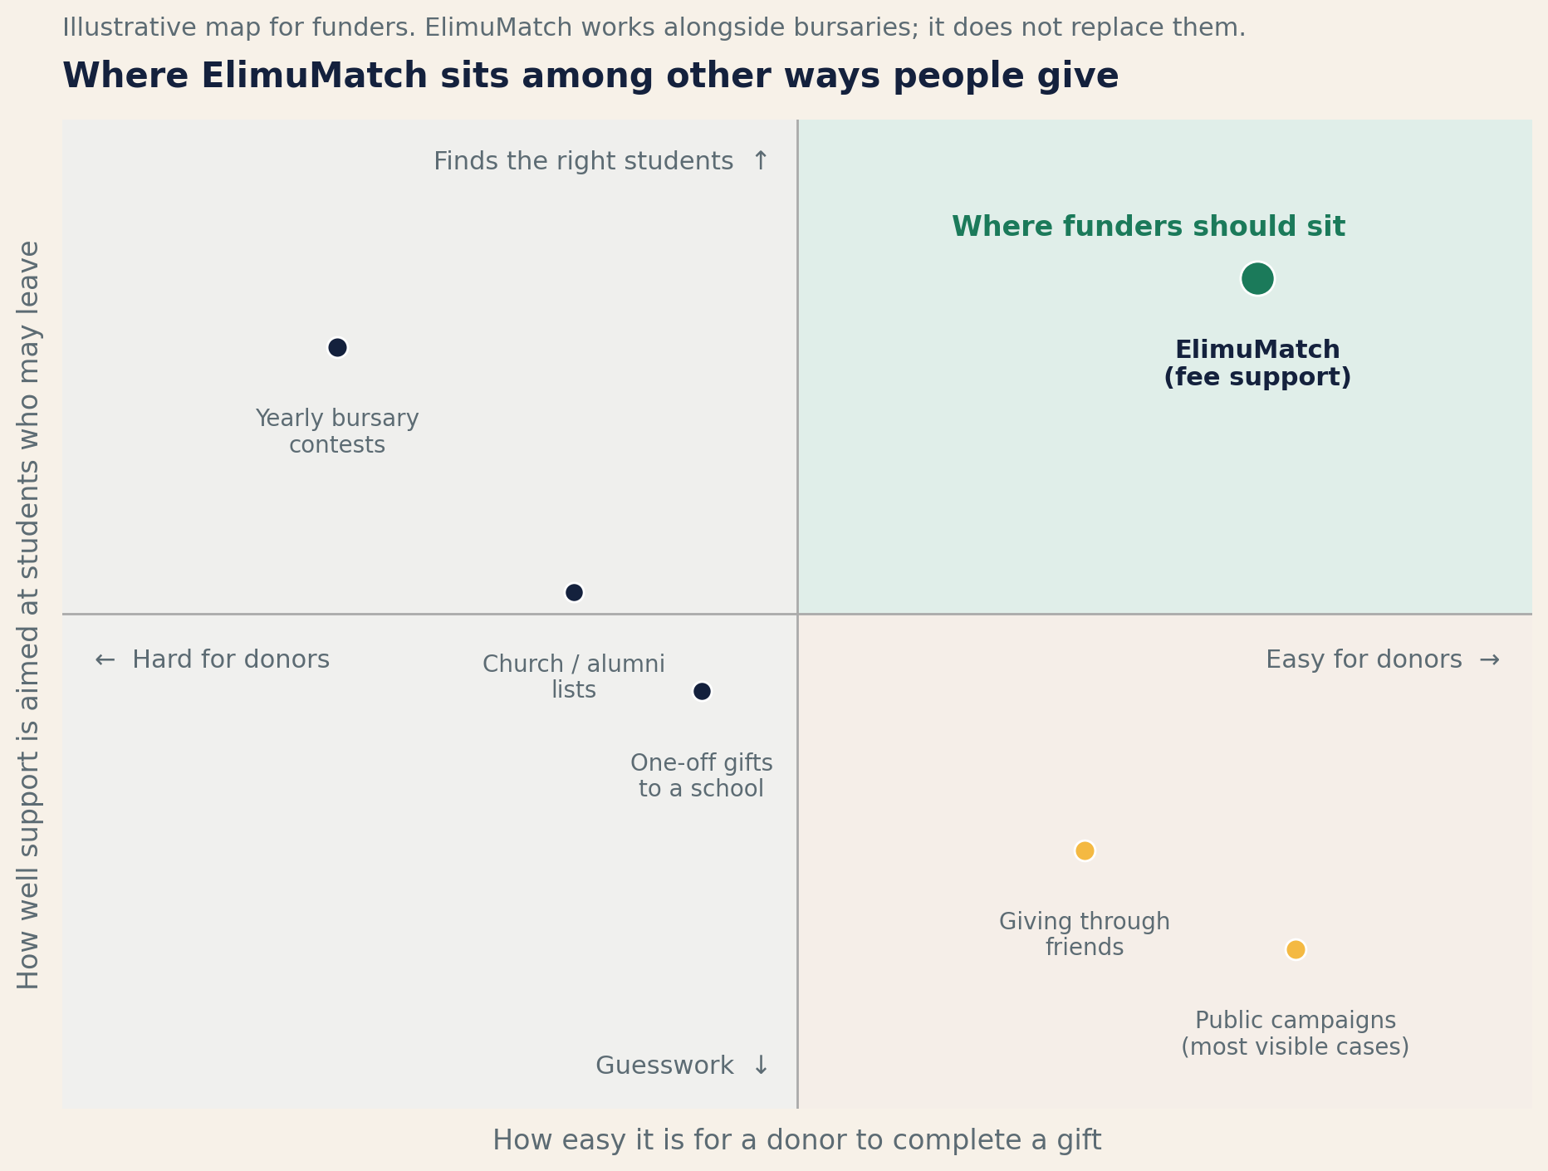
OPPORTUNITY
NGO help often focuses on ASAL, while students elsewhere also face fee pressure and dropout risk
How support is directed today:
• Many NGO programs concentrate on arid and semi-arid lands (ASAL), while students elsewhere also face fee pressure and dropout risk.
• Most individual donors rely on personal contacts, so students without connections are overlooked.
• Bursary contests run once a year with heavy paperwork, leaving gaps the rest of the time.
• Crowdfunding and school lists rarely rank who is most at risk of leaving.
ElimuMatch covers all 47 counties: donors can choose any place, and priority follows measured risk, not geography alone.

Slide 4
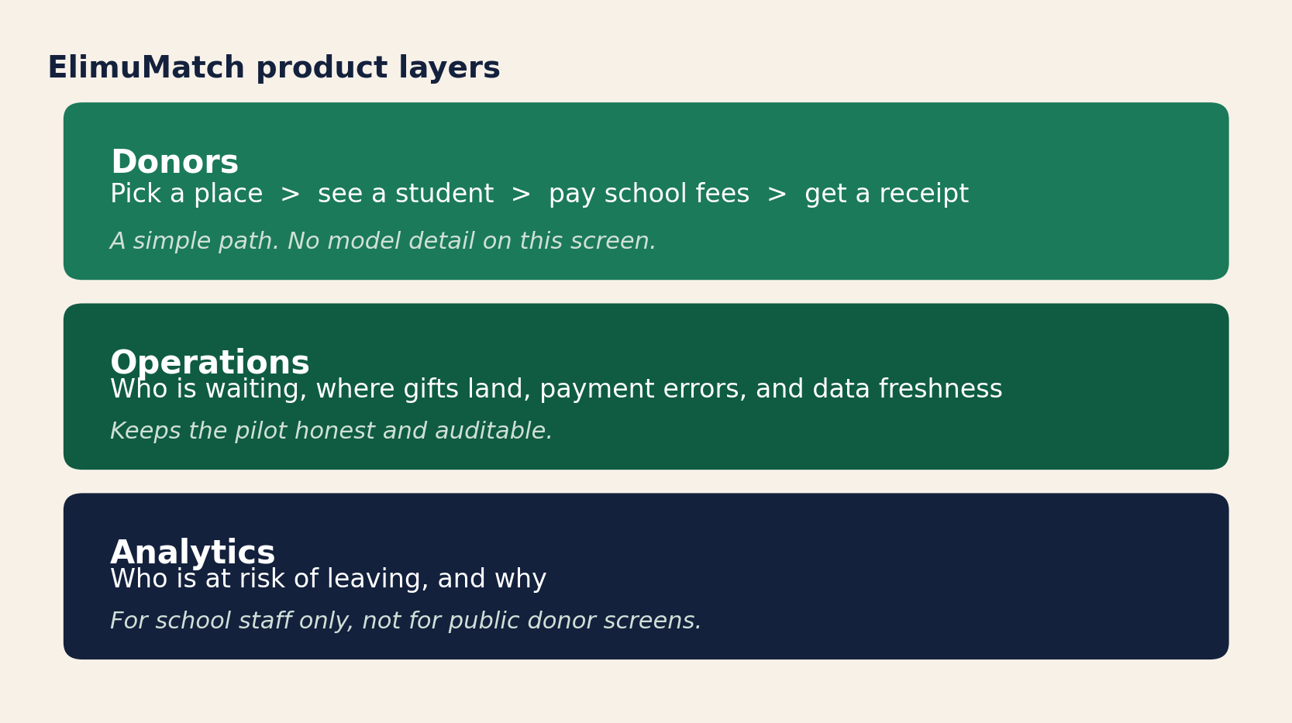
OUR SOLUTION
ElimuMatch identifies at-risk students and lets donors support them in four simple steps
What donors experience:
They pick a county, choose a school, see a student's fee balance, give, and get a receipt.
What happens behind the scenes:
Our system scores each student's risk of dropping out. Only students who need fee help appear. School staff can see the reasons behind each score.
Every shilling goes directly to the school's fee account. ElimuMatch does not take a cut.
Privacy: Donors see anonymized profiles only. Student identities are protected.

Slide 5
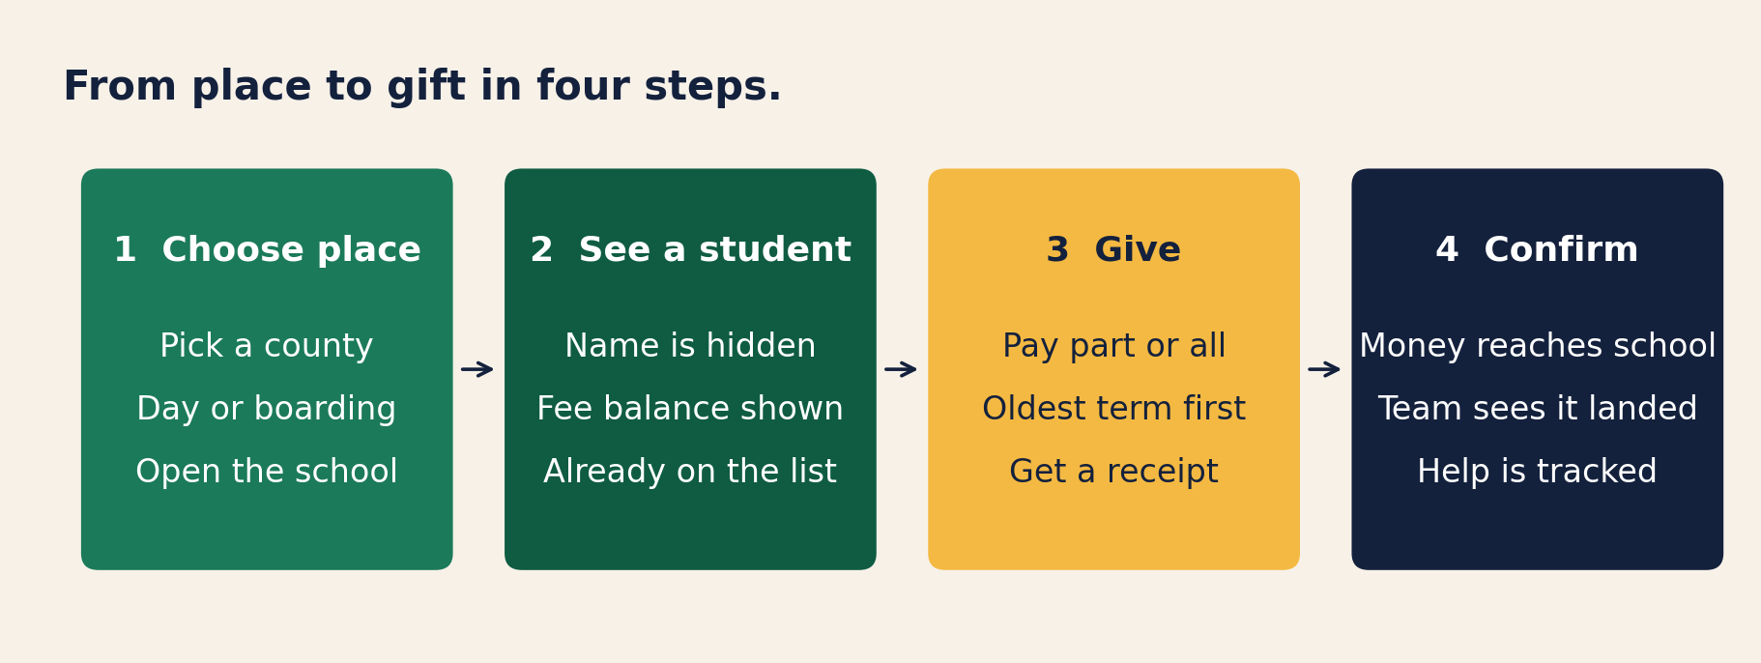
HOW IT WORKS
A donor chooses where to give, pays school fees, and gets a receipt
Every gift goes directly to the school's fee account. Oldest unpaid terms are cleared first.
Overpayments are blocked automatically, and every transaction is tracked and auditable.
Live demo: jesyldah.github.io/ElimuMatch

Slide 6
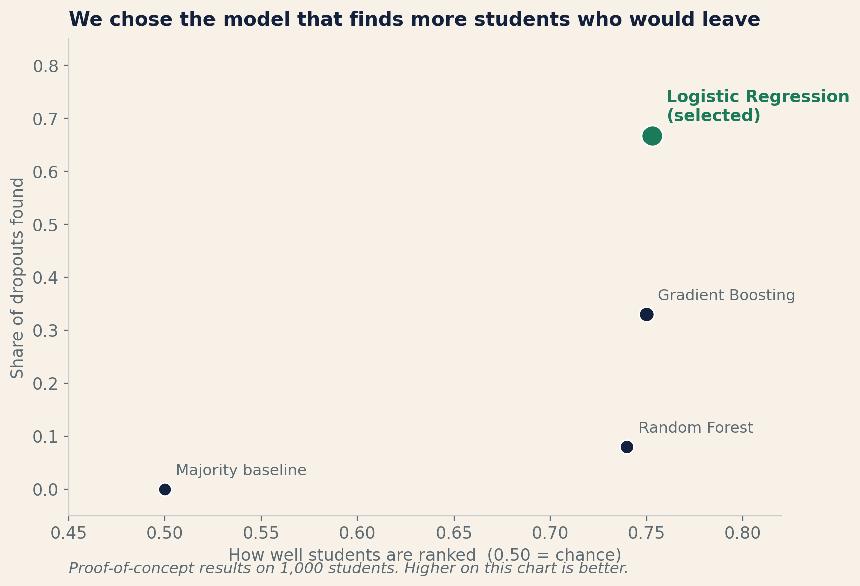
KEY INSIGHT
Our system identifies about two out of three students who would drop out, twice the nearest alternative
We tested four different approaches.
Logistic Regression is the one we selected: it catches about 67% of students who later drop out. Gradient Boosting catches only about 33%.
The strongest warning signs are health problems, family economic pressure, and falling grades.
School staff see why each student is flagged, so they can take informed action. Donors see only a simple, clear profile.
Results from proof-of-concept data (1,000 students). Real school validation is the next step.

Slide 7
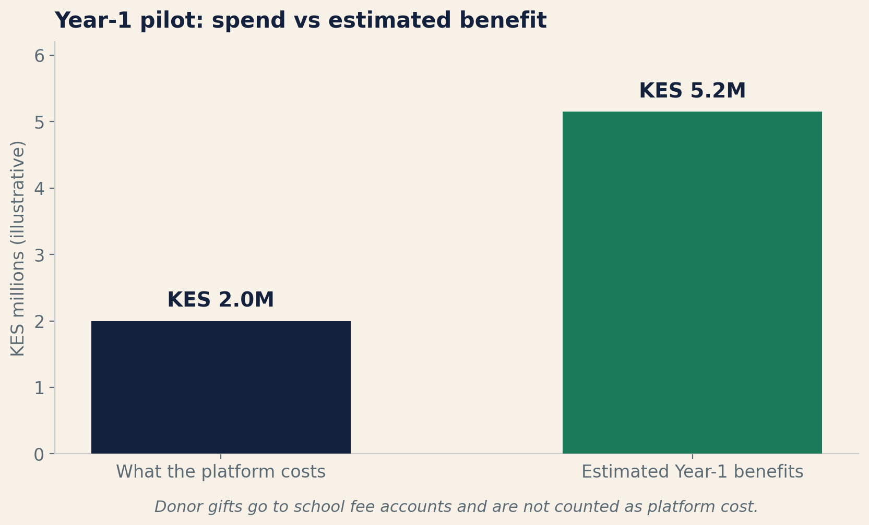
BUSINESS VALUE
An 8-school pilot returns about KES 2.6 for every KES 1 of platform cost
Year-1 pilot: 8 schools, about 1,000 students
It costs about KES 2.0M to set up and run the platform for one year.
Donor gifts of about KES 4.0M pass through to schools separately.
The estimated benefits total about KES 5.2M from better targeting, fewer dropouts, and staff time saved.
Conservative estimate: roughly break-even.
Base case: 2.6x return. Best case: 5.4x.
We measure success by whether priority students actually receive gifts, whether payments land without errors, and whether helped students stay in school.
All figures are estimates for an illustrative pilot, not audited financials. Benefits depend on real outcomes.

Slide 8
IMPLEMENTATION ROADMAP
We scale only if the pilot clears three decision gates
1. Legal Gate
2. Partner Data
3. Soft Pilot
4. Live Giving
5. Measure
6. Scale Decision
Sign agreements with 8 partner schools. Data protection and child safeguarding.
Collect school records under the signed agreements. Check quality, validate on real extracts, and set a termly refresh.
Rank students on real data. Review every list before anything is made public.
Donors give through the platform. Money goes to school fee accounts.
Track whether helped students stay enrolled. Check payments and fairness each term.
Add schools or new support types only if pilot results justify it.
▶
▶
▶
▶
▶
Months 0-4
Months 1-4
Term 1
Terms 1-2
Each term
End of Year 1
Scale is unlocked only if these three results hold:
The model identifies at least 40% of students who later drop out
Payment error rates stay below 10%
Helped students stay in school longer within two terms
Every gate requires a formal review. Capital unlocks the next stage only when the previous one clears.

Slide 9
The Ask
Fund an 8-school Year-1 pilot to prove fee-support matching on real school data
✓ About KES 2.0M for platform setup and operations (donor gifts go to schools separately).
✓ A part-time analyst and school liaison to run the pilot.
✓ Access to partner school records under signed agreements.
✓ Live fee giving with human review of every student list before it is published.
✓ A decision to expand only after pilot results justify it.
We can direct fee support to the students most likely to leave school, replacing guesswork with transparent, auditable matching.

Slide 10
SOURCES
References
Adhola, F., Ochola, J., & Tikoko, B. (2025). Donor funding and school operations, Nakuru County.
Adelman, C. (2006). The Toolbox Revisited. U.S. Dept. of Education.
Basch, C. E. (2011). Healthier students are better learners. J. School Health, 81(10).
Childress, M. (2015). Dynamics of education in Kenya. The School Fund.
Cortez, P. & Silva, A. (2008). Using data mining to predict student performance.
Cursor. (2026). Auto (Composer) drafting assistance. cursor.com.
Glennerster, R. et al. (2011). Access and quality in Kenyan education. J-PAL / IPA.
Gongera, E. & Okoth, N. (2013). Alternative financing, Kisii County.
Kenya National Bureau of Statistics. (2025). Economic Survey 2025.
Lundberg, S. & Lee, S.-I. (2017). Interpreting model predictions. NeurIPS 30.
Otieno, M. & Ochieng, J. (2020). 100% transition policy, Machakos.
Realinho, V. et al. (2022). Predicting student dropout and success.
RELI Africa. (2020). Status of secondary education in Kenya.
Tinto, V. (1993). Leaving College (2nd ed.). U. of Chicago Press.
UNESCO IICBA. (2025). Kenya education data brief.
Figure sources:
Slide 2: Author charts from UNESCO IICBA (2025) and KNBS (2025)
Slide 3: Illustrative positioning map (author)
Slide 4: Product layer diagram (author)
Slide 5: Gift journey and operations flow (author)
Slide 6: Model comparison from project pipeline on test data
Slide 7: Year-1 economics chart (illustrative, author)
All results are from proof-of-concept data (1,000 students). Not yet validated on live school records.
Live demo: jesyldah.github.io/ElimuMatch | Code: github.com/Jesyldah/ElimuMatch

