Slide 1


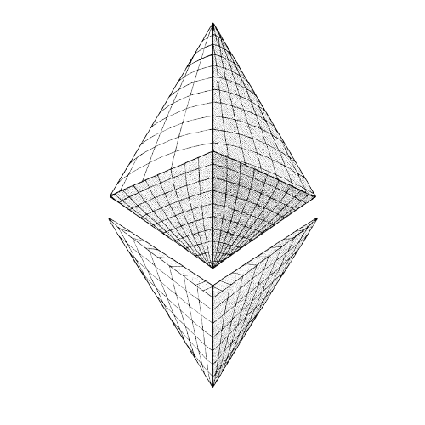
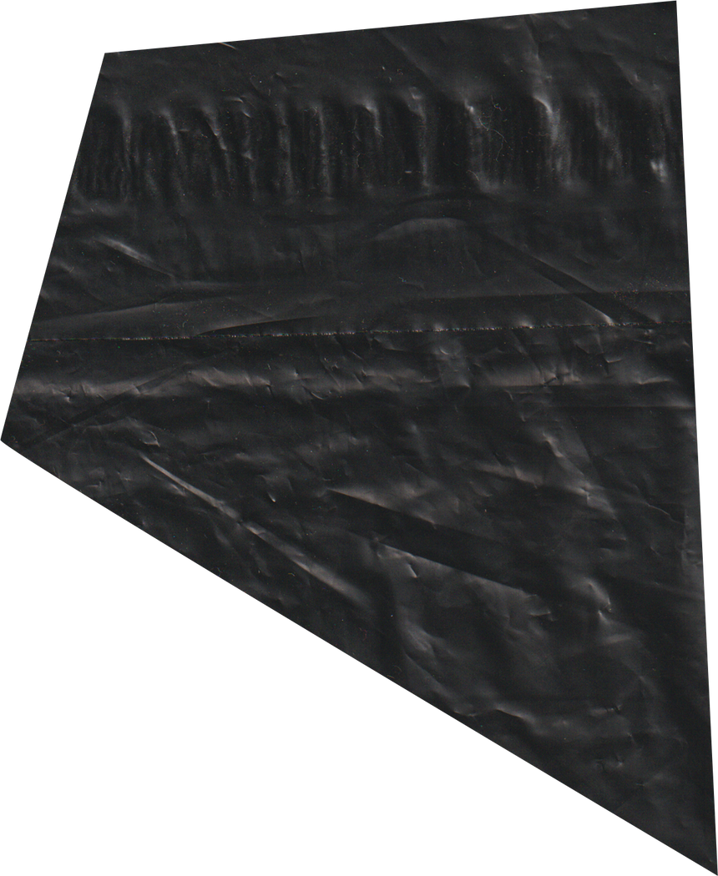

TEAM
PROSTO
REAL WORLD
TOKENIZATION
ETHBRATISLAVA

Slide 2
THE REAL ESTATE MARKET IS BROKEN
1
LONG CLOSING PROCESSES (WEEKS/MONTHS)
4
LEGAL COMPLEXITY AND BUREAUCRACY
2
LACK OF TRANSPARENCY AND TRUST
5
LIMITED GLOBAL ACCESS TO FOREIGN PROPERTY
3
NO TRANSPARENT OWNERSHIP VERIFICATION
6
HIGH REALTOR FEES (UP TO 5%)

Slide 3
dEST — Decentralized real estate marketplace
1
BUY & SELL REAL ESTATE USING NFTS
4
LOW FEES — FLAT 0.5% PLATFORM FEE VS 5%+ IN TRADITIONAL MARKETS
2
100% DIGITAL —
NO NEED FOR REALTOR OR NOTARY
5
PRIVATE, YET TRANSPARENT — PSEUDONYMOUS BLOCKCHAIN IDENTITY.
3
INSTANT OWNERSHIP TRANSFER VIA SMART CONTRACTS
6
TRADEABLE ASSETS — dEST CAN BE AUCTIONED, TRADED, OR USED IN DEFI.

Slide 4
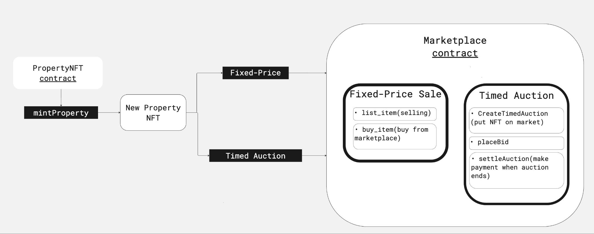
OUR CONCEPT

Slide 5


LEGAL FRAMEWORK
Legally Valid Ownership in Web3
ESTONIA
UAE
NFTs are recognized as representations of digital ownership.
Dubai Land Department (DLD) has piloted real estate tokenization.

Slide 8









OUR TECH STACK
Frontend
Backend
Smart Contracts

Slide 9
ROAD MAP
Phase 1
Registration and Pseudonymous Identification
Real Estate Listings
Buy/Sell Mechanism
On-Chain Auction System
Admin Panel (Basic)
Phase 3
Real Estate-Backed Lending
Multi-Currency Support
Legal Bridge Layer
Global Commercial Real Estate Marketplace
Mobile Applicaion
Phase 2
Fractional NFTs / ERC-20 Shares
Smart Revenue Distribution
Investment Rounds
P2P Share Marketplace
Analytics + Ratings

Slide 10
THANK YOU
We’re ready for your questions!

