Slide 1
Index Lookup Pre-Filter in MATCH
Three PRs, one mechanism · #822 → #923 → #973
Sandra Adamiec · YouTrackDB
Notes:
This talk covers the pre-filter mechanism for MATCH edge traversals. Three PRs that share one idea: filter vertices before you load them from disk. I will walk you through the architecture, then the cost model, then how to read what the optimization does at runtime through PROFILE. By the end you should be able to debug a MATCH query and know whether the pre-filter fired, why, and what it cost.

Slide 2
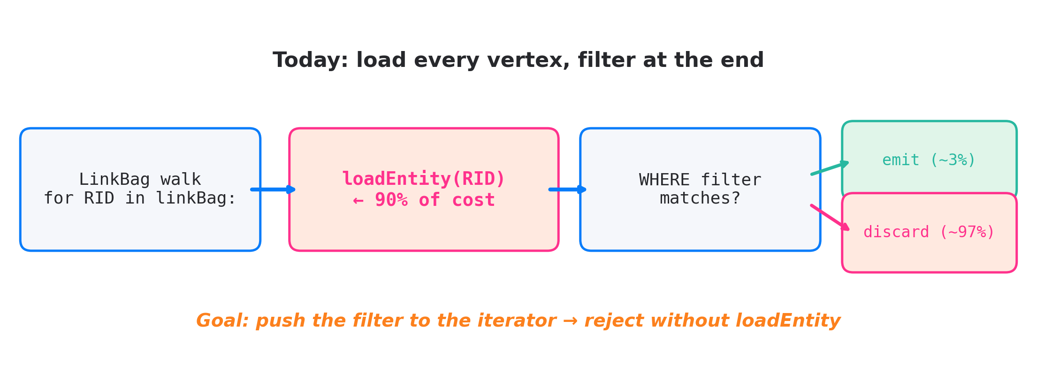
TL;DR — pre-filter MATCH edge traversals
• MATCH loaded every vertex from disk only to throw most of them away
• Three PRs move filtering before loadEntity()
• Three mechanisms: class ID check, index RID intersection, adjacency intersection
• IC7 +1087%, IC12 +106%, IS7 +220% from #822 alone on JMH LDBC
Notes:
Look at the diagram. A MATCH edge traversal walks a LinkBag, calls loadEntity for each RID, then asks the WHERE clause if the vertex matches. That loadEntity call is the expensive part. On a forum with ten thousand posts, when WHERE matches three of them, we load and throw away nine thousand nine hundred ninety seven. The fix is small in idea and big in plumbing: we push the filter before the load. Three PRs build, validate, and tune this mechanism.

Slide 3
Glossary for the next 25 minutes
Term | One-line definition
MATCH | YTDB's pattern-matching SQL extension. {class: X, as: a, where: …}.out('E'){as: b}
LinkBag | YTDB's on-disk list of target RIDs that an edge property holds
RID | Record ID, cluster:position. Cluster ≈ a class's storage segment
collection ID | Numeric tag every record carries — lets us check class without loading
@class, @rid | Metadata accessors in SQL: class name and RID of the current record
$matched | Inside MATCH, the bindings already made earlier in the pattern
LDBC SNB IC1–IC13 | Standard graph-DB benchmark suite. Each IC is a fixed read-heavy query
pre-filter | Reject a vertex *before* the disk read that loads it
PROFILE | SQL keyword wrapping a query, emits per-step timing and counters
Notes:
Quick glossary for anyone who has not touched MATCH. LinkBag is the on disk list of target RIDs of an edge. RID is record ID, cluster plus position. Collection ID is the numeric tag every record carries identifying its class. Dollar matched is the MATCH context that holds already bound aliases. PROFILE is the SQL keyword that emits per step counters.

Slide 4
IC3 as our reference case
MATCH {class: Person, as: start, where: (id = :personId)}
.out('KNOWS'){while $depth<2, as: person,
where @rid <> $matched.start.@rid},
{person}.out('IS_LOCATED_IN').out('IS_PART_OF') ← BRANCH A
{where: name NOT IN [:countryX, :countryY]},
{person}.in('HAS_CREATOR') ← BRANCH B
{as: message, where: creationDate >= :start AND < :end}
.out('IS_LOCATED_IN')
{as: msgCountry, where: name IN [:countryX, :countryY]}
RETURN person, msgCountry
Four filter shapes in one query:
• Index-backed range: creationDate >= … AND < …
• Index-backed IN list: msgCountry.name IN [...]
• Class / NOT-IN literal: country.name NOT IN [...]
• Multi-branch: two sub-patterns from person
Notes:
This is LDBC IC3, friends in countries. The reason it is our anchor is that it carries four different filter shapes in a single query. There is a date range on the message that maps to an index. There is an IN list on the message country, also indexed. There is a NOT IN list on the person country. And the whole thing has two branches from the friend vertex. We will see each PR in this talk hit a different one of those four shapes.

Slide 5
Three bottleneck classes
Class | Example query shape | Why slow
Back-reference | out('E'){where: @rid = $matched.X.@rid} | Per-row scan of a LinkBag we already know the target of
Class filter after expand | expand(out('E')) + WHERE @class = 'Post' | Loads Comments only to discard them
Index-backed property | WHERE creationDate >= :start on a target | Loads vertices outside the date window
• IC3 (our anchor) hits two of these three classes
• IC5 adds a back-reference on its final edge
• IC10 mixes class filter and back-reference
Notes:
We did not pick these patterns from a textbook. They came out of profiling LDBC SNB. IC3 has two of the three classes: date range and country IN are index-backed property filters; NOT IN is effectively a class filter. IC5 adds back-reference. IC10 mixes class filter and back-reference.

Slide 6
Three query shapes that hurt today
1. Class filter after edge
.out('E'){where: @class = 'Post'}
← walks every LinkBag entry, loads every vertex,
filters at the end — only ~3% are Post
2. Index-backed range / IN list
.out('E'){where: creationDate >= :start AND < :end}
.out('E'){where: msgCountry.name IN [:cX, :cY]}
← walks every LinkBag entry, loads every vertex,
filters at the end — index is unused
3. Back-reference (adjacency intersection)
.out('E'){where: @rid = $matched.X.@rid}
← walks every LinkBag entry, loads every vertex,
filters at the end — but we know the target RID
All three: walk LinkBag → load every vertex → filter at the end. Fix = push filter *before* the load.
Notes:
Three shapes, one structure. Each walks the LinkBag, loads every vertex, filters at the end. PR 822 adds the mechanism. PR 923 adds tests plus corner cases. PR 973 tunes the cost model.

Slide 7
Why this was not fixed earlier
• MATCH scheduler picks edges by cost
• But after an edge is picked, the traversal forgets about the target's WHERE
• And it forgets that another alias may pin the target's RID via $matched
• The scheduler optimises the order; nothing optimises the scan inside an edge
Notes:
The MATCH planner already does cost-based edge ordering. The gap is that once an edge is chosen, the runtime treats it as a plain LinkBag walk. It does not look at the target's WHERE clause, and it does not look at whether another alias has pinned the target's RID. Closing this gap is what the first PR does.

Slide 8
PR #822 — Three descriptor types
Maps directly to shapes 1, 2, 3 from previous slide
Case | Shape | Filters by | Test runs | I/O cost
A — Class | 1 | @class = 'Post' | collection ID in LinkBag iterator | zero
B — IndexLookup | 2 | indexed property condition | resolved RID set, intersected | one index scan
C — EdgeRidLookup | 3 | out('E').@rid = $matched.X.@rid | reverse LinkBag RID set, intersected | one LinkBag walk
• Filter target: VertexFromLinkBagIterator fields acceptedCollectionIds & acceptedRids
• The test runs before loadEntity()
Notes:
Three descriptor types cover the three bottleneck classes. Case A checks the class through the collection ID, no disk access. Case B asks the index for the set of RIDs that match. Case C reads the reverse adjacency list of the bound vertex and intersects. All three end up as fields on the LinkBag iterator. Same iterator code, three different data sources.

Slide 9
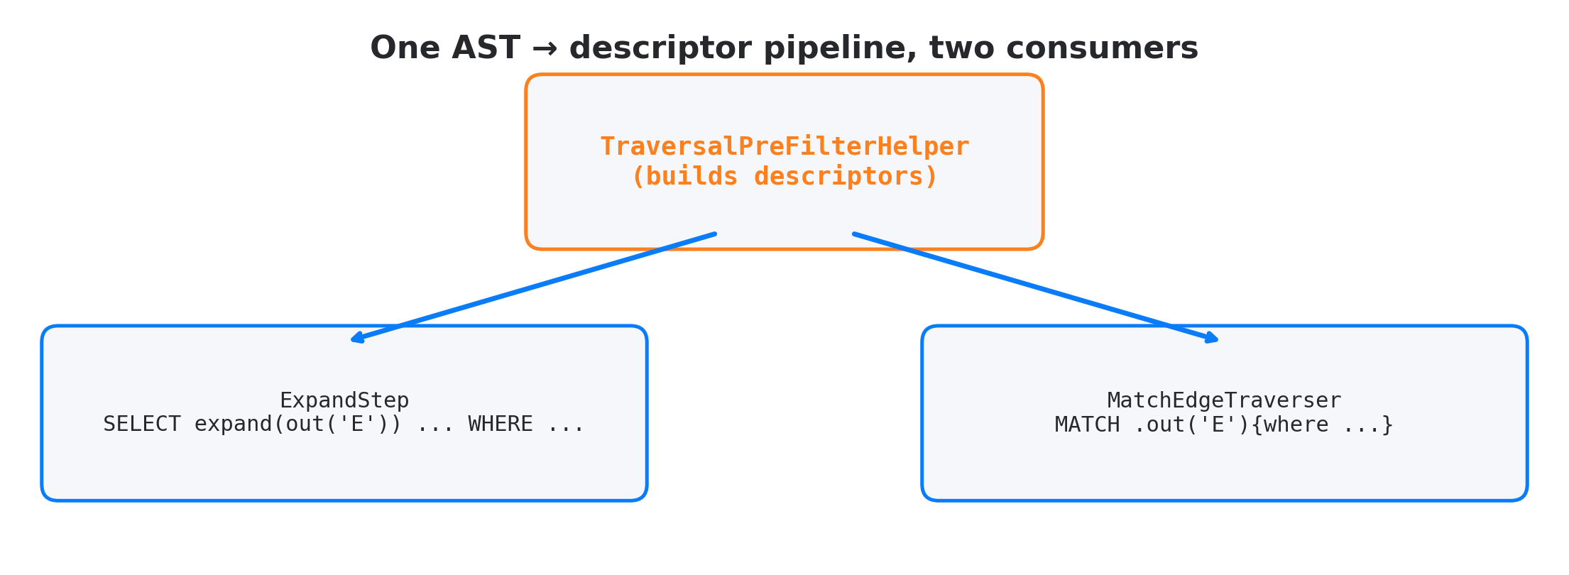
Shared helper, two callers
• One AST → descriptor pipeline
• Two consumers, same descriptor types, same iterator
• SELECT expand and MATCH have the same bottleneck shape
Notes:
Pre-filter is not MATCH-only. SELECT expand(out('E')) followed by a WHERE is the same problem in a different syntax. So the analyzer lives in TraversalPreFilterHelper, and both ExpandStep and MatchEdgeTraverser call it.

Slide 10
Planner pass
MatchExecutionPlanner.optimizeScheduleWithIntersections()
// Runs AFTER cost-based edge reordering
for each scheduled edge:
if target.WHERE has selectivity estimate below threshold:
attach RidFilterDescriptor to the EdgeTraversal
• Second pass — first pass reorders edges by cost
• Reuses existing cost-model selectivity estimate
• No pre-filter attached on edges where it would not pay off
Notes:
The planner pass is a second pass. The first pass reorders edges by cost. The second pass walks the ordered edges and asks: does this edge's target have a WHERE we can pre-filter? If yes, attach a descriptor. We reuse the existing cost-model selectivity estimate to gate attachment.

Slide 11
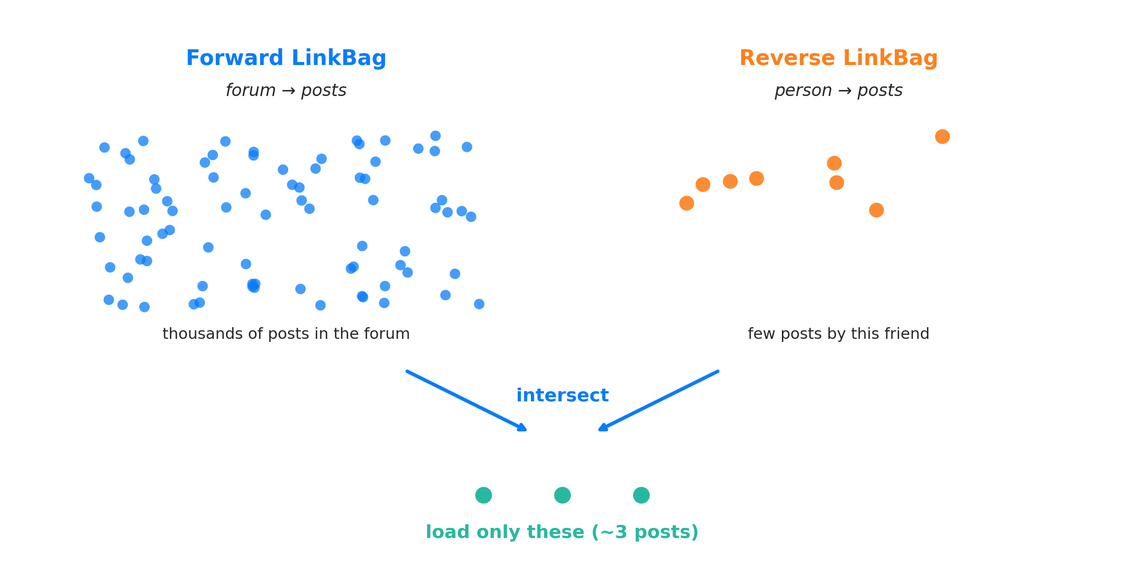
Adjacency intersection in pictures
• Backed by RidSet: IntMap + Roaring64Bitmap (PR #781)
• Probe is O(1) per LinkBag entry
Notes:
This is the picture for IC5. The forward LinkBag is huge: every post in the forum. The reverse LinkBag is small: posts by this one friend. Their intersection is what we actually want. RidSet, rewritten in PR 781, uses an IntMap of Roaring bitmaps. Membership test is a few instructions.

Slide 12
What changes after #822
• WHERE @class = 'X' after expand: target class skipped without I/O
• Indexed property filter on target: RID set intersected with LinkBag during iteration
• Adjacency intersection: forward LinkBag ∩ reverse LinkBag from a bound vertex
• Planner attaches descriptors per edge during optimizeScheduleWithIntersections
• → See closing slide for cumulative measured impact
Notes:
Three pre-filter mechanisms in place after PR 822. Class filter, index filter, adjacency intersection. All three live behind the same iterator. The planner decides which descriptor to attach per edge.

Slide 13
What #822 left on the table
• One selectivity formula for all descriptor types: ridSetSize / linkBagSize
• RID literals and parameters not handled: @rid = #12:0, @rid = :param slipped through
• BETWEEN not recognised as an indexable range
• No observability: PROFILE did not say whether pre-filter fired
Notes:
PR 822 is the foundation, not the finish line. Four gaps. One: the selectivity check is a single formula, fine for adjacency intersection but wrong for IndexLookup, fixed in PR 973. Two and three: small parser gaps that PR 923 picks up. Four: no PROFILE output, lands in 973 too.

Slide 14
PR #923 — Why 90 tests
• Pre-filter is invisible in query results
• Visible only in EXPLAIN plan shape
• Without systematic tests, the next refactor can silently disable it
• 'Optimization that does not fire' looks identical to 'optimization that fires'
Notes:
Pre-filter is correct either way. If it does not fire, the query still returns the right answer, just slower. So a regression is invisible to any test that checks results. PR 923 is the test layer that asserts this query uses the pre-filter, through EXPLAIN.

Slide 15
Test coverage matrix
Axis | Coverage
Descriptor types | 4 (IndexLookup, EdgeRidLookup, DirectRid, Composite)
Graph topologies | 11 (linear, star, diamond, triangle, tree, bipartite, self-ref, multi-edge, fan-out, fan-in, isolated)
Edge methods | 6 (out, in, outE+inV, inE+outV, bothE, both)
Negative tests | 20 (cases where pre-filter must NOT fire)
• Every positive test asserts the descriptor type in EXPLAIN
• Every negative test has a comment explaining why
Notes:
Four descriptor types times eleven topologies times six edge methods. The twenty negative tests are the interesting part. both() cannot use pre-filter because direction is ambiguous. WHILE cannot use it. OR in WHERE cannot use it. Each negative test is comment-as-spec.

Slide 16
Two fixes that fell out of writing tests
• DirectRid singleton: WHERE @rid = #12:0 or :param now creates a singleton intersection. Was silently skipped.
• BETWEEN as range: SQLBetweenCondition.flatten() rewrites val BETWEEN low AND high → val >= low AND val <= high. Existing index infra now recognises it.
• Both fixes were invisible without the test suite
• Writing tests is faster than reviewing for completeness
Notes:
Two bugs. Writing tests caught both. RID literals were skipped because the planner only handled $matched.X.@rid. BETWEEN was not recognised as a range because the condition class did not implement isIndexAware.

Slide 17
PR #973 — Problem after #822 deployment
• All descriptor types shared one formula: ridSetSize / linkBagSize
• That ratio is per-vertex overlap
• Correct semantics for EdgeRidLookup (LinkBag changes per source vertex)
• Wrong semantics for IndexLookup (the RID set is class-level, constant per query)
Notes:
Once 822 was deployed we reviewed PROFILE output on production-shaped workloads. For IndexLookup edges, the selectivity check ran per vertex and made the same decision every time. A signal that does not change should not be sampled per vertex. So we split the check.

Slide 18
Per-descriptor selectivity
sealed interface RidFilterDescriptor {
boolean passesSelectivityCheck(int linkBagSize, int ridSetSize);
}
// DirectRid: always passes
// EdgeRidLookup: ridSetSize / linkBagSize ≤ edgeLookupMaxRatio (0.8)
// IndexLookup: class-level selectivity ≤ indexLookupMaxSelectivity (0.95)
// Composite: passes if any child passes
• Each type has its own threshold and its own data source
• IndexLookup looks at class statistics, not per-vertex overlap
• Defaults from LDBC SF 1 calibration; all configurable
Notes:
Four concrete descriptor types now. DirectRid always passes. EdgeRidLookup keeps per-vertex overlap, threshold 0.8. IndexLookup asks index statistics for class-level selectivity, threshold 0.95. Composite passes if any child passes.

Slide 19
Build cost for IndexLookup
• IndexLookup build = materialise RID set from index
• Cost: one index scan, allocates a RidSet
• One-time cost per query, charged on the first qualifying vertex
• Question: does the traversal volume justify the build?
Break-even formula:
m = estimatedSize / (loadToScanRatio × (1 − selectivity))
• loadToScanRatio ≈ 100 (random vertex load is ~100× a RidSet probe)
• m is the number of LinkBag entries to filter before the build pays for itself
Notes:
The selectivity check decides whether to pre-filter. We also need to decide when to materialise. Building the RID set is not free. The formula is the break-even. If the LinkBag walk will touch at least m entries, the build is worth it.

Slide 20
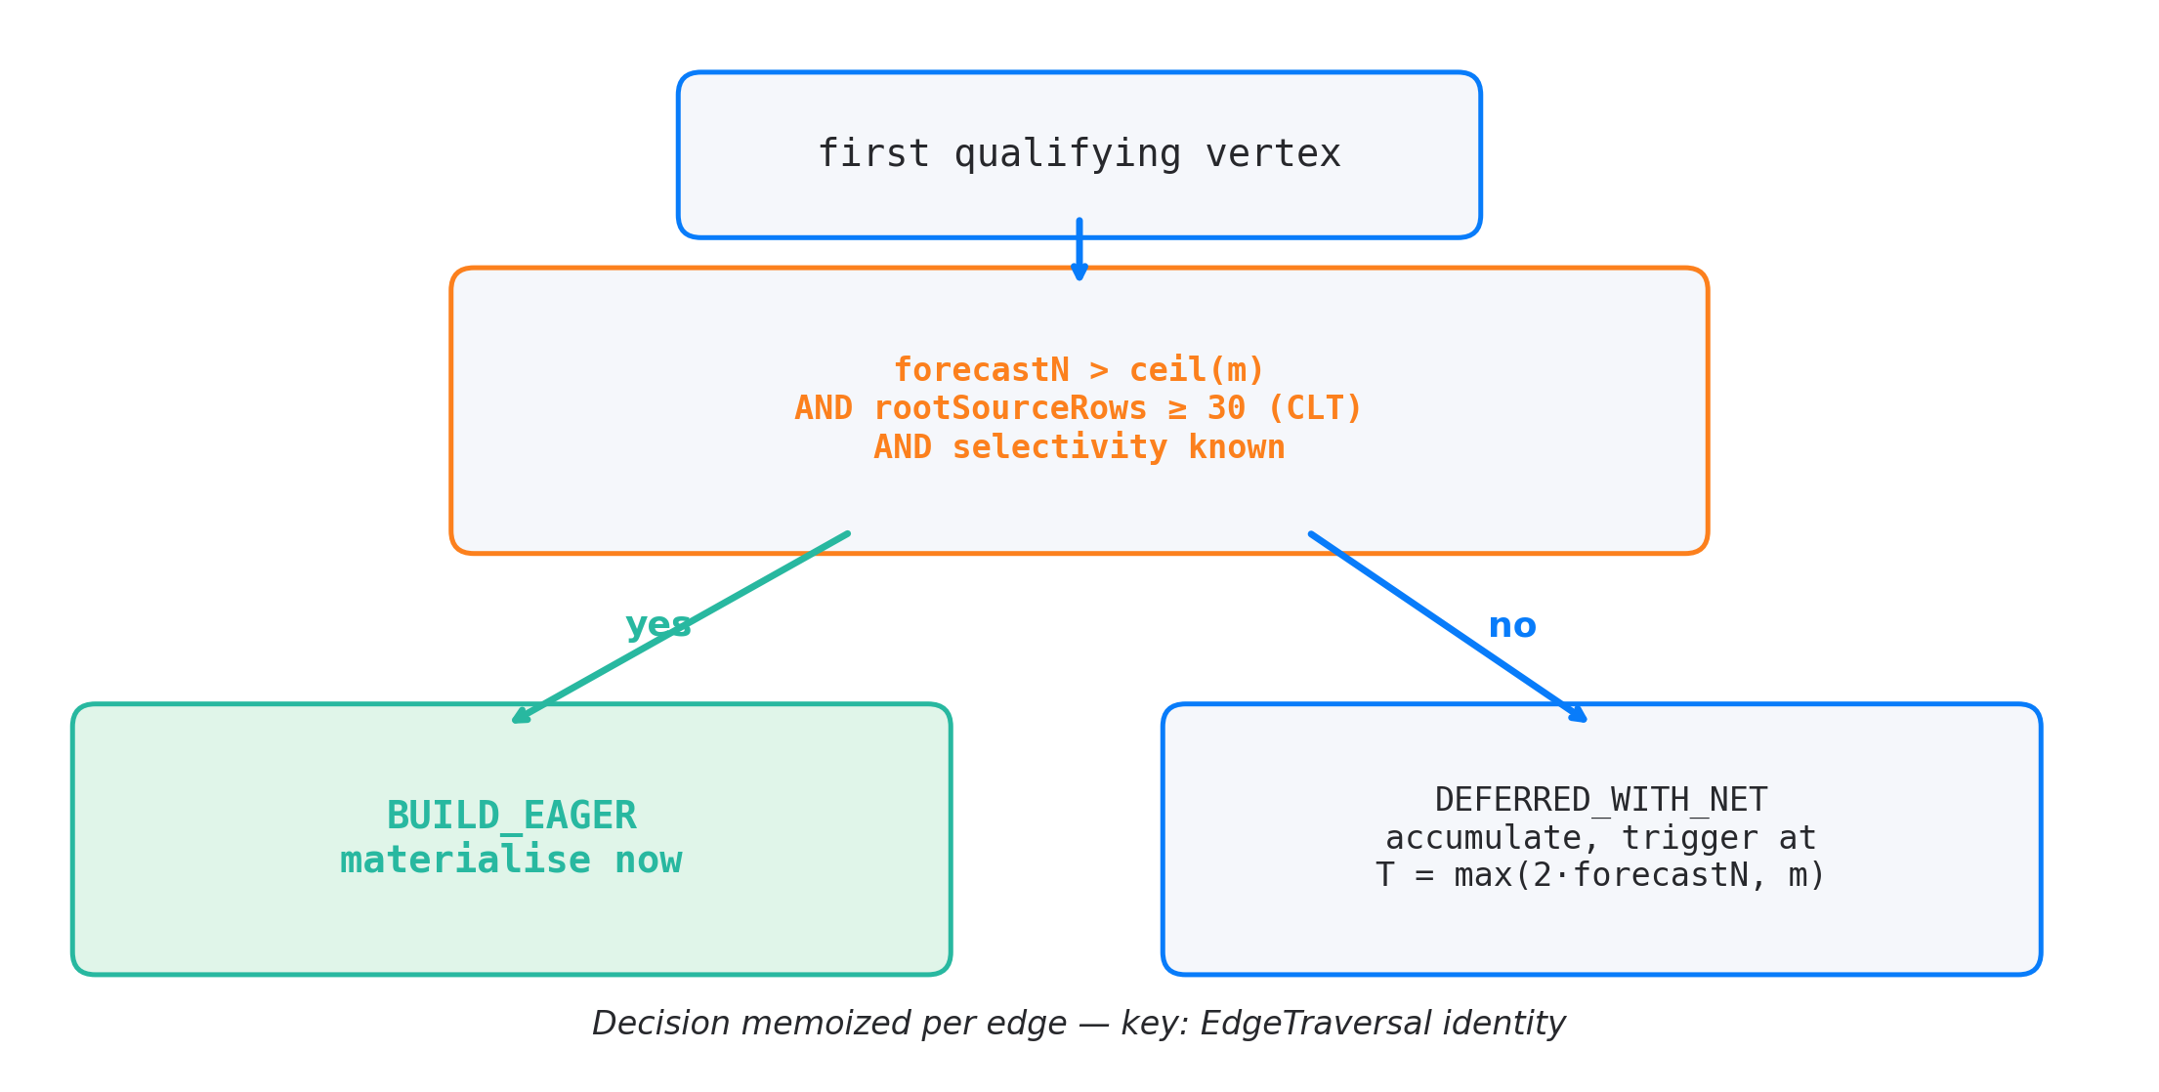
Two modes: BUILD_EAGER vs DEFERRED_WITH_NET
Notes:
Two modes. BUILD_EAGER materialises on the first qualifying vertex. DEFERRED_WITH_NET waits. Three conditions for eager: forecastN > ceil(m), rootSourceRows >= 30 (CLT), and selectivity is known. If any fails, defer and let runtime accumulator decide.

Slide 21
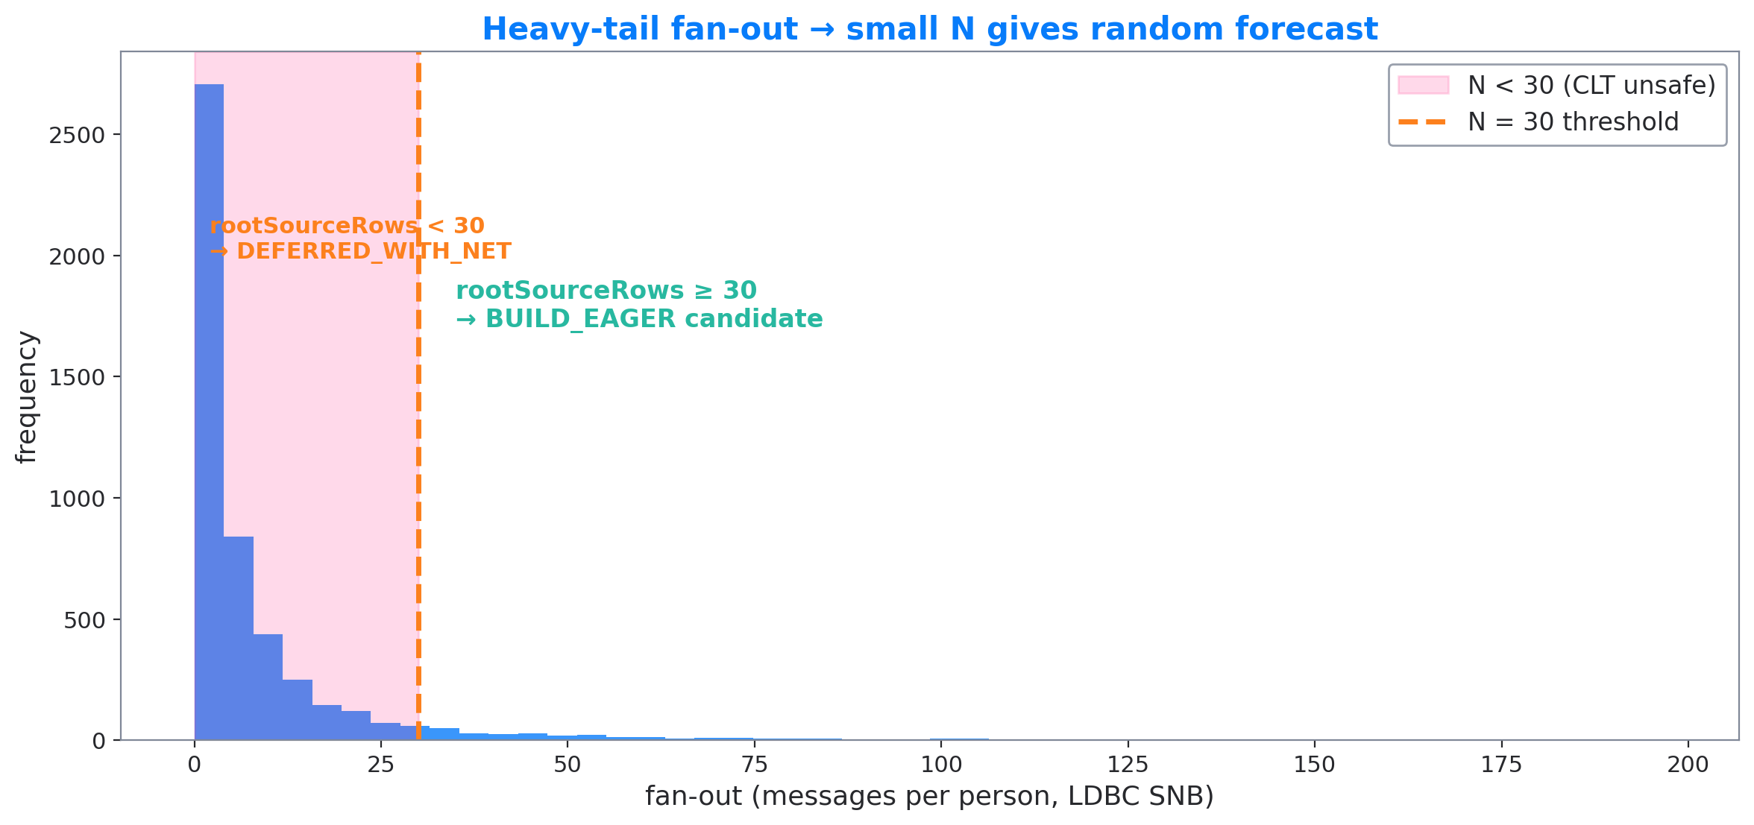
Why CLT gate at 30
• forecastN = sourceRows × fanOut_mean → relative error ∝ CV / √N
• LDBC SNB fan-out is heavy-tail (power-law) → CV is large
• N < 30 → forecast essentially random → route to DEFERRED_WITH_NET
Notes:
The forecast is sourceRows times mean fan-out. CLT says the mean of a sample of size N has relative error proportional to one over sqrt(N). For LDBC SNB the fan-out is heavy-tailed. With small N, the forecast is unreliable. Below 30 we defer. Thirty is the textbook CLT threshold.

Slide 22
Unknown selectivity → REJECT
• When does estimateSelectivity() return −1?
◦ Histogram missing
◦ Index never loaded
• Old behaviour: optimistic PROCEED, capped by fixed 100K maxRidSetSize
• New behaviour: REJECT, with skip reason STATS_UNAVAILABLE
• Why: cap is now auto-scaled (up to 10M of RAM), the old safety net is gone
Notes:
Before PR 973, when selectivity came back unknown, we proceeded optimistically because the cap was 100K. PR 973 auto-scales the cap up to 10M. The safety net is gone. So we switched to defensive REJECT with a named skip reason.

Slide 23
PROFILE output: what you read to debug
MATCH ... PROFILE:
edge: forum.containerOf.post.hasCreator
preFilter: applied=4823, skipped=0, ridSetSize=14210,
buildTime=2.1ms, filterRate=0.96
descriptor: EdgeRidLookup
edge: post.hasCreator
preFilter: NEVER APPLIED (reason: STATS_UNAVAILABLE,
threshold: selectivity != -1)
descriptor: IndexLookup
• Per-edge counters: applied / skipped / probed / filtered / buildTime / ridSetSize
• PreFilterSkipReason enum: 8 values
• Global metric: PREFILTER_EFFECTIVENESS (filter-rate aggregated)
Notes:
This is what you read when debugging a slow query. Per edge, you see whether the pre-filter applied, how many times, the build time, the filter rate. When it did not apply, you see why, with the threshold checked. Eight skip reasons cover every gate.

Slide 24
Best wins per PR (final JMH against own fork point)
PR | LDBC query | Δ% ST | Δ% MT | Mechanism
#822 | IC7 recentLikers | +1087% | +1110% | lazy expand + class filter
#822 | IC12 expertSearch | +106% | +101% | adjacency intersection on hierarchy
#822 | IS7 messageReplies | +220% | +212% | index-backed property filter
#822 | IC1 transitiveFriends | +12% | +8% | adjacency intersection on KNOWS
#923 | — | — | — | test suite + DirectRid + BETWEEN (no JMH delta)
#973 | IC3 friendsInCountries | +1117% | +929% | per-descriptor selectivity + amortization
#973 | IC9 recentFofMessages | +483% | +433% | unknown-selectivity REJECT
#973 | IC13 shortestPath | +7% | +8% | smaller RidSets from CLT-gated builds
• Each row is from that PR's own JMH comparison
• Fork points differ per PR — percentages are not additive across rows
Notes:
The wins per PR, each row from that PR's own JMH comparison. PR 822: IC7 over 10x, IC12 over 2x, IS7 over 2x. PR 923 is test suite, no headline delta. PR 973: IC3 over 11x, IC9 nearly 5x. Each percentage is against a different fork point, you cannot add them. The chain produced two queries with over 10x speedup on its own, IC7 from 822 and IC3 from 973.

Slide 25
Back to IC3 — where pre-filter fires
BRANCH A: {person}.out('IS_LOCATED_IN').out('IS_PART_OF')
{where name NOT IN [:cX, :cY]} ← class filter / NOT IN
BRANCH B: {person}.in('HAS_CREATOR')
{message, where creationDate >= …} ← IndexLookup (date)
.out('IS_LOCATED_IN')
{msgCountry, where name IN […]} ← IndexLookup (name IN)
Part of IC3 | Descriptor | PR enabling | PR tuning
creationDate >= … AND < … | IndexLookup | #822 | #973
msgCountry.name IN [...] | IndexLookup | #822 | #973
country.name NOT IN [...] | Class filter (Case A) | #822 | —
• Pre-filter alone activates these three sites
• Multi-branch handling is a sibling optimization (out of scope)
Notes:
Back to the query we opened with. Pre-filter fires at three sites in IC3. Two IndexLookup descriptors, one class filter. PR 822 enables all three. PR 973 tunes IndexLookup activation. Multi-branch structure is a sibling project on hash join, not part of this talk.

Slide 26
What's next
• Live cost measurement from runtime metrics (loadToScanRatio is static today)
• Histogram coverage for edge properties (EdgeFanOutEstimator is class-level)
• Composite pre-filter for index + back-reference together
• Better integration with sibling hash-join work (out of scope here)
Notes:
Four things on the roadmap. Live cost measurement so load-to-scan adapts to the storage tier. Histograms on edge properties so fan-out picks up correlation. Composite pre-filter combining index lookup and back-reference. Tighter integration with hash-join.

Slide 27
Reading order if you want to verify
Root: core/src/main/java/com/jetbrains/youtrackdb/internal/core/sql/executor/
• 1. TraversalPreFilterHelper.java
• 2. match/MatchExecutionPlanner.optimizeScheduleWithIntersections
• 3. match/EdgeTraversal.resolveWithCache
• 4. RidFilterDescriptor.passesSelectivityCheck
• 5. match/MatchStep.appendPreFilterStats (what PROFILE shows)
Durable ADR: docs/adr/index-assisted-traversal/design-final.md
Thanks. Questions.
Notes:
Five files, in order. Start with the helper, follow the planner pass, then resolveWithCache, then the per-descriptor selectivity check, then the PROFILE output. Thanks. Questions.

Slide 28
Backup slides (for Q&A)

Slide 29
Backup A — EdgeTraversal.cache
• Per-edge LRU, capacity 64
• Key: descriptor cache fingerprint
• Value: resolved RidSet, or null with parallel cachedSkipReasons map
• Why a separate map for reasons: cached-null hit must restore the original skip reason, not the most-recent one
Notes:
This is the internal cache that PR 973 hardened. The cache stores RID sets. When a key is rejected we cache null. Without the parallel reasons map, an interleaved skip on a different vertex would mask the original cause in PROFILE.

Slide 30
Backup B — RidSet data structure
• Int2ObjectOpenHashMap<Roaring64Bitmap> (cluster ID → bitmap of positions)
• Rewritten in PR #781 from a HashSet<RID>
• Membership test: ~3 instructions
• Iteration: cluster-by-cluster, friendly to LinkBag layout

Slide 31
Backup C — IndexSearchDescriptor.cacheFingerprint
• Previously cache key was index.getName()
• Two IndexLookups on same index with different conditions would have aliased
• Latent bug: planner happens to emit at most one IndexLookup per edge today
• Fix: include keyCondition and additionalRangeCondition in fingerprint

Slide 32
Backup D — stampEdgeForecasts pitfalls
• Forecast pass exists only to feed BUILD_EAGER decision
• Short-circuit: skip if no edge has IndexLookup (standalone or in Composite)
• Long.MAX_VALUE sentinels for inferred-class aliases stripped at input
• Saturated forecast stored as −1, not clamped (clamping would re-introduce inflation)

Slide 33
Backup E — Why no live cost measurement in #973
• We considered using runtime metrics to update loadToScanRatio per query
• Sample bias: pre-filter pre-rejected vertices never get loaded → cannot measure their hypothetical load cost
• Solution: collect cost samples from queries where pre-filter did not apply
• Out of scope for #973, planned for a follow-up
Notes:
The most common question on this PR. loadToScanRatio is constant 100. Why not measure it live? Because pre-filter pre-rejects vertices that we would have measured. The sample is biased toward cheap loads.

