Slide 1
RidSet Pre-Filter in MATCH
Filter link bags by RID intersection — before loadEntity()
Sandra Adamiec · YouTrackDB
Notes:
This talk covers the pre-filter mechanism for MATCH edge traversals. Three PRs that share one idea: filter vertices before you load them from disk. I will walk you through the architecture, then the cost model, then how to read what the optimization does at runtime through PROFILE. By the end you should be able to debug a MATCH query and know whether the pre-filter fired, why, and what it cost.

Slide 2
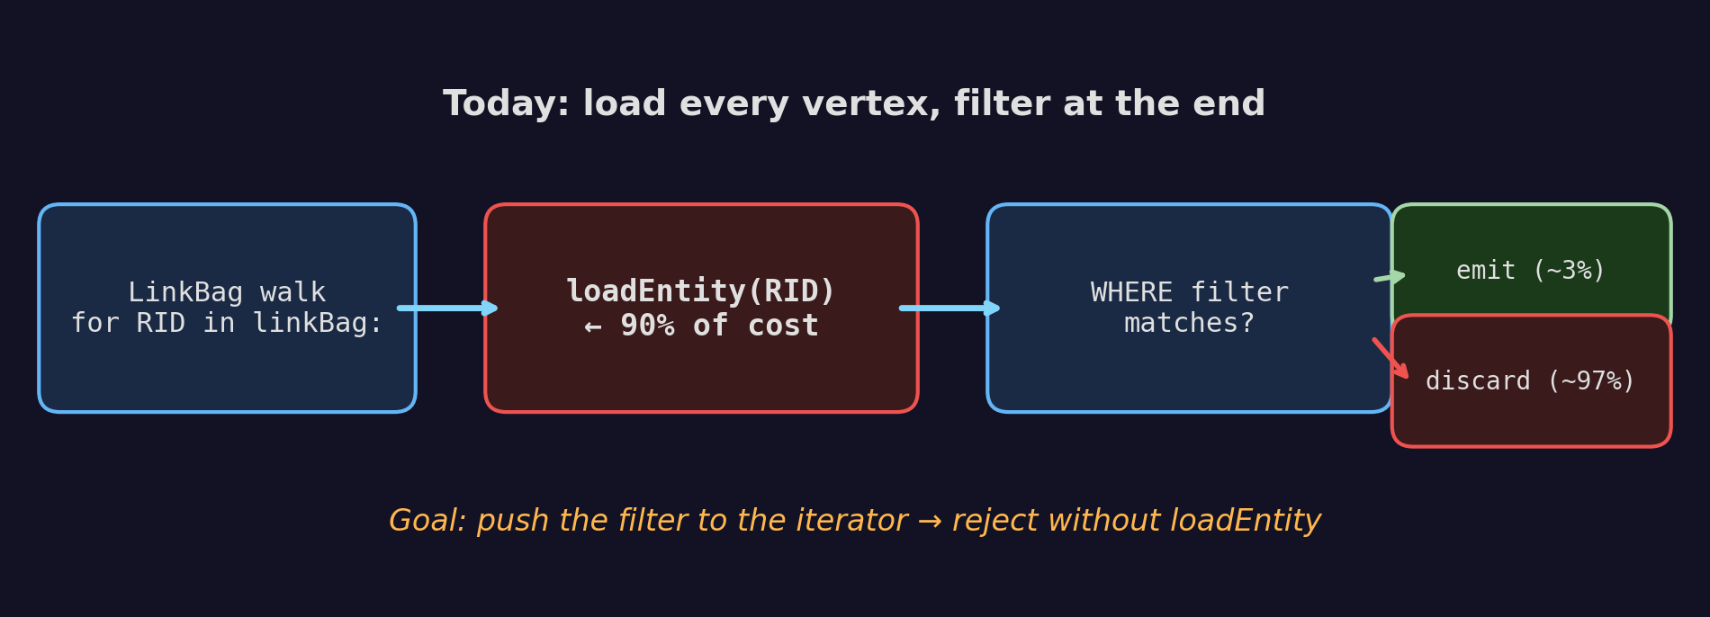
TL;DR — pre-filter MATCH edge traversals
• MATCH walks a link bag of RIDs, then loads each vertex to evaluate WHERE — wastes I/O when most are rejected
• Pre-filter intersects the link bag with a pre-computed RID set before loadEntity() is called
• Four descriptor types build that RID set: DirectRid, EdgeRidLookup, IndexLookup, Composite
• Two gates decide whether to build: selectivity (per-type) and amortization (IndexLookup only — break-even on build cost)
• Measured impact on LDBC SF 1: IC3 +1117%, IC7 +1087%, IC9 +483%, IS7 +220%
Notes:
Look at the diagram. A MATCH edge traversal walks a LinkBag, calls loadEntity for each RID, then asks the WHERE clause if the vertex matches. That loadEntity call is the expensive part. On a forum with ten thousand posts, when WHERE matches three of them, we load and throw away nine thousand nine hundred ninety seven. The fix is small in idea and big in plumbing: we push the filter before the load. If we know the class we want, we check the collection ID. If we have an index, we resolve to a RID set and intersect. If we have a back-reference to a bound vertex, we intersect with its reverse LinkBag. Three PRs build, validate, and tune this mechanism.

Slide 3
Glossary for the next 25 minutes
Term | One-line definition
MATCH | YTDB's pattern-matching SQL extension. {class: X, as: a, where: …}.out('E'){as: b}
LinkBag | YTDB's on-disk list of target RIDs that an edge property holds
RID | Record ID, cluster:position. Cluster ≈ a class's storage segment
collection ID | Numeric tag every record carries — lets us check class without loading
@class, @rid | Metadata accessors in SQL: class name and RID of the current record
$matched | Inside MATCH, the bindings already made earlier in the pattern
LDBC SNB IC1–IC13 | Standard graph-DB benchmark suite. Each IC is a fixed read-heavy query
pre-filter | Reject a vertex *before* the disk read that loads it
PROFILE | SQL keyword wrapping a query, emits per-step timing and counters
Notes:
Quick glossary for anyone who has not touched MATCH. MATCH is our pattern matching SQL extension. The shape inside curly braces is a vertex, followed by an edge step like out or in, then another vertex. LinkBag is the on disk list of target RIDs of an edge. RID is record ID, cluster plus position. Collection ID is the numeric tag every record carries identifying its class. Dollar matched is the MATCH context that holds already bound aliases. LDBC SNB is the social network benchmark suite. PROFILE is the SQL keyword that emits per step counters. If you forget any of these, this slide is the cheat sheet.

Slide 4
IC3 as our reference case
MATCH {class: Person, as: start, where: (id = :personId)}
.out('KNOWS'){while $depth<2, as: person,
where @rid <> $matched.start.@rid},
{person}.out('IS_LOCATED_IN').out('IS_PART_OF') ← BRANCH A
{where: name NOT IN [:countryX, :countryY]},
{person}.in('HAS_CREATOR') ← BRANCH B
{as: message, where: creationDate >= :start AND < :end}
.out('IS_LOCATED_IN')
{as: msgCountry, where: name IN [:countryX, :countryY]}
RETURN person, msgCountry
Four filter shapes in one query:
• Index-backed range: creationDate >= … AND < …
• Index-backed IN list: msgCountry.name IN [...]
• Class / NOT-IN literal: country.name NOT IN [...]
• Multi-branch: two sub-patterns from person
Notes:
This is LDBC IC3, friends in countries. The reason it is our anchor is that it carries four different filter shapes in a single query. There is a date range on the message that maps to an index. There is an IN list on the message country, also indexed. There is a NOT IN list on the person country. And the whole thing has two branches from the friend vertex. We will see each PR in this talk hit a different one of those four shapes.

Slide 5
Three bottleneck classes
Class | Example query shape | Why slow
Back-reference | out('E'){where: @rid = $matched.X.@rid} | Per-row scan of a LinkBag we already know the target of
Class filter after expand | expand(out('E')) + WHERE @class = 'Post' | Loads Comments only to discard them
Index-backed property | WHERE creationDate >= :start on a target | Loads vertices outside the date window
• IC3 (our anchor) hits two of these three classes
• IC5 adds a back-reference on its final edge
• IC10 mixes class filter and back-reference
• All three classes load vertices that the WHERE clause will then reject
Notes:
We did not pick these three patterns from a textbook. They came out of profiling LDBC SNB. Take our anchor IC3: the date range and IN list are both index-backed property filters, and the NOT IN list against the person country is effectively a class filter. So IC3 alone hits two of the three classes. IC5 adds the third one, the back-reference on its final edge. The three rows in the table are the three forms of 'we know in advance this vertex will be rejected, and we can prove it without loading the vertex.'

Slide 6
Why this was not fixed earlier
• MATCH scheduler picks edges by cost
• But after an edge is picked, the traversal forgets about the target's WHERE
• And it forgets that another alias may pin the target's RID via $matched
• The scheduler optimises the order; nothing optimises the scan inside an edge
Notes:
The MATCH planner already does cost-based edge ordering. It picks the cheapest edge first, then the next cheapest given the bindings so far. That part works. The gap is that once an edge is chosen, the runtime treats it as a plain LinkBag walk. It does not look at the target's WHERE clause, and it does not look at whether another alias has pinned the target's RID. Closing this gap is what the first PR does.

Slide 7
Architecture — where pre-filter sits in execution
A single layer between scheduler decisions and the link-bag walk
┌─────────────────────────────────────────────────────────────────────────┐
│ PLANNING — once per query MatchExecutionPlanner │
│ │
│ 1. cost-based edge ordering (scheduler — existing logic) │
│ 2. optimizeScheduleWithIntersections │
│ ↳ inspects each edge's WHERE │
│ ↳ creates RidFilterDescriptor → attaches to EdgeTraversal │
│ 3. stampEdgeForecasts │
│ ↳ forecastN, rootSourceRows (feeds amortization gate) │
└─────────────────────────────────────────────────────────────────────────┘
│
▼
┌─────────────────────────────────────────────────────────────────────────┐
│ EXECUTION — per source vertex MatchStep │
│ │
│ EdgeTraversal.resolveWithCache(ctx, linkBagSize) │
│ ↳ cache lookup (LRU 64, key = desc.cacheFingerprint) │
│ ↳ gates: passesSelectivityCheck + checkIndexLookupAmortization │
│ ↳ desc.resolve() materialises RidSet │
│ │
│ MatchEdgeTraverser.applyPreFilter(vertex, ridSet) │
│ ↳ per-vertex passesSelectivityCheck on actual size │
│ ↳ VertexFromLinkBagIterator.acceptedRids ← bitmap filter │
└─────────────────────────────────────────────────────────────────────────┘
│
▼
┌─────────────────────────────────────────────────────────────────────────┐
│ STORAGE — loadEntity() runs only for RIDs that survived the filter │
└─────────────────────────────────────────────────────────────────────────┘
• Two callers, one mechanism: SELECT ExpandStep uses the same descriptor model via TraversalPreFilterHelper
• Pre-filter never changes query results — observable only through PROFILE counters

Slide 8
Three filter mechanisms — what gets attached to the iterator
Pre-filter sits between scheduler decisions and the link-bag walk
Case | Shape | Filters by | Test runs | I/O cost
A — Class | 1 | @class = 'Post' | collection ID in LinkBag iterator | zero
B — IndexLookup | 2 | indexed property condition | resolved RID set, intersected | one index scan
C — EdgeRidLookup | 3 | out('E').@rid = $matched.X.@rid | reverse LinkBag RID set, intersected | one LinkBag walk
• Filter target: VertexFromLinkBagIterator fields acceptedCollectionIds and acceptedRids
• The test runs before loadEntity()
Notes:
Three descriptor types cover the three bottleneck classes. Case A checks the class through the collection ID, no disk access at all. Case B asks the index for the set of RIDs that match the condition, then intersects. Case C reads the reverse adjacency list of the already-bound vertex and intersects. All three end up as fields on the LinkBag iterator. The iterator checks them before it calls loadEntity. Same iterator code, three different data sources for what RIDs are acceptable here.

Slide 9
Descriptor #1 — DirectRid
Singleton from a literal or parameter RID
Filters: WHERE @rid = #12:0 or WHERE @rid = :personId
record DirectRid(SQLExpression ridExpression)
implements RidFilterDescriptor {
estimatedSize(...) → 1 // exact
resolve(ctx, key) → RidSet of 1
cacheKey(ctx) → null // too cheap to cache
passesSelectivityCheck(...) → true // 1 RID always worth it
}
Created by
• SELECT path: SelectExecutionPlanner.java:3425 after extractAndRemoveRidEquality()
• MATCH path: MatchExecutionPlanner.java:3354 when @rid = literal/param and no $matched involved
When it fires
• Always — singleton filter is essentially free
• Detected first in MATCH; takes precedence over IndexLookup detection (continue;)
Gain
• Replaces load → check @rid with RidSet.contains — ~100× I/O reduction for link bags with one expected hit

Slide 10
Descriptor #2 — EdgeRidLookup
Reverse-edge intersection: walk back-bag once, intersect with forward bag
Filters:
SELECT: WHERE out/in('Edge').@rid = <expr>
MATCH: {as: msg, where: (@rid = $matched.person.@rid)}
record EdgeRidLookup(
String edgeClassName, String traversalDirection,
SQLExpression targetRidExpression,
boolean collectEdgeRids) implements RidFilterDescriptor {
estimatedSize(...) → reverse link-bag size (O(1) field read on target)
resolve(...) → load target, read in_E / out_E, materialise RidSet
cacheKey(ctx) → target RID (same $matched.X → same RidSet)
passesSelectivityCheck(rs, lb) → rs / lb ≤ 0.8
}
Created by
• SELECT: SelectExecutionPlanner.java:3412 (collectEdgeRids = false)
• MATCH: MatchExecutionPlanner.java:3322 — attached to edge producing $matched.X, not the current edge
• collectEdgeRids = true when path is .outE/.inE — iterator walks edge RIDs, not vertex RIDs
Why ratio ≤ 0.8
• Per-vertex overlap: if reverse-bag is ≥ 80% of forward-bag, intersection saves ≤ 20% loads
• Build cost (one in_E/out_E read) is small but not free; LDBC-calibrated threshold
Gain
• IC1 transitiveFriends: +12% IC12 expertSearch: +106%
• Amortises ONE reverse-bag read across ALL forward traversals through that edge (cache hit on $matched.X RID)

Slide 11
Descriptor #3 — IndexLookup
Class-level RID set from an index — constant for the whole query
Filters:
{as: msg, where: (creationDate >= :start AND creationDate < :end)}
{as: c, where: (name IN [:cX, :cY])}
{as: p, where: (val BETWEEN x AND y)} ← via PR #923 BETWEEN rewrite
record IndexLookup(IndexSearchDescriptor indexDescriptor)
implements RidFilterDescriptor {
estimatedSize(...) → indexDescriptor.estimateHits() // histogram, O(1)
resolve(...) → index scan → RidSet
cacheKey(ctx) → cacheFingerprint() // PR #973 fix
(index name + key cond + range cond)
passesSelectivityCheck(...) → selectivity ≤ 0.95
if NaN/<0 → REJECT (STATS_UNAVAILABLE)
}
Created by
• MATCH only: MatchExecutionPlanner.java:3402 after findIndexForFilter() succeeds on non-$matched part of WHERE
• SELECT uses raw IndexSearchDescriptor passed alongside ExpandStep — not wrapped in this record
Two independent gates before materialise
• passesSelectivityCheck — does filter actually filter enough? (sel ≤ 0.95)
• checkIndexLookupAmortization — will we process enough vertices to pay back the build?
→ BUILD_EAGER when forecastN > m AND rootSourceRows ≥ 30 (CLT gate)
→ DEFERRED_WITH_NET otherwise: accumulate linkBag entries, materialise at T = max(2·forecastN, m)
Gain
• IS7 messageReplies +220%; IC3 friendsInCountries +1117%; IC9 +483%
• RidSet is CONSTANT for the query → cached on first vertex, free for all the rest through that edge

Slide 12
Descriptor #4 — Composite
Automatic intersection — never built directly by the planner
Filters: any edge where both a back-ref AND an indexable condition apply
{as: msg, where: (@rid = $matched.person.@rid AND creationDate > :date)}
// EdgeTraversal.addIntersectionDescriptor — the only construction site
if (intersectionDescriptor == null) {
intersectionDescriptor = descriptor; // first one wins as-is
} else {
flatten both sides → list;
intersectionDescriptor = new Composite(list); // auto-wrap
}
How it forms
• Planner adds EdgeRidLookup first (back-ref detection runs before index detection)
• Same loop iteration later adds IndexLookup → addIntersectionDescriptor wraps both
• appendFlattened keeps depth = 1: child Composites are unpacked so findIndexLookup() sees every leaf
Runtime semantics
• estimatedSize() → MIN of children (intersection bounded by smallest child)
• resolve() → resolve each, intersect RidSets at bitmap level
• cacheKey() → list of child keys; null if any child returns null
• passesSelectivityCheck() → true if ANY child passes (intersection wins on most-selective child)
Special: anyChildPassesExcluding(IndexLookup.class)
• Used after IndexLookup amortization REJECT to check if remaining children still justify materialising

Slide 13
Descriptor lifecycle — from SQL to filtered link bag
Three decision points: which to create, whether to build, whether to apply
1. PARSING (once)
SQL → AST (SQLStatement, SQLWhereClause, …)
2. PLANNING (once per query)
MatchExecutionPlanner.optimizeScheduleWithIntersections:
for each scheduled edge j:
targetFilter = edgeJ.in.filter
if @rid = $matched.X.@rid → EdgeRidLookup on edge producing X
elif @rid = literal/parameter → DirectRid (continue;)
if indexable(WHERE − $matched) → IndexLookup
second add on same edge → Composite (auto, flat)
stampEdgeForecasts:
skip if no edge has IndexLookup (short-circuit, PR #973)
for each edge with IndexLookup:
forecastN = sourceRows × fanOut_mean (Long.MAX_VALUE stripped)
rootSourceRows = root-lineage sample size for CLT gate
3. EXECUTION (per source vertex v)
resolveWithCache(ctx, linkBagSize):
key = desc.cacheKey(ctx)
cache hit → return cached RidSet (or null + cachedSkipReason)
cache miss → desc.estimatedSize()
desc.passesSelectivityCheck(estSize, linkBagSize, ctx)
IndexLookup? → checkIndexLookupAmortization
BUILD_EAGER vs DEFERRED_WITH_NET
PROCEED → desc.resolve() → cache → return RidSet
applyPreFilter(v, ridSet):
desc.passesSelectivityCheck(actualSize, linkBagSize, ctx)
if pass → iterate v's link bag, keep only RIDs in ridSet
skip reason recorded for PROFILE output

Slide 14
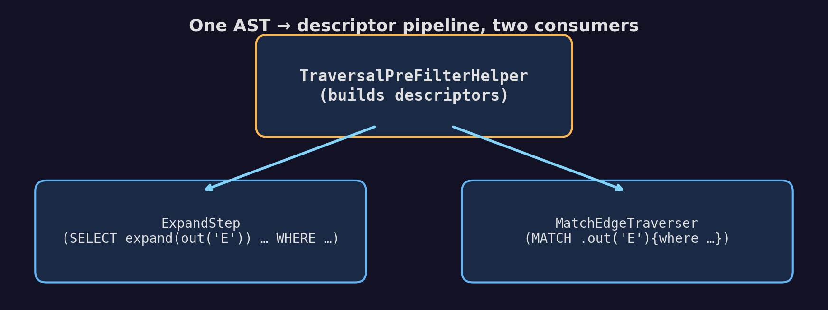
Shared helper, two callers
• One AST → descriptor pipeline
• Two consumers, same descriptor types, same iterator
• Symmetry is deliberate: SELECT expand and MATCH have the same bottleneck shape
Notes:
Pre-filter is not MATCH-only. SELECT expand(out('E')) followed by a WHERE is the same problem in a different syntax. So the analyzer lives in TraversalPreFilterHelper, and both ExpandStep and MatchEdgeTraverser call it. One place to maintain, one place to test, one set of descriptor types. When someone adds a new query shape later, they extend the helper and both call sites pick it up.

Slide 15
Planner pass
MatchExecutionPlanner.optimizeScheduleWithIntersections()
// Runs AFTER cost-based edge reordering
for each scheduled edge:
if target.WHERE has selectivity estimate below threshold:
attach RidFilterDescriptor to the EdgeTraversal
• Second pass — first pass reorders edges by cost
• Reuses existing cost-model selectivity estimate
• No pre-filter attached on edges where it would not pay off
Notes:
The planner pass is a second pass. The first pass reorders edges by cost. The second pass walks the ordered edges and asks: does this edge's target have a WHERE that we can pre-filter? If yes, attach a descriptor. This separation matters. The cost model already estimates selectivity. We reuse that estimate to gate attachment.

Slide 16
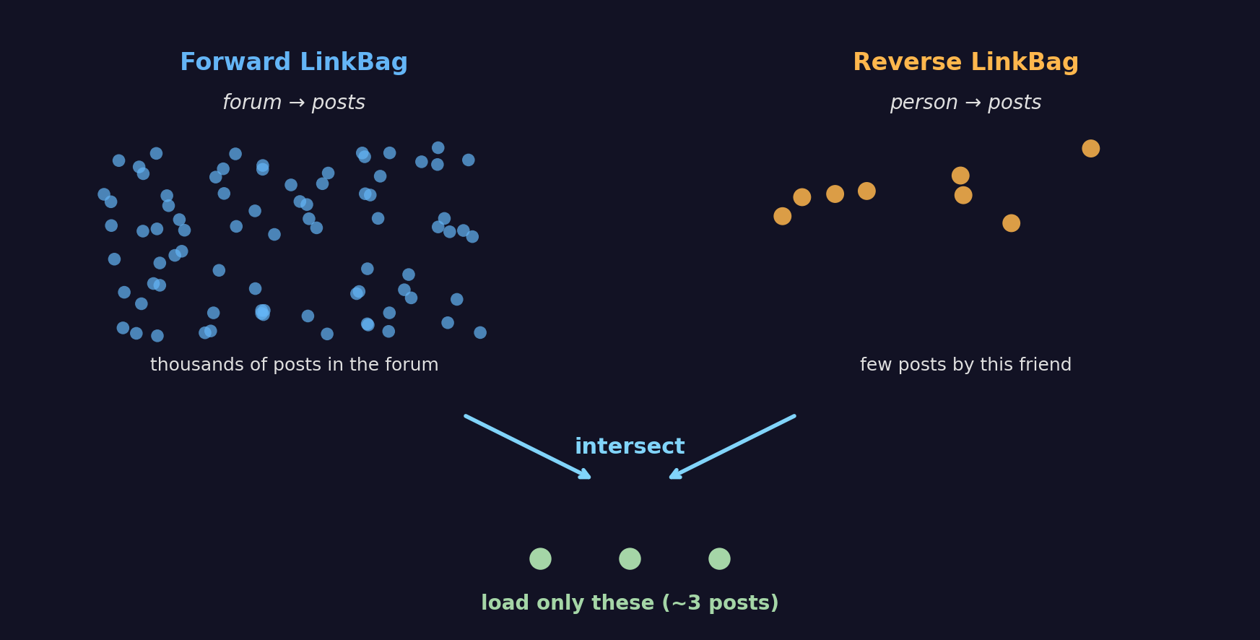
Adjacency intersection in pictures
• Forward: thousands of posts in the forum
• Reverse: a few posts created by the friend
• Backed by RidSet: IntMap + Roaring64Bitmap (PR #781). Probe is O(1) per LinkBag entry
Notes:
This is the picture for IC5. The forward LinkBag is huge: every post in the forum. The reverse LinkBag is small: posts created by this one friend. Their intersection is what we actually want. The data structure underneath is RidSet, rewritten in PR seven eighty one to use an IntMap of Roaring bitmaps. Membership test is a few instructions.

Slide 17
Per-descriptor selectivity
sealed interface RidFilterDescriptor {
boolean passesSelectivityCheck(int linkBagSize, int ridSetSize);
}
// DirectRid: always passes
// EdgeRidLookup: ridSetSize / linkBagSize ≤ edgeLookupMaxRatio (0.8)
// IndexLookup: class-level selectivity ≤ indexLookupMaxSelectivity (0.95)
// Composite: passes if any child passes
• Each type has its own threshold and its own data source
• IndexLookup looks at class statistics, not per-vertex overlap
• Defaults from LDBC SF 1 calibration; all configurable
Notes:
Four concrete descriptor types now, each with its own check. DirectRid always passes because it is a singleton. EdgeRidLookup keeps the per-vertex overlap ratio, threshold zero point eight. IndexLookup asks the index statistics for class-level selectivity, threshold zero point nine five. Composite passes if any child passes.

Slide 18
Two independent gates before building a RidSet
Selectivity and amortization answer different questions
Gate | Question | Where | Applies to
passesSelectivityCheck | Does the filter eliminate enough to be useful? | RidFilterDescriptor | All four types
checkIndexLookupAmortization | Will traversal volume pay back the build cost? | EdgeTraversal | IndexLookup only
Selectivity check — per-type formulas
DirectRid: always true (singleton, free to apply)
EdgeRidLookup: resolvedSize / linkBagSize ≤ 0.8 (per-vertex overlap)
IndexLookup: classSelectivity ≤ 0.95 (constant per query)
Composite: any child passes (intersection bounded by most selective)
Amortization gate — break-even on one-time build cost
m = estimatedSize / (loadToScanRatio × (1 − selectivity)) (break-even rows)
BUILD_EAGER — forecastN > ⌈m⌉ AND rootSourceRows ≥ 30 (CLT gate)
DEFERRED_WITH_NET — accumulate linkBagSize, materialise at T = max(2·forecastN, m)
REJECT — unknown selectivity or never enough volume
• Both gates must pass for IndexLookup to materialise; DirectRid and EdgeRidLookup bypass amortization (build is trivial)

Slide 19
Build cost for IndexLookup
• IndexLookup build = materialise RID set from index
• Cost: one index scan, allocates a RidSet
• One-time cost per query, charged on the first qualifying vertex
• Question: does the traversal volume justify the build?
Break-even formula:
m = estimatedSize / (loadToScanRatio × (1 − selectivity))
• loadToScanRatio ≈ 100 (random vertex load is ~100× a RidSet probe)
• m is the number of LinkBag entries to filter before the build pays for itself
Notes:
The selectivity check decides whether to pre-filter. We also need to decide when to materialise. Building the RID set is not free. One index scan, one allocation. If the traversal only touches a handful of vertices, the build cost never amortises. The formula is the break-even. If the LinkBag walk will touch at least m entries, the build is worth it.

Slide 20
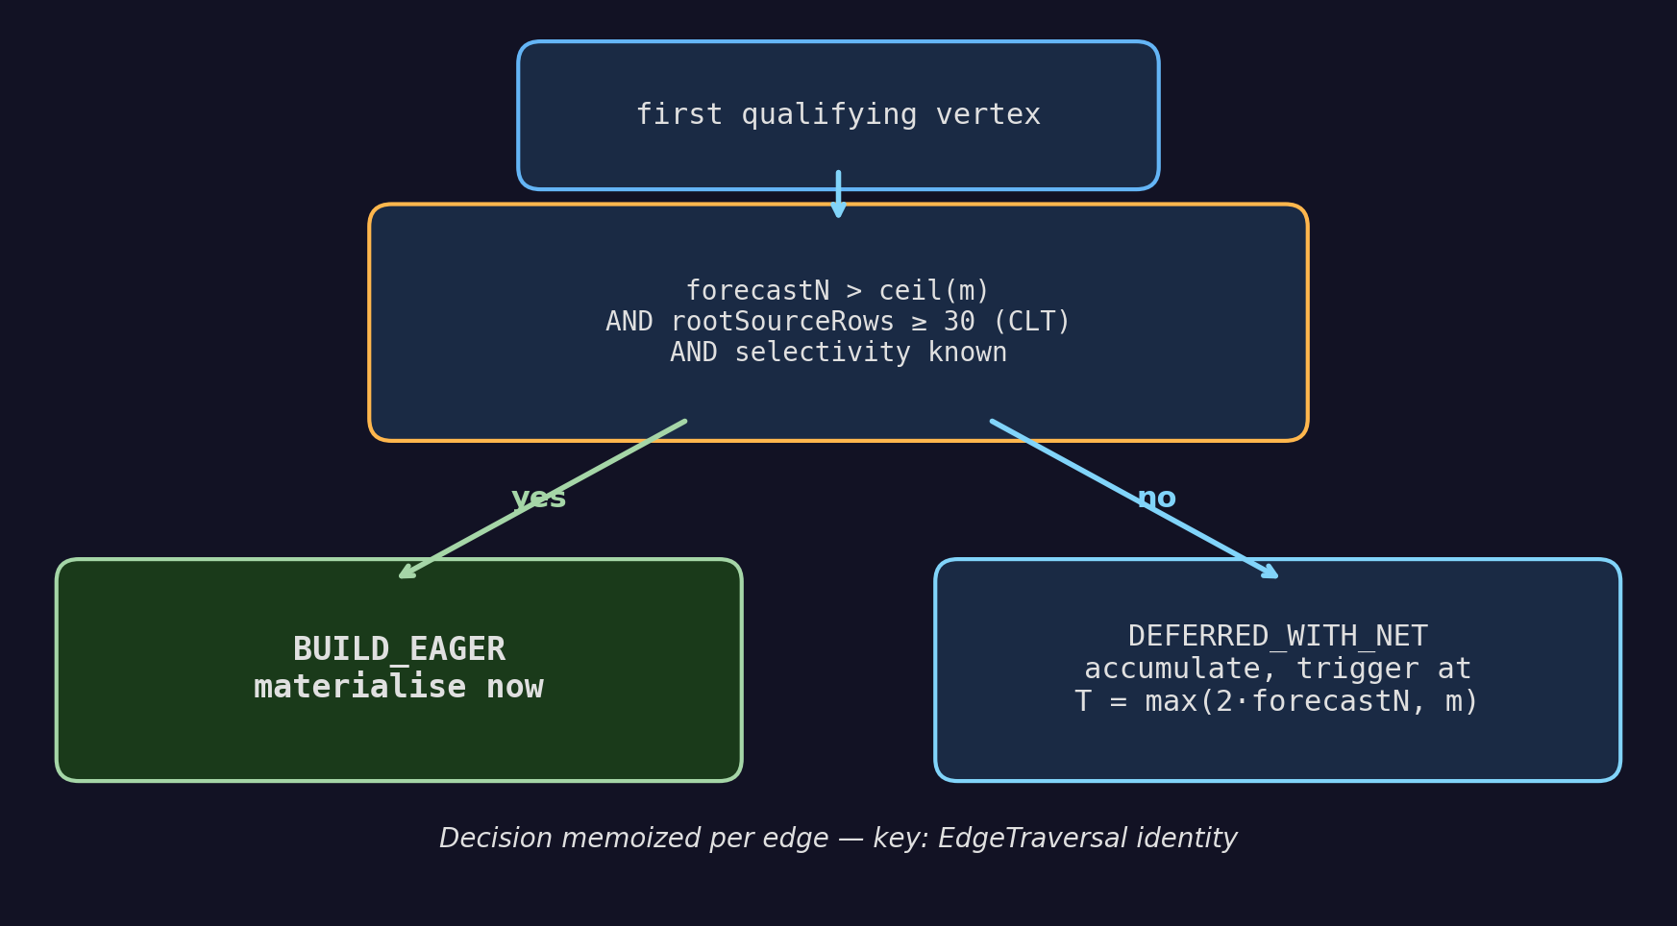
Two modes: BUILD_EAGER vs DEFERRED_WITH_NET
Notes:
Two modes. BUILD_EAGER materialises on the first qualifying vertex. DEFERRED_WITH_NET waits. Three conditions need to hold for eager: the forecast says we will touch more than m entries, the root sample size is statistically meaningful, and the selectivity estimate exists. If any fails, we defer and let the runtime accumulator decide. The decision is memoized per edge.

Slide 21
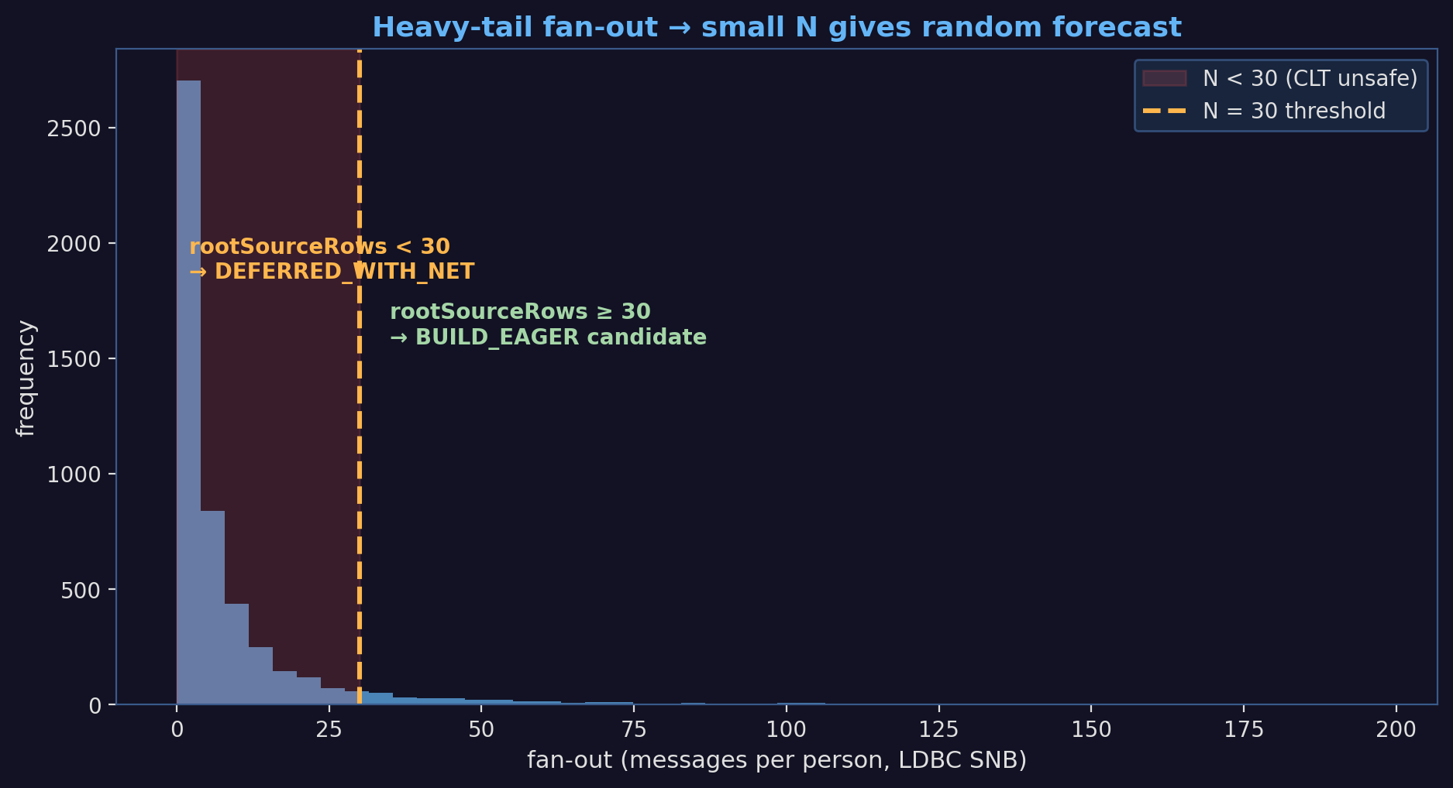
Why CLT gate at 30
• forecastN = sourceRows × fanOut_mean → relative error ∝ CV / √N
• LDBC SNB fan-out is heavy-tail (power-law) → CV is large
• N < 30 → forecast essentially random → route to DEFERRED_WITH_NET
Notes:
The forecast is sourceRows times mean fan-out. We are treating the sources as a sample from the fan-out distribution. The Central Limit Theorem says the mean of a sample of size N has relative error proportional to one over square root of N. For LDBC SNB the fan-out distribution is heavy-tailed. Messages per person follows a power law. With a small sample, the forecast is unreliable. Committing to BUILD_EAGER on a bad forecast is the worst outcome: we pay the build, the traversal stops early, we never amortise. Thirty is the textbook threshold for CLT.

Slide 22
Unknown selectivity → REJECT
• When does estimateSelectivity() return −1?
– Histogram missing
– Index never loaded
• Old behaviour: optimistic PROCEED, capped by fixed 100K maxRidSetSize
• New behaviour: REJECT, with skip reason STATS_UNAVAILABLE
• Why: cap is now auto-scaled (up to 10M of RAM), the old safety net is gone
Notes:
One detail with a sharp edge. Before PR nine seventy three, when the selectivity estimate came back as unknown, we proceeded optimistically. That was safe because the RID set cap was a hard one hundred kilobytes. The cap was a safety net. PR nine seventy three auto-scales the cap based on heap size, up to ten million. The safety net is gone. So we changed the optimistic PROCEED to a defensive REJECT, with a named skip reason.

Slide 23
PROFILE output: what you read to debug
MATCH ... PROFILE:
edge: forum.containerOf.post.hasCreator
preFilter: applied=4823, skipped=0, ridSetSize=14210,
buildTime=2.1ms, filterRate=0.96
descriptor: EdgeRidLookup
edge: post.hasCreator
preFilter: NEVER APPLIED (reason: STATS_UNAVAILABLE,
threshold: selectivity != -1)
descriptor: IndexLookup
• Per-edge counters: applied / skipped / probed / filtered / buildTime / ridSetSize
• PreFilterSkipReason enum: 8 values
• Global metric: PREFILTER_EFFECTIVENESS (filter-rate aggregated)
Notes:
This is what you read when debugging a slow query. Per edge, you see whether the pre-filter applied, how many times, the build time, the filter rate. When it did not apply you see why, with the threshold that was checked. Eight skip reasons cover every gate in the pipeline. This output is the contract for the next person who has to debug a pre-filter regression.

Slide 24
Measured impact by mechanism
LDBC SNB SF 1, single-thread / multi-thread % speed-up
Mechanism | LDBC query | Δ% ST | Δ% MT
Class filter via collection ID | IC7 recentLikers | +1087% | +1110%
IndexLookup (indexed property) | IS7 messageReplies | +220% | +212%
IndexLookup (indexed property) | IC3 friendsInCountries | +1117% | +929%
IndexLookup (indexed property) | IC9 recentFofMessages | +483% | +433%
EdgeRidLookup (back-ref intersection) | IC1 transitiveFriends | +12% | +8%
EdgeRidLookup (back-ref intersection) | IC12 expertSearch | +106% | +101%
Amortization gates (CLT-bounded build) | IC13 shortestPath | +7% | +8%
• Each row is a separate measurement against its own baseline — percentages are not additive across rows
• Pre-filter is invisible in query output — only PROFILE counters reveal whether it fired
Notes:
The wins per PR, each row from that PR's own JMH comparison. PR eight twenty two: IC7 over ten times, IC12 over two times, IS7 over two times. PR nine twenty three is a test suite PR; no headline benchmark delta, but the test suite is what catches regressions in the rest of the chain. PR nine seventy three: IC3 over eleven times, IC9 nearly five times. The caveat below the table matters. Each percentage is against a different fork point, you cannot add them. The chain produced two queries with over ten times speedup on its own, IC7 from #822 and IC3 from #973.

Slide 25
Back to IC3 — where pre-filter fires
BRANCH A: {person}.out('IS_LOCATED_IN').out('IS_PART_OF')
{where name NOT IN [:cX, :cY]} ← class filter / NOT IN
BRANCH B: {person}.in('HAS_CREATOR')
{message, where creationDate >= …} ← IndexLookup (date)
.out('IS_LOCATED_IN')
{msgCountry, where name IN […]} ← IndexLookup (name IN)
Part of IC3 | Descriptor
creationDate >= … AND < … | IndexLookup
msgCountry.name IN [...] | IndexLookup
country.name NOT IN [...] | Class filter (Case A)
• Pre-filter alone activates these three sites
• Multi-branch handling is a sibling optimization (out of scope)
Notes:
Back to the query we opened with. Pre-filter fires at three sites in IC3. Two IndexLookup descriptors, one class filter. PR eight twenty two enables all three. PR nine seventy three tunes the IndexLookup activation so it stays correct across all vertices in the traversal. The multi-branch structure of IC3 is optimised by a sibling project on hash join that is not part of this talk.

Slide 26
What's next
• Live cost measurement from runtime metrics (loadToScanRatio is static today)
• Histogram coverage for edge properties (EdgeFanOutEstimator is class-level)
• Composite pre-filter for index + back-reference together
• Better integration with sibling hash-join work (out of scope here)
Notes:
Four things on the roadmap. Live cost measurement so the load-to-scan ratio adapts to the storage tier. Histograms on edge properties so fan-out estimates pick up correlation. Composite pre-filter that combines index lookup and back-reference in one descriptor. And tighter integration with the hash-join work that lives in a sibling project.

Slide 27
Reading order if you want to verify
Root: core/src/main/java/com/jetbrains/youtrackdb/internal/core/sql/executor/
• 1. TraversalPreFilterHelper.java
• 2. match/MatchExecutionPlanner.optimizeScheduleWithIntersections
• 3. match/EdgeTraversal.resolveWithCache
• 4. RidFilterDescriptor.passesSelectivityCheck
• 5. match/MatchStep.appendPreFilterStats (what PROFILE shows)
Durable ADR: docs/adr/index-assisted-traversal/design-final.md
Thanks. Questions.
Notes:
Five files, in order. Start with the helper that builds descriptors, follow the planner pass that attaches them, then the runtime decision in resolveWithCache, then the per-descriptor selectivity check, then the PROFILE output. The ADR for PR eight twenty two is the durable design document. Thanks. Questions.

Slide 28
Backup slides (for Q&A)

Slide 29
Backup A — EdgeTraversal.cache
• Per-edge LRU, capacity 64
• Key: descriptor cache fingerprint
• Value: resolved RidSet, or null with parallel cachedSkipReasons map
• Why a separate map for reasons: cached-null hit must restore the original skip reason, not the most-recent one
Notes:
This is the internal cache that PR nine seventy three hardened. The cache stores RID sets. When a key is rejected we cache null. Without the parallel reasons map, an interleaved skip on a different vertex would mask the original cause in PROFILE.

Slide 30
Backup B — RidSet data structure
• Int2ObjectOpenHashMap<Roaring64Bitmap> (cluster ID → bitmap of positions)
• Rewritten in PR #781 from a HashSet<RID>
• Membership test: ~3 instructions
• Iteration: cluster-by-cluster, friendly to LinkBag layout

Slide 31
Backup C — IndexSearchDescriptor.cacheFingerprint
• Previously cache key was index.getName()
• Two IndexLookups on the same index with different conditions would have aliased
• Latent bug: planner happens to emit at most one IndexLookup per edge today
• Fix: include keyCondition and additionalRangeCondition in fingerprint
• Regression test: EdgeTraversalCacheTest.indexLookup_cacheKey_distinctConditionsDoNotAlias

Slide 32
Backup D — stampEdgeForecasts pitfalls
• Forecast pass exists only to feed BUILD_EAGER decision
• Short-circuit: skip if no edge has IndexLookup (standalone or in Composite)
• Long.MAX_VALUE sentinels for inferred-class aliases stripped at input
• Saturated forecast stored as −1, not clamped (clamping would re-introduce inflation)

Slide 33
Backup E — Why no live cost measurement
• We considered using runtime metrics to update loadToScanRatio per query
• Sample bias: pre-filter pre-rejected vertices never get loaded → cannot measure their hypothetical load cost
• Solution: collect cost samples from queries where pre-filter did not apply
• Out of scope, planned for a follow-up
Notes:
The most common question on this PR. We have loadToScanRatio as a configurable constant, default one hundred. Why not measure it live? Because pre-filter pre-rejects vertices that we would have measured. The sample is biased toward cheap loads. To get an unbiased measurement we have to collect from queries where pre-filter did not run, and we have not built that path yet.

