Slide 1
IndexLookup Optimization in MATCH
Skipping vertices that won't match — by asking the index first
Sandra Adamiec · YouTrackDB
Notes:
Welcome. This talk is about a specific optimization in the MATCH execution engine: asking an index whether a vertex would pass a WHERE clause BEFORE paying to load it. The optimization gives us 200–1000% throughput wins on LDBC SNB workloads, but only when we make the right runtime decisions about WHEN to use it. About 60% of this talk is about those decisions — the cost arithmetic, the gates, the bounded-loss contract. By the end you should know exactly when this fires, when it doesn't, and how to read the PROFILE counters to verify it in production.

Slide 2
What we want to skip — concretely
IC9 as a graph: red = vertices loaded and thrown away by WHERE; green = vertices that actually pass
MATCH {Person, id=:pid}.out('KNOWS'){friend}.in('HAS_CREATOR'){post, where: creationDate > :sinceDate} RETURN post
friend_1
link bag
5,000 RIDs
✗
✗
✗
✓
✗
✗
✗
✗
✗
✗
✗
✓
✗
✗
Person
:pid
(1 vertex)
friend_2
link bag
5,000 RIDs
✗
✗
✗
✗
✗
✗
✓
✗
✗
✗
✗
✗
✗
✗
friend_3
link bag
5,000 RIDs
✗
✓
✗
✗
✗
✗
✗
✗
✓
✗
✗
✗
✗
✓
Legend: ✗ red = loaded then rejected by WHERE ✓ green = actually matches creationDate > :sinceDate
Reality: 200 friends × 5,000 posts = 1,000,000 vertex loads; ~0.2% pass WHERE.
The optimization skips every red box.
Notes:
Visual recap before we describe the fix in pseudocode. The query at the top is the same IC9 we just traced. The graph below shows what executes today.
One Person on the left. Three friend vertices shown — in reality 200. Each friend has a link bag of 5,000 message RIDs — fourteen boxes per row stand in for that 5,000.
Red crosses are vertices we LOAD from disk today and then THROW AWAY because their creationDate doesn't match. Green checkmarks are the few vertices that actually pass.
Across the whole picture: 36 posts shown, 6 green, 30 red. Generalize to reality and you get 200 times 5,000 equals one million loads, of which roughly 2,000 actually pass the WHERE. Every red box is wasted I/O.
The IndexLookup optimization is, in one sentence: skip every red box. Don't even touch them. Load only the green ones. Next slide shows how.

Slide 3
How edges are stored — the link bag
Each vertex carries its own adjacency as fields on the record
VERTEX #12:5 (class: Person)
Edge fields = built-in adjacency index
────────────────────────────────────────────────────────
• Every vertex stores its own neighbors as out_<EdgeClass> and in_<EdgeClass> fields
• Each is a LinkBag — a list of RIDs of the neighbor records
• Walking the LinkBag is cheap — sequential RIDs, O(bag size)
• Loading each RID is expensive — random disk I/O per neighbor record
The pre-filter shortcuts the load step:
• Build a fast lookup RidSet of every RID that would pass WHERE
• While walking the LinkBag, probe the RidSet first
• Only load RIDs that pass the probe — ~99% rejection happens at memory speed
name: 'Alice'
birthDay: 1989-04-21
out_KNOWS: LinkBag[#12:9, #12:14, …] (200 RIDs)
in_HAS_CREATOR: LinkBag[#13:0, #13:7, …] (5 000 RIDs)
out_LOCATED_IN: LinkBag[#15:2] (1 RID)
Notes:
One more piece of background. In YouTrackDB, edges aren't separate records — each vertex carries its own adjacency as fields on its own record. A Person record has out_KNOWS pointing to a list of friend RIDs, in_HAS_CREATOR pointing to message RIDs. The LinkBag is just that list. Walking the list is cheap — it's sequential RIDs already in memory once the vertex is loaded. Loading each RID is the expensive part — random disk I/O per neighbor record. That asymmetry is the entire economic premise of this optimization. We trade one cheap operation, a bitmap probe, for many expensive operations, vertex loads we won't use.

Slide 4
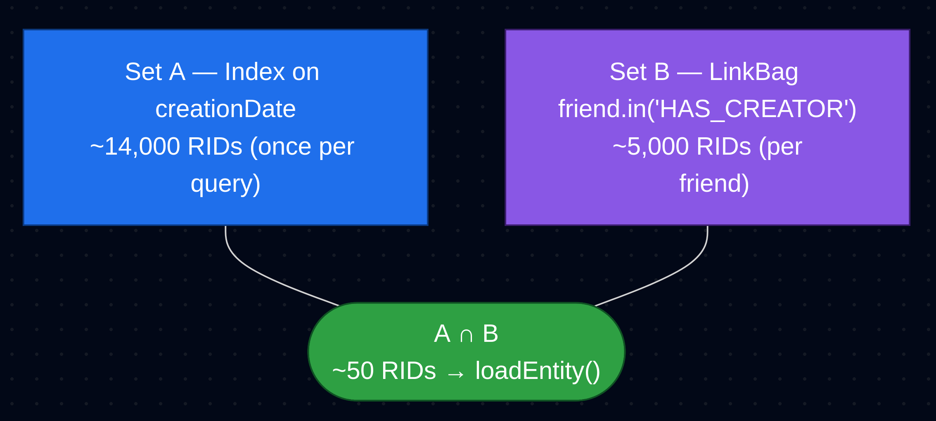
Notes:
Concrete example. LDBC SNB IC9 — friend-of-friend recent messages. Today's execution: 200 friends, each has roughly 5000 messages in their HAS_CREATOR link bag, we want only messages created after a specific date. We load all million messages, just to check their creationDate field. 99.8 percent of those loads are wasted — the WHERE clause rejects them. The crucial detail: the WHERE only checks creationDate. We have an index on Message.creationDate. We could resolve the answer from the index without ever loading those messages. That's the structural opportunity this optimization captures.

Slide 5
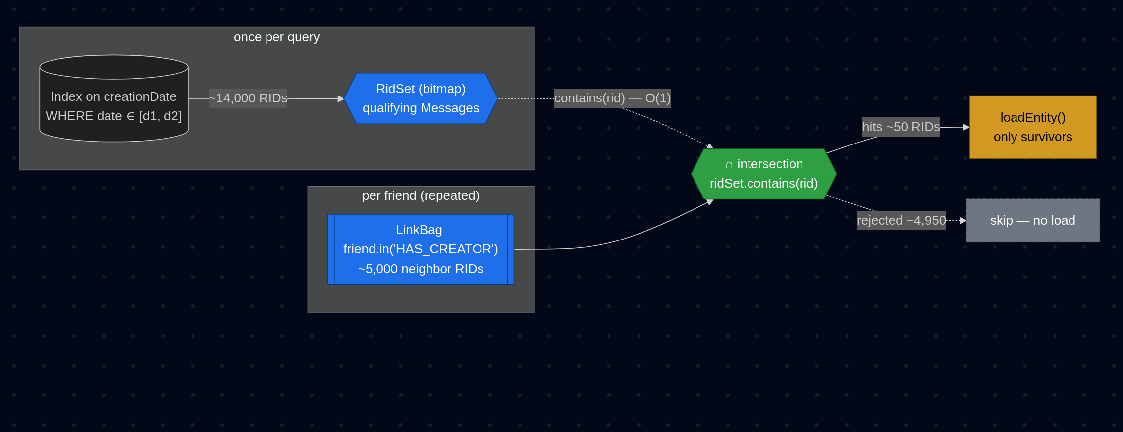
The idea — ask the index once, intersect for free
Notes:
The fix in pseudocode. Once, before the friend loop: scan the creationDate index for the date range, get back roughly 14,000 qualifying message RIDs, materialize them into a fast bitmap we call a RidSet. Then per friend: walk the 5000-RID link bag as before, but for each RID probe the bitmap first. Only RIDs that pass the probe reach loadEntity. The index scan is paid ONCE for the entire query. The bitmap probe is O(1) memory access. The orders-of-magnitude cost gap between "probe" and "load" is what makes this profitable.

Slide 6
Concrete example: friends recent messages
MATCH {class: Person, where: id = :pid}.out('KNOWS'){as: friend}
.in('HAS_CREATOR'){as: msg, where: creationDate > :sinceDate}
RETURN msg
Per-friend execution pre-optimization:
for friend in person.out('KNOWS'): // ~200 friends
bag = friend.in_HAS_CREATOR // ~5 000 message RIDs
for rid in bag:
msg = loadEntity(rid) // ← random I/O
if msg.creationDate > :sinceDate: // ~10 of 5 000 match
yield msg
Class Message has an index on creationDate. One scan of the index gives every qualifying RID — for the whole query, once.
Per-friend execution post-optimization:
// once, before the friend loop:
qualifyingRids = creationDateIndex.scan(> :sinceDate) // 14 000 RIDs
ridSet = new RidSet(qualifyingRids) // fast lookup bitmap
// per friend:
for friend in person.out('KNOWS'):
bag = friend.in_HAS_CREATOR // 5 000 RIDs
for rid in bag:
if ridSet.contains(rid): // O(1), no I/O
yield loadEntity(rid) // only ~10 survive
Notes:
Concrete example. LDBC SNB IC9 — friend-of-friend recent messages. Today's execution: 200 friends, each has roughly 5000 messages in their HAS_CREATOR link bag, we want only messages created after a specific date. We load all million messages, just to check their creationDate field. 99.8 percent of those loads are wasted — the WHERE clause rejects them. The crucial detail: the WHERE only checks creationDate. We have an index on Message.creationDate. We could resolve the answer from the index without ever loading those messages. That's the structural opportunity this optimization captures.

Slide 7
Which queries benefit?
MATCH target nodes whose WHERE matches an index on the target class
Query shapes the planner recognises:
{as: msg, where: (creationDate >= :start AND creationDate < :end)}
{as: country, where: (name IN [:cX, :cY])}
{as: post, where: (length BETWEEN 100 AND 500)} // rewritten to >= AND <=
{as: forum, where: (title = :title)} // unique index
Three requirements
1. Target node has a WHERE clause
2. The class has an index covering that condition (range, hash, unique, etc.)
3. The condition does not reference $matched — index parameters must be resolvable when the query starts
Notes:
When does the planner attach an IndexLookup descriptor? Three requirements. One: target node has a WHERE clause. Two: the target class has an index covering that condition — range, hash, unique, full-text whatever. Three: the condition does NOT reference $matched. Index parameters must be resolvable at query start, not mid-traversal — otherwise the result isn't constant per query and we lose the amortization. Common shapes are date ranges, IN lists, BETWEEN (which we rewrite), and exact-match on unique indexes. On LDBC: IC3, IC9, IS7 hit this pattern. Any production query whose target node filters on indexed properties is a candidate. Note: filters that reference $matched — like "where my friend's friend is in this list" — need different techniques. This optimization is specifically for class-level predicates.

Slide 8
The catch — the index scan itself costs something
If the source is small, the scan can cost more than the savings
Index scan produces 14 000 RIDs. Cost ≈ 14 000 I/O reads once — that's the build cost (denoted B from here on).
Scenario | Traversal volume (n) | Build cost (B) | Without optimization | With optimization | Verdict
200 friends × 5 000 bag | 1 000 000 probes | 14 000 reads | 1 000 000 vertex loads | 16 000 I/O | WIN (62×)
10 friends × 50 bag | 500 probes | 14 000 reads | 500 vertex loads | 14 050 I/O | LOSS (28×)
3 friends × 500 bag | 1 500 probes | 14 000 reads | 1 500 vertex loads | 14 015 I/O | LOSS (9×)
Consequence
• Building the index-backed RidSet is not always profitable
• We need a runtime decision: should this edge build the set, or should it skip the optimization?l
Notes:
Here's where it gets interesting. The index scan itself costs about 14,000 I/O reads. That's the BUILD COST — paid once per query if we choose to build. Three scenarios in the table. First scenario: 200 friends each with 5000-RID bags. One million traversals; building 14,000 pays back 62 times. Clear win. Second: 10 friends, 50-RID bags each. 500 traversals; building 14,000 is a 28× LOSS. Third: 3 friends with 500-RID bags. 1500 traversals; same story, 9× loss. The same code path can be a 62× win OR a 28× loss depending purely on traversal volume. The next half of this talk is about HOW we decide.

Slide 9
The descriptor — what gets attached to the edge
A small object the planner creates and the runtime consults
record IndexLookup(IndexSearchDescriptor indexDescriptor) {
// cheap estimate before deciding to build
estimatedSize() → indexDescriptor.estimateHits() // histogram, O(1)
// actually run the index scan and materialise the bitmap
resolve() → run index scan → fill RidSet
// cache lookup key — same index + same condition → same RidSet
cacheKey() → indexDescriptor.cacheFingerprint()
// gate 1
passesSelectivityCheck() → estimateSelectivity() ≤ 0.95
}
The fingerprint = index name + key condition + range condition
• Same index used twice with different conditions must NOT share a cache entry
Where it's attached: MatchExecutionPlanner.optimizeScheduleWithIntersections
Where it's consumed: EdgeTraversal.resolveWithCache (cache + gates) and MatchEdgeTraverser.applyPreFilter (per-vertex)
Notes:
The descriptor is a record with four methods. estimatedSize gives a histogram-based hit count — fast, O(1). resolve actually runs the index scan and builds the bitmap — slow, paid once. cacheKey returns a fingerprint that includes index name, key condition, and range condition — so two IndexLookups on the same index with different parameters get different cache slots. passesSelectivityCheck is gate 1. Important historical note: the fingerprint used to be index.getName alone, which would have aliased two IndexLookups on the same index with different conditions. The collision was latent — today's planner emits at most one IndexLookup per edge — but the fingerprint fix pins correctness on data instead of on planner discipline. One PR change away from a silent bug.

Slide 10
Gate 1 — is the filter selective enough at all?
Skip the optimization when the filter passes almost everything through
selectivity = hits / classTotalCount ∈ [0, 1]
pass ⇔ selectivity ≤ 0.95
Gate 2 — will the traversal volume pay back the build?
Break-even math: how many traversals before the index scan is recovered
m × (1−s)·L = B
m = B / (loadToScanRatio × (1 − s))
B ≈ build cost (one I/O per index hit),
s = selectivity
(1 − s)= LinkBag fraction rejected per vertex (savings per probe)
loadToScanRatio = random vertex load vs RidSet probe
Notes:
Gate 1 is fast. Selectivity equals hits divided by class total count — the fraction of the class matching the filter. Threshold 0.95: if the filter rejects fewer than 5 percent of class members, even a free build wouldn't save meaningful work. We skip. The threshold is conservative — break-even on individual probe cost is way out near 0.9997, but 0.95 avoids degenerate cases like "creationDate less than year 3000" that the planner can't reason about. Special case: estimateSelectivity returns minus one when no histogram exists. Then we REJECT — better to skip than optimistically build a RidSet we can't bound. The selectivity check evaluates ONCE per query, not per vertex; result is cached for all subsequent vertices.

Slide 11
Three modes in time — when does the build actually fire?
Stream of source vertices entering the edge — three different build triggers
BUILD_EAGER
build on first qualifying
vertex
▲ BUILD here (14k I/O) — then filter v1..v200
v1
v2
v3
·
·
·
·
·
·
·
·
·
·
·
·
·
·
·
DEFERRED_WITH_NET
accumulate, build when
total ≥ T = max(2·F, m)
v1..v11 paid full vertex-load cost (no filter yet)
v1
v2
v3
·
·
·
·
·
·
·
·
◆
v13
·
·
·
·
·
▲ accumulator reached T, BUILD now
REJECT
no build, ever
(volume too low)
every vertex loaded fully — no filter attempted
v1
v2
v3
·
·
·
·
·
·
·
·
·
·
·
·
·
·
·
Legend: green = filter applied · red = no filter (full load) · ◆ = build trigger
Notes:
Visual of the three modes in time. Top row, BUILD_EAGER — vertex 1 triggers the build, every subsequent vertex gets filtered. Build cost amortized across 200 traversals. Middle row, DEFERRED_WITH_NET — vertices 1 through 11 process at full unfiltered cost (these are the deferral-tax neighbors we discussed), accumulator reaches T at vertex 12, build fires, remaining 188 vertices get filtered. The math has to work out that the deferral-phase loss is less than the build's savings on the remaining vertices — that's why T has the m floor. Bottom row, REJECT — every vertex loaded fully. No optimization, no build. That's the contract for unknown-selectivity case: better to be slow but predictable than to build an unbounded RidSet we can't reason about.

Slide 12
Three modes — eager, deferred, reject
Decided once per edge at the first call, then memoised
Mode | Condition | Runtime action
BUILD_EAGER | forecastN > ⌈m⌉ AND sample big enough | build on the first qualifying vertex
DEFERRED_WITH_NET | selectivity known, but eager conditions not met | accumulate linkBagSize per vertex; build when total ≥ max(2·forecastN, m)
REJECT | volume guaranteed too low | cache null with skip reason; never retry on this edge
• Forecasts can under-estimate when fan-out is heavy-tailed (one 'whale' vertex with thousands of edges)
• The runtime accumulator catches reality: even if forecast said 100, if we actually accumulated 12 000 traversals, the build is now justified
• T = max(2·forecastN, m) — the 2× term catches under-forecasts, the m floor catches no-forecast cases
Once decided, the mode is stored on the EdgeTraversal — no re-evaluation per vertex
Notes:
Three modes table. BUILD_EAGER fires when forecast comfortably exceeds m AND the sample size for the forecast is at least 30 — that's the CLT threshold we cover in two slides. DEFERRED_WITH_NET is the fall-through: selectivity is known but eager conditions not met. Accumulate per-vertex link bag size; when the running total exceeds T equals max of 2 times forecast OR m, build now. The 2× term catches forecast under-estimates — if reality is twice the forecast, the forecast was clearly wrong by enough that a build is justified. The m floor catches the no-forecast case — when we have no useful forecast at all, the m floor takes over. REJECT is for unknown selectivity or guaranteed-low volume — never retry on this edge. Once the mode is decided at the first call, it's memoised on the EdgeTraversal — no re-evaluation per vertex.

Slide 13
The cache for RidSet
The whole reason IndexLookup pays back: the RidSet is constant for the query
friend_1
(first vertex)
friend_50
(later)
friend_200
(last)
cache MISS
→ run gates → resolve()
cache HIT (RidSet)
→ reuse stored bitmap
cache HIT (RidSet)
→ reuse stored bitmap
BUILD RidSet of 14 000 RIDs
RidSet of 14 000 RIDs
RidSet of 14 000 RIDs
OR
REJECT / BUILD_FAILED
Build cost amortizes: 14 000 reads paid by friend_1, then 199 cache hits for the rest of the query.
Notes:
Visual recap of caching. Friend 1 hits the cache, misses, runs gates, builds, caches the RidSet, applies to its own link bag. Friends 50 and 200 — hundreds of vertices later — hit the cache and reuse the same RidSet for free. The whole reason this optimization is profitable: the index result is constant for the query, so we build once and amortize. The bottom path — cache.put key null plus a skip reason in the parallel map — is the rejection branch. Once we decide an edge isn't worth it, subsequent vertices on that edge skip without re-running gates. Cache capacity is 64 per edge — plenty for any realistic pattern, tiny memory footprint.

Slide 14
Skip reasons
Why these are permanent
• SELECTIVITY_TOO_LOW — selectivity is a property of (index, condition, class), invariant for the query
• STATS_UNAVAILABLE — missing histogram is a schema fact; doesn't appear mid-query
• CAP_EXCEEDED — estimatedSize is class-wide; if it overflows once, it overflows always
• BUILD_FAILED — same index, same params, same data → same failure next time
Why these are NOT cached
• BUILD_NOT_AMORTIZED — accumulator may cross T at a later vertex and trigger the build. Caching null would freeze the decision and kill the safety net.
• LINKBAG_TOO_SMALL — different source vertices have different bag sizes; a small bag now doesn't mean every bag is small.

Slide 15
How to tell if it's firing — PROFILE output
Counters per edge + diagnostic strings for every skip path
MATCH ... PROFILE:
edge: post.hasCreator descriptor: IndexLookup
preFilter: applied=4823, skipped=0,
ridSetSize=14210, buildTime=2.1ms, filterRate=0.96
edge: forum.containerOf descriptor: IndexLookup
preFilter: NEVER APPLIED
(reason: STATS_UNAVAILABLE,
threshold: selectivity != -1)
edge: person.knows descriptor: IndexLookup
preFilter: NEVER APPLIED
(reason: BUILD_NOT_AMORTIZED,
threshold: T = max(2·forecastN, m) = 12000)
What each counter tells you
• applied / skipped — how many vertices probed the RidSet vs short-circuited
• ridSetSize — actual size after resolve (compare with forecast — was the estimate accurate?)
• filterRate — fraction of LinkBag entries the filter rejected. 0.96 = excellent. < 0.5 = consider tuning thresholds.
Every NEVER APPLIED diagnostic carries its threshold — you can see exactly why it was rejected
Aggregate metric: PREFILTER_EFFECTIVENESS — global average filter rate across all queries
Notes:
How to verify this in production. PROFILE prints per-edge counters. applied versus skipped count. RidSet size after resolve. Build time in nanos. filter rate — fraction of link bag entries the filter rejected. A 0.96 filter rate means the optimization rejected 96 percent of would-be loads — great. A skip diagnostic carries the threshold value. "NEVER APPLIED reason BUILD_NOT_AMORTIZED threshold T equals 12000" tells you exactly why it didn't fire and how big the volume gap was. Eight enumerable skip reasons cover every code path: NONE, CAP_EXCEEDED, SELECTIVITY_TOO_LOW, BUILD_NOT_AMORTIZED, LINKBAG_TOO_SMALL, OVERLAP_RATIO_TOO_HIGH, BUILD_FAILED, STATS_UNAVAILABLE. Global metric PREFILTER_EFFECTIVENESS aggregates filter rate across all queries — that's your headline operational metric for ops.

Slide 16
Measured impact — LDBC SNB SF 1
Single-thread / multi-thread % speed-up, baselines independent per row
LDBC query | Δ% ST | Δ% MT | What fires
IC3 friendsInCountries | +1117% | +929% | two IndexLookups: creationDate range + name IN list
IC9 recentFofMessages | +483% | +433% | IndexLookup on creationDate
IS7 messageReplies | +220% | +212% | IndexLookup on edge target property
IC13 shortestPath | +7% | +8% | smaller RidSets thanks to CLT-bounded BUILD_EAGER
Notes:
LDBC SNB SF1 numbers, single-thread and multi-thread percentage speedups against own-baseline. IC3 — two IndexLookups stacked on one pattern, biggest gain. IC9 — single IndexLookup on creationDate. IS7 — index on edge target property. IC13 — a modest 7 percent. That one is interesting — IC13 doesn't have an IndexLookup attached. The 7 percent comes from the CLT gate PREVENTING a BUILD_EAGER mis-fire that would have happened with the old logic. So the gates aren't just for capturing gains; they prevent regressions too. Percentages are not additive across queries — each row is its own measurement against its own baseline. What's NOT in this table: queries where the gates correctly chose not to build. Those stay at baseline. No regression. That's the bounded-loss contract from the earlier slide actually delivering in measurements.

Slide 17
Where to look in the code
Order matters — start at the descriptor, end at the planner
core/src/main/java/com/jetbrains/youtrackdb/internal/core/sql/executor/
1. RidFilterDescriptor.java
record IndexLookup ← the descriptor itself
IndexLookup.passesSelectivityCheck ← gate 1
2. match/EdgeTraversal.java
resolveWithCache ← cache + gates entry point
checkIndexLookupAmortization ← gate 2, three-way decision
evaluateIndexLookupAmortization ← Composite-rescue variant
getForecastN / getRootSourceRows ← values stamped by planner
3. match/MatchExecutionPlanner.java
optimizeScheduleWithIntersections ← creates and attaches the descriptor
stampEdgeForecasts ← forecast pass (short-circuited)
anyEdgeHasIndexLookup ← short-circuit predicate
4. TraversalPreFilterHelper.java
findIndexForFilter ← planner-side index detection
resolveIndexToRidSet ← runtime materialisation
maxRidSetSize / loadToScanRatio ← thresholds and config
5. match/MatchStep.java
appendPreFilterStats ← PROFILE diagnostic emitter
Notes:
If you want to verify the design from the code. Start with RidFilterDescriptor — the descriptor record, gate 1 lives on the IndexLookup variant. Then EdgeTraversal — resolveWithCache is the entry point, checkIndexLookupAmortization is gate 2 with its three-way decision, evaluateIndexLookupAmortization is the Composite-rescue variant. Then MatchExecutionPlanner — optimizeScheduleWithIntersections attaches the descriptor, stampEdgeForecasts runs the forecast pass with the anyEdgeHasIndexLookup short-circuit. TraversalPreFilterHelper holds findIndexForFilter for planner-side detection and resolveIndexToRidSet for runtime materialisation. Plus MatchStep.appendPreFilterStats emits the PROFILE diagnostic strings. Durable ADR lives in docs/adr/index-assisted-traversal/design-final.md. The implementation PR is number 973 on the JetBrains/youtrackdb repo — design details there too.

Slide 18
Thanks — questions?
Notes:
Questions. IndexLookup is one descriptor in a broader RidSet pre-filter mechanism — the companion deck covers all four descriptor types end to end if you want the wider picture. Happy to dig into the cost arithmetic, the forecast propagation, the regression test cases, or how this lands against Neo4j's NodeHashJoin equivalent.

