Slide 1
Purchasing A Family Home
Variables Effecting the House Prices in America

Slide 2




What Determines House Price?
House Size?
Bedrooms?
Land?
Location?

Slide 3
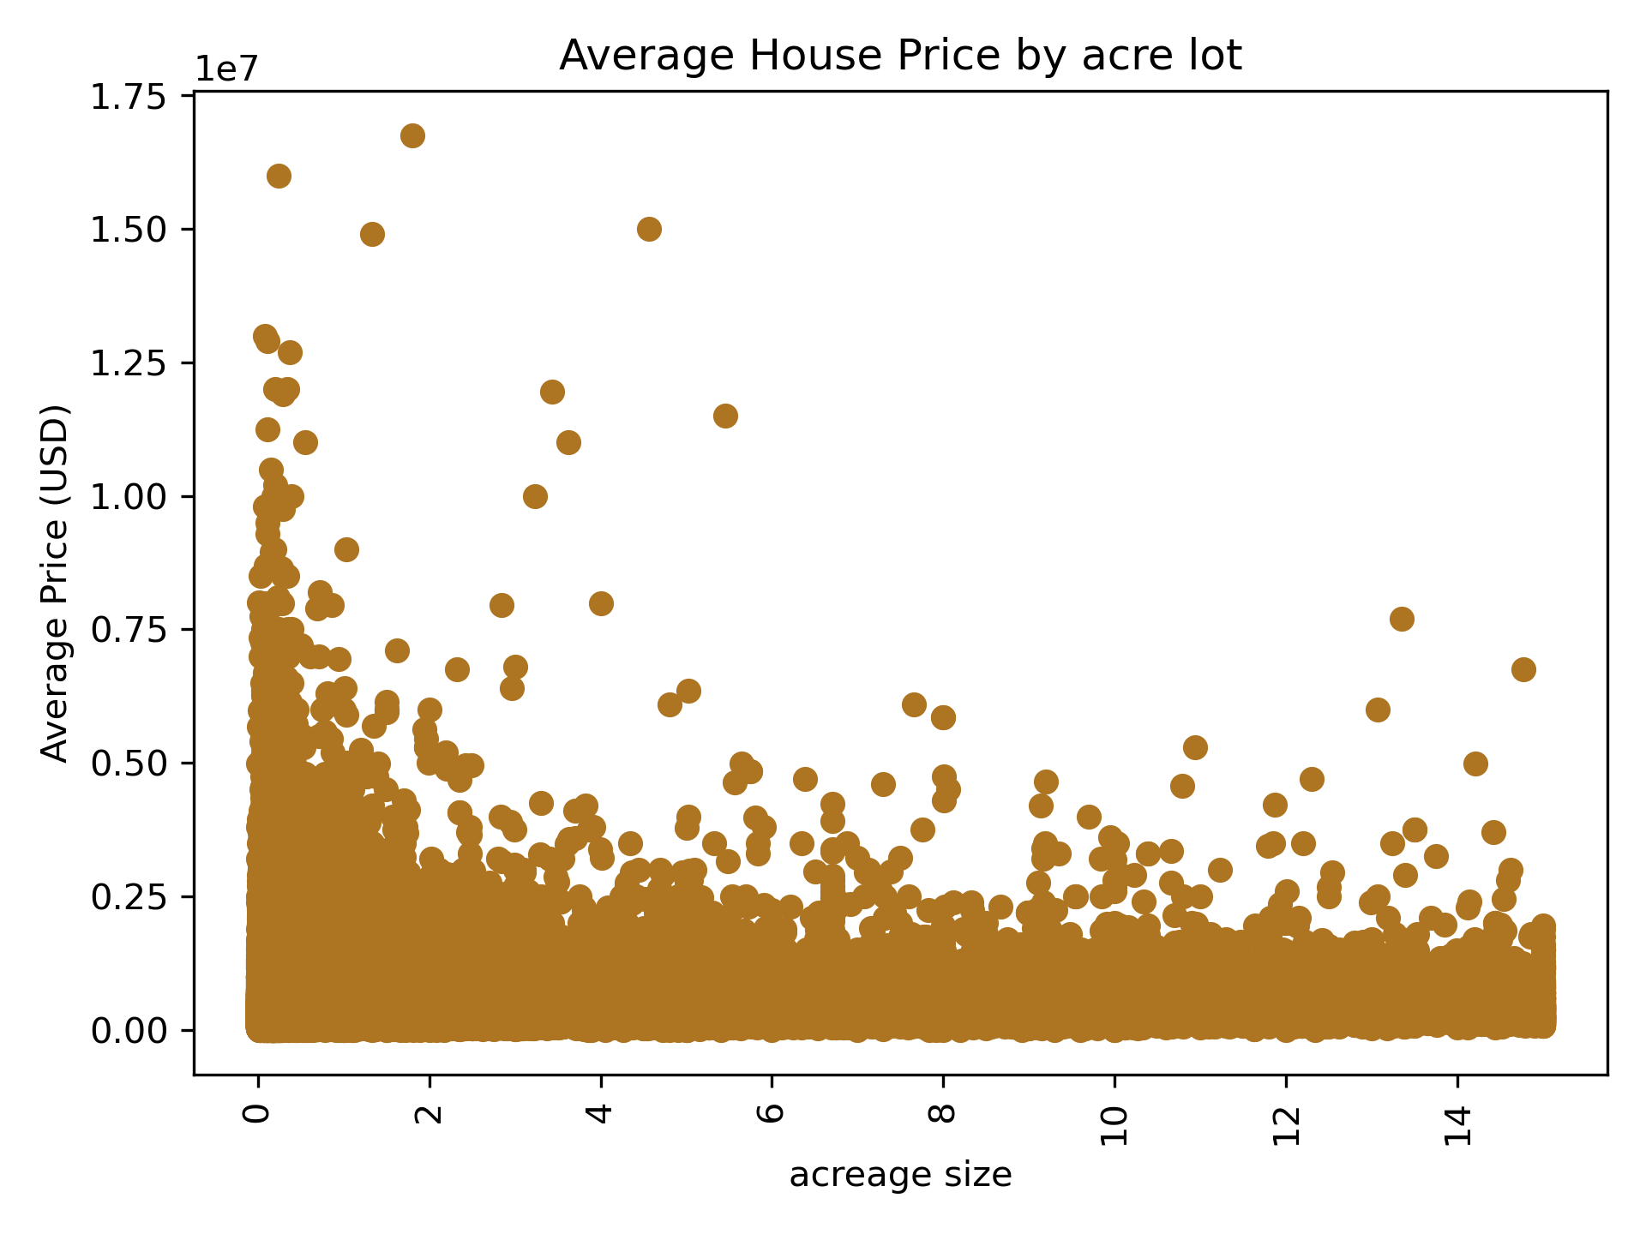
Average Cost Acreage
H₀: There is no relationship between property size and house price.
H₁: Larger lot size is associated with higher price.
T-score ≈ 74.85
P ≈ 0.0
Correlation Coe ≈ 0.02
P ≈ 0.0

Slide 4
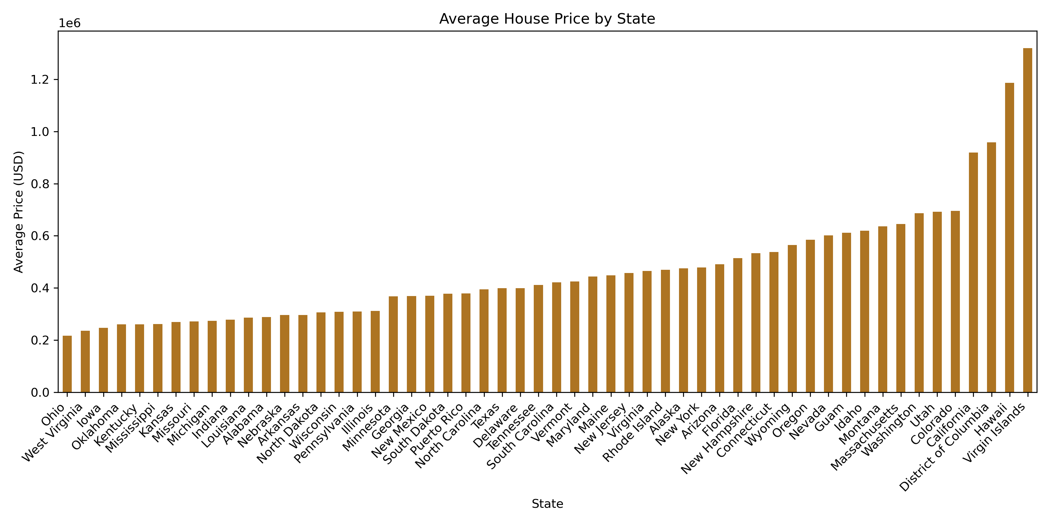
Average Cost per State

Slide 5
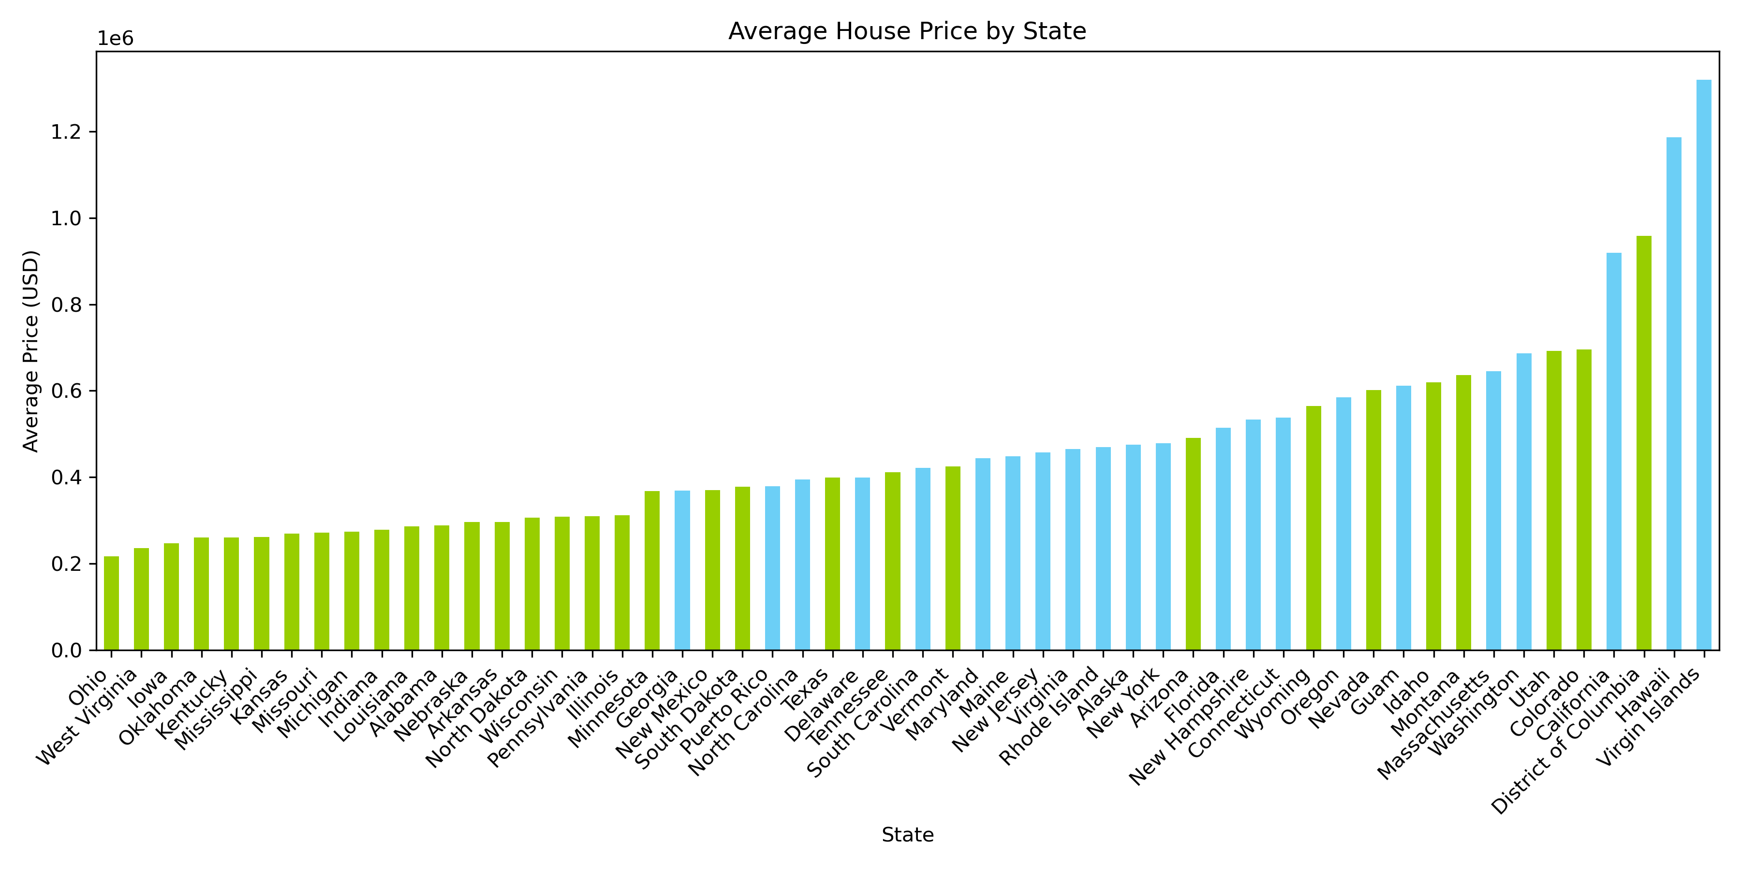
Average Cost per State (Region Overlay)

Slide 6
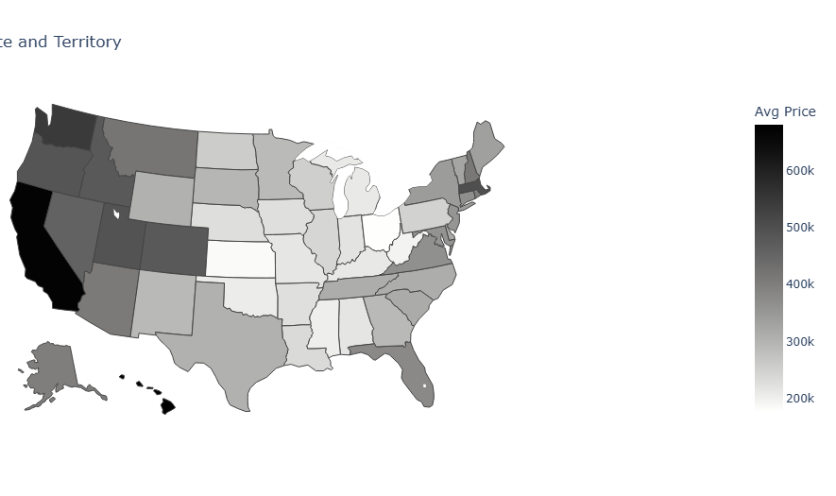
Average Cost per State (GeoSpatial)

Slide 7
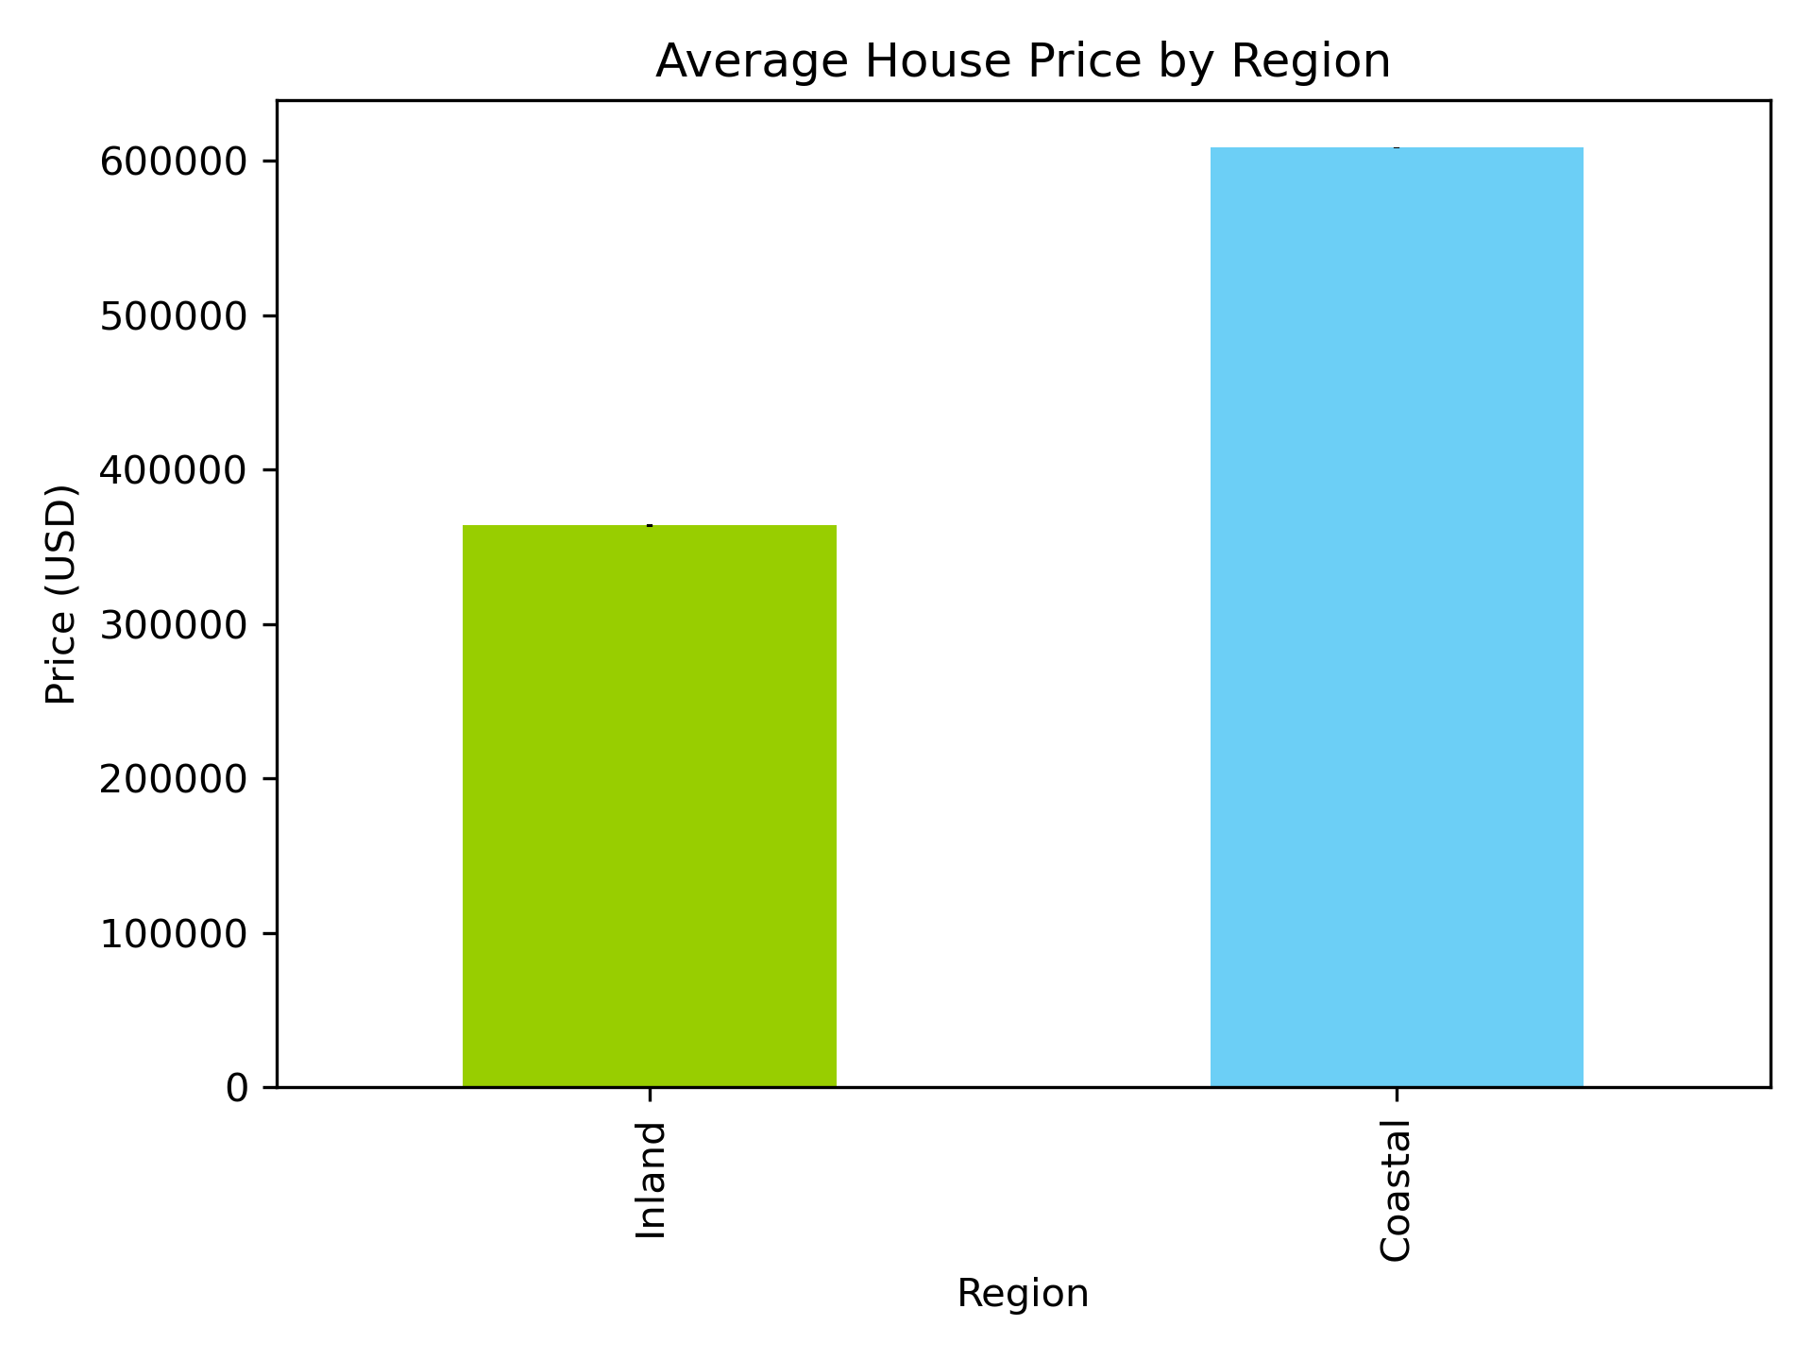
Average Cost Region Versus Coastal
H₀: No difference in prices between coastal states and inland states.
H₁: Coastal states have higher prices.
T-score ≈ 74.85
P ≈ 0.0
F-Stat ≈ 87,773
P ≈ 0.0

Slide 8





Urban Versus Suburbs Versus Suburbs
Urban
Suburbs
Rural
>50,000
<20,000

Slide 9
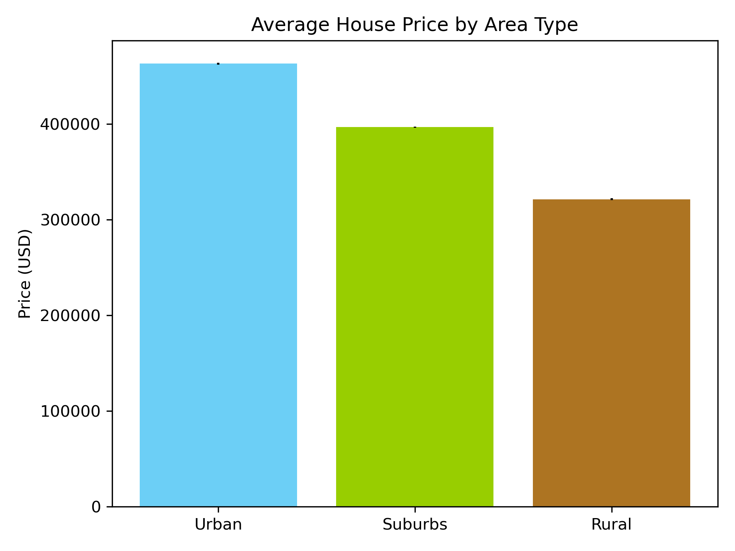
Average Cost per Area Type
H₀: No difference in prices between Urban Houses, Rural Houses, and Suburban Houses.
H₁: Urban Houses have higher prices.
T-score ≈ 38.19
P ≈ 0.0
F-Stat ≈ 5,124
P ≈ 0.0

Slide 10
So What Determines House Price?
House Size?
Bedrooms?
Land?
Location?

Slide 11
Price Categories
$ 300,000
$ 600,000
$ 1,000,000
Affordable
Moderate
Expensive
Luxury
Baseline: 47.41%

Slide 12
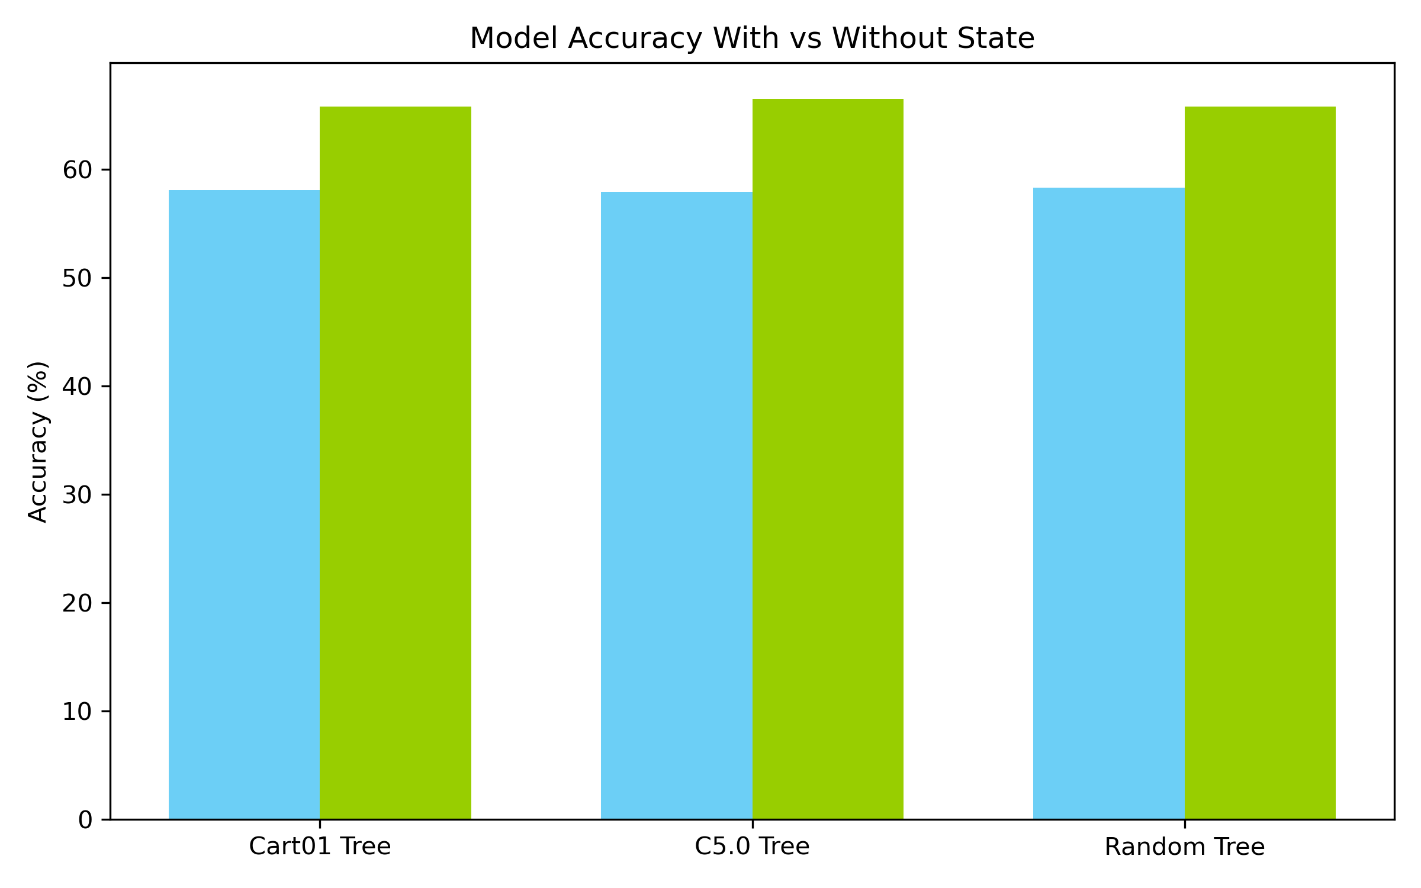
Decision Tree Improvement
H₀: No difference Accuracy when adding state.
H₁: Adding state would increase Accuracy.
65.8%
66.5%
65.8%
58.1%
57.9%
58.3%
T-score ≈ 30.47
P ≈ 0.0
7.7+%
8.6+%
7.5+%
F-Stat ≈ 2.30
P ≈ 0.0
Without State
With State
Without State
With State
Without State
With State

Slide 13




Finding the Right House
Coastal Score
Weighted Score
Tax Score
House Size Score
Bed Score
Acreage Score
Bath Score

Slide 14
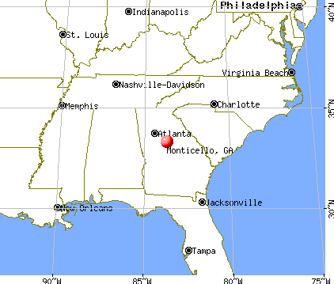
The Best House
Monticello, Georgia (2,833 Pop.)
5 Bed
4 Bath
14.80 Acres
2,313 Square Feet
Predicted Price
Actual Price
>$300,000
$369,000

Slide 15



Location is Important!
Hawaii $$$
Texas $$
Ohio $

Slide 17






Finding the Right House
Coastal Score
Weighted Score
Tax Score
House Size Score
Bed Score
Acreage Score
Bath Score

Slide 18
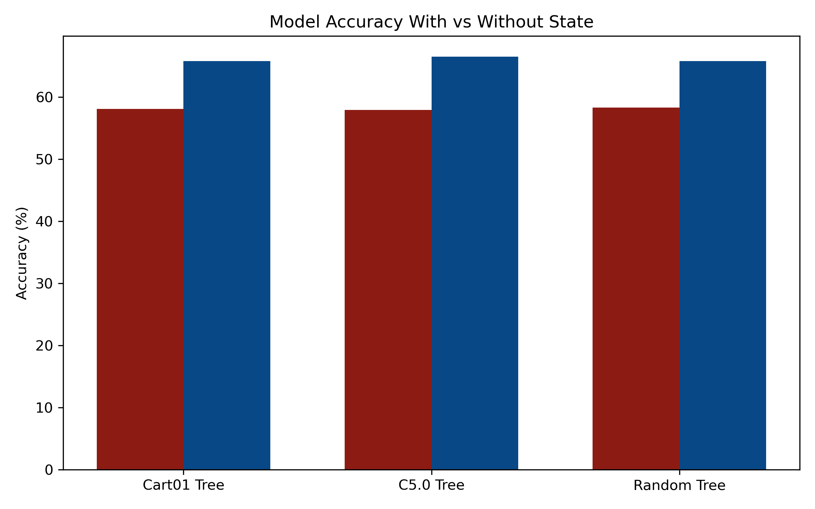
Decision Tree Improvement
H₀: No difference Accuracy when adding state.
H₁: Adding state would increase Accuracy.
65.8%
66.5%
65.8%
58.1%
57.9%
58.3%
T-score ≈ 30.47
P ≈ 0.0
7.7+%
8.6+%
7.5+%
F-Stat ≈ 2.30
P ≈ 0.0
Without State
With State
Without State
With State
Without State
With State

