Slide 1
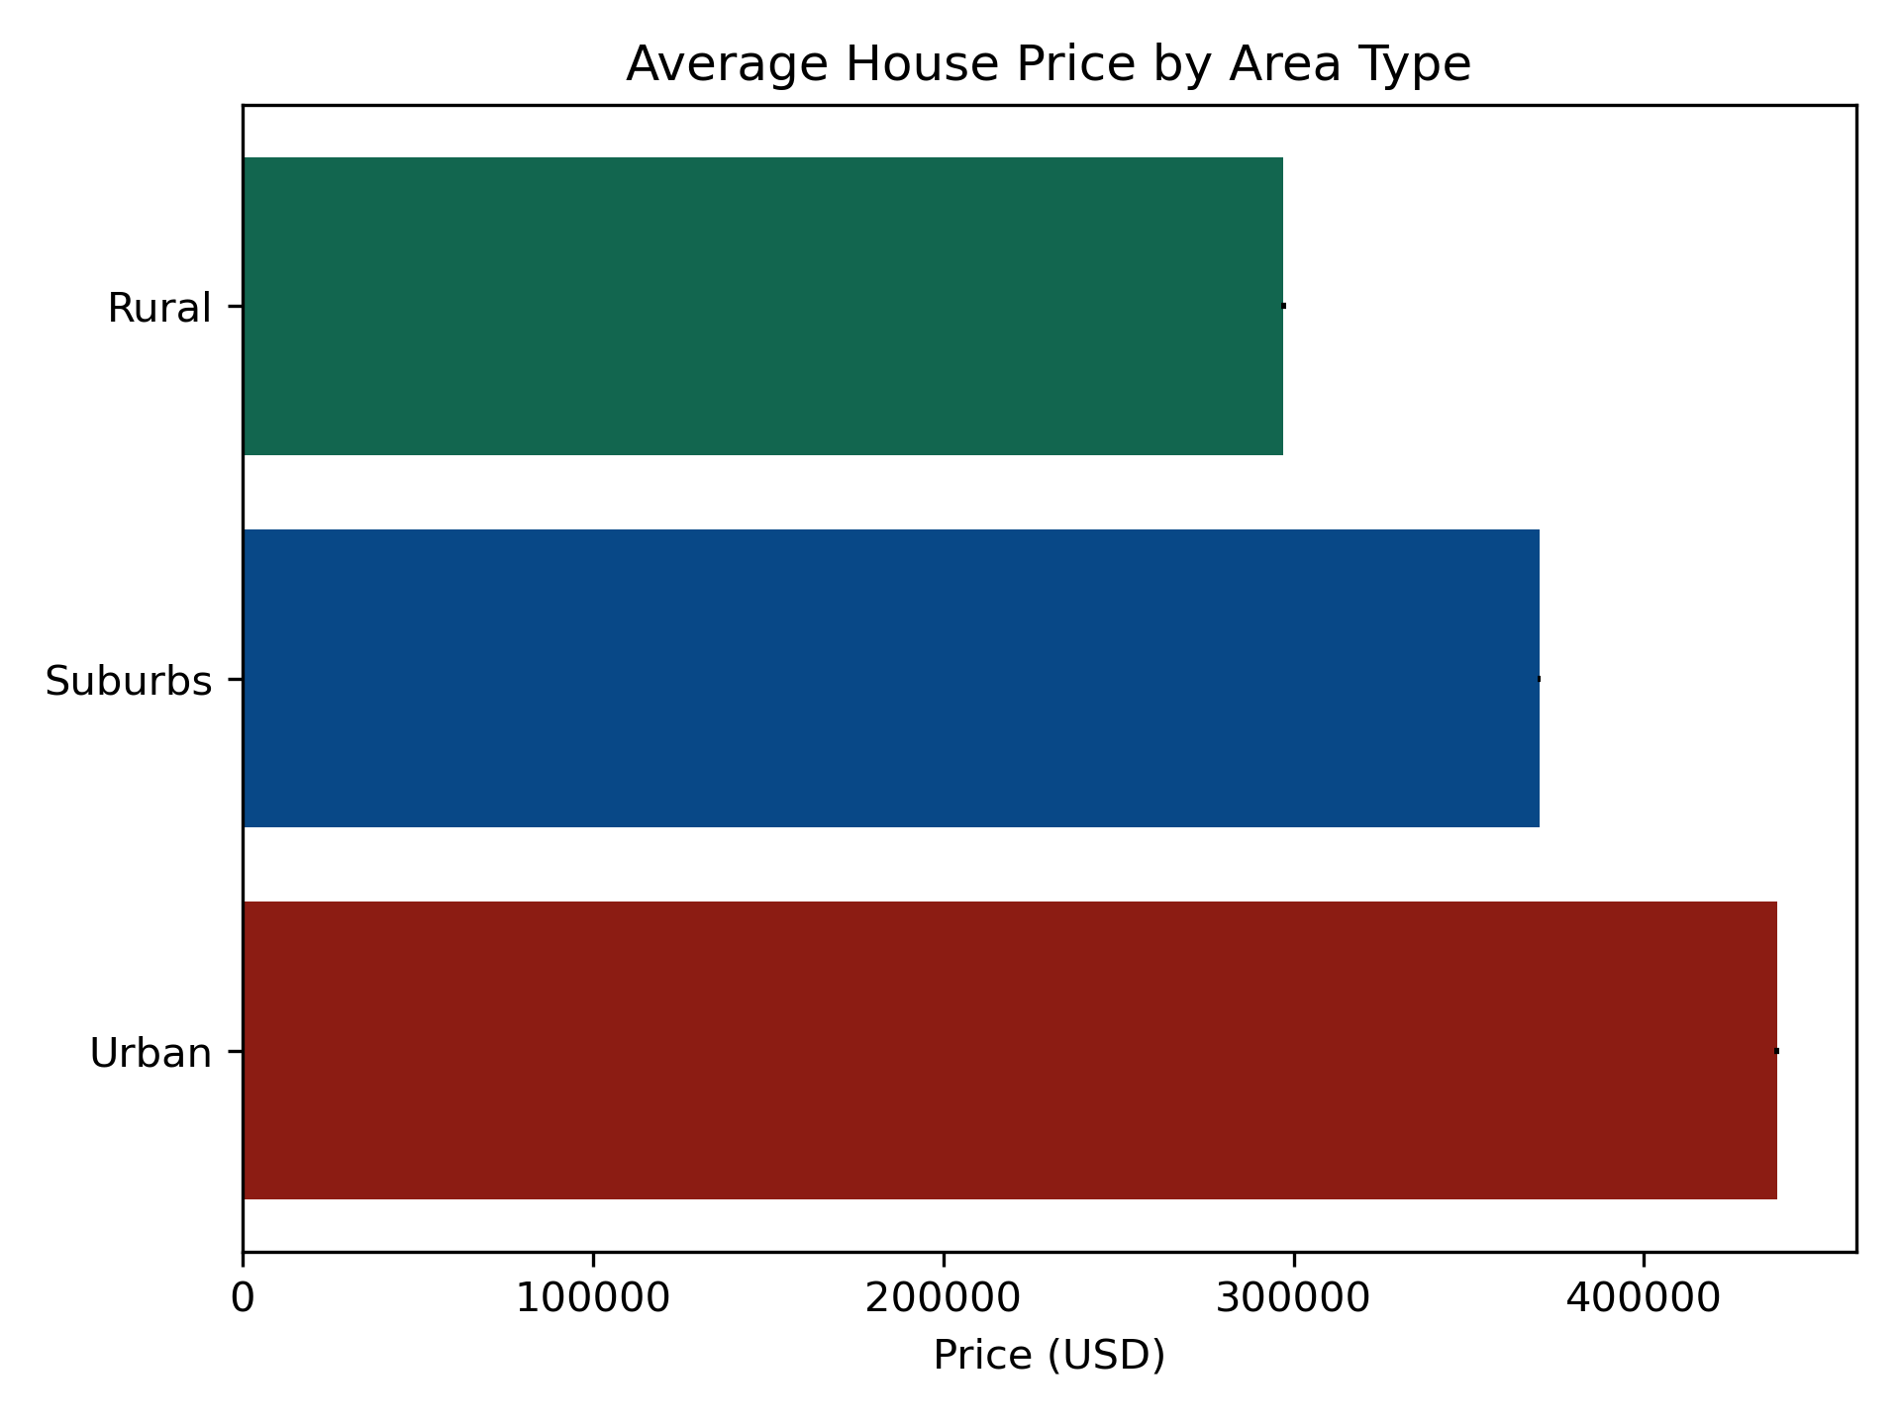
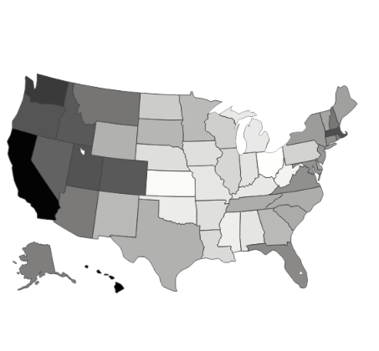
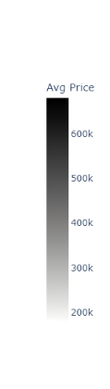
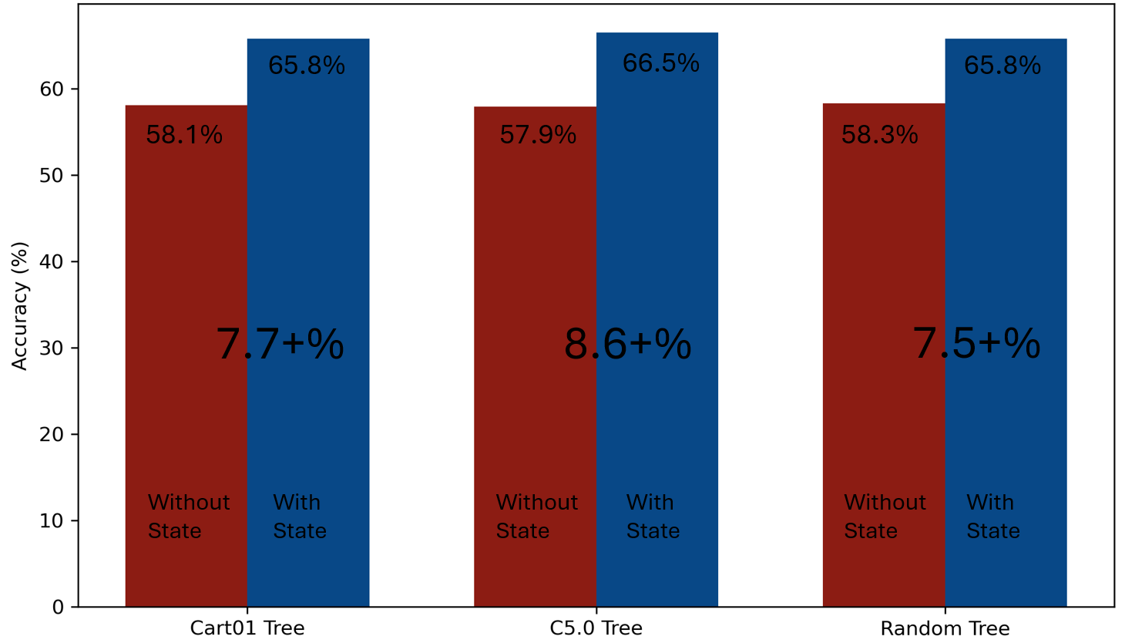
Price Per Region
USA Real Estate Dataset
How Location Effects Prices:
A Data Analysis
v
Price Per Sate
Average Price (USD)
600k
500k
400k
v
300k
Prediction Improvement
200k
Price Range
$ 300,000
$ 600,000
$ 1,000,000
Affordable
Moderate
Expensive
Luxury

