Slide 1
Who we Are?
Ganymede (木卫三又称为“盖尼米德”)
Jet Qin
Max
Frank

Slide 2
What Problem We meet ?
Cannot faster & stendardize user response for all level 1 queries
Reduced efforts for report queries
Continuous learning in Bots will improve the query resolution accuracy using self-learning algorithms
24/7 user support for level one queries
Retenton of complete knowledge within Bot Vs efforts spent of Human knowledge and tanlent retention

Slide 3
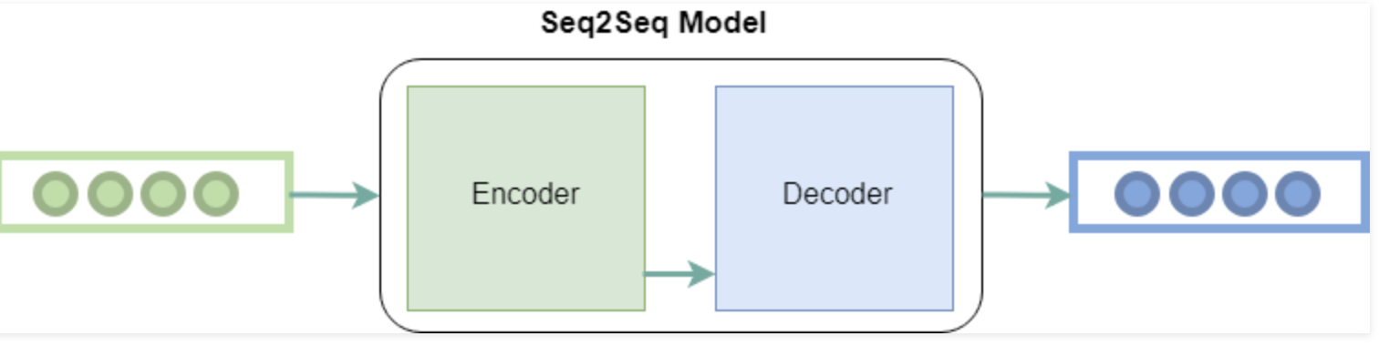
How Do we solve it
1: Convert the question and answer to a vector. eg. Who are you => [ 0.03075174, 0.01077418, 0.04825656, -0.02901061, -0.02860381],
2: We know the exact answer for the question? So we got a formula.
Who are you =>. I am iBot
[ 0.03075174, 0.01077418, 0.04825656, -0.02901061, -0.02860381] => [-0.01487043, 0.03127805, -0.00348612, 0.00670124, 0.03629971]
3: Then we only need to train the model to fit the formula W * X = f(x)
4: Seq2Seq Model encode the question and output the answer.
Improve confidence level from XX% on the date of implenmentation to YY% in 6 month's time

Slide 4
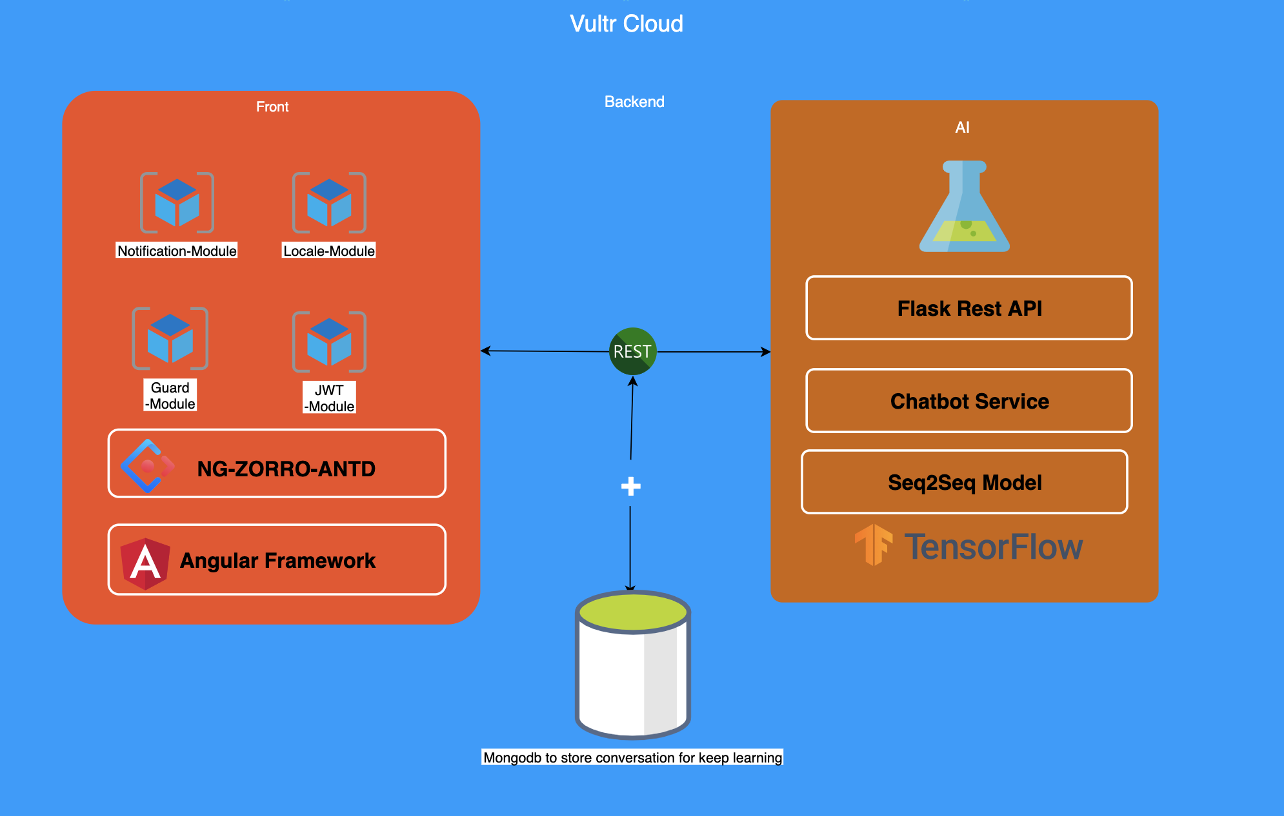
System Architecture

Slide 5
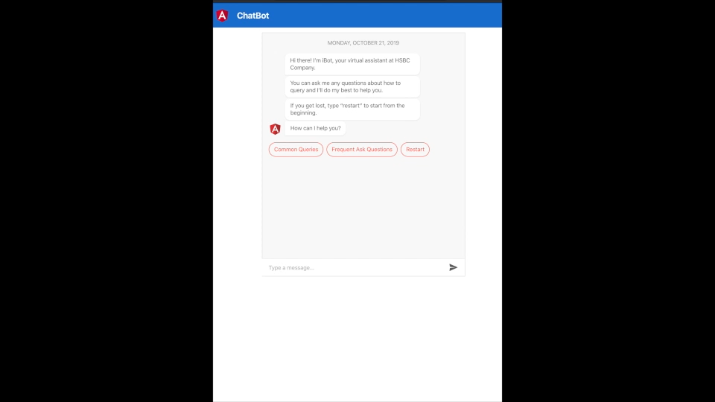
Demo
Try Our service: http://149.28.24.249/
What benefit do we have?
Cost: 5$/month
One-click release
Support 24/7
Keep Learning

