Slide 1
Mercury GENAI SDK

Slide 2
AgenDA
01
SDK Design
02
SDK Implementation
03
SDK Release
04
Demo

Slide 3
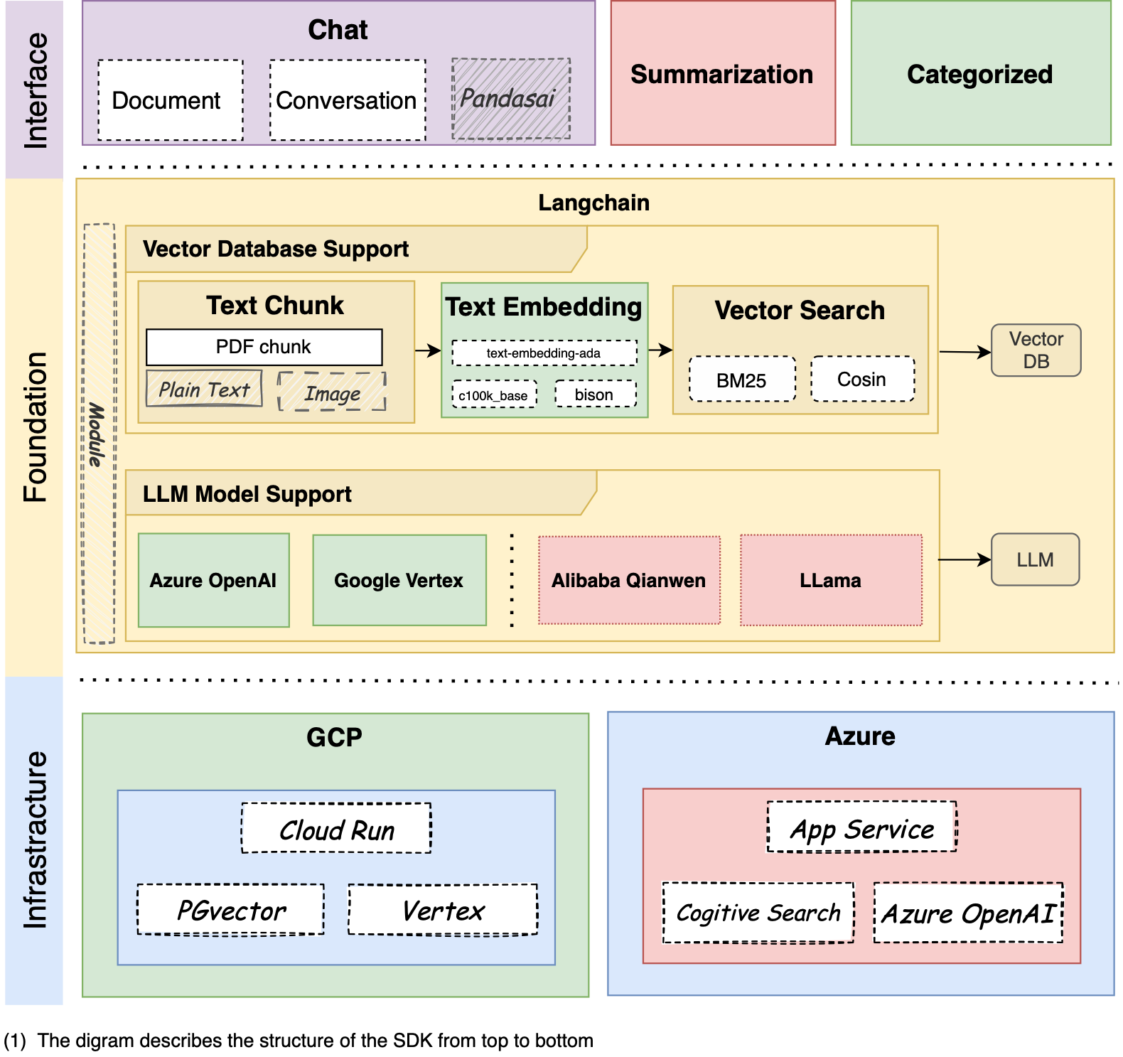
SDK Design
Objectives and capabilities of SDK
RCGENAI is a framework for developing applications powered by language models. You can easily deploy your application to GCP and azure with it
The framework consists of several parts:
Chat
Summarization
Categorized

Slide 4

SDK Implementation
Code Structure
Unit tests

Slide 5
SDK Release
Package tools
Generate documents
Publish package to nexus
Py -m build -w -o dist
Make html
Twine upload

Slide 6
DEMO
DEMO Time

