Slide 1
[Campaign name]
Comms Evaluation
[department name]
[month] [year]
OFFICIAL - SENSITIVE - FOR HMG USE ONLY

Slide 2
[Project name] – at a glance
[Campaign image]
Innovations
Where applicable, include innovative approaches, such as establishing new media partnerships or utilising new technology
KPIs | Baseline: DD MM YY | Target: DD MM YY | Achieved: DD MM YY
KPI one | ??% | ??% | ??%
KPI two | ??% | ??% | ??%
KPI three etc . | ??% | ??% | ??%
Objectives
Campaign objective(s)
Target Audience:
Brief outline of target audience demographics, behaviours, beliefs etc
Policy and wider impact
Brief summary of the campaign impact, how it help to achieve policy objectives, successes and learnings

Slide 3
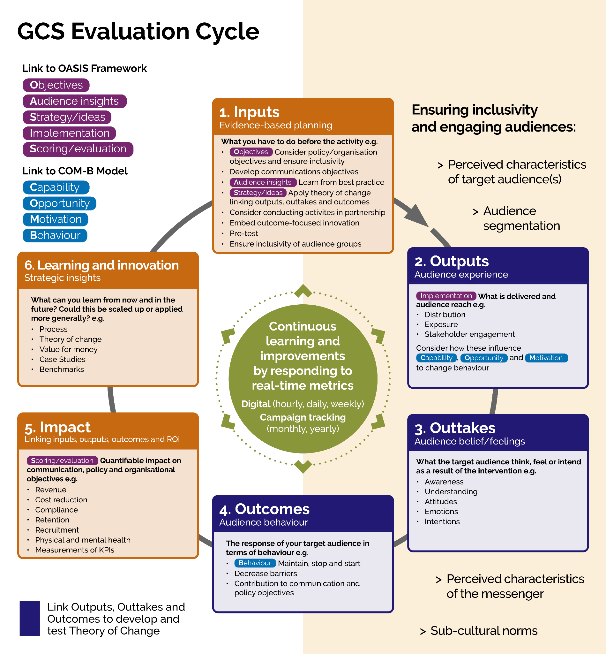
Stages of the Evaluation Cycle
The Evaluation Cycle consists of six stages:
Inputs – what you put in: evidence-based planning and content creation.
Outputs – audience experience: the experience you delivered and created for your audience through the reach of your communications.
Outtakes – audience perceptions: what they think, feel or intend to do because of your communication activities.
Outcomes – audience behaviour: response from and/or behaviour of your audience.
Impact – the organisation and/or policy objectives and KPIs you achieve
Learning and Innovation – what you play forward: the lessons you take forward to improve the current or future communication activities.
Take note of the links to other frameworks:
OASIS – to conduct campaign planning alongside evaluation planning
COM-B – to identify any capability, opportunity, and motivation barriers that your comms can help your target audience overcome
Audience Inclusivity – to tailor communicative strategies for different segments of your target audience based on characteristics, needs and interests
Theory of Change – to consider how your Outputs will lead to your Outtakes, Outcomes, and ultimately Impact in terms of comms and policy objectives
Check out the Evaluation Cycle in full.

Slide 4
1. INPUTS – evidence-based planning
Objectives
Audience Insight
[key insight with figure to support]
…
… add links to full reports as appropriate.
OASIS
OASIS
Problem or behaviour
[Stat]
[Info about the statistic]
[group, e.g. age, gender, location…]
COM-B: Capability, Opportunity & Motivation
Capability: [to fill in, if any] | → | Increase [physical/psychological] capability by …
Opportunity: [to fill in, if any] | → | Increase [social/psychological] opportunity by …
Motivation: [to fill in, if any] | → | Increase [automatic/reflective] motivation by …
Policy objective
[objective]
[Context for objective]
Strategy
Outline the specific actions you took based on your learnings. Define your communication strategy including messaging, channels, and partnerships. Map the audience journey and tailor communication for each stage. Outline all other overarching directions you have taken in terms of content creation, asset testing, partnerships, etc.
OASIS
Comms objective
[objective]
[Context for objective]

Slide 5
2. OUTPUTS – audience experience
Implementation
Add campaign imagery
OASIS
Note overall performance of campaign.
[media type] | List …
[media type] | List …
[Stat] [info about stat] vs [stat] projected | [Stat] [info about stat] vs [stat] projected | [Stat] [info about stat] vs [stat] projected | [Stat] [info about stat] vs [stat] projected
Summarise impact on COM-B principles, as outlined in the previous slide i.e. increased opportunity by doing X, increased motivation through X.

Slide 6
3. OUTTAKES – audience beliefs/feelings
Summarise overall effect on audience beliefs and feelings.
[group, e.g. age, gender, location…]
Awareness and Recognition
[Stat] [info about stat] | [Stat] [info about stat] | [Stat] [info about stat]
Attitudes and Intentions
[Stat] [info about stat] | [Stat] [info about stat] | [Stat] [info about stat]
Claimed behaviours
[Stat] [info about stat] | [Stat] [info about stat] | [Stat] [info about stat]
Add expanded description for any metrics for awareness/recognition, attitudes/intentions, and claimed behaviours.

Slide 7
4. OUTCOMES – audience behaviour
Summarise overall effect on audience behaviour.
[group, e.g. age, gender, location…]
Behavioural barriers addressed | Behaviours started, stopped or maintained
[Capability/Opportunity/Motivation]: How was the barrier addressed? | What behaviour was started, stopped, or maintained? (If this cannot be measured consider how barriers to behaviour change have been addresses)
[Capability/Opportunity/Motivation]: How was the barrier addressed? | What behaviour was started, stopped, or maintained? (If this cannot be measured consider how barriers to behaviour change have been addresses)
Contribution to comms objectives
Outline how the campaign contributed to your comms objectives through addressing audience’s behavioural barriers or changing behaviours.
Contribution to policy objectives
Outline how meeting comms objectives in turn contribute to your policy objectives.

Slide 8
5. IMPACT – linking stages together
Outputs Short summary | → | Outtakes Short summary | → | Outcomes Short summary
Scoring/Evaluation
Return on Investment (ROI)
Summarise investment (cost), return (benefit) and ROI calculation.
Also consider intangible social costs and benefits.
OASIS
KPIs (at end of comms) | Target | Achieved
KPI one | ??% | ??%
KPI two | ??% | ??%
KPI three etc . | ??% | ??%
Policy and Wider Impacts
Outline impact on policy work and organisational objectives as well as any wider considerations.
Outline how achieving or not achieving the KPIs has helped with or impeded the progress of reaching the comms and policy objectives. Add links to full reports as appropriate.

Slide 9


6. LEARNING & INNOVATION – strategic insight
INSIGHT
INNOVATION or LESSON LEARNT
State what worked well and what worked not so well.
For 10% innovation that worked well, outline how to embrace it in future comms, scale up or down.
Replace the tick and cross icons accordingly…
For things that didn’t work well or worked better than expected, outline any lessons learnt.
Or feel free to replace with other icons where you see fit.
Also outline possible ways to tweak your approach.
What else can we do better or differently in the future?
State other difficulties you have encountered during your comms and what lessons you can thus take.
Note down any aspects of your comms that the current evaluation could not investigate and thus warrant further exploration in future evaluations.

Slide 10
For more information:
[representative]
[email]
[representative]
[email]
GCS Applied Data and Insight Team
adi@cabinetoffice.gov.uk
[month] [year]
OFFICIAL - SENSITIVE - FOR HMG USE ONLY

