Slide 1
[Low/no-cost comms name]
[Wave/time period]
Comms Evaluation
[department name]
Evaluation published in [month] [year]
OFFICIAL - SENSITIVE - FOR HMG USE ONLY

Slide 2
[Project name] – at a glance
[Comms image or post screenshot]
Comms Approach
Summarise the use of low/no-cost comms approach. Where applicable, include innovative approaches, such as utilising new technology.
Targets (averages over time) | Benchmark: DD MM YY | Target: DD MM YY | Achieved: DD MM YY
Target one | ?? | ?? | ??
Target two | ?? | ?? | ??
Target three, etc . | ?? | ?? | ??
Objectives
Comms objective(s)
Target Audience:
Brief outline of target audience demographics, behaviours, beliefs etc
Policy and wider impact
Brief summary of the comms impact. Include anecdotal description or other qualitative evidence if applicable.

Slide 3
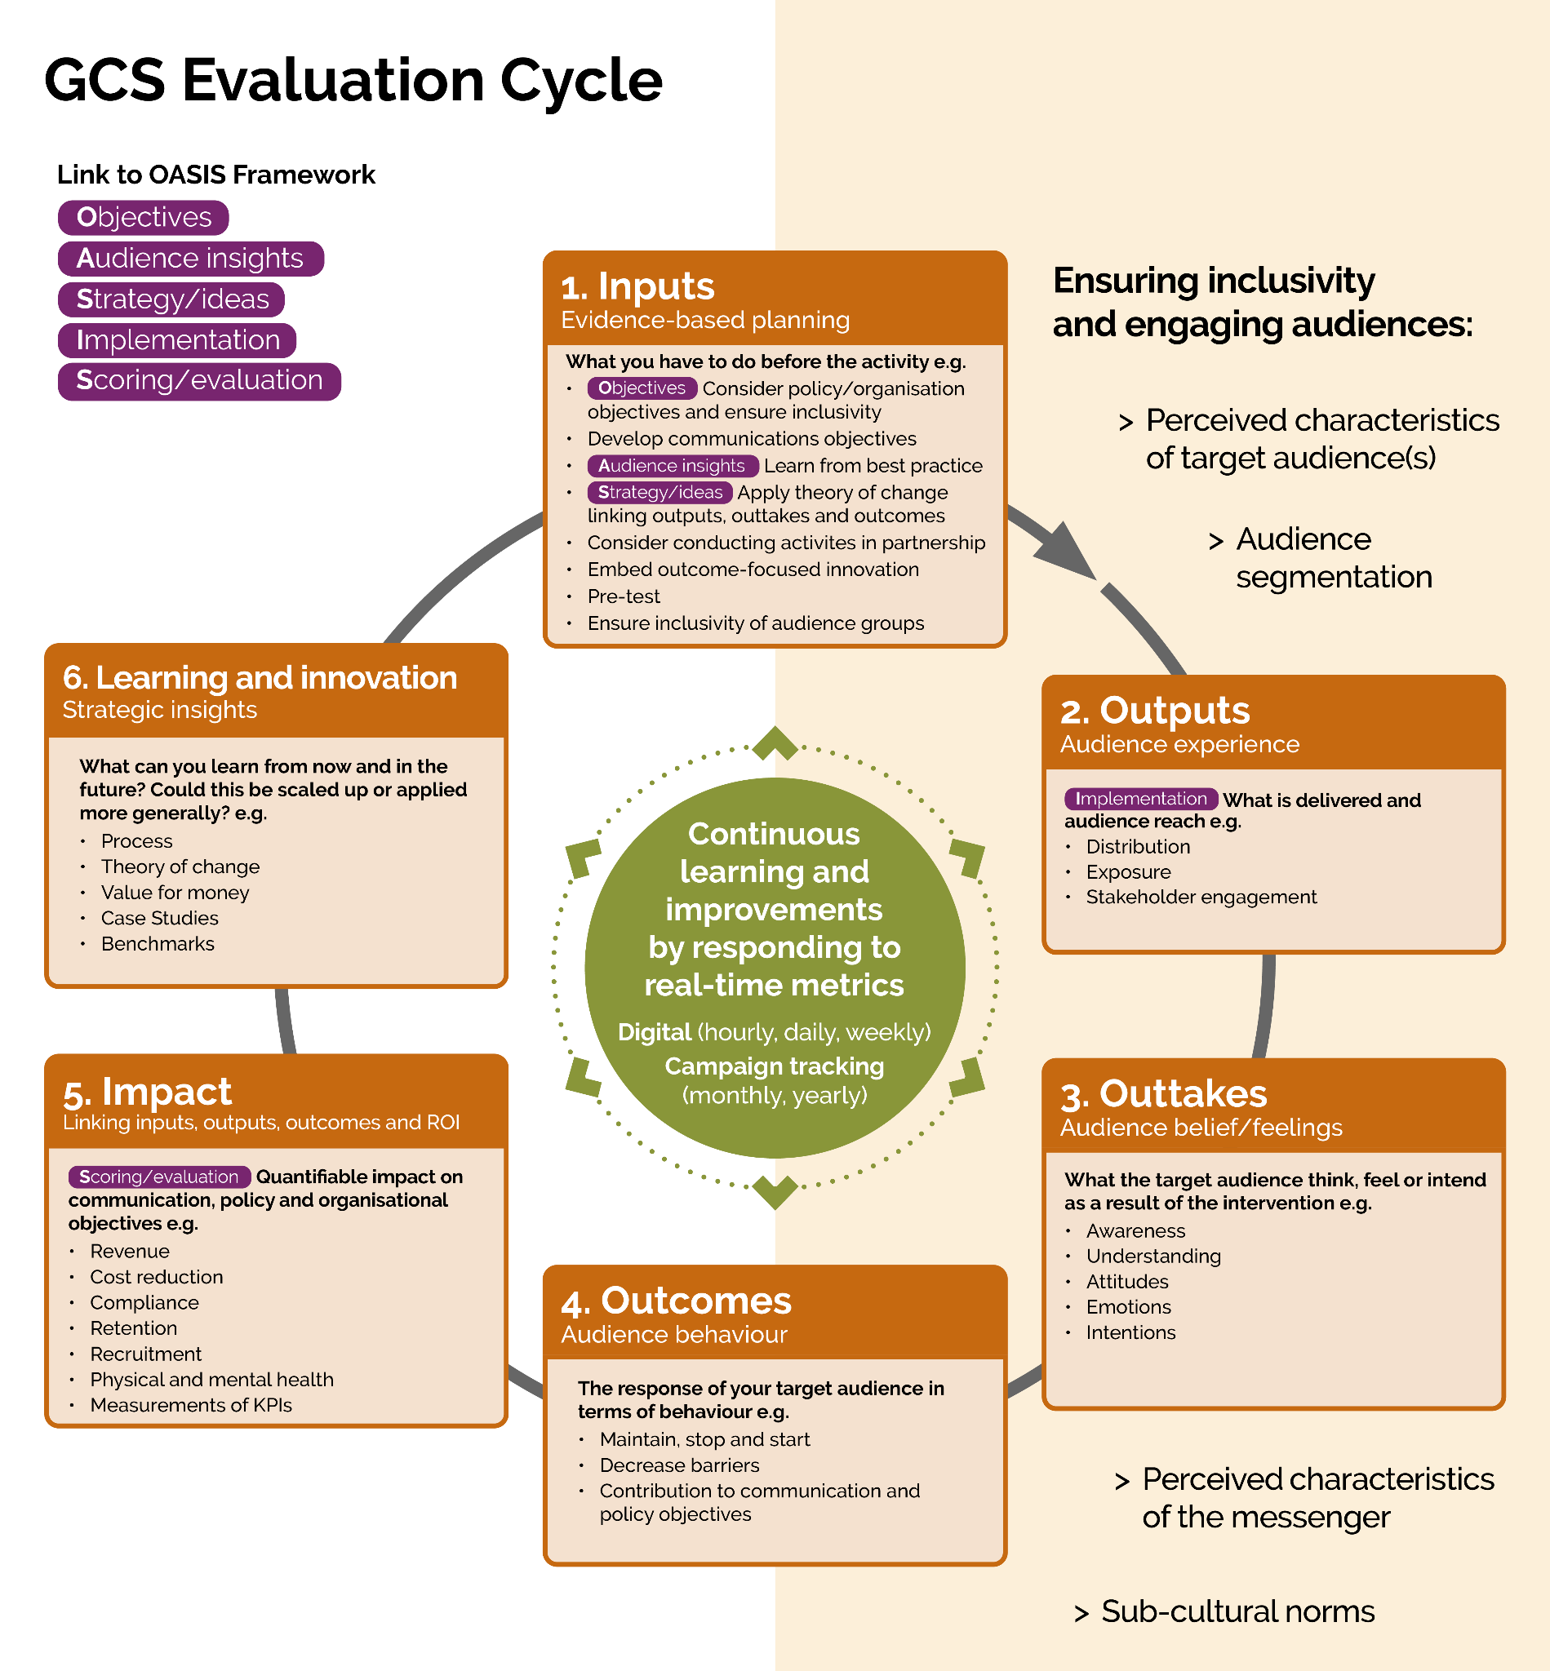
Stages of the Evaluation Cycle
The Evaluation Cycle consists of six stages:
Inputs – what you put in: evidence-based planning and content creation.
Outputs – audience experience: the experience you delivered and created for your audience through the reach of your communications.
Outtakes – audience perceptions: what they think, feel or intend to do because of your communication activities.
Outcomes – audience behaviour: response from and/or behaviour of your audience.
Impact – the organisation and/or policy objectives and KPIs you achieve
Learning and Innovation – what you play forward: the lessons you take forward to improve the current or future communication activities.
Take note of the links to other frameworks:
OASIS – conduct comms planning alongside evaluation planning
Audience Behaviour – consider how your comms can lead to changes in audience feelings and beliefs, then behaviours (read more about COM-B behaviour barriers)
Audience Inclusivity – tailor communicative strategies for different segments of your target audience based on characteristics, needs and interests
Link to Policy Objectives – evaluate whether comms effort support and advance policy goals, with insights benefitting future strategic planning.
Check out the Evaluation Cycle in full.

Slide 4
1. INPUTS – evidence-based planning
Objectives
Audience Insight
[key insight with figures to support]
Try breaking down your audience further by demographics, geographics, behavioural traits, values, lifestyles, technographics, etc.
… add links to full reports as appropriate.
OASIS
OASIS
Problem
[Stat]
[Info about the statistic]
[group, e.g. age, gender, location…]
Policy/org/marketing objective
[Objective(s)]
[Context]
How audience insight has informed your strategy
Key messages to deliver: Outline succinctly what the key messages are and how they might differ for different target audiences.
Channel and Strategy: State what channel(s) you will use for you audience(s) and what insights underpin your content creation.
Expected attitude/behaviour: Consider using COM-B principles to outline what awareness, attitudinal or behavioural barriers your comms will help overcome.
OASIS
Comms objectives
[Objective(s)]
[Context]

Slide 5
2. OUTPUTS
Summary of what was delivered
How successfully your communication activity reached your target audience
[Comms imagery, post screenshots, messaging used, engagement/event photos etc…]

Slide 6
2. OUTPUTS, 3. OUTTAKES and Continuous Learning
Activity
Output
Outtake
Learning
State what you have done at each stage or wave of comms activity. | → | E.g. audience reach, impressions, exposure etc. Metrics should correspond to the key messages and channels outlined on the INPUT slide. | → | Outline observed attitudinal or intention changes due to this output, e.g:, Audience’s awareness and recognition Audience’s attitudes and intentions Stakeholder/press’s response and sentiments | → | What have you learnt? What improvements will you next implement? (Here, for example, the learnings from Wave 1 should already be applied in Wave 2.)
Wave 1: 15 Jan Launched “Fuel Your Future” out-of-home comms targeting under-18s pupils | → | 78,500 impressions with a reach of 19,600 unique viewers for posters at 7 train stations and 45 bus shelters near schools. | → | 36% of target audience aware. Those who are aware mentioned feeling “told off” for not being healthier and think advice to exercise 60 minutes per day is “prescriptive”. | → | Government as messenger might have created a hierarchy with students, making messages “hard to stomach”. Awareness is low for out-of-home comms. Influencers may be a more suitable messenger and social media would be a better channel.
Wave 2: 17 - 31 Jul 3 Instagram reels advice led by 3 lifestyle influencers. New tagline tweaked “Fuel Your New School Year”. | → | 420,000 impressions with a reach of 125,000 unique views Average 140,000 impressions and 41,700 users per reel. | → | 15% view through rate. 61% of comments were positive – comments mentioned “feeling part of a movement” when joining influencers. Some want more advice on meat substitutes like non-meat burgers. | → | Audience more positive about message from influencers compared to previous government led advice. Next comms wave will include directing viewers to website that responds to queries specific to different dietary requirements.

Slide 7
4. OUTCOMES, 5. IMPACT
Outputs Short summary | → | Outtakes Short summary | → | Outcomes Short summary of how Outputs and Outtakes have influenced Outcomes
Scoring/Evaluation
Outcomes
(barriers to behaviour change reduced / behaviour change observed)
Consider how barriers to behaviour change have been reduced.
If possible, also highlight what actual behaviour change you have observed.
Discuss any contextual factors (events, seasons effects, etc.) that may influence outcomes.
See a worked example of COM-B in the low/no-cost evaluation guidance.
OASIS
Metric description (averages over time) | Target or benchmark | Achieved
Metric one | ??% | ??%
Metric two | ??% | ??%
Metric three etc. . | ??% | ??%
Impact on Comms and Policy Objectives
Outline how this comms might have:
Contributed to your comms objectives through addressing audience awareness, attitudes and/or behavioural barriers or changing behaviours
Supported delivery of a specific policy
Served as the backdrop/branding or built reputation to enable the success of a wider campaign
Contributed to any wider organisational aspirations
Consider money spent vs outcomes reached.
Outline how achieving or not achieving the targets or KPIs has helped with or impeded the progress of reaching the comms and policy objectives. Add links to full reports as appropriate.

Slide 8


6. LEARNING & INNOVATION – strategic insight
INSIGHT
LESSON LEARNT
State what worked well and what worked not so well.
What worked well, outline how to embrace it in future comms, scale up or down.
Replace the tick and cross icons accordingly…
For things that didn’t work well or worked better than expected, outline any lessons learnt.
Or feel free to replace with other icons where you see fit.
Also outline possible ways to tweak your approach in the future. Try include details of any pilots or experiments that you will be running.
Have you conducted any experiments or trials to test your innovation?
What else can you do better or differently in the future?
State other difficulties you have encountered during your comms and what lessons you can thus take.
Suggest who or comms of what nature can benefit from these lessons learnt.
Note down any aspects of your comms that the current evaluation could not investigate and thus warrant further exploration in future evaluations.

Slide 9
For more information:
[representative]
[email]
[representative]
[email]
GCS Applied Data and Insight Team
iandeteam@cabinetoffice.gov.uk
[month] [year]
OFFICIAL - SENSITIVE - FOR HMG USE ONLY

