Slide 1


G.H. Patel College
Of
Engineering & Technology
Subject Name: Project-II
Subject code : 2180706
Guided by: Prof. Khayti Mehta
Presented BY: Jetal Chaudhari [150110107022]

Slide 2
Project Title:
Ideal Time to Book a Flight

Slide 3
Content:
Introduction
  Description
Literature Review
Plan of work
Flow diagram with Implementation
Future plan & Limitation
References

Slide 4
Introduction

Slide 5
Description:
Flight prices changes constantly, so purchasing at difference times could give large differences in price. Using data mining and machine learning techniques this project could predict the price of flight considering its different properties and state whether customer should book his/her flight or wait for reduction in price.
Due to high complexity of the pricing models applied by the airlines, it is very difficult to a customer to purchase an air ticket in the lowest price, since the price changes dynamically.
For this reason, several techniques are able to provide the right time to the customer to purchase an air ticket by predicting the airfare price.

Slide 6
Focusing Area:
Airlines
Who is the user
  Business people
  Traveling people
System predict the price of particular flight

Slide 7
Literature Review
I have Referred 4 research paper mentioned below,
  Airfare analysis and prediction using data mining and machine learning
  When to book: predicting flight pricing, Stanford university
  Airfare Prices prediction using machine learning techniques
  Predicting Airfare Prices by Manolis Papadakis

Slide 8
Research Paper | Published under | Model |  | Accuracy
Airfare analysis and prediction using data mining and machine learning | International Journal of Engineering Science Invention | Support Vector Machine (Classification) |  | 83.97%
 |  | Naïve Bayes (Classification) |  | 84.01%
When to book: predicting flight pricing | Stanford university | training and test set | SVM | 98.2% | 94.1%
 |  |  | Random Forest (n=18) | 99.3% | 95.2%
 |  | test set pos/neg accuracies | kNN (k=3) | 90.2% | 92.0%
 |  |  | Random Forest (n=18) | 93.1% | 95.6%
Airfare Prices prediction using machine learning techniques | 25th European signal processing conference under the IEEE. | Random Forest Regression Tree |  | 85.91
 |  | Bagging Regression Tree |  | 87.42
Predicting Airfare Prices by Manolis Papadakis | - | Ripple Down Rule Learner |  | 74.5%

Slide 9
Plan of work:
My Work is divided in to three part,
  Data Collection
  Data Preparation
  Build Model

Slide 10
Flow diagram with Implementation

Slide 11
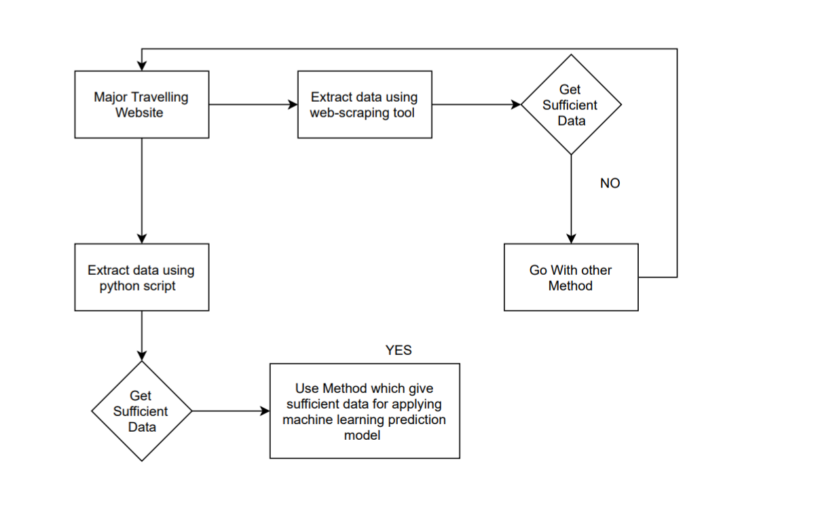
Flow of data collection

Slide 12
Web Scrapping Tool
Web Scrapping Tool [method 1]:
    Dexi.io(known as CloudScrape)
    WebHose.io
    Import.io
Python Script [method 2]
Here I collected data from above mentioned methods
Raw data collected from python script are in use of this project

Slide 13
For Working on my flow ,
I used dexi.io known as cloud Scrape(one method),
  Which supports data collection from any website and require no download.
  It provide browser-based editor to set up crawlers and extract data in real-time.
  We can save the collected data on cloud platforms like google drive and box.net or export as CSV or JSON.
To collecting data of flight with its price.
The website I used is makemytrip.com

Slide 14
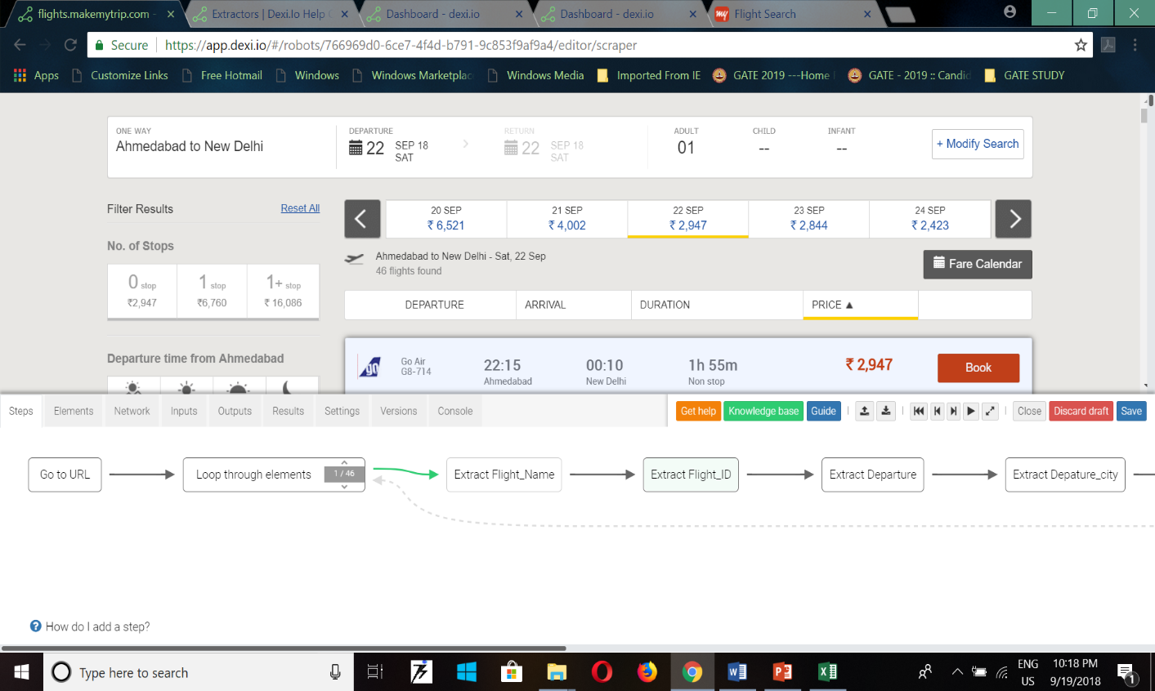
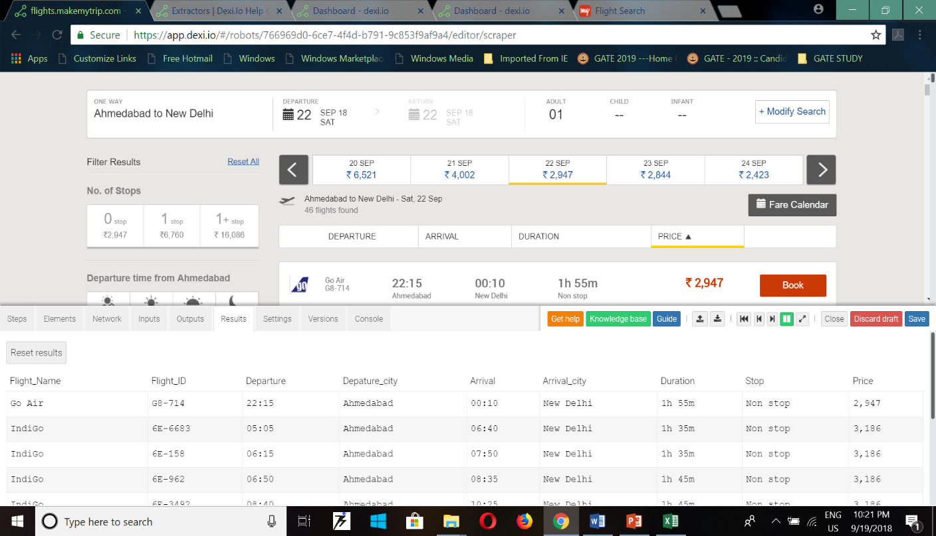

Slide 15
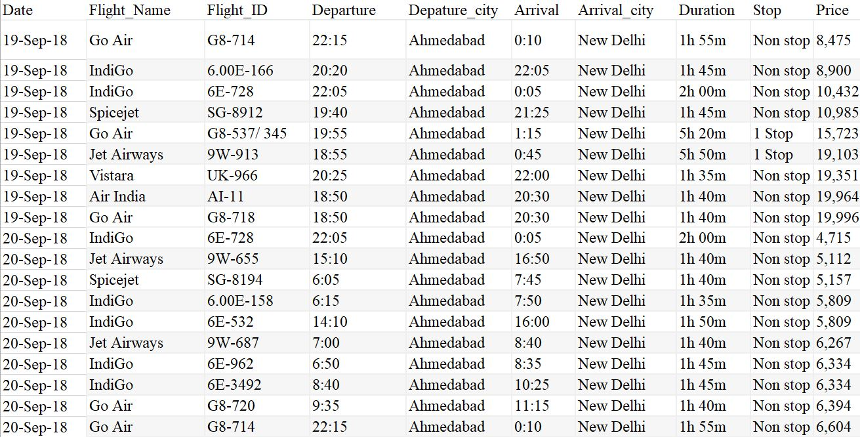
This is the snapshot of data which I collected from the makemytrip.com using dexi.io tool

Slide 16
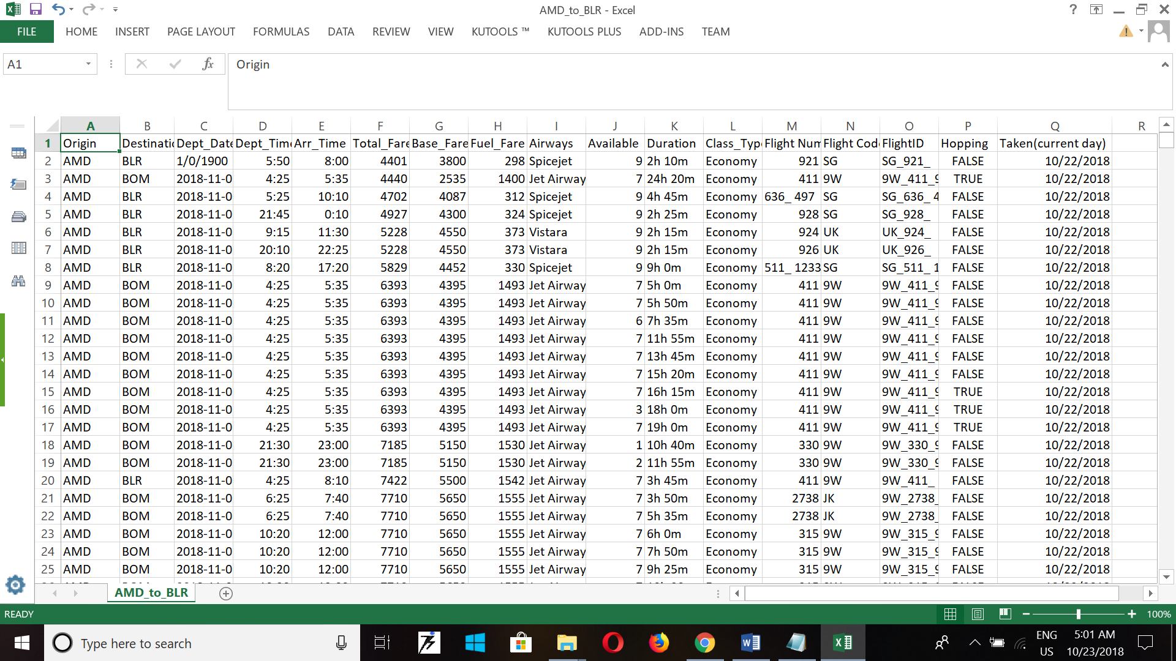
Python script[second method],
import urllib
from urllib.request import urlopen
BASE_URL=http://flights.makemytrip.com/makemytrip/

Slide 17
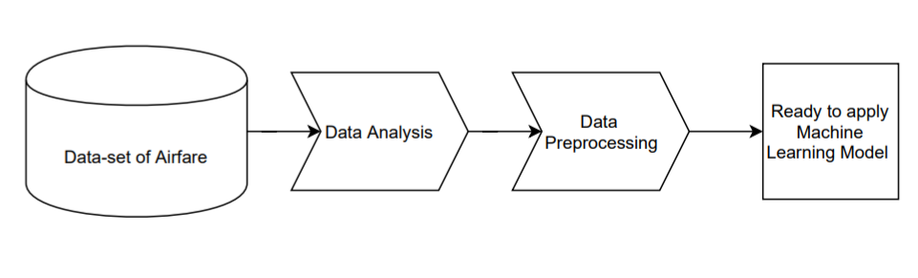
Flow of data preparation

Slide 18
Info about Collected Data:
  Duration of 6 month- Nov’18 to April’19
  Total 10173 values
  No. of Attribute-17
Attributes of this data-set,
  Origin
  Destination
  Dept_time,
  dept_date,
  Arr_time,
  Total_fare,
  Base_fare,
  Fuel_fare
  Airways,
  class type
  Available, flight_num, flight_id, flight_code
  Duration, Hopping, Token

Slide 19
Is this attribute is similar to standard data-set or attribute is match to the referred research paper?
Below Attribute are similar to the referred research paper,
Dept_time
Arr_Time
Total_Fare
Base_Fare
Fuel_Fare
Available
Duration
Current day

Slide 20
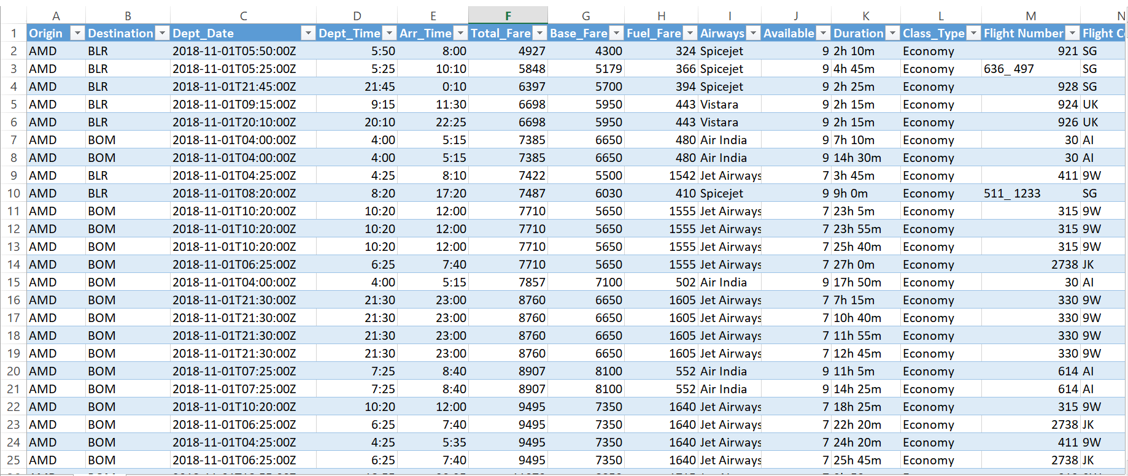
Data-Set
Data-set use for this project is display below,

Slide 21
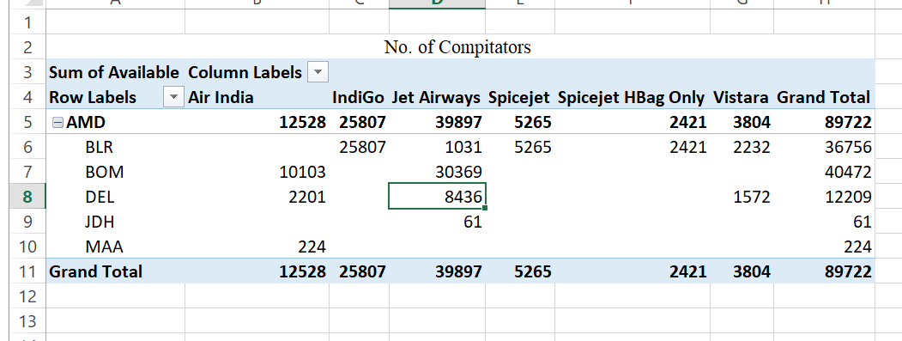
Quick Analysis, pivot table

Slide 22
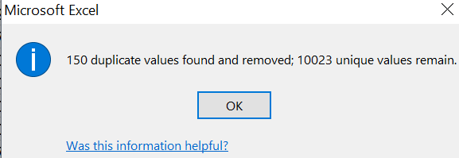
Data-Cleaning
There is duplicate data in created data-set which need to be removed,
For it I use Microsoft excel to remove and delete the duplicate data
There is 150 duplicate values in 10173 values, after removing it 10023 unique values are remain.

Slide 23
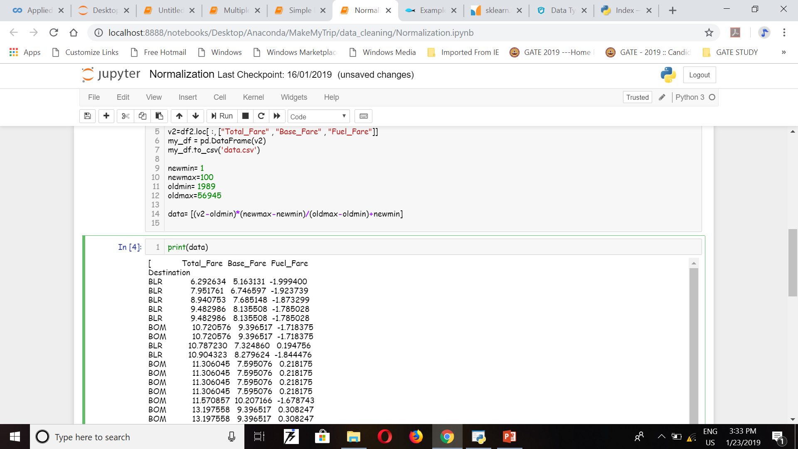
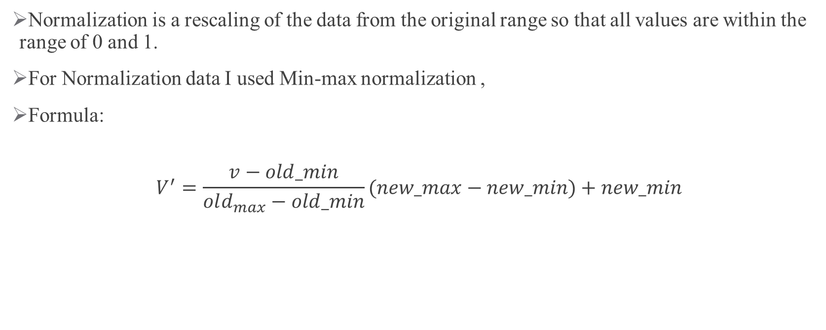
Data-Normalization
Normalization is a rescaling of the data from the original range so that all values are within the range of 0 and 1.
For Normalization data I used Min-max normalization ,
Formula:
$$V^{′}=\frac{v−old_min}{old_{max}−old_min}(new_max−new_min)+new_min$$

Slide 24
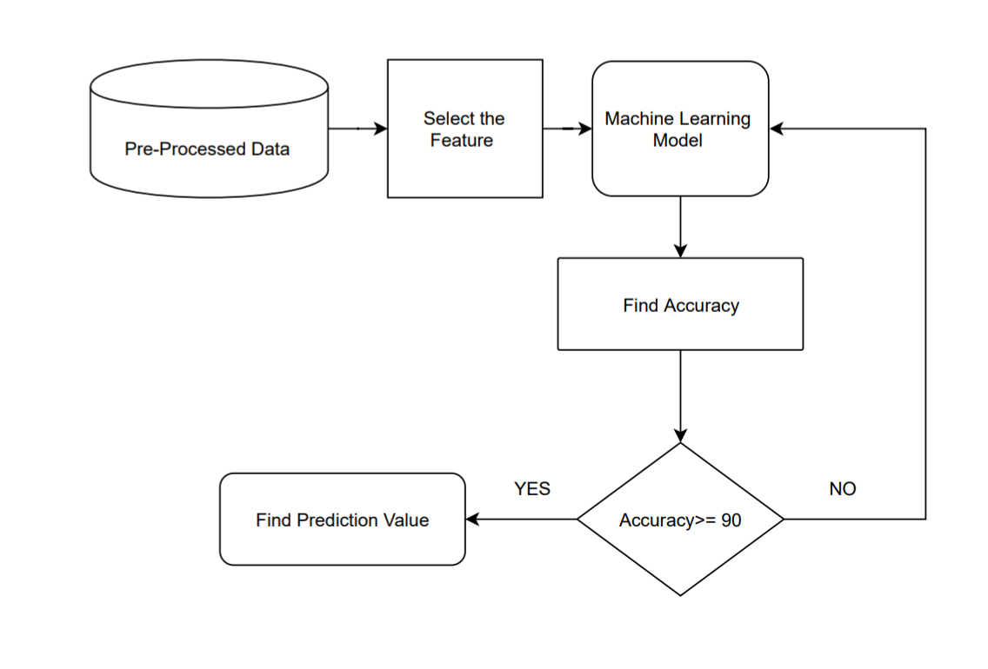
Flow of how to find prediction value

Slide 25
Model Selection
Machine Learning Algorithms;
    Simple Linear Regression
    Multiple Linear Regression.
    KNN
    Support Vector Machine
    Random Forest

Slide 26
Model Name | Accuracy
Multiple Linear Regression | 99.98
KNN(N=6) | 99.80
SVM | 25.05
Random Forest | 99.80

Slide 27
Linear Regression model & Multiple Regression Model:
In simple linear regression,
we predict value on one variable from the value on a second variable.
The variable we are predicting is called the criterion variable and is referred to as Y.
The variable we are basing our predictions on is called the predictor variable and is referred to as X.
When there is only one predictor variable, the prediction method is called simple regression.
Linear regression consists of finding the best-fitting straight line through the points. The best-fitting line is called a regression line.

Slide 28

The formula for a regression line is
${y=b}_{0}+b_{1}x$
Pseudo code,
from sklearn.model_selection import train_test_split as split
import sklearn.linear_model as linear
x=value,y=value
reg=linear.LinearRegression()
reg.fit(x,y)
y_pred=reg.predict(x)

Slide 29
Random Forest
Random Forest is a popular supervised ensemble learning algorithm.
it takes a bunch of ‘weak learners’ and has them work together to form one strong predictor.
In this case, the weak learners are all randomly implemented decision trees that are brought together to form the strong predictor — a random forest.
Pseudo code,
    from sklearn.ensemble import RandomForestClassifier
    classifier=RandomForestClassifier()
    classifier=classifier.fit(x, y)
    predicted=classifier.predict(x)

Slide 30
Future Plan & Limitation:
Future Plan
  Solving variation
  A GUI or Webpage will be made
Limitation
  Restriction on collecting data
  Difficult to deal with real time data

Slide 31
References
Bhavuk Chawla, Ms. Chandandeep Kaur; Airfare Analysis and prediction using data mining and machine learning[J]//International journal of engineering Science Invention. ISSN(online):2319-6734,www.ijesi.org ||volume 6 Issue 11 ||November 2017 ||PP.10-17
K.Tziridis, Th. Kalampokas, G.A. Papakostas, K.I. Diamantaras; Airfare Prices Prediction using machine learning techniques[C]//2017 25th European Signal Processing Conference(EUSIPCO) under IEEE
Manalis Papadakis; Predicting Airfare Prices, 2014
Qiqi ren: when to book: Predicting Flight Pricing; Stanford university

Slide 32
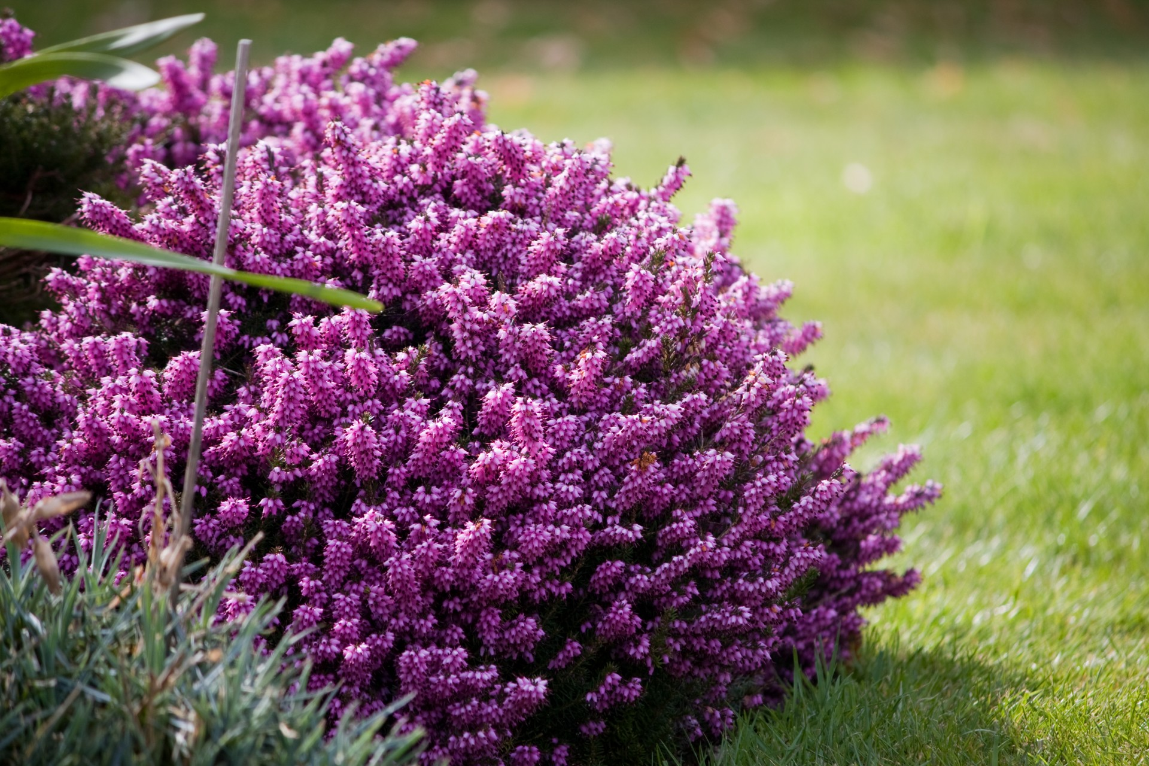
Thank You

