Slide 1
Loan Prediction Project
A Machine Learning Approach to Predict Loan Approval

Slide 2
Introduction
This project aims to predict loan approval based on applicant details. Using machine learning, we analyze key features affecting approval and optimize model performance.
Loan prediction plays a vital role in the banking sector by determining a customer's eligibility for loans.
Challenges in loan approval include:
Risk of default
Accurate creditworthiness assessment
Balancing customer trust and financial security
Machine Learning models can automate and improve decision-making by learning from historical data.

Slide 3
Dataset Description
The dataset consists of 13 columns:
1. Loan_ID: Unique ID
2. Gender: Male/Female
3. Married: Marital status (Y/N)
4. Dependents: Number of dependents
5. Education: Graduate/Undergraduate
6. Self_Employed: Y/N
7. ApplicantIncome: Applicant's income
8. CoapplicantIncome: Co-applicant's income
9. LoanAmount: Loan amount
10. Loan_Amount_Term: Loan term in months
11. Credit_History: Credit history meets guidelines
12. Property_Area: Urban/Semi-Urban/Rural
13. Loan_Status: Loan approved (Y/N)

Slide 4
Data Preprocessing
To ensure high-quality data for model training, performed this following steps:
Handling Missing Values:
Numerical columns filled with mean values
Categorical columns filled with mode values
Encoding Categorical Variables:
Used Label Encoding for categorical features
Feature Scaling:
Standardized numerical features using StandardScaler.

Slide 5
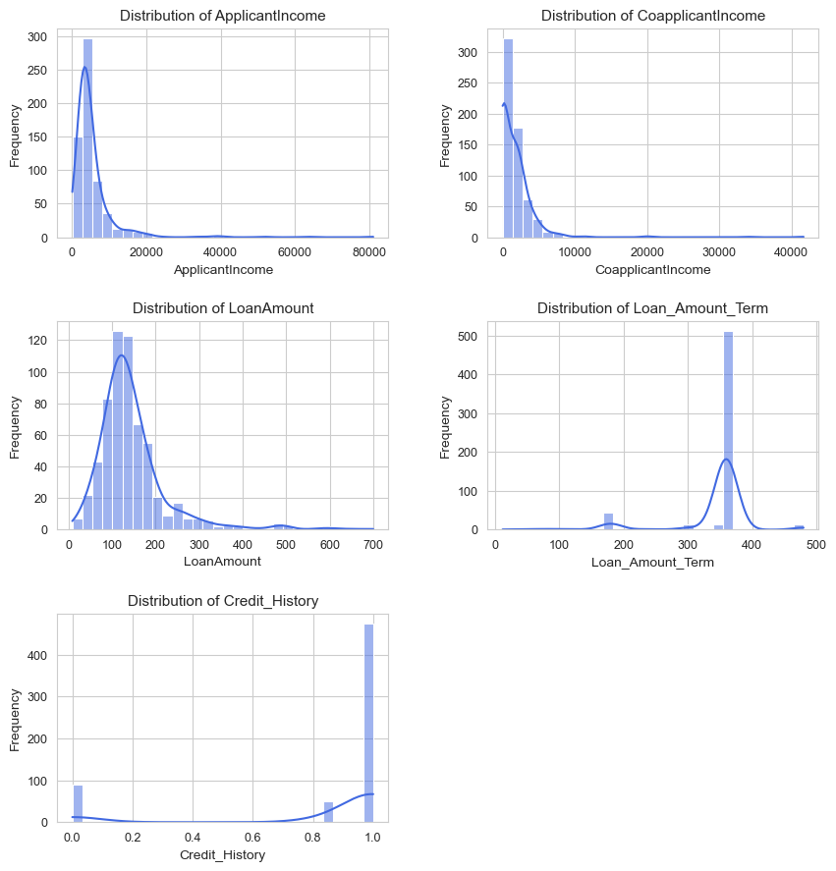
Data Visualization
1. Histograms for numerical features to check distributions.

Slide 6
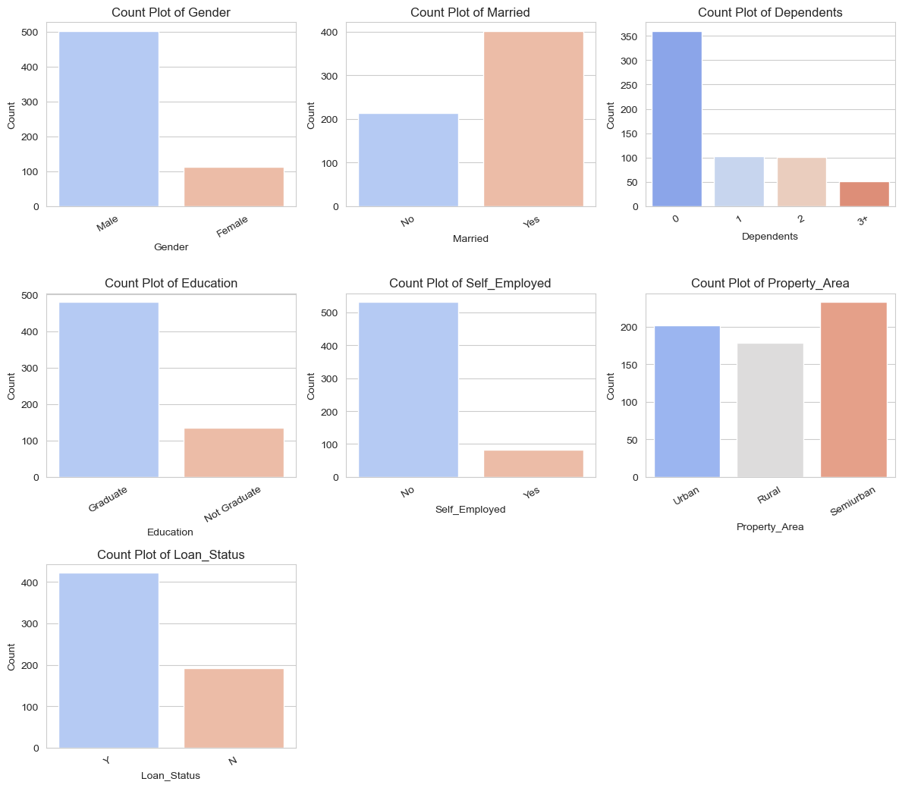
Data Visualization
2. Count plots for categorical features to understand class distribution

Slide 7
Model Selection & Hyperparameter Tuning
Model Selection
Logistic Regression
Random Forest Classifier
XGBoost Classifier
Models evaluated based on accuracy & performance metrics.
Hyperparameter Tuning
Used GridSearchCV to optimize Random Forest and XGBoost.
Best parameters selected to improve accuracy.
Optimized models provided better accuracy and reduced overfitting.

Slide 8
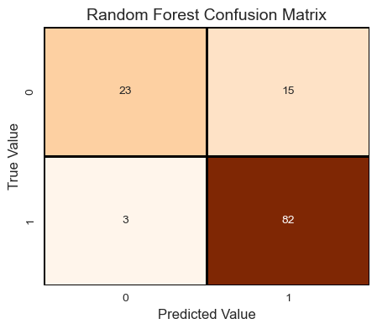
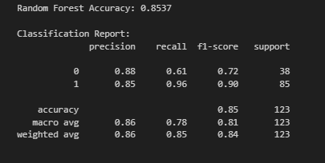
Random Forest (Best Model)
Accuracy: ~85%
Recall for class 1: 0.96
Precision for class 1: 0.85
Pros: Balances recall and precision for class 1, often more robust to data variations.
Cons: Can be more computationally expensive than Logistic Regression.

Slide 9
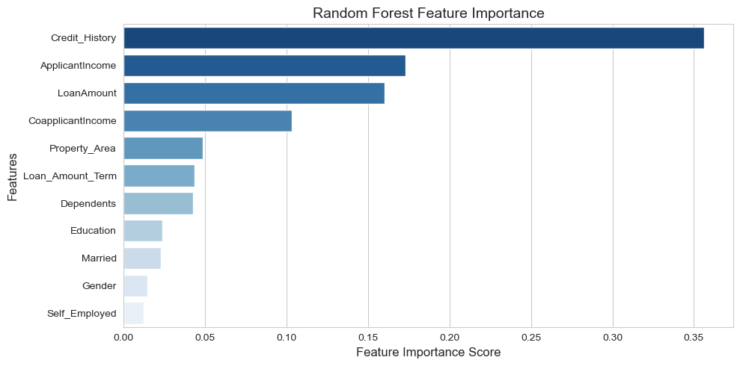
Random Forest Feature Importance

Slide 10
Conclusion & Next Steps
Key Insights:
Credit history is crucial for loan approval.
Income and loan amount also impact the decision.
Machine learning models can automate loan approval with high accuracy.
Features such as Property_Area ,Loan_Amount_Term, Dependents played a role in approval.
Next Steps:
✔ Incorporating deep learning techniques for better accuracy.
✔ Experiment with deep learning techniques.
✔ Deploy model as a web application for real-world use.

