Slide 1


Project Title:-Shop Management
Prepared By:-
Student Name : JETANI KRISH BHAVESHBHAI.
Roll no:125
Enrollment No:24002171210066
Batch:A5 Branch : CSE

Slide 2
Project Outline:-
Introduction
System design diagram (flow-chart / Algorithm….)
Functionality
Class Details
Merits & Demerits

Slide 3
Introduction:-
The Furniture Shop Management System is a Java console-based application that simulates a furniture store.
It enables user registration and unique ID generation, making the shopping experience personalized.
Users can interactively select products such as sofas, dining tables, beds, and wardrobes.
The system maintains an order history, calculates billing (with applicable discounts), processes payments, and collects customer feedback.

Slide 4
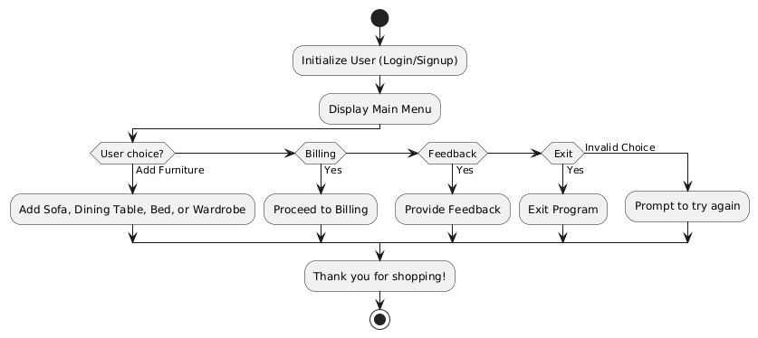

Slide 5
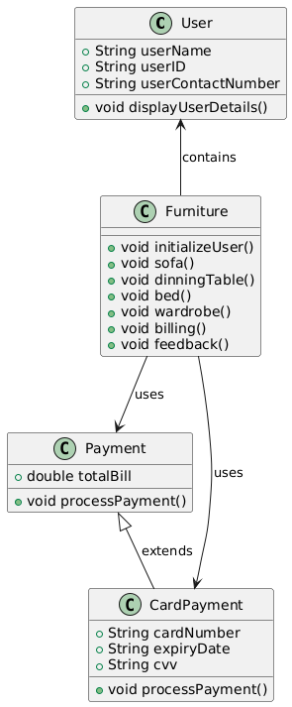
Class diagram:-

Slide 6
Functionality:-
User Registration:
initialize User()-Prompts for the user’s name and creates a unique ID using generate UserID().
Input & Date Validation:
IsValidDate()-Validates the day, month, and year (including leap year handling).
enterDate()-Ensures the user inputs a date in DD/MM/YYYY format, re-prompting until valid.

Slide 7
Product Ordering:
sofa() Method:
Displays available sofas with prices.
Collects the user’s choice, color, and quantity.
Calculates the total price and records the order (with a delivery date).
dinningTable(), bed(), and wardrobe() Methods:
Follow a similar process for their respective product categories.
Order History & Billing:
display OrderHistory():-Iterates over the stored orders and prints product details, total price, and delivery date.

Slide 8
billing():
Totals the orders and applies a 10% discount if the bill exceeds 50,000.
Processes payment via Online Payment or Card Payment.
Additional Features:
feedback() : Collects user feedback.
display UserDetails() : Shows the current user’s name and unique ID.

Slide 9
Merits & Demerits :-
User-friendly, interactive console interface.
Comprehensive order tracking and history management.
Automated billing with discount application.
Multiple payment options provide flexibility.
Straightforward implementation in Java.
Merits:

Slide 10
Lacks a graphical user interface (GUI).
Static product listings with no dynamic updates.
Basic error handling for user inputs.
No real-time inventory management.
DeMerits:-

Slide 11
THANK YOU….

