Slide 1
Site selection for new warehouse
IBM Data Science capstone presentation

Slide 2
Agenda
1. Problem introduction
2. Methodology
3. Findings
4. Conclusions

Slide 3
Problem introduction
Task: Locate a frontline warehouse in Manhattan and use it as a proof of concepts
Target Costumers: café shops

Slide 4
Methodology
Approach 1
Utilize existing groupings (neighborhoods) to find the ideal location
Algorithms: Descriptive analysis, K-Means
Approach 2
Establish new groupings based on café shops locations
Algorithms: DBSCAN Clustering, center of gravity

Slide 5
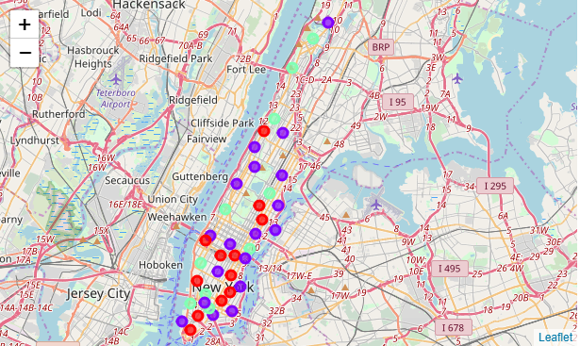
Findings
1. No clear pattern find via current neighborhoods groupings
2. It seems that somewhere in Manhattan downtown should be a optimal location

Slide 6
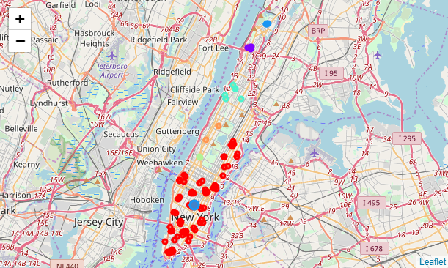
Findings (cont.)
1. A new cluster of Downtown is identified
2. (40.74, -73.99) should be a ideal location

Slide 7
Conclusions
(40.74, -73.99) should be a ideal location
Further cost analysis and effort of implementation should be involved
Further adjustments may need to be applied as new information come in

Slide 8
Thank you for listening

Slide 9
Q & A Session

