Slide 1
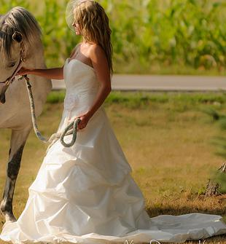
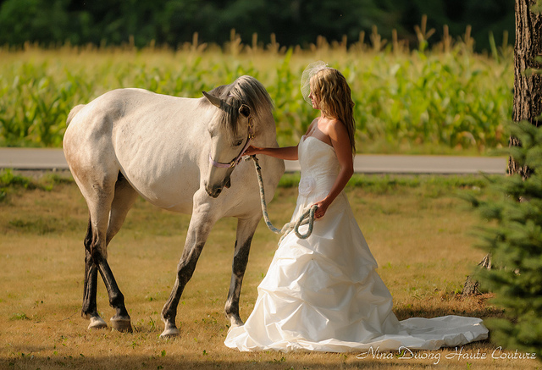
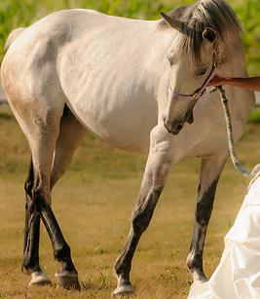
Step 1 – Inference module -> Image splitting.
Inference from matterport Mask-RCNN

Slide 2
Uses Matterport’s Mask RCNN to identify objects and crop on pictures.
Images with only one object are ignored.
Using weights trained on MS COCO data set (~80 classes).
This step is to ensure input for our CNN has only one object per image.

Slide 3
Step 2- Get Image embeddings from CNN
Inference from CNN
Conv
Pool
Activation
Pool
Fully connected layer
Output feature vector =
[f1,f2,f3, …….., fn]₁
[f1,f2,f3, …….., fn]₂

Slide 4
Step 2 takes a folder with multiple images as input
Ituses popular CNNs structures defined in Keras (ResNet, VGG, Inception V3)
Pre trained weights are used are from ImageNet data set, which has (~1000 classes)
The top fully connected layer is chopped off, and the feature vector output written to a text file.
The above step is repeated for all images the folder.
Final output is a text file with all image vectors in order.

Slide 5
Step3 – Word2Vec
Hidden Layer
Image feature vector =
[f1,f2,f3, …….., fn]₂
Image feature vector =
[f1,f2,f3, …….., fn]₁
W2
W1
(Embeddings)
Step 3 reads the file written in step 2. Each image vector is considered as an input and all other image vectors in the file as it’s context.
The learned weights w1 are then extracted
Implemented in Numpy

