Slide 1
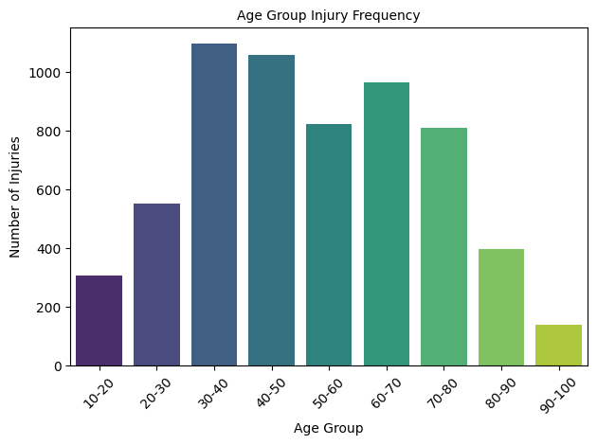
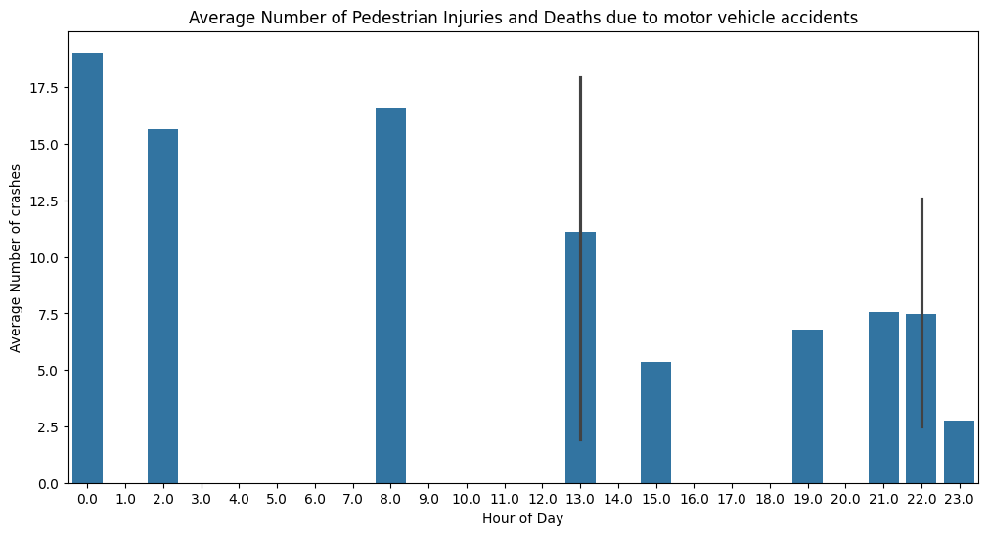
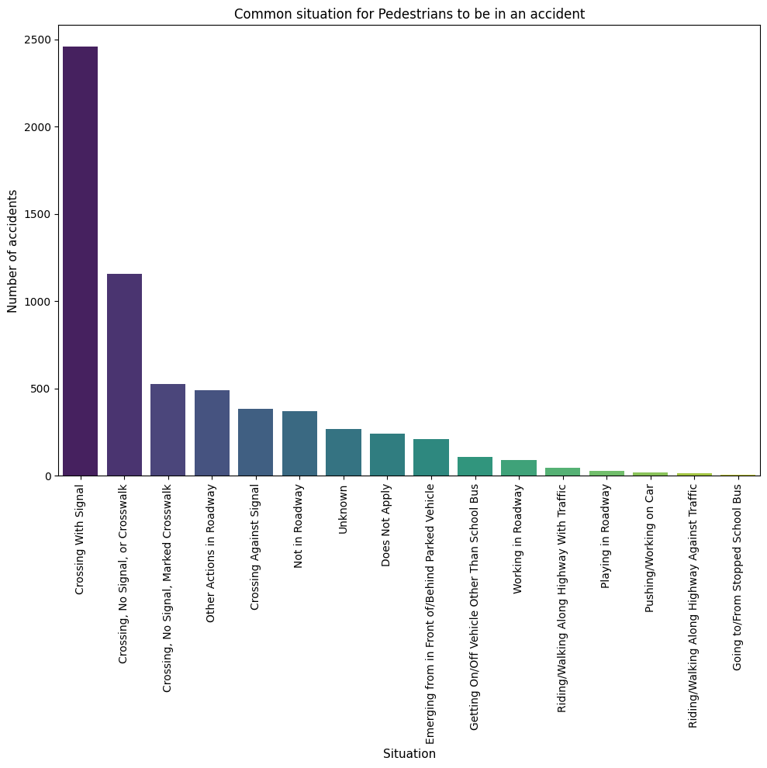
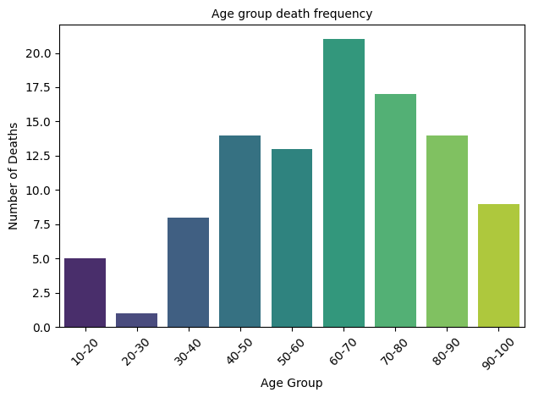
Analysis of pedestrian injuries and deaths in New York City in 2021
By Sahil Jartare
According to The Nation Health, in 2024 more than 20 people were struck and killed by vehicles every day. About 7,520 pedestrians died after being hit by cars in 2022. Pedestrian deaths are at an all time high and I would like research on the possible causes.
My research focuses on analysing the New York City Motor Vehicle Collisions to Person for 2021. Only cases of injuries or death over $1000 are filtered out.I will try to understand the reasons why pedestrian deaths occur using pandas, matplotlib and seaborn libraries in python.
Now lets look at the age group of pedestrians that get injured and killed by motor vehicles. According to the Nations Health pedestrians are at highest rick include older adults and people with disabilities. Through my analysis we will look at the age group that in injured and killed in New York City.
We looked at reasons and age group, now let us look at the time the accidents occur to make our hypothesis and suggest what the Department of Transportation and Federal Highway Authority can do to possibly reduce the deaths.
Graph 2
Graph 4
First, we will analyse in what situation pedestrians are more prone to get into accidents
Graph 1
From Graph 4, we can observe that most accidents on pedestrians occur during the morning at 12 am, 2 am, 8 am and 1 pm. During these hours it is highly likely that there is extreme foot traffic to go to office or lunch, or people in the city going home late at night drunk are ignorant of the traffic laws.
Graph 3
The analysis shows that pedestrians generally follow traffic rules and most accidents occur during a timeframe where foot traffic is extremely high. Second in place, accidents occur in crossings where there is no signal.
I suggest the department to install signals on crossings where there is no crosswalk but pedestrians choose to cross the street from there. Let the traffic police be aware of the locations where most accidents are likely to happen so that they can surveil these locations more tightly.
Educate new drivers about the etiquette of following traffic laws and the consequences of not following them.
As observed from the above graph, most pedestrians are involved in accidents when crossing the streets when the street light is green. In fact, over 35% of pedestrian deaths or injuries are attributed when they are crossing the street. Only 6% of the accidents were caused when crossing against the signal.
From the chart above, it is less likely for pedestrians to get into an accident if they are crossing against the signal but more likely if they are crossing against it.
Limitations of the analysis include the inability to pinpoint the location of the most frequent accidents. Along with that the data only focuses on the year 2021, making it unable to graph trends to make a more firmer conclusion.
References:
“NYC Motor Vehicle Collisions to Person”, NYC Open Data, version 4, 2022, https://www.kaggle.com/datasets/kukuroo3/nyc-motor-vehicle-collisions-to-person/data.
Michele Late, “US pedestrian deaths reach four-decade high, report says”, The Nation’s Health, 2024, https://www.thenationshealth.org/content/54/6/9.1
As observed from graph 2 and 3 we can see that pedestrian injuries are most common in the age group from 30-50 while deaths are more common from the age of 60-70. In general most frequent injuries and death are from the age group 30-40, with 40-50 and 60-70 following. We can conclude that people from the age group of 30-50 are faced with more accidents then the rest of the age group.

