Slide 1
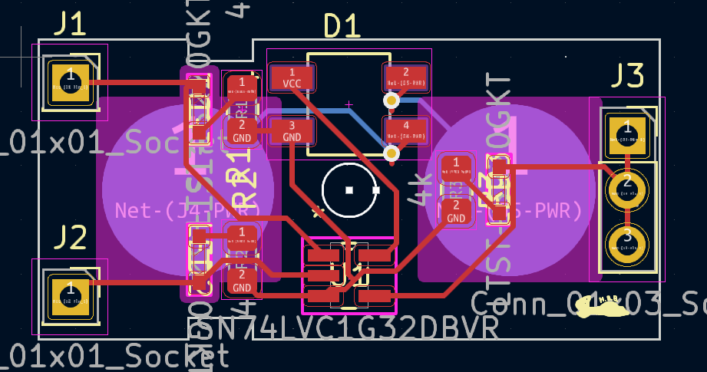
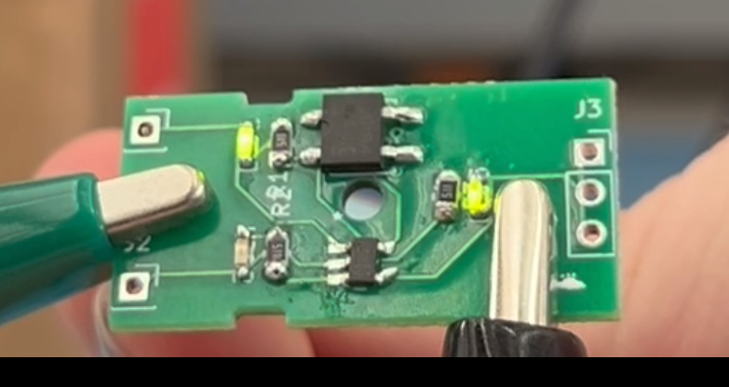
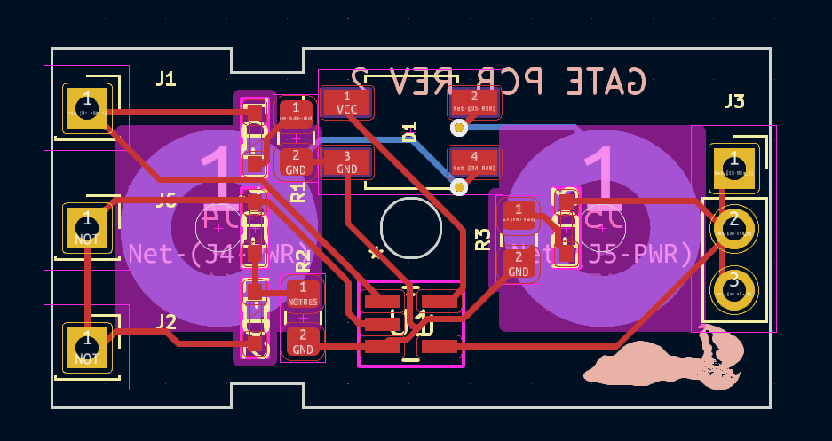
Department of Electrical and Computer Engineering
Association or meeting title
Date
Jonathan Hess
Digital Logic Lab Tool
Content
Acknowledgments

