Slide 1
STUDENTS DETAILS: 1. Khagga Mounika 2. Jetty Kavya Sudha 3. Jerripothu Nagaveni 4. Shaik suffiya 5. Ramisetty Poojitha College Name : Malineni Lakshmaiah women’s Engineering College College State : Andhra pradesh Internship Domain : Front end development Project Name : Personal Technical portfolio web application

Slide 2

PORTFOLIO SITE

Slide 3
AGENDA: In this course you will learn how to build a responsive portfolio website with a modern design and cool JavaScript-based effects. You can use what you learn in this course and customize your portfolio website to show off your work history and design skills. It provides a platform to showcase your relevant skills and experience it shows your personality. It lets hiring managers find you instead of you reaching out to them you are easily searchable on search engines like google.

Slide 4
PROJECT OVERVIEW: A portfolio website is a unique way to showcase your work and let others know about yourself. It's like an evergreen platform for your projects, case studies, and information about you. In addition, it's one of the best ways to express your personality, experience, and capabilities . Bootstrap is the best framework for making a responsive webpage/website . In this we will also be learning other css&javascript libraries like-AOS(Animate on scroll),Animate style and much more.

Slide 5
WHO ARE THE END USERS OF THIS PROJECT? Some designers prefer to keep things simple and business-like, focusing on the technical aspects of their work. Others prefer to infuse their portfolios with personality, sharing their passions, design styles, and unique approaches to web design. It provides a convenient way for potential clients to view your work while also allowing you to expand on your skills, experiences, and services. This site [Personal Portfolio] has four sections on one page: Home, Portfolio, About, and Contact, and each section is attractive and eye-catching . A portfolio can be thought of as a digital resume that showcases the user’s talent to the client. A portfolio is a website that developers use to showcase their skills in the market so that they can be hired based on their skill set.

Slide 6
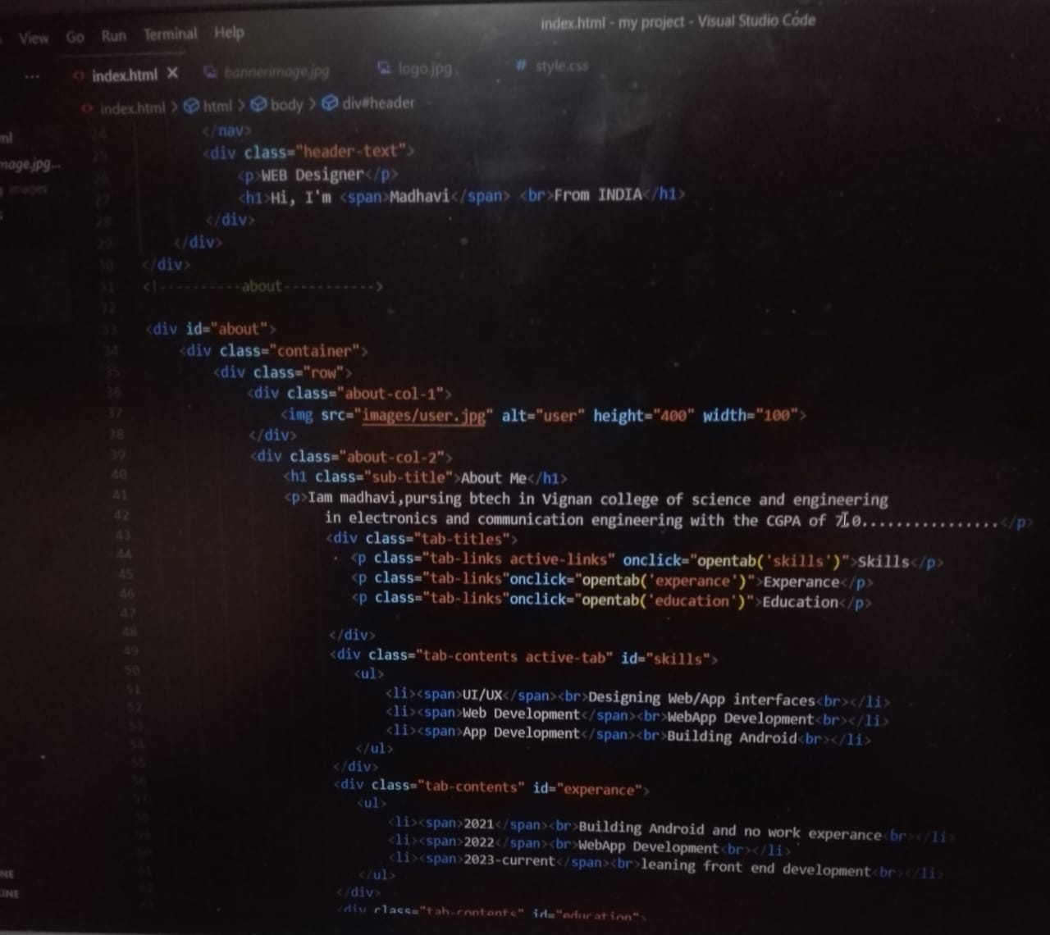
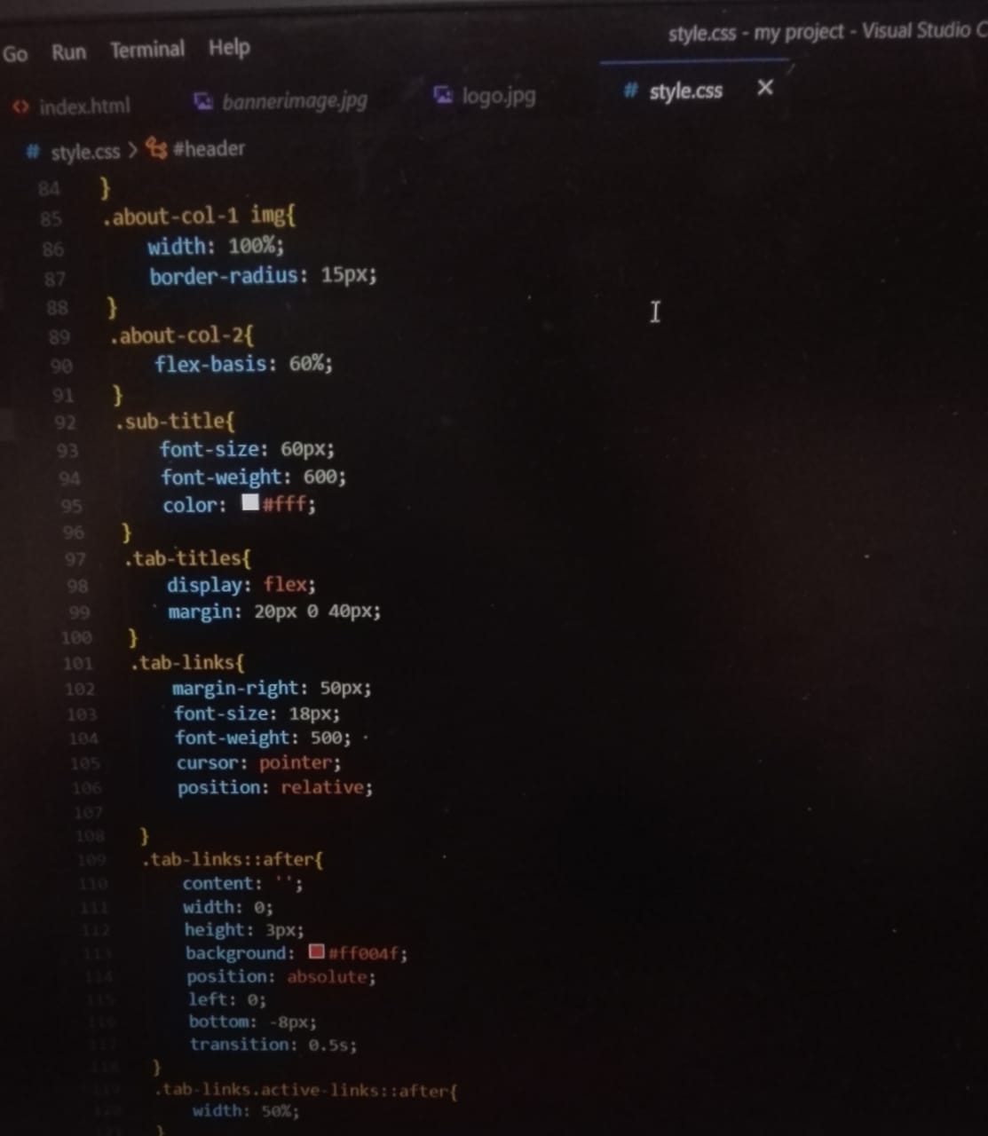
SOLUTION & IT’S VALUE PROPOSITION:

Slide 7
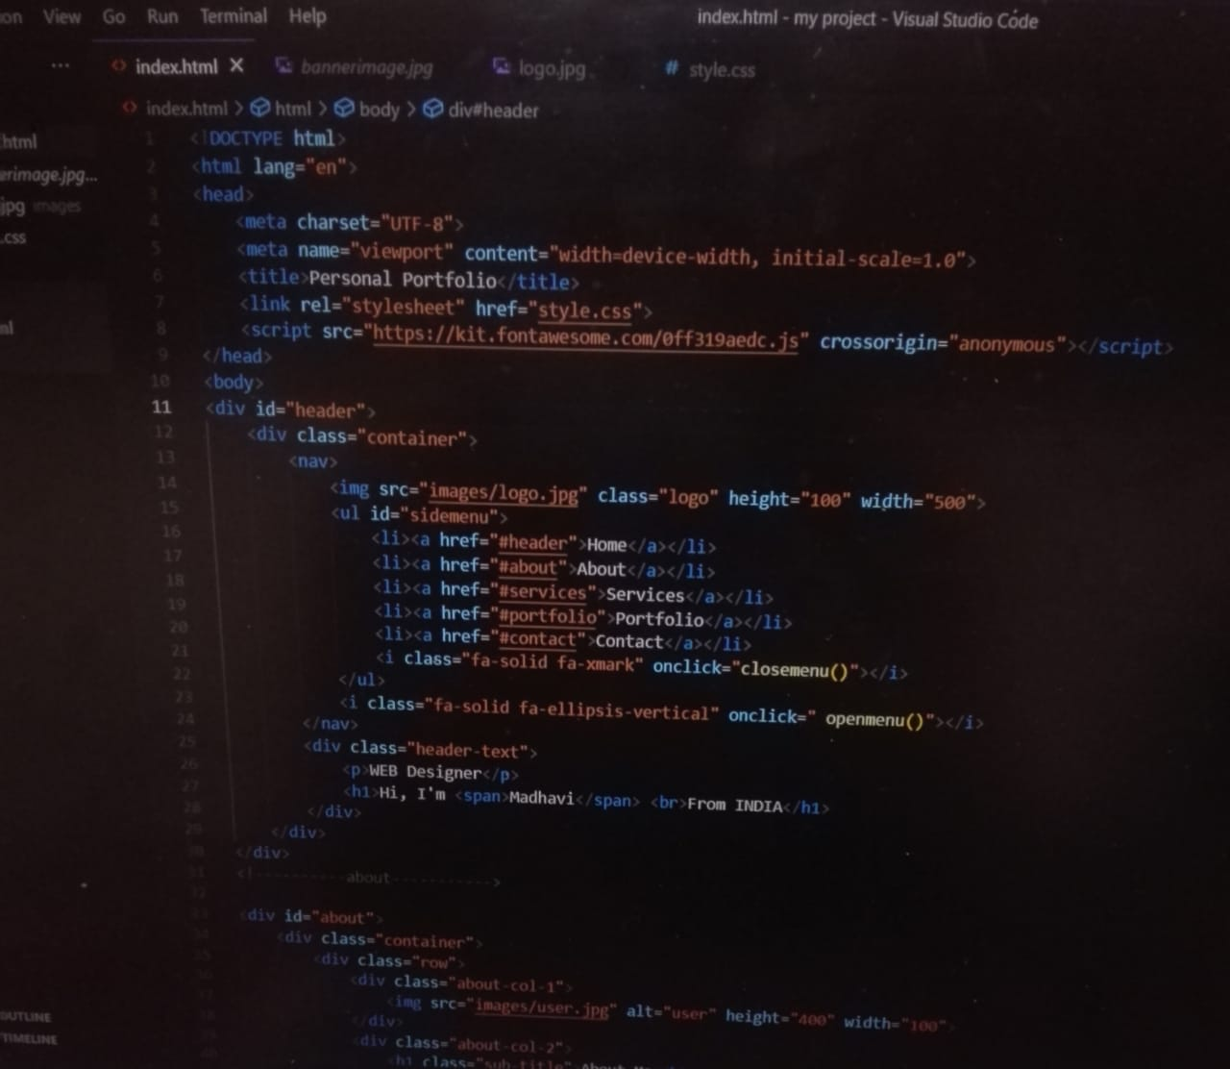
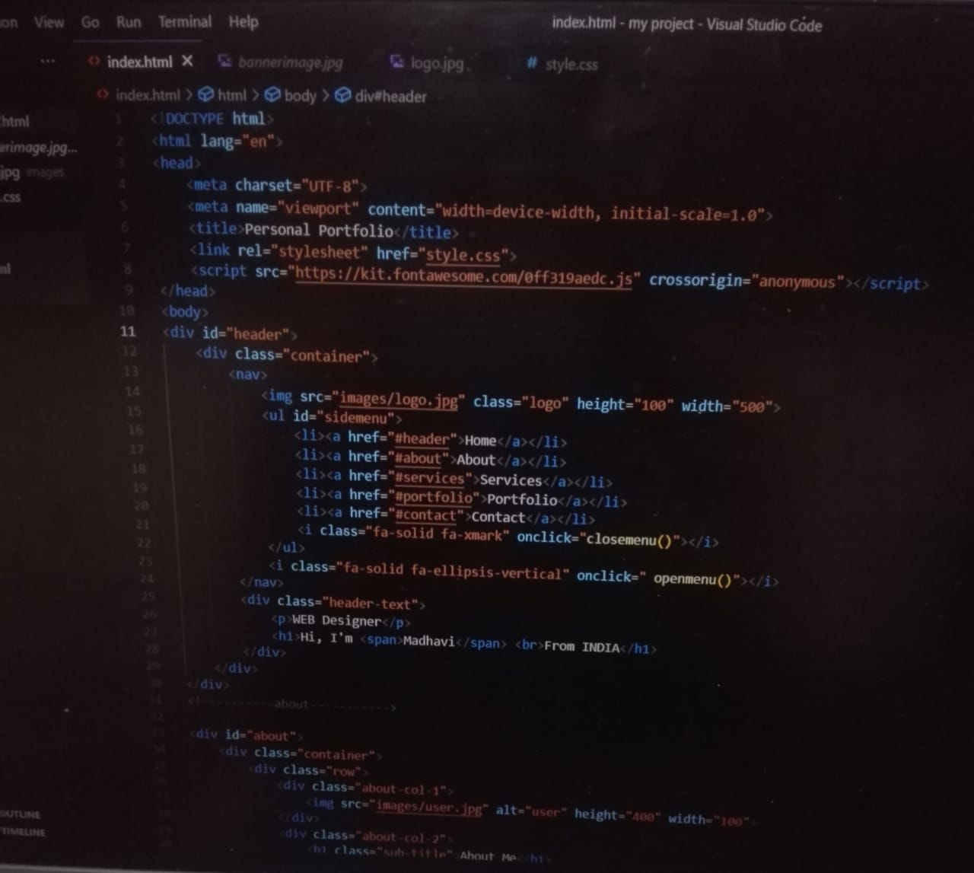

Slide 8
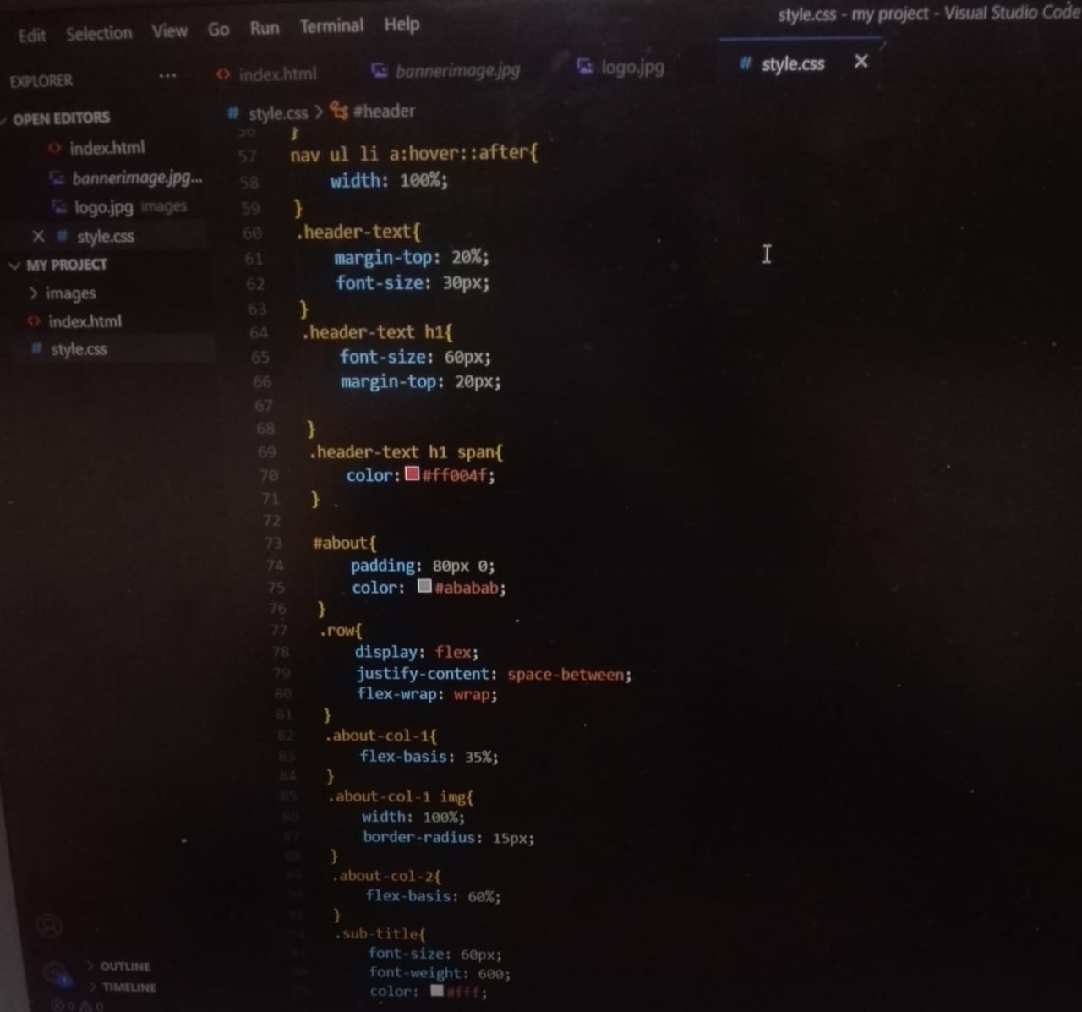

Slide 9
FEATURES OF THE PROJECT:
A High-Quality Image of Yourself. Your Image help clients connect with you better if you share a picture of yourself on your website.
Information About Yourself.
Content.
Your Best Projects.
Services.
My Work.
Contact Information.
Relevant Social Media Accounts.

Slide 10
MODELLING TECHNICQUES:
Creating of web page using Bootstrap and real time techniques used while designing it.
Import external Fonts, Implementing Favicon and bootstrap Icons.
Implement various CSS Libraries.
Implement various JS Libraries.

Slide 11
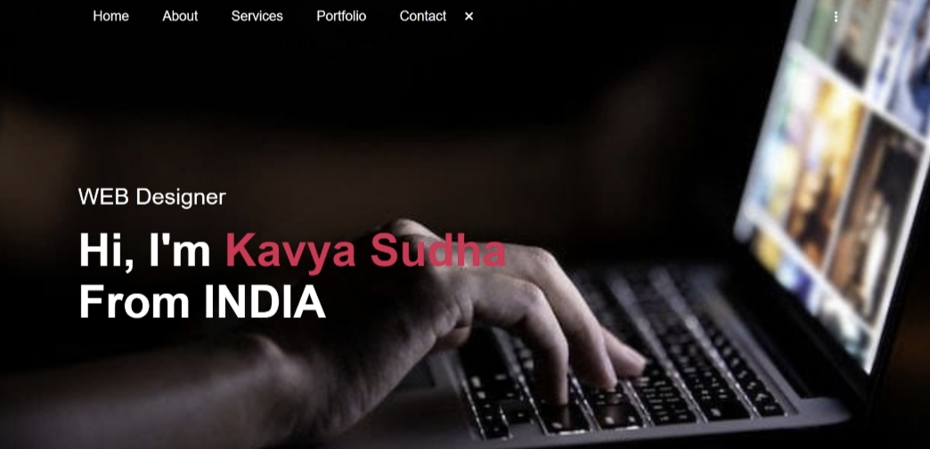
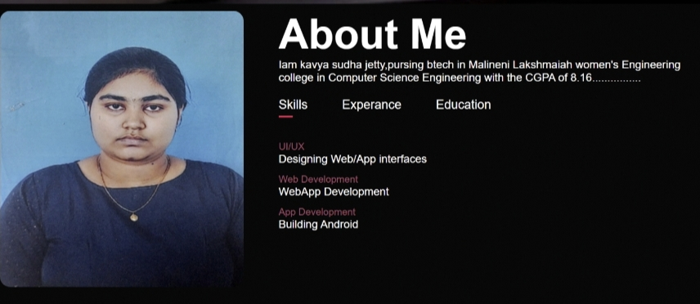
RESULT:

Slide 12
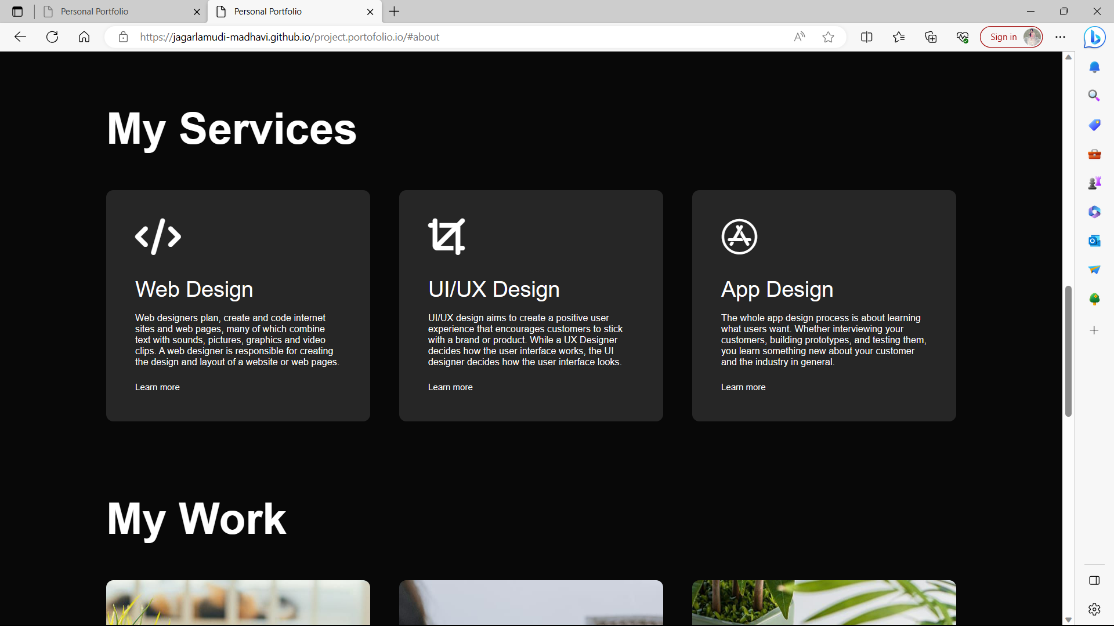
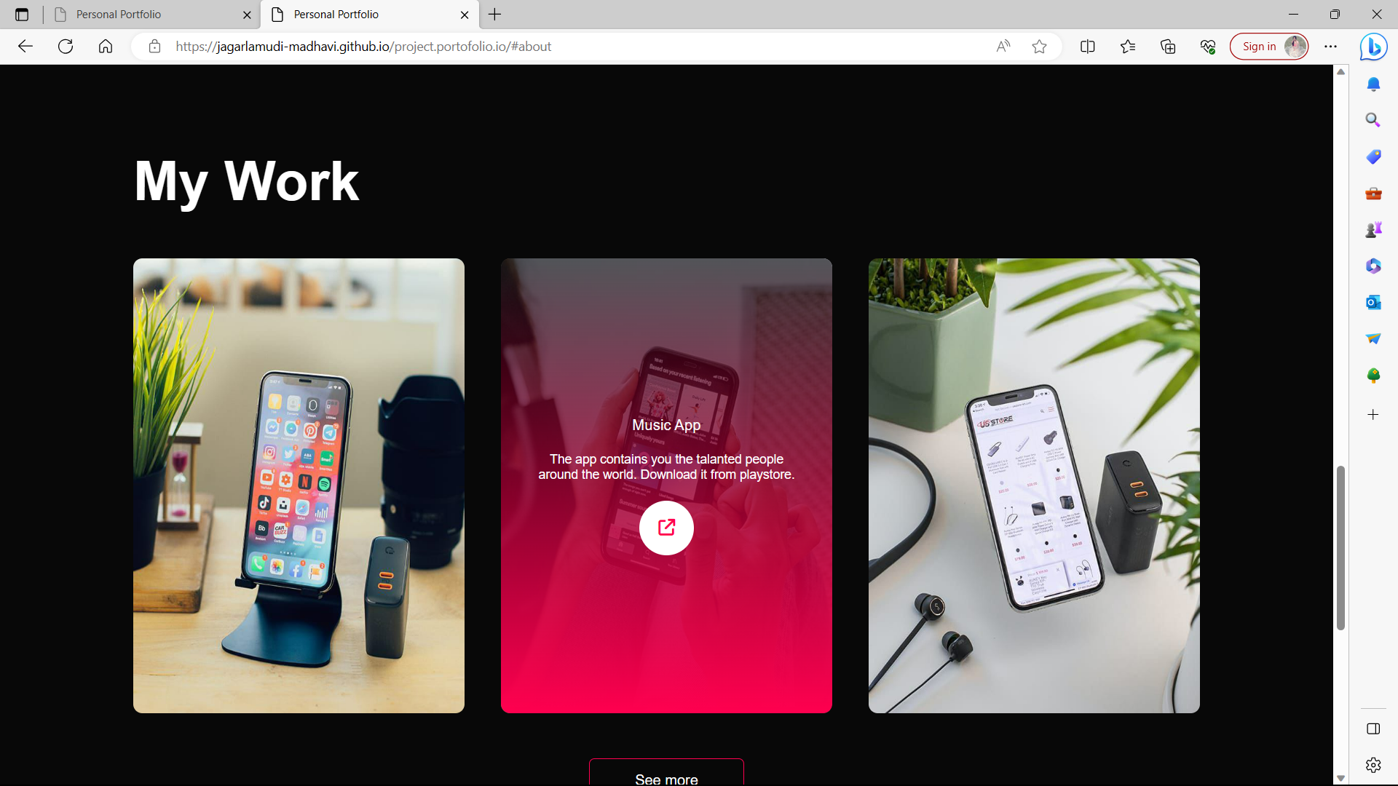

Slide 13
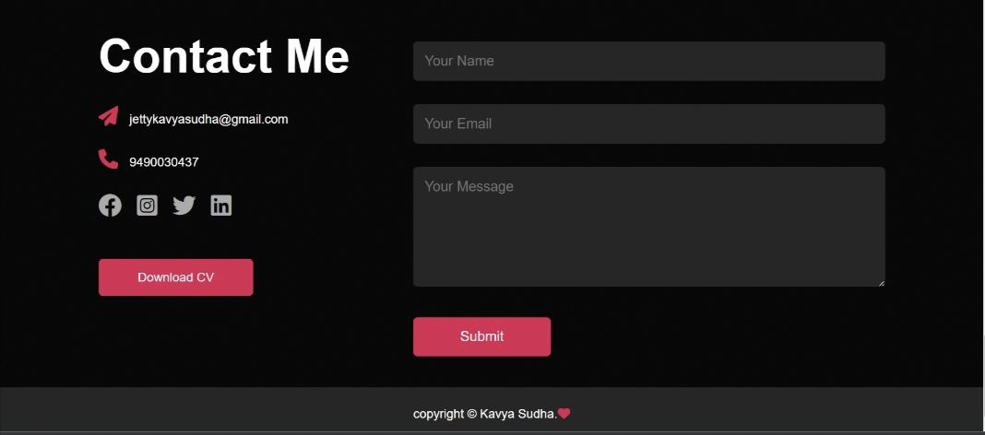

Slide 14
LINKS: https://github.com/Jettykavyasudha https://jettykavyasudha.github.io/portfolio.project.io/ ( portfolio website )

Slide 15
THANK YOU

