Slide 1

Big Data Presentation
JAD Solutions
Notes:
Jetze Luyten

Slide 2



Team
Jetze Luyten
Axel Van Gestel
David Silva
Notes:
Jetze Luyten

Slide 3



Agenda
Getting the data
Scraping
Cleaning the data
FastAI modeling
Modeling
Quick & dirty
Advanced options
Live demo(Streamlit)
Summary
Notes:
Jetze Luyten

Slide 4

Getting the data
Notes:
Jetze Luyten

Slide 5
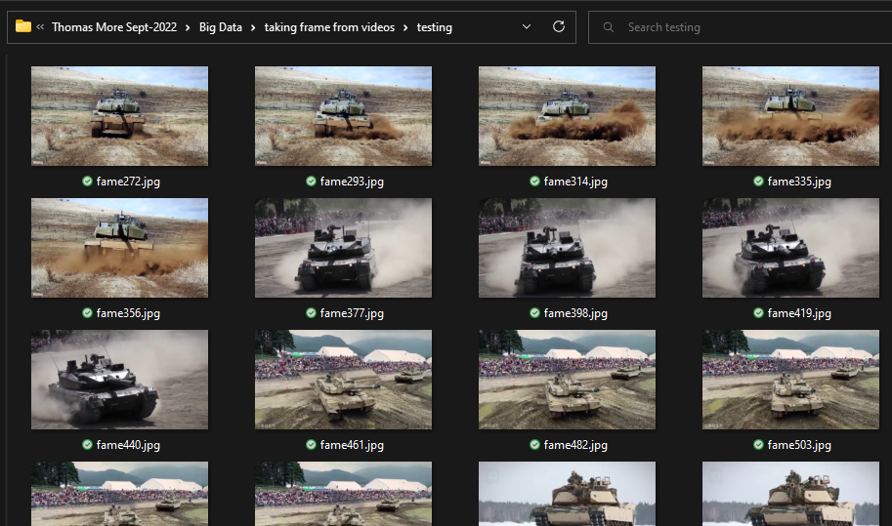
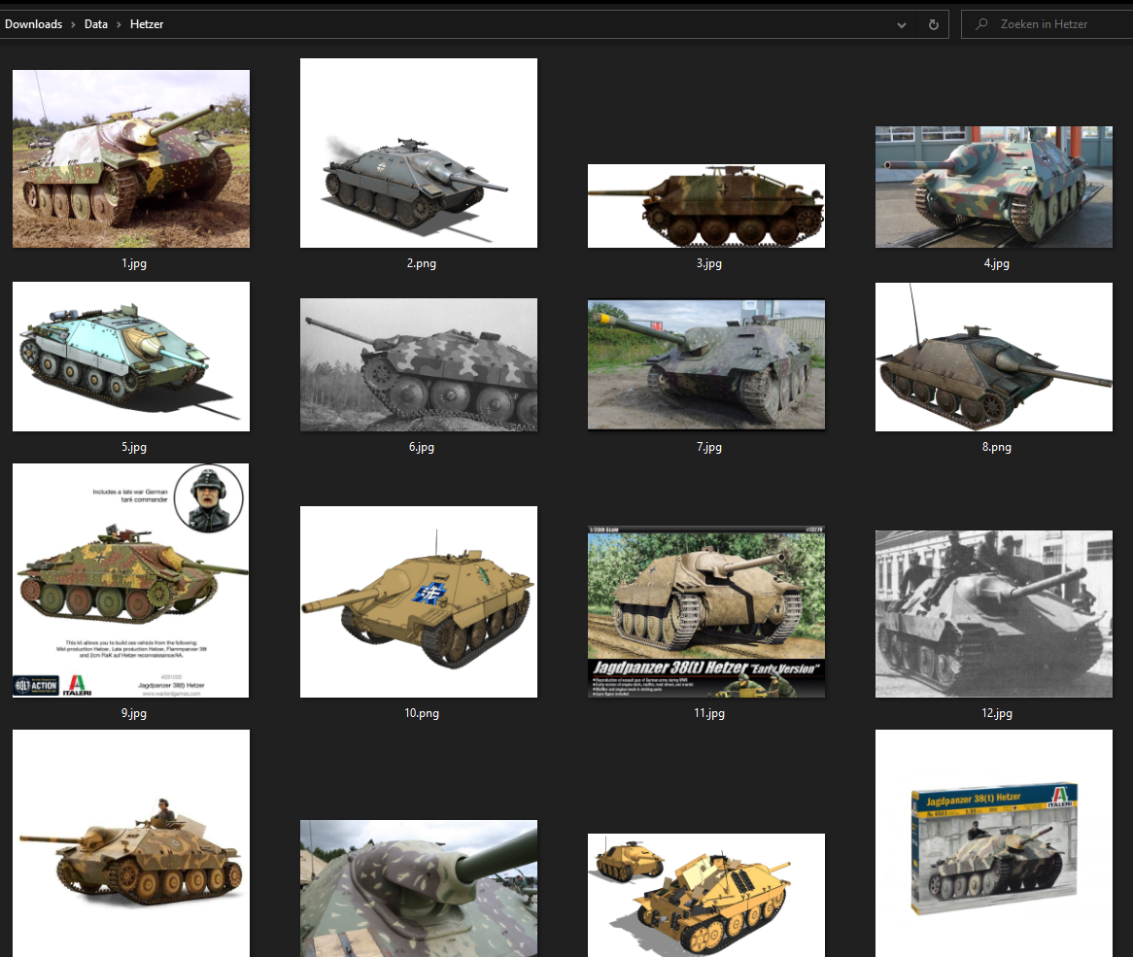
Scraping
Video frame extraction
Google image scraper
Fast for a lot of samples
Samey frames
Lots to clean
More variety
Some wrong images
Little less to clean
Notes:
Axel
SibSp = Number of Siblings / Spouses aboard
Parch = Number of Parents / Children aboard
Age increases -> Number of Siblings / Family member aboard decreases

Slide 6

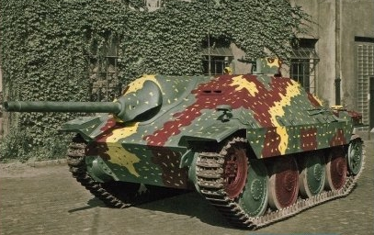
Cleaning the data
Removing wrong tanks
Cropping using Inbac
Notes:
Axel
Most of the male and female passengers in the same age group
Some older male outliers

Slide 7
FastAI Modeling
Notes:
Jetze Luyten

Slide 8
Modeling
2 different models
Quick & dirty
Advanced options
Google drive
Datablock
Notes:
Axel
Some outlier who paid over 500 pounds

Slide 9
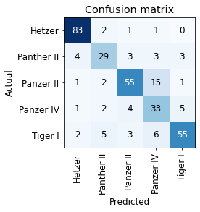
Quick & dirty
Data block
Presizing (450 --> 224)
RandomResizedCrop (128)
Training
Resnet50
4 x fine tune
Result
Notes:
Axel
Alone or 1 other family member
In their Mid-30s
All survived

Slide 10
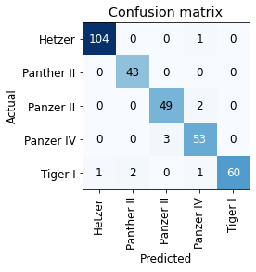
Advanced options
Data block
Presizing (460 --> 224)
Normalize
Training
Resnet152
2 x Learning rate finder
2 x Mixed precision
Result
Notes:
Axel
Alone or 1 other family member
In their Mid-30s
All survived

Slide 11
Live demo (streamlit)
Notes:
David
https://davidsiltroy-python-big-data-image-classification-main-zrtmm1.streamlit.app/

Slide 12

Summary
Notes:
Jetze Luyten

Slide 13
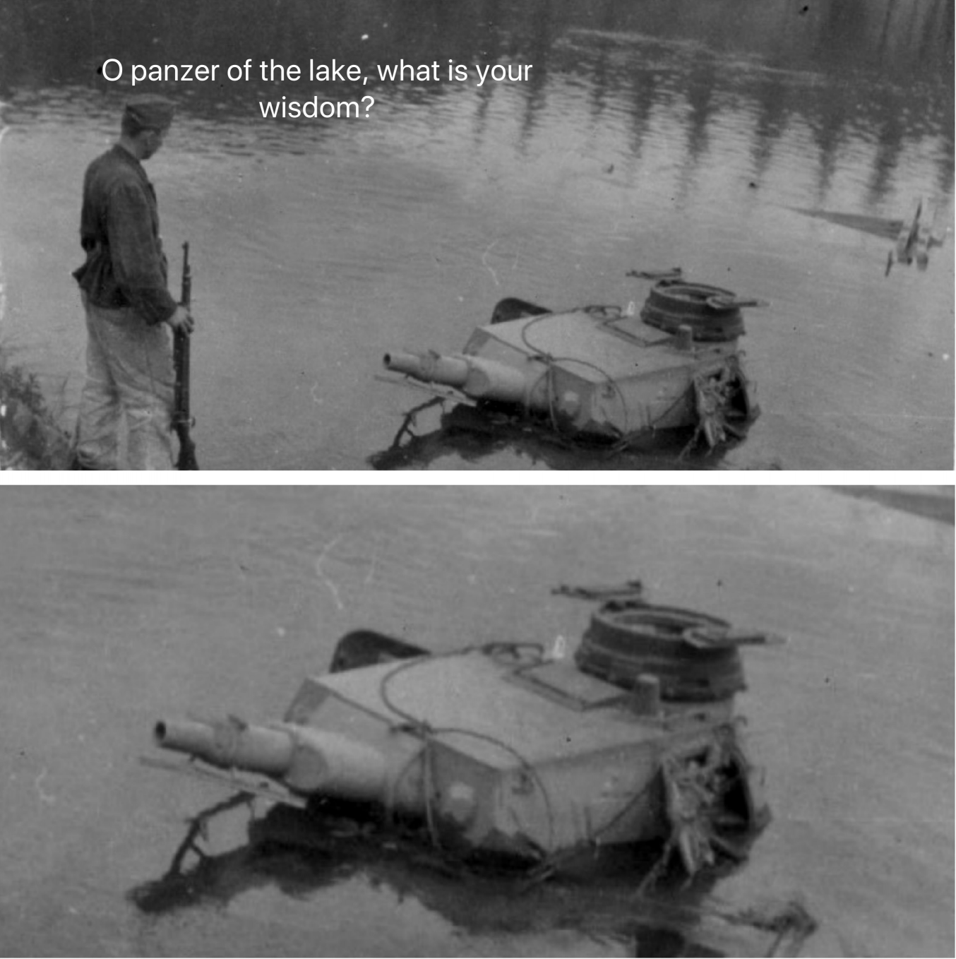

Thank You
Any questions?
Not every tank is a Hetzer
JAD Solutions
Notes:
Jetze Luyten

