Slide 1


http://www.comp.nus.edu.sg/~cs2100/
Lecture #22
Cache
Part I: Direct Mapped Cache

Slide 2
Lecture #22: Cache I: Direct Mapped Cache
Introduction
Cache
2.1 Locality
2.2 Memory Access Time
Memory to Cache Mapping
Direct Mapping
Reading Data (Memory Load)
Types of Cache Misses
Writing Data (Memory Store)
Write Policy

Slide 3
1. Data Transfer: The Big Picture
Computer
Processor
Memory
Devices
Control
Input
Datapath
+
Registers
Store to memory
Output
Load from memory
Registers are in the datapath of the processor. If operands are in memory we have to load them to processor (registers), operate on them, and store them back to memory.

Slide 4
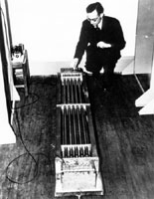
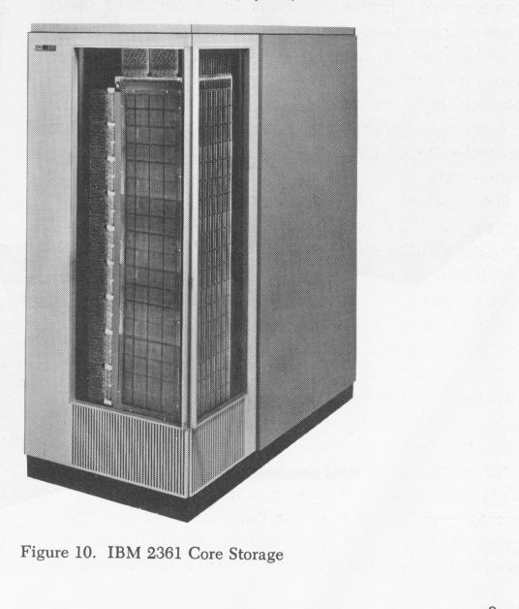
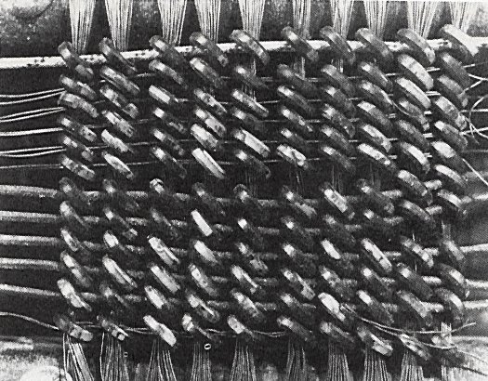

1. Memory Technology: 1950s
1948: Maurice Wilkes examining
EDSAC’s delay line memory tubes
16-tubes each storing 32 17-bit words
1952: IBM 2361 16KB magnetic core memory
Maurice Wilkes: 2005

Slide 5
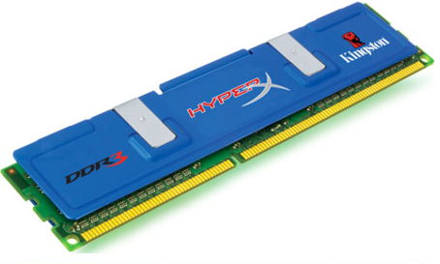
1. Memory Technology Today: DRAM
DDR SDRAM
Double Data Rate
– Synchronous Dynamic RAM
The dominant memory technology in PC market
Delivers memory on the positive and negative edge of a clock (double rate)
Generations:
DDR (MemClkFreq x 2(double rate) x 8 words)
DDR2 (MemClkFreq x 2(multiplier) x 2 x 8 words)
DDR3 (MemClkFreq x 4(multiplier) x 2 x 8 words)
DDR4 (released in 2014)
DDR5 (in Q3 2021)

Slide 6
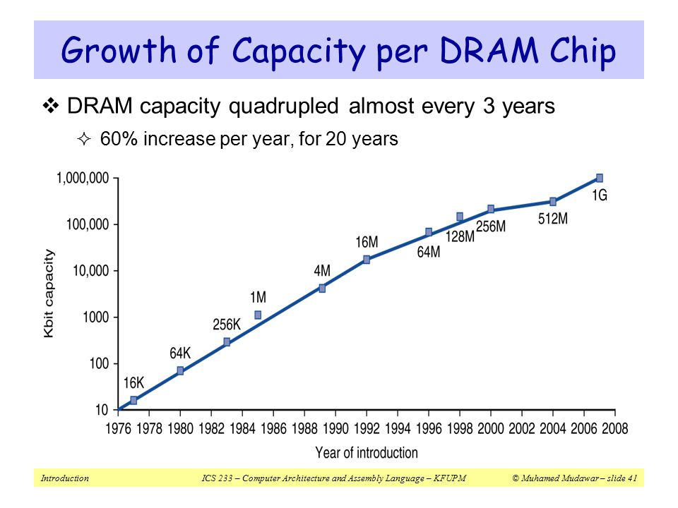
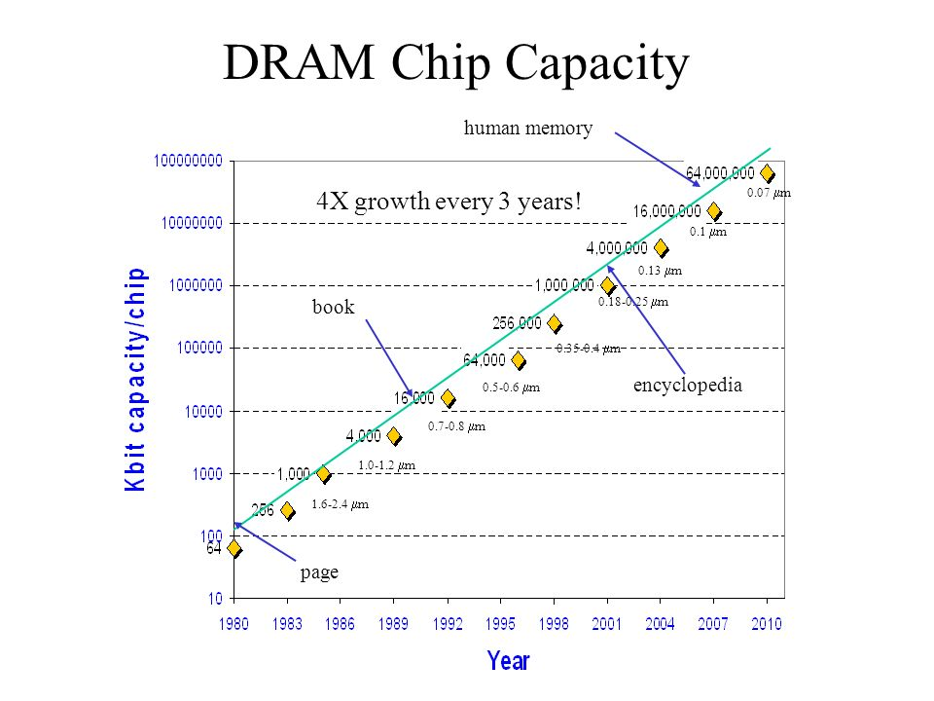
1. DRAM Capacity Growth
Unprecedented growth in density, but we still have a problem

Slide 7
1. Processor-DRAM Performance Gap
Memory Wall:
1GHz Processor ➔ 1 ns per clock cycle
50ns for DRAM access ➔ 50 processor clock cycles per memory access!
1000
CPU
“Moore’s Law”
Gordon Moore noticed that the number of transistors per square inch on integrated circuits had doubled every year/18 months since their invention.
100
Performance
10
DRAM
1
1980
Time
1981
1982
1983
1984
1985
1986
1987
1988
1989
1990
1991
1992
1993
1994
1995
1996
1997
1998
1999
2000

Slide 8
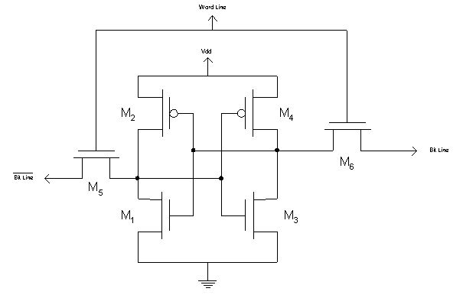
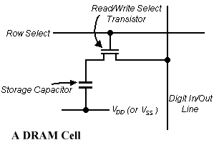
1. Faster Memory Technology: SRAM
A SRAM Cell
SRAM
6 transistors per memory cell
→ Low density
Fast access latency of 0.5 – 5 ns
More costly
Uses flip-flops
DRAM
1 transistor per memory cell
→ High density
Slow access latency of 50-70ns
Less costly
Used in main memory

Slide 9
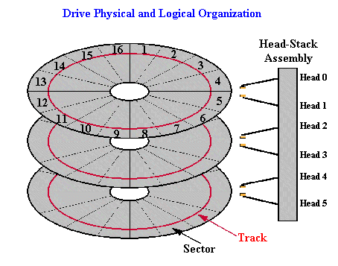

1. Slow Memory Technology: Magnetic Disk
Typical high-end hard disk:
Average Latency: 4 - 10 ms
Capacity: 500-2000GB

Slide 10
1. Quality vs Quantity
Processor
Memory
(DRAM)
Devices
Control
Input
Datapath
Registers
Output
(Harddisk)
 | Capacity | Latency | Cost/GB
Register | 100s Bytes | 20 ps | $$$$
SRAM | 100s KB | 0.5-5 ns | $$$
DRAM | 100s MB | 50-70 ns | $
Hard Disk | 100s GB | 5-20 ms | Cents
Ideal | 1 GB | 1 ns | Cheap

Slide 11
1. Best of Both Worlds
What we want:
A BIG and FAST memory
Memory system should perform like 1GB of SRAM (1ns access time) but cost like 1GB of slow memory
Key concept:
Use a hierarchy of memory technologies:
Small but fast memory near CPU
Large but slow memory farther away from CPU

Slide 12
1. Memory Hierarchy
Registers
SRAM
Speed
DRAM
Harddisk
Size

Slide 13

2. Cache: The Library Analogy
Imagine you are forced to put back a book to its bookshelf before taking another book…….

Slide 14
2. Solution: Book on the Desk!
What if you are allowed to take the books that are likely to be needed soon with you and place them nearby on the desk?

Slide 15
2. Cache: The Basic Idea
Keep the frequently and recently used data in smaller but faster memory
Refer to bigger and slower memory:
Only when you cannot find data/instruction in the faster memory
Why does it work?
Principle of Locality
Program accesses only a small portion of the
memory address space within a small time interval

Slide 16
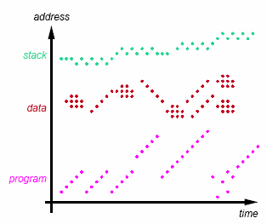
2.1 Cache: Types of Locality
Temporal locality
If an item is referenced, it will tend to be referenced again soon
Spatial locality
If an item is referenced, nearby items will tend to be referenced soon
Different locality for
Instructions
Data

Slide 17
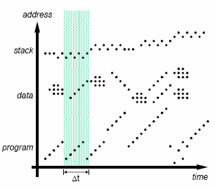
2.1 Working Set: Definition
Set of locations accessed during Δt
Different phases of execution may use different working sets
Our aim is to capture the working set and keep it in the memory closest to CPU

Slide 18
2.2 Two Aspects of Memory Access
Processor
Memory
(DRAM)
Devices
Control
Input
Datapath
Registers
Cache
(SRAM)
Output
(Harddisk)
How to make SLOW main memory appear faster?
Cache – a small but fast SRAM near CPU
Hardware managed: Transparent to programmer
How to make SMALL main memory appear bigger than it is?
Virtual memory
OS managed: Transparent to programmer
Not in the scope of this module (covered in CS2106)

Slide 19
2.2 Memory Access Time: Terminology
Processor
Memory
Cache
X
Y
Hit: Data is in cache (e.g., X)
Hit rate: Fraction of memory accesses that hit
Hit time: Time to access cache
Miss: Data is not in cache (e.g., Y)
Miss rate = 1 – Hit rate
Miss penalty: Time to replace cache block + hit time
Hit time < Miss penalty

Slide 20
2.2 Memory Access Time: Formula
Average Access Time
= Hit rate x Hit Time + (1-Hit rate) x Miss penalty
Example:
Suppose our on-chip SRAM (cache) has 0.8 ns access time, but the fastest DRAM (main memory) we can get has an access time of 10ns. How high a hit rate do we need to sustain an average access time of 1ns?
Let h be the desired hit rate.
1 = 0.8h + (1 – h) × (10 + 0.8) = 0.8h + 10.8 – 10.8h
10h = 9.8 → h = 0.98
Hence we need a hit rate of 98%.


Slide 21
3. Memory to Cache Mapping (1/2)
Cache Block/Line:
Unit of transfer between memory and cache
Block size is typically one or more words
e.g.: 16-byte block ≅ 4-word block
32-byte block ≅ 8-word block
Why is the block size bigger than word size?
Notes:
Block size bigger than word size to transfer more data

Slide 22
3. Memory to Cache Mapping (2/2)
Address
8-byte blocks
Block
Word
..00000
Byte
..00001
Word0
..00010
..00011
Block0
..00100
Observations:
2^{N}-byte blocks are aligned at 2^{N}-byte boundaries
The addresses of words within a 2^{N}-byte block have identical (32-N) most significant bits (MSB).
Bits [31:N] ➔ the block number
Bits [N-1:0] ➔ the byte offset within a block
..00101
Word1
..00110
..00111
..01000
..01001
Word2
..01010
..01011
Block1
Memory Address
..01100
31
N
N-1
0
..01101
Word3
Block Number
Offset
..01110
..01111
Notes:
1 block on the left (vertical) equals to 1 horizontal row on the right, each box on the left is 1 byte.

Slide 23
4. Direct Mapping Analogy
Imagine there are 26 “locations” on the desk to store books. A book’s location is determined by the first letter of its title.
➔ Each book has exactly one location.

Slide 24
4. Direct Mapped Cache: Cache Index
Block Number (Not Address!)
Cache Index
..00000
One block
One block
00
Index
..00001
01
..00010
10
..00011
Mapping Function:
Cache Index
= (BlockNumber) modulo
(NumberOfCacheBlocks)
11
..00100
Cache
..00101
..00110
Memory
..00111
..01000
Observation:
If Number of Cache Blocks = 2^{M}
➔ the last M bits of the block number is the cache index
Example:
Cache has 2² = 4 blocks
➔ last 2 bits of the block number is the cache index.
..01001
..01010
..01011
..01100
..01101
..01110
..01111
Notes:
Each box is one block now

Slide 25
4. Direct Mapped Cache: Cache Tag
Block Number (Not Address!)
Cache Index
..00000
One block
One block
00
..00001
01
Tag
..00010
10
..00011
Mapping Function:
Cache Index
= (BlockNumber) modulo
(NumberOfCacheBlocks)
11
..00100
Cache
..00101
..00110
Memory
..00111
..01000
Observation:
Multiple memory blocks can map to the same cache block
➔ Same Cache Index
However, they have unique tag number:
Tag = Block number / Number of Cache Blocks
..01001
..01010
..01011
..01100
..01101
..01110
..01111

Slide 26
4. Direct Mapped Cache: Mapping
Memory Address
31
N
N-1
0
Block Number
Offset
Cache Block size = 2^{N} bytes
Memory Address
31
N+M-1
N
N-1
0
Tag
Index
Offset
Cache Block size = 2^{N} bytes
Number of cache blocks = 2^{M}
Offset = N bits
Index = M bits
Tag = 32 – (N + M) bits

Slide 27
4. Direct Mapped Cache: Cache Structure
Valid
Tag
Data
Index
Cache
00
01
10
11
Along with a data block (line), cache also contains the following administrative information (overheads):
Tag of the memory block
Valid bit indicating whether the cache line contains valid data
When is there a cache hit?
( Valid[index] = TRUE ) AND ( Tag[ index ] = Tag[ memory address ] )

Slide 28
4. Cache Mapping: Example
Memory Address
Memory
4GB
31
N
N-1
0
Block Number
Offset
Offset, N = 4 bits
Block Number = 32 – 4 = 28 bits
Check: Number of Blocks = 2²⁸
1 Block
= 16 bytes
31
N+M-1
N
N-1
0
Cache
16KB
Tag
Index
Offset
Number of Cache Blocks
= 16KB / 16bytes = 1024 = 2¹⁰
Cache Index, M = 10bits
Cache Tag = 32 – 10 – 4 = 18 bits
1 Block
= 16 bytes

Slide 29
4. Cache Circuitry: Example
16-KB cache: 4-word (16-byte) blocks
Hit
31 30 . . . 15 14 13 . . . 5 4 3 2 1 0
Data
Tag
Index
Ofst
Tag
18
10
2 (Addr[3:2])
Block offset
Index
Data
Valid
Tag
Word0
Word1
Word2
Word3
0
1
2
.
.
.
1022
1023
18
Cache Hit =
[Tag Matches] AND [Valid]
MUX
32
Notes:
Index -> focus on index 2 -> check if valid bit == 1 (valid) -> extract 18bit tag from cache -> take 18bit tag from given address and compare with 18bit tag from cache -> if both 1, it’s a hit -> take the block offset and load the offset into the MUX to extract the correct word -> that’s your data.

Slide 30
5. Reading Data: Setup
Given a direct mapped 16KB cache:
16-byte blocks x 1024 cache blocks
Trace the following memory accesses:
Tag
Index
Offset
31
14
13
4
3
0
000000000000000000
0000000001
0100
000000000000000000
0000000001
1100
000000000000000000
0000000011
0100
000000000000000010
0000000001
1000
000000000000000000
0000000001
0000

Slide 31
5. Reading Data: Initial State
Intially cache is empty
➔ All valid bits are zeroes (false)
Data
Word0
Word1
Word2
Word3
Index
Valid
Tag
Bytes 0-3
Bytes 4-7
Bytes 8-11
Bytes 12-15
0
0
1
0
2
0
3
0
4
0
5
0
... ... ... … … … … …
1022
0
1023
0

Slide 32
5. Reading Data: Load #1-1
Tag
Index
Offset
Load from
Step 1. Check Cache Block at index 1
000000000000000000
0000000001
0100
Data
Word0
Word1
Word2
Word3
Index
Valid
Tag
Bytes 0-3
Bytes 4-7
Bytes 8-11
Bytes 12-15
0
0
1
0
2
0
3
0
4
0
5
0
... ... ... … … … … …
1022
0
1023
0

Slide 33
5. Reading Data: Load #1-2
Tag
Index
Offset
Load from
Step 2. Data in block 1 is invalid [Cold/Compulsory Miss]
000000000000000000
0000000001
0100
Data
Word0
Word1
Word2
Word3
Index
Valid
Tag
Bytes 0-3
Bytes 4-7
Bytes 8-11
Bytes 12-15
0
0
1
0
2
0
3
0
4
0
5
0
... ... ... … … … … …
1022
0
1023
0

Slide 34
5. Reading Data: Load #1-3
Tag
Index
Offset
Load from
Step 3. Load 16 bytes from memory; Set Tag and Valid bit
000000000000000000
0000000001
0100
Data
Word0
Word1
Word2
Word3
Index
Valid
Tag
Bytes 0-3
Bytes 4-7
Bytes 8-11
Bytes 12-15
0
0
1
1
0
A
B
C
D
2
0
3
0
4
0
5
0
... ... ... … … … … …
1022
0
1023
0

Slide 35
5. Reading Data: Load #1-4
Tag
Index
Offset
Load from
Step 4. Return Word1 (byte offset = 4) to Register
000000000000000000
0000000001
0100
Data
Word0
Word1
Word2
Word3
Index
Valid
Tag
Bytes 0-3
Bytes 4-7
Bytes 8-11
Bytes 12-15
0
0
1
1
0
A
B
C
D
2
0
3
0
4
0
5
0
... ... ... … … … … …
1022
0
1023
0

Slide 36
5. Reading Data: Load #2-1
Tag
Index
Offset
Load from
Step 1. Check Cache Block at index 1
000000000000000000
0000000001
1100
Data
Word0
Word1
Word2
Word3
Index
Valid
Tag
Bytes 0-3
Bytes 4-7
Bytes 8-11
Bytes 12-15
0
0
1
1
0
A
B
C
D
2
0
3
0
4
0
5
0
... ... ... … … … … …
1022
0
1023
0

Slide 37
5. Reading Data: Load #2-2
Tag
Index
Offset
Load from
Step 2. [Cache Block is Valid] AND [Tags match] ➔ Cache hit!
000000000000000000
0000000001
1100
Data
Word0
Word1
Word2
Word3
Index
Valid
Tag
Bytes 0-3
Bytes 4-7
Bytes 8-11
Bytes 12-15
0
0
1
1
0
A
B
C
D
2
0
3
0
4
0
5
0
... ... ... … … … … …
1022
0
1023
0

Slide 38
5. Reading Data: Load #2-3
Tag
Index
Offset
Load from
Step 3. Return Word3 (byte offset = 12) to Register [Spatial Locality]
000000000000000000
0000000001
1100
Data
Word0
Word1
Word2
Word3
Index
Valid
Tag
Bytes 0-3
Bytes 4-7
Bytes 8-11
Bytes 12-15
0
0
1
1
0
A
B
C
D
2
0
3
0
4
0
5
0
... ... ... … … … … …
1022
0
1023
0

Slide 39
5. Reading Data: Load #3-1
Tag
Index
Offset
Load from
Step 1. Check Cache Block at index 3
000000000000000000
0000000011
0100
Data
Word0
Word1
Word2
Word3
Index
Valid
Tag
Bytes 0-3
Bytes 4-7
Bytes 8-11
Bytes 12-15
0
0
1
1
0
A
B
C
D
2
0
3
0
4
0
5
0
... ... ... … … … … …
1022
0
1023
0

Slide 40
5. Reading Data: Load #3-2
Tag
Index
Offset
Load from
Step 2. Data in block 3 is invalid [Cold/Compulsory Miss]
000000000000000000
0000000011
0100
Data
Word0
Word1
Word2
Word3
Index
Valid
Tag
Bytes 0-3
Bytes 4-7
Bytes 8-11
Bytes 12-15
0
0
1
1
0
A
B
C
D
2
0
3
0
4
0
5
0
... ... ... … … … … …
1022
0
1023
0

Slide 41
5. Reading Data: Load #3-3
Tag
Index
Offset
Load from
Step 3. Load 16 bytes from memory; Set Tag and Valid bit
000000000000000000
0000000011
0100
Data
Word0
Word1
Word2
Word3
Index
Valid
Tag
Bytes 0-3
Bytes 4-7
Bytes 8-11
Bytes 12-15
0
0
1
1
0
A
B
C
D
2
0
3
1
0
I
J
K
L
4
0
5
0
... ... ... … … … … …
1022
0
1023
0

Slide 42
5. Reading Data: Load #3-4
Tag
Index
Offset
Load from
Step 4. Return Word1 (byte offset = 4) to Register
000000000000000000
0000000011
0100
Data
Word0
Word1
Word2
Word3
Index
Valid
Tag
Bytes 0-3
Bytes 4-7
Bytes 8-11
Bytes 12-15
0
0
1
1
0
A
B
C
D
2
0
3
1
0
I
J
K
L
4
0
5
0
... ... ... … … … … …
1022
0
1023
0

Slide 43
5. Reading Data: Load #4-1
Tag
Index
Offset
Load from
Step 1. Check Cache Block at index 1
000000000000000010
0000000001
1000
Data
Word0
Word1
Word2
Word3
Index
Valid
Tag
Bytes 0-3
Bytes 4-7
Bytes 8-11
Bytes 12-15
0
0
1
1
0
A
B
C
D
2
0
3
1
0
I
J
K
L
4
0
5
0
... ... ... … … … … …
1022
0
1023
0

Slide 44
5. Reading Data: Load #4-2
Tag
Index
Offset
Load from
Step 2. Cache block is Valid but Tags mismatch [Cold miss]
000000000000000010
0000000001
1000
Data
Word0
Word1
Word2
Word3
Index
Valid
Tag
Bytes 0-3
Bytes 4-7
Bytes 8-11
Bytes 12-15
0
0
1
1
0
A
B
C
D
2
0
3
1
0
I
J
K
L
4
0
5
0
... ... ... … … … … …
1022
0
1023
0

Slide 45
5. Reading Data: Load #4-3
Tag
Index
Offset
Load from
Step 3. Replace block 1 with new data; Set Tag
000000000000000010
0000000001
1000
Data
Word0
Word1
Word2
Word3
Index
Valid
Tag
Bytes 0-3
Bytes 4-7
Bytes 8-11
Bytes 12-15
0
0
1
1
2
E
F
G
H
2
0
3
1
0
I
J
K
L
4
0
5
0
... ... ... … … … … …
1022
0
1023
0

Slide 46
5. Reading Data: Load #4-4
Tag
Index
Offset
Load from
Step 4. Return Word2 (byte offset = 8) to Register
000000000000000010
0000000001
1000
Data
Word0
Word1
Word2
Word3
Index
Valid
Tag
Bytes 0-3
Bytes 4-7
Bytes 8-11
Bytes 12-15
0
0
1
1
2
E
F
G
H
2
0
3
1
0
I
J
K
L
4
0
5
0
... ... ... … … … … …
1022
0
1023
0

Slide 47
5. Reading Data: Load #5-1
Tag
Index
Offset
Load from
Step 1. Check Cache Block at index 1
000000000000000000
0000000001
0000
Data
Word0
Word1
Word2
Word3
Index
Valid
Tag
Bytes 0-3
Bytes 4-7
Bytes 8-11
Bytes 12-15
0
0
1
1
2
E
F
G
H
2
0
3
1
0
I
J
K
L
4
0
5
0
... ... ... … … … … …
1022
0
1023
0

Slide 48
5. Reading Data: Load #5-2
Tag
Index
Offset
Load from
Step 2. Cache block is Valid but Tags mismatch [Cold miss]
000000000000000000
0000000001
0000
Data
Word0
Word1
Word2
Word3
Index
Valid
Tag
Bytes 0-3
Bytes 4-7
Bytes 8-11
Bytes 12-15
0
0
1
1
2
E
F
G
H
2
0
3
1
0
I
J
K
L
4
0
5
0
... ... ... … … … … …
1022
0
1023
0

Slide 49
5. Reading Data: Load #5-3
Tag
Index
Offset
Load from
Step 3. Replace block 1 with new data; Set Tag
000000000000000000
0000000001
0000
Data
Word0
Word1
Word2
Word3
Index
Valid
Tag
Bytes 0-3
Bytes 4-7
Bytes 8-11
Bytes 12-15
0
0
1
1
0
A
B
C
D
2
0
3
1
0
I
J
K
L
4
0
5
0
... ... ... … … … … …
1022
0
1023
0

Slide 50
5. Reading Data: Load #5-4
Tag
Index
Offset
Load from
Step 4. Return Word0 (byte offset = 0) to Register
000000000000000000
0000000001
0000
Data
Word0
Word1
Word2
Word3
Index
Valid
Tag
Bytes 0-3
Bytes 4-7
Bytes 8-11
Bytes 12-15
0
0
1
1
0
A
B
C
D
2
0
3
1
0
I
J
K
L
4
0
5
0
... ... ... … … … … …
1022
0
1023
0

Slide 51
5. Reading Data: Summary
Read address (RA) sent from processor → cache
In cache?
Read Miss
[Tags Mismatch] OR [!Valid]
Access memory block at RA
Read Hit
[Tags Match] AND [Valid]
Allocate cache line
Use Offset and delivery data to processor
Load into cache line
Set Tag and Valid bit (if needed)

Slide 52
6. Types of Cache Misses
Compulsory misses
On the first access to a block; the block must be brought into the cache
Also called cold start misses or first reference misses
Conflict misses
Occur in the case of direct mapped cache or set associative cache, when several blocks are mapped to the same block/set
Also called collision misses or interference misses
Capacity misses
Occur when blocks are discarded from cache as cache cannot contain all blocks needed

Slide 53
Exercise #1: Setup Information
Memory Address
Memory
4GB
31
N
N-1
0
Block Number
Offset
3
Offset, N =
Block Number =
29
1 Block
= 8 bytes
31
N+M-1
N
N-1
0
Tag
Index
Offset
Cache
32Bytes
4
Number of Cache Blocks =
Cache Index, M =
Cache Tag =
2
1 Block
= 8 bytes
27


Slide 54
Exercise #2: Tracing Memory Accesses
Using the given setup in exercise #1, trace the following memory loads:
Load from addresses:
4, 0, 8, 12, 36, 0, 4
Note that “A”, “B”…. “J” represent word-size data
Assume 1 word = 4 bytes
Memory Content
Addr | Data
0 | A
4 | B
8 | C
12 | D
… | …
32 | I
36 | J
… | …

Slide 55
Exercise #2: Load #1
Addr. | Data
0 | A
4 | B
8 | C
12 | D
… | …
32 | I
36 | J
Miss
Addresses: 4, 0, 8, 12, 36, 0, 4
Tag
Index
Offset
Address 4 =
00000000000000000000000000
00
100
Index | Valid | Tag | Word0 | Word1
0 | 0
1 | 0
2 | 0
3 | 0
1
0
A
B


Slide 56
Exercise #2: Load #2
Addr. | Data
0 | A
4 | B
8 | C
12 | D
… | …
32 | I
36 | J
Miss
Hit
Addresses: 4, 0, 8, 12, 36, 0, 4
Tag
Index
Offset
Address 0 =
00000000000000000000000000
00
000
Index | Valid | Tag | Word0 | Word1
0 | 1 | 0 | A | B
1 | 0
2 | 0
3 | 0


Slide 57
Exercise #2: Load #3
Addr. | Data
0 | A
4 | B
8 | C
12 | D
… | …
32 | I
36 | J
Miss
Hit
Miss
Addresses: 4, 0, 8, 12, 36, 0, 4
Tag
Index
Offset
Address 8 =
00000000000000000000000000
01
000
Index | Valid | Tag | Word0 | Word1
0 | 1 | 0 | A | B
1 | 0
2 | 0
3 | 0
1
0
C
D


Slide 58
Exercise #2: Load #4
Addr. | Data
0 | A
4 | B
8 | C
12 | D
… | …
32 | I
36 | J
Miss
Hit
Miss
Hit
Addresses: 4, 0, 8, 12, 36, 0, 4
Tag
Index
Offset
Address 12 =
00000000000000000000000000
01
100
Index | Valid | Tag | Word0 | Word1
0 | 1 | 0 | A | B
1 | 1 | 0 | C | D
2 | 0
3 | 0


Slide 59
Exercise #2: Load #5
Addr. | Data
0 | A
4 | B
8 | C
12 | D
… | …
32 | I
36 | J
Miss
Hit
Miss
Hit
Miss
Addresses: 4, 0, 8, 12, 36, 0, 4
Tag
Index
Offset
Address 36 =
00000000000000000000000001
00
100
Index | Valid | Tag | Word0 | Word1
0 | 1 | 0 | A | B
1 | 1 | 0 | C | D
2 | 0
3 | 0
1
I
J


Slide 60
Exercise #2: Load #6
Addr. | Data
0 | A
4 | B
8 | C
12 | D
… | …
32 | I
36 | J
Miss
Hit
Miss
Hit
Miss
Miss
Addresses: 4, 0, 8, 12, 36, 0, 4
Tag
Index
Offset
Address 0 =
00000000000000000000000000
00
000
Index | Valid | Tag | Word0 | Word1
0 | 1 | 0 | A | B
1 | 1 | 0 | C | D
2 | 0
3 | 0
1
0
I
A
J
B

Notes:
Conflict miss

Slide 61
Exercise #2: Load #7
Addr. | Data
0 | A
4 | B
8 | C
12 | D
… | …
32 | I
36 | J
Miss
Hit
Miss
Hit
Miss
Miss
Hit
Addresses: 4, 0, 8, 12, 36, 0, 4
Tag
Index
Offset
Address 4 =
00000000000000000000000000
00
100
Index | Valid | Tag | Word0 | Word1
0 | 1 | 0 | A | B
1 | 1 | 0 | C | D
2 | 0
3 | 0
1
0
I
A
J
B


Slide 62
7. Writing Data: Store #1-1
Tag
Index
Offset
Store X to
Step 1. Check Cache Block 1
000000000000000000
0000000001
1000
Data
Word0
Word1
Word2
Word3
Index
Valid
Tag
Bytes 0-3
Bytes 4-7
Bytes 8-11
Bytes 12-15
0
0
1
1
0
A
B
C
D
2
0
3
1
0
I
J
K
L
4
0
5
0
... ... ... … … … … …
1022
0
1023
0

Slide 63
7. Writing Data: Store #1-2
Tag
Index
Offset
Store X to
Step 2. [Cache Block is Valid] AND [Tags match] ➔ Cache hit!
000000000000000000
0000000001
1000
Data
Word0
Word1
Word2
Word3
Index
Valid
Tag
Bytes 0-3
Bytes 4-7
Bytes 8-11
Bytes 12-15
0
0
1
1
0
A
B
C
D
2
0
3
1
0
I
J
K
L
4
0
5
0
... ... ... … … … … …
1022
0
1023
0

Slide 64
7. Writing Data: Store #1-3
Tag
Index
Offset
Store X to
Step 2. Replace Word2 (offset = 8) with X
000000000000000000
0000000001
1000
See any problem here?
Data
Word0
Word1
Word2
Word3
Index
Valid
Tag
Bytes 0-3
Bytes 4-7
Bytes 8-11
Bytes 12-15
0
0
1
1
0
A
B
C
X
D
2
0
3
1
0
I
J
K
L
4
0
5
0
... ... ... … … … … …
1022
0
1023
0

Slide 65
8. Changing Cache Content: Write Policy
Cache and main memory are inconsistent
Modified data only in cache, not in memory!
Solution 1: Write-through cache
Write data both to cache and to main memory
Solution 2: Write-back cache
Only write to cache
Write to main memory only when cache block is replaced (evicted)

Slide 66
8. Write-Through Cache
Cache
Processor
DRAM
Write Buffer
Problem:
Write will operate at the speed of main memory!
Solution:
Put a write buffer between cache and main memory
Processor: writes data to cache + write buffer
Memory controller: write contents of the buffer to memory

Slide 67
8. Write-Back Cache
Problem:
Quite wasteful if we write back every evicted cache blocks
Solution:
Add an additional bit (Dirty bit) to each cache block
Write operation will change dirty bit to 1
Only cache block is updated, no write to memory
When a cache block is replaced:
Only write back to memory if dirty bit is 1

Slide 68
8. Handling Cache Misses
On a Read Miss:
Data loaded into cache and then load from there to register
Write Miss option 1: Write allocate
Load the complete block into cache
Change only the required word in cache
Write to main memory depends on write policy
Write Miss option 2: Write around
Do not load the block to cache
Write directly to main memory only
Notes:
Write miss: if data to be overwritten is not in cache

Slide 69
8. Writing Data: Summary
Write address (WA) and value sent from processor → cache
Depends on
Write Miss Policy
(Write Allocate) or (Write Around)
In cache?
Write Miss
[Tags Mismatch] OR [!Valid]
Write Hit
[Tags Match] AND [Valid]
Depends on
Write Policy
(Write Back)
or (Write Through)

Slide 70
Summary
Memory hierarchy gives the illusion of a fast and big memory
Hardware-managed cache is an integral component of today’s processors
Next lecture: How to improve cache performance

Slide 71
Reading
Large and Fast: Exploiting Memory Hierarchy
Chapter 7 sections 7.1 – 7.2 (3rd edition)
Chapter 5 sections 5.1 – 5.2 (4th edition)

Slide 72
End of File

Slide 73
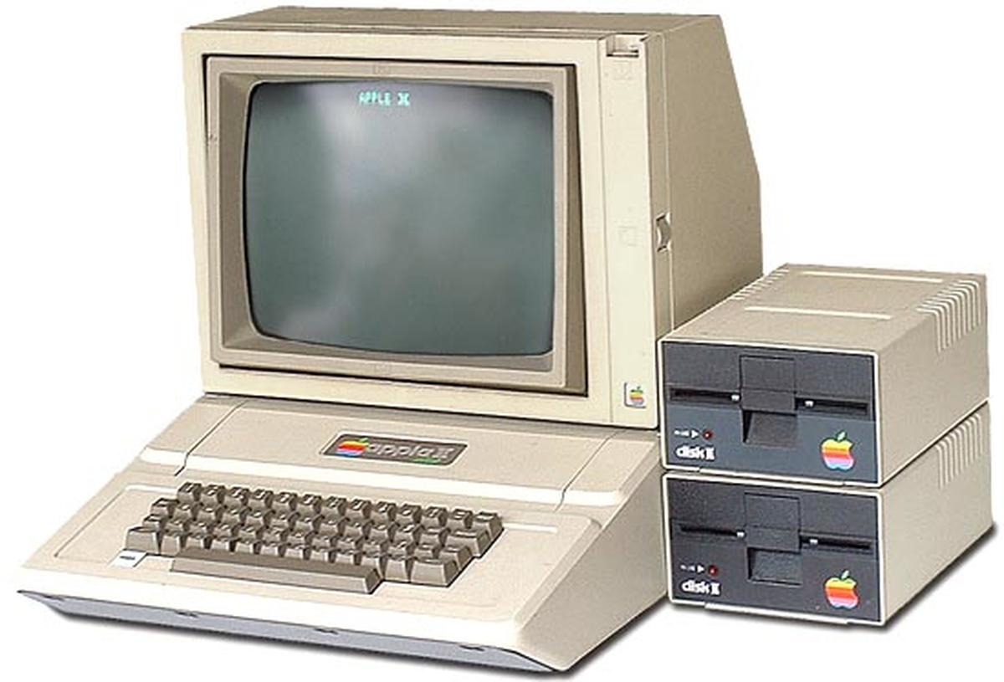
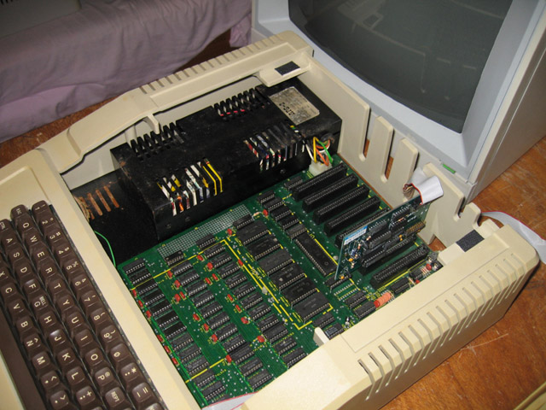

Slide 74
