Slide 1


http://www.comp.nus.edu.sg/~cs2100/
Lecture #23
Cache
Part II: Set/Fully Associative Cache

Slide 2
Lecture #23: Cache II: Set/Fully Associative Cache
Types of Cache Misses
Block Size Trade-off
Set Associative Cache
Fully Associative Cache
Block Replacement Policy
Additional Examples
Summary
Exploration

Slide 3
1. (Recall) Types of Cache Misses
Compulsory misses
On the first access to a block; the block must be brought into the cache
Also called cold start misses or first reference misses
Conflict misses
Occur in the case of direct mapped cache or set associative cache, when several blocks are mapped to the same block/set
Also called collision misses or interference misses
Capacity misses
Occur when blocks are discarded from cache as cache cannot contain all blocks needed

Slide 4
2. Block Size Trade-off (1/2)
Average Access Time
= Hit rate x Hit Time + (1-Hit rate) x Miss penalty
Larger block size:
+ Takes advantage of spatial locality
– Larger miss penalty: Takes longer time to fill up the block
– If block size is too big relative to cache size
➔ Too few cache blocks ➔ miss rate will go up
Miss
Penalty
Miss
Rate
Average
Access
Time
Exploits Spatial Locality
Fewer blocks:
compromises
temporal locality
Block Size
Block Size
Block Size

Slide 5
2. Block Size Trade-off (2/2)

Slide 6
3. Set Associative (SA) Cache
Compulsory misses
On the first access to a block; the block must be brought into the cache
Also called cold start misses or first reference misses
Conflict misses
Occur in the case of direct mapped cache or set associative cache, when several blocks are mapped to the same block/set
Also called collision misses or interference misses
Capacity misses
Occur when blocks are discarded from cache as cache cannot contain all blocks needed
Solution:
Set Associative Cache

Slide 7

3. Set Associative Cache: Analogy
Many book titles start with “T”
➔ Too many conflicts!
Hmm… how about we give more slots per letter, 2 books start with “A”, 2 books start with “B”, …. etc?

Slide 8
3. Set Associative (SA) Cache
N-way Set Associative Cache
A memory block can be placed in a fixed number (N) of locations in the cache, where N > 1
Key Idea:
Cache consists of a number of sets:
Each set contains N cache blocks
Each memory block maps to a unique cache set
Within the set, a memory block can be placed in any of the N cache blocks in the set

Slide 9
3. Set Associative Cache: Structure
Valid
Tag
Data
Valid
Tag
Data
Set Index
00
01
Set
10
11
2-way Set Associative Cache
An example of 2-way set associative cache
Each set has two cache blocks
A memory block maps to a unique set
In the set, the memory block can be placed in either of the cache blocks
➔ Need to search both to look for the memory block

Slide 10
3. Set Associative Cache: Mapping
Memory Address
31
N
N-1
0
Block Number
Offset
Cache Block size = 2^{N} bytes
Cache Set Index
= (BlockNumber) modulo (NumberOfCacheSets)
31
N+M-1
N
N-1
0
Tag
Set Index
Offset
Cache Block size = 2^{N} bytes
Number of cache sets = 2^{M}
Offset = N bits
Set Index = M bits
Tag = 32 – (N + M) bits
Observation:
It is essentially unchanged from the direct-mapping formula

Slide 11
3. Set Associative Cache: Example
Memory Address
Memory
4GB
31
N
N-1
0
Block Number
Offset
Offset, N = 2 bits
Block Number = 32 – 2 = 30 bits
Check: Number of Blocks = 2³⁰
1 Block
= 4 bytes
31
N+M-1
N
N-1
0
Tag
Set Index
Offset
Number of Cache Blocks
= 4KB / 4bytes = 1024 = 2¹⁰
4-way associative, number of sets
= 1024 / 4 = 256 = 2⁸
Set Index, M = 8 bits
Cache Tag = 32 – 8 – 2 = 22 bits
Cache
4 KB

Slide 12
3. Set Associative Cache: Circuitry
4-way 4-KB cache: 1-word (4-byte) blocks
31 30 . . . 11 10 9 . . . 2 1 0
Tag
Idx
Ofst
Tag
22
8
Set Index
V
Tag
Data
V
Tag
Data
V
Tag
Data
V
Tag
Data
0
0
0
0
1
1
1
1
2
2
2
2
.
.
.
.
.
.
.
.
.
.
.
.
254
254
254
254
255
255
255
255
22
22
22
22
=
=
=
=
Note the simultaneous "search" on all tags of a set.
A
B
C
D
A
B
C
4 x 1 Select
Hit
D
32
Data
Notes:
4 blocks per set (4-way)
Index -> check validity on all 4 sets of data -> check tag for all 4 sets -> if any one set matches, hit -> use offset , whichever set is a hit (of A,B,C,D) will be selected, data obtained from that set

Slide 13
3. Advantage of Associativity (1/3)
Block Number (Not Address)
Cache Index
0
a block
00
1
01
2
10
3
11
4
Cache
5
Memory
Direct Mapped Cache
6
7
8
9
10
Example:
Given this memory block sequence: 0 4 0 4 0 4 0 4
Result:
Cold Miss = 2 (First two accesses)
Conflict Miss = 6 (The rest of the accesses)
11
12
13
14
15

Slide 14
3. Advantage of Associativity (2/3)
Block Number (Not Address)
Set Index
0
a block
0
1
1
2
Cache
3
4
5
Memory
2-way Set Associative Cache
6
7
8
9
10
Example:
Given this memory block sequence: 0 4 0 4 0 4 0 4
Result:
Cold Miss = 2 (First two accesses)
Conflict Miss = None (as all of them are hits!)
11
12
13
14
15

Slide 15
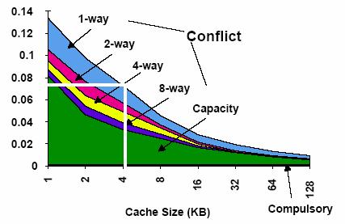
3. Advantage of Associativity (3/3)
Rule of Thumb:
A direct-mapped cache of size N has about the same miss rate
as a 2-way set associative cache of size N/2

Slide 16
3. SA Cache Example: Setup
Given:
Memory access sequence: 4, 0, 8, 36, 0
2-way set-associative cache with a total of four 8-byte blocks ➔ total of 2 sets
Indicate hit/miss for each access
31
4
3
2
0
Tag
Set Index
Offset
Offset, N = 3 bits
Block Number = 32 – 3 = 29 bits
2-way associative, number of sets= 2 = 2¹
Set Index, M = 1 bits
Cache Tag = 32 – 3 – 1 = 28 bits

Slide 17
3. SA Cache Example: Load #1
Miss
4, 0 , 8, 36, 0
Tag
Index
Offset
Load from 4 ➔
Check: Both blocks in Set 0 are invalid [ Cold Miss ]
000000000000000000000000000
0
100
Result: Load from memory and place in Set 0 - Block 0
 | Block 0 |  |  |  | Block 1
Set Index | Valid | Tag | W0 | W1 | Valid | Tag | W0 | W1
0 | 0 |  |  |  | 0
1 | 0 |  |  |  | 0
1
0
M[0]
M[4]

Slide 18
3. SA Cache Example: Load #2
Miss
Hit
4, 0 , 8, 36, 0
Tag
Index
Offset
Load from 0 ➔
Result:
[Valid and Tags match] in Set 0-Block 0 [ Spatial Locality ]
000000000000000000000000000
0
000
 | Block 0 |  |  |  | Block 1
Set Index | Valid | Tag | W0 | W1 | Valid | Tag | W0 | W1
0 | 1 | 0 | M[0] | M[4] | 0
1 | 0 |  |  |  | 0

Slide 19
3. SA Cache Example: Load #3
Miss
Hit
Miss
4, 0 , 8, 36, 0
Tag
Index
Offset
Load from 8 ➔
Check: Both blocks in Set 1 are invalid [ Cold Miss ]
000000000000000000000000000
1
000
Result: Load from memory and place in Set 1 - Block 0
 | Block 0 |  |  |  | Block 1
Set Index | Valid | Tag | W0 | W1 | Valid | Tag | W0 | W1
0 | 1 | 0 | M[0] | M[4] | 0
1 | 0 |  |  |  | 0
1
0
M[8]
M[12]

Slide 20
3. SA Cache Example: Load #4
Miss
Hit
Miss
Miss
4, 0 , 8, 36, 0
Tag
Index
Offset
Load from 36 ➔
Check: [Valid but tag mismatch] Set 0 - Block 0 [Invalid] Set 0 - Block1 [ Cold Miss ]
000000000000000000000000010
0
100
Result: Load from memory and place in Set 0 - Block 1
 | Block 0 |  |  |  | Block 1
Set Index | Valid | Tag | W0 | W1 | Valid | Tag | W0 | W1
0 | 1 | 0 | M[0] | M[4] | 0
1 | 1 | 0 | M[8] | M[12] | 0
1
2
M[32]
M[36]

Slide 21
3. SA Cache Example: Load #5
Miss
Hit
Miss
Miss
Hit
4, 0 , 8, 36, 0
Tag
Index
Offset
Load from 0 ➔
Check: [Valid and tags match] Set 0-Block 0 [Valid but tags mismatch] Set 0-Block1
[ Temporal Locality ]
000000000000000000000000000
0
000
 | Block 0 |  |  |  | Block 1
Set Idx | Valid | Tag | W0 | W1 | Valid | Tag | W0 | W1
0 | 1 | 0 | M[0] | M[4] | 1 | 2 | M[32] | M[36]
1 | 1 | 0 | M[8] | M[12] | 0

Slide 22
4. Fully Associative (FA) Cache
Compulsory misses
On the first access to a block; the block must be brought into the cache
Also called cold start misses or first reference misses
Conflict misses
Occur in the case of direct mapped cache or set associative cache, when several blocks are mapped to the same block/set
Also called collision misses or interference misses
Capacity misses
Occur when blocks are discarded from cache as cache cannot contain all blocks needed
Occurs in
Fully Associative Cache

Slide 23
4. Fully Associative (FA) Cache: Analogy
Let's not restrict the book by title any more. A book can go into any location on the desk!

Slide 24
4. Fully Associative (FA) Cache
Fully Associative Cache
A memory block can be placed in any location in the cache
Key Idea:
Memory block placement is no longer restricted by cache index or cache set index
++ Can be placed in any location, BUT
--- Need to search all cache blocks for memory access

Slide 25
4. Fully Associative Cache: Mapping
Memory Address
31
N
N-1
0
Block Number
Offset
Cache Block size = 2^{N} bytes
31
N
N-1
0
Tag
Offset
Cache Block size = 2^{N} bytes
Number of cache blocks = 2^{M}
Offset = N bits
Tag = 32 – N bits
Observation:
The block number serves as the tag in FA cache.

Slide 26
4. Fully Associative Cache: Circuitry
Example:
4KB cache size and 16-Byte block size
Compare tags and valid bit in parallel
Tag
Offset
28-bit
4-bit
Index
Tag
Valid
Bytes 0-3
Bytes 4-7
Bytes 8-11
Bytes 12-15
=
0
=
1
=
2
=
3
... ... ... … … … … …
=
254
=
255
No Conflict Miss (since data can go anywhere)

Slide 27
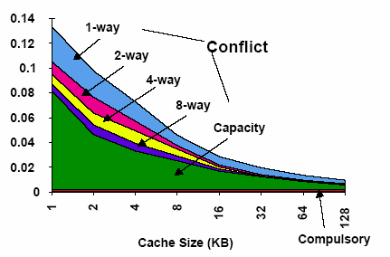
4. Cache Performance
Observations:
Cold/compulsory miss remains the same irrespective of cache size/associativity.
For the same cache size, conflict miss goes down with increasing associativity.
Conflict miss is 0 for FA caches.
For the same cache size, capacity miss remains the same irrespective of associativity.
Capacity miss decreases with increasing cache size .
Identical block size
Total Miss = Cold miss + Conflict miss + Capacity miss
Capacity miss (FA) = Total miss (FA) – Cold miss (FA), when Conflict Miss➔0

Slide 28
5. Block Replacement Policy (1/3)
Set Associative or Fully Associative Cache:
Can choose where to place a memory block
Potentially replacing another cache block if full
Need block replacement policy
Least Recently Used (LRU)
How: For cache hit, record the cache block that was accessed
When replacing a block, choose one which has not been accessed for the longest time
Why: Temporal locality

Slide 29
5. Block Replacement Policy (2/3)
Least Recently Used policy in action:
4-way SA cache
Memory accesses: 0 4 8 12 4 16 12 0 4
LRU
Access 4
0
4
8
12
Hit
Access 16
0
8
12
4
Miss (Evict Block 0)
x
Access 12
8
12
4
16
Hit
Access 0
8
4
16
12
Miss (Evict Block 8)
x
Access 4
4
16
12
0
Hit
16
12
0
4

Slide 30
5. Block Replacement Policy (3/3)
Drawback for LRU
Hard to keep track if there are many choices
Other replacement policies:
First in first out (FIFO)
Random replacement (RR)
Least frequently used (LFU)

Slide 31
6. Additional Examples #1
Addr: Tag Index Offset
4: 00…000 00 100
8: 00…000 01 000
36: 00…001 00 100
48: 00…001 10 000
68: 00…010 00 100
0: 00…000 00 000
32: 00…001 00 000
Direct-Mapped Cache:
Four 8-byte blocks
Memory accesses: 4, 8, 36, 48, 68, 0, 32
Index | Valid | Tag | Word0 | Word1
0 | 0
1 | 0
2 | 0
3 | 0
1
M[32]
M[36]
1
0
M[0]
M[4]
1
M[32]
M[36]
2
M[64]
M[68]
0
M[0]
M[4]
1
0
M[8]
M[12]
1
1
M[48]
M[52]


Slide 32
6. Additional Examples #2
Addr: Tag Offset
4: 00…00000 100
8: 00…00001 000
36: 00…00100 100
48: 00…00110 000
68: 00…01000 100
0: 00…00000 000
32: 00…00100 000
Fully-Associative Cache:
Four 8-byte blocks
LRU Replacement Policy
Memory accesses: 4, 8, 36, 48, 68, 0, 32
Hit
Index | Valid | Tag | Word0 | Word1
0 | 0
1 | 0
2 | 0
3 | 0
1
0
M[0]
M[4]
8
M[64]
M[68]
1
1
M[8]
M[12]
0
M[0]
M[4]
1
4
M[32]
M[36]
1
6
M[48]
M[52]


Slide 33
6. Additional Examples #3
Addr: Tag Index Offset
4: 00…0000 0 100
8: 00…0000 1 000
36: 00…0010 0 100
48: 00…0011 0 000
68: 00…0100 0 100
0: 00…0000 0 000
32: 00…0010 0 000
2-way Set-Associative Cache:
Four 8-byte blocks
LRU Replacement Policy
Memory accesses: 4, 8, 36, 48, 68, 0, 32
 | Block 0 |  |  |  | Block 1
Set Index | Valid | Tag | Word0 | Word1 | Valid | Tag | Word0 | Word1
0 | 0 |  |  |  | 0
1 | 0 |  |  |  | 0
0
M[0]
M[4]
2
M[32]
M[36]
1
3
M[48]
M[52]
1
4
M[64]
M[68]
0
M[0]
M[4]
2
M[32]
M[36]
1
0
M[8]
M[12]


Slide 34
7. Summary: Cache Organizations
One-way set associative
(direct mapped)
Two-way set associative
Set
Tag
Data
Tag
Data
Block
Tag
Data
0
1
2
3
0
1
2
3
4
5
6
7
Four-way set associative
Set
Tag
Data
Tag
Data
Tag
Data
Tag
Data
0
1
Eight-way set associative (fully associative)
Tag
Data
Tag
Data
Tag
Data
Tag
Data
Tag
Data
Tag
Data
Tag
Data
Tag
Data

Slide 35
7. Summary: Cache Framework (1/2)
Block Placement: Where can a block be placed in cache?
Direct Mapped:
N-way Set-Associative:
Fully Associative:
Only one block defined by index
Any one of the N blocks within the set defined by index
Any cache block
Block Identification: How is a block found if it is in the cache?
Direct Mapped:
N-way Set Associative:
Fully Associative:
Tag match with only one block
Tag match for all the blocks within the set
Tag match for all the blocks within the cache

Slide 36
7. Summary: Cache Framework (2/2)
Block Replacement: Which block should be replaced on a cache miss?
Direct Mapped:
N-way Set-Associative:
Fully Associative:
No Choice
Based on replacement policy
Based on replacement policy
Write Strategy: What happens on a write?
Write Policy: Write-through vs write-back
Write Miss Policy: Write allocate vs write no allocate

Slide 37
8. Exploration: Improving Cache Penalty
Average Access Time
= Hit rate x Hit Time + (1-Hit rate) x Miss penalty
So far, we tried to improve Miss Rate:
Larger block size
Larger Cache
Higher Associativity
What about Miss Penalty?

Slide 38
8. Exploration: Multilevel Cache
Options:
Separate data and instruction caches, or a unified cache
Sample sizes:
L1: 32KB, 32-byte block, 4-way set associative
L2: 256KB, 128-byte block, 8-way associative
L3: 4MB, 256-byte block, Direct mapped
Processor
L1 I$
Reg
Unified
L2 $
Disk
Memory
L1 D$

Slide 39
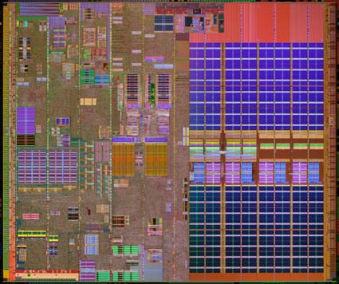
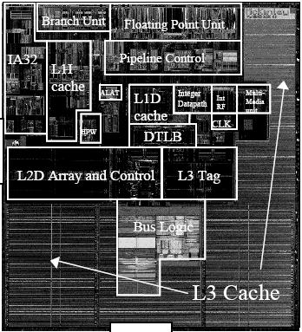
8. Exploration: Intel Processors
Pentium 4 Extreme Edition
L1: 12KB I$ + 8KB D$
L2: 256KB
L3: 2MB
Itanium 2 McKinley
L1: 16KB I$ + 16KB D$
L2: 256KB
L3: 1.5MB – 9MB

Slide 40
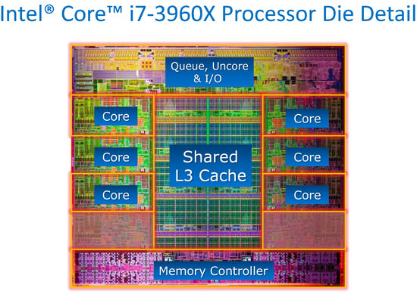
8. Exploration: Trend: Intel Core i7-3960K
Intel Core i7-3960K
per die:
2.27 billion transistors
15MB shared Inst/Data Cache (LLC)
per Core:
-32KB L1 Inst Cache
-32KB L1 Data Cache
-256KB L2 Inst/Data Cache
-up to 2.5MB LLC

Slide 41
Reading
Large and Fast: Exploiting Memory Hierarchy
Chapter 7 sections 7.1 – 7.2 (3rd edition)
Chapter 5 sections 5.1 – 5.2 (4th edition)

Slide 42
End of File

