Slide 1
CS2100
9 November 2021
Selected Past Years’ Exam Questions
(Prepared by: Aaron Tan)

Slide 2
Contents:
AY2020/21 Sem2 Exam Q12 (Sequential Circuits)
AY2020/21 Sem2 Exam Q13 (Combinational Circuits)
AY2020/21 Sem2 Exam Q14 (MIPS)
AY2020/21 Sem2 Exam Q15 (Cache)
AY2017/18 Sem2 Exam Q3 (Combinational circuits)
AY2017/18 Sem2 Exam Q4 (Datapath/control)
AY2017/18 Sem2 Exam Q7 (Cache)
AY2016/17 Sem2 Midterm Test Q4 (Boolean Algebra)
AY2016/17 Sem2 Exam Q2
AY2016/17 Sem2 Exam Q6
AY2016/17 Sem2 Exam Q4(a)-(d) (Zephyr)
AY2016/17 Sem2 Exam Q5 (Datapath/control)
AY2015/16 Sem1 Exam Q11 (Pipelining)
AY2015/16 Sem1 Exam Q12 (Cache)

Slide 3
AY2020/21 Semester 2

Slide 4
AY2020/21 Semester 2 Q12
5 valid states: 000 to 100.
Present state |  |  | Input | Flip-flop A |  | Flip-flop B |  | Flip-flop C |  | Next state
A | B | C | x | JA | KA | JB | KB | JC | KC | A⁺ | B⁺ | C⁺
0 | 0 | 0 | 0 | 0 | 0 | 1 | 1 | 1 | 1 | 0 | 1 | 1
0 | 0 | 0 | 1 | 0 | 0 | 0 | 1 | 0 | 1 | 0 | 0 | 0
0 | 0 | 1 | 0 | 0 | 0 | 1 | 0 | 1 | 1 | 0 | 1 | 0
0 | 0 | 1 | 1 | 0 | 0 | 0 | 0 | 0 | 1 | 0 | 0 | 0
0 | 1 | 0 | 0 | 0 | 1 | 1 | 1 | 1 | 1 | 0 | 0 | 1
0 | 1 | 0 | 1 | 0 | 1 | 0 | 1 | 0 | 1 | 0 | 0 | 0
0 | 1 | 1 | 0 | 0 | 1 | 1 | 0 | 1 | 1 | 0 | 1 | 0
0 | 1 | 1 | 1 | 0 | 1 | 0 | 0 | 0 | 1 | 0 | 1 | 0
1 | 0 | 0 | 0 | 0 | 0 | 1 | 1 | 1 | 1 | 1 | 1 | 1
1 | 0 | 0 | 1 | 1 | 0 | 0 | 1 | 0 | 1 | 1 | 0 | 0
1 | 0 | 1 | 0 | 0 | 0 | 1 | 0 | 1 | 1 | 1 | 1 | 0
1 | 0 | 1 | 1 | 1 | 0 | 0 | 0 | 0 | 1 | 1 | 0 | 0
1 | 1 | 0 | 0 | 0 | 1 | 1 | 1 | 1 | 1 | 0 | 0 | 1
1 | 1 | 0 | 1 | 1 | 1 | 0 | 1 | 0 | 1 | 0 | 0 | 0
1 | 1 | 1 | 0 | 0 | 1 | 1 | 0 | 1 | 1 | 0 | 1 | 0
1 | 1 | 1 | 1 | 1 | 1 | 0 | 0 | 0 | 1 | 0 | 1 | 0
x
J
Q
A
K
Q'
J
Q
B
K
Q'
J
Q
1
K
Q'
C'
Clock
JA = A; KA = B
JB = x'; KB = C'
JC = x’; KC = 1

Slide 5
AY2020/21 Semester 2 Q12
5 valid states: 000 to 100.
Present state |  |  | Input | Flip-flop A |  | Flip-flop B |  | Flip-flop C |  | Next state
A | B | C | x | JA | KA | JB | KB | JC | KC | A⁺ | B⁺ | C⁺
0 | 0 | 0 | 0 | 0 | 0 | 1 | 1 | 1 | 1 | 0 | 1 | 1
0 | 0 | 0 | 1 | 0 | 0 | 0 | 1 | 0 | 1 | 0 | 0 | 0
0 | 0 | 1 | 0 | 0 | 0 | 1 | 0 | 1 | 1 | 0 | 1 | 0
0 | 0 | 1 | 1 | 0 | 0 | 0 | 0 | 0 | 1 | 0 | 0 | 0
0 | 1 | 0 | 0 | 0 | 1 | 1 | 1 | 1 | 1 | 0 | 0 | 1
0 | 1 | 0 | 1 | 0 | 1 | 0 | 1 | 0 | 1 | 0 | 0 | 0
0 | 1 | 1 | 0 | 0 | 1 | 1 | 0 | 1 | 1 | 0 | 1 | 0
0 | 1 | 1 | 1 | 0 | 1 | 0 | 0 | 0 | 1 | 0 | 1 | 0
1 | 0 | 0 | 0 | 0 | 0 | 1 | 1 | 1 | 1 | 1 | 1 | 1
1 | 0 | 0 | 1 | 1 | 0 | 0 | 1 | 0 | 1 | 1 | 0 | 0
1 | 0 | 1 | 0 | 0 | 0 | 1 | 0 | 1 | 1 | 1 | 1 | 0
1 | 0 | 1 | 1 | 1 | 0 | 0 | 0 | 0 | 1 | 1 | 0 | 0
1 | 1 | 0 | 0 | 0 | 1 | 1 | 1 | 1 | 1 | 0 | 0 | 1
1 | 1 | 0 | 1 | 1 | 1 | 0 | 1 | 0 | 1 | 0 | 0 | 0
1 | 1 | 1 | 0 | 0 | 1 | 1 | 0 | 1 | 1 | 0 | 1 | 0
1 | 1 | 1 | 1 | 1 | 1 | 0 | 0 | 0 | 1 | 0 | 1 | 0
x
J
Q
A
K
Q'
J
Q
B
K
Q'
J
Q
1
K
Q'
C'
Clock
1
0
1
0
1
4
1
0
0
1
3
2
0,1

Slide 6
AY2020/21 Semester 2 Q12
Remove state 4.
DF
G
DG
G
1
0
0
1
1
0
0
0
F
0
0
1
1
F
1
0
0
0
DF = F’⋅x’ + F⋅G
x
x
DG = G’⋅x’
Present state |  | Input | Next state
F | G | x | DF = F⁺ | DG = G⁺
0 | 0 | 0 | 1 | 1
0 | 0 | 1 | 0 | 0
0 | 1 | 0 | 1 | 0
0 | 1 | 1 | 0 | 0
1 | 0 | 0 | 0 | 1
1 | 0 | 1 | 0 | 0
1 | 1 | 0 | 1 | 0
1 | 1 | 1 | 1 | 0
1
0
0
1
1
0
0
1
3
2
0,1

Slide 7
AY2020/21 Semester 2 Q13
(a) F(A,B,C,D) = Σm(4, 6, 7, 9, 11, 12, 14, 15).
A | B | C | D | F
0 | 0 | 0 | 0 | 0
0 | 0 | 0 | 1 | 0
0 | 0 | 1 | 0 | 0
0 | 0 | 1 | 1 | 0
0 | 1 | 0 | 0 | 1
0 | 1 | 0 | 1 | 0
0 | 1 | 1 | 0 | 1
0 | 1 | 1 | 1 | 1
1 | 0 | 0 | 0 | 0
1 | 0 | 0 | 1 | 1
1 | 0 | 1 | 0 | 0
1 | 0 | 1 | 1 | 1
1 | 1 | 0 | 0 | 1
1 | 1 | 0 | 1 | 0
1 | 1 | 1 | 0 | 1
1 | 1 | 1 | 1 | 1
0
0
1
C
0
1
1
C
0
1
2
3
4
5
6
7
0
A
0
A
1
0
1
1
0
1
2
3
4
5
6
7
8:1
MUX
8:1
MUX
F
F
S₀
S₀
S₁
S₁
S₂
S₂
A B D
B C D

Slide 8
AY2020/21 Semester 2 Q13
(b) F(A,B,C,D) = Σm(4, 6, 7, 9, 11, 12, 14, 15).
A | B | C | D | F
0 | 0 | 0 | 0 | 0
0 | 0 | 0 | 1 | 0
0 | 0 | 1 | 0 | 0
0 | 0 | 1 | 1 | 0
0 | 1 | 0 | 0 | 1
0 | 1 | 0 | 1 | 0
0 | 1 | 1 | 0 | 1
0 | 1 | 1 | 1 | 1
1 | 0 | 0 | 0 | 0
1 | 0 | 0 | 1 | 1
1 | 0 | 1 | 0 | 0
1 | 0 | 1 | 1 | 1
1 | 1 | 0 | 0 | 1
1 | 1 | 0 | 1 | 0
1 | 1 | 1 | 0 | 1
1 | 1 | 1 | 1 | 1
0
0
1
2
3
A
4:1
MUX
F
1
S₀
C
S₁
B D

Slide 9
AY2020/21 Semester 2 Q13
(c) G(A,B,C)
3x8
DEC
0
1
2
3
4
5
6
7
A | B | C | x | y | G
0 | 0 | 0 | 0 | 1 | 0
0 | 0 | 1 | 1 | 1 | 1
0 | 1 | 0 | 1 | 1 | 1
0 | 1 | 1 | 0 | 1 | 0
1 | 0 | 0 | 1 | 0 | 0
1 | 0 | 1 | 1 | 1 | 1
1 | 1 | 0 | 1 | 1 | 1
1 | 1 | 1 | 1 | 0 | 0
x
A
B
C
S₂
S₁
S₀
G
y
E
1
G = B ⊕ C

Slide 10
AY2020/21 Semester 2 Q13
(d) Design a circuit that takes in a 3-bit unsigned binary number X=X₂X₁X₀ and a one-bit value y to generate the output Z₃Z₂Z₁Z₀ which is a binary number representing the value X+5y.
F-block
X₂ | X₁ | X₀ | y | Z₃ | Z₂ | Z₁ | Z₀
0 | 0 | 0 | 0 | 0 | 0 | 0 | 0
0 | 0 | 0 | 1 | 0 | 1 | 0 | 1
0 | 0 | 1 | 0 | 0 | 0 | 0 | 1
0 | 0 | 1 | 1 | 0 | 1 | 1 | 0
0 | 1 | 0 | 0 | 0 | 0 | 1 | 0
0 | 1 | 0 | 1 | 0 | 1 | 1 | 1
0 | 1 | 1 | 0 | 0 | 0 | 1 | 1
0 | 1 | 1 | 1 | 1 | 0 | 0 | 0
1 | 0 | 0 | 0 | 0 | 1 | 0 | 0
1 | 0 | 0 | 1 | 1 | 0 | 0 | 1
1 | 0 | 1 | 0 | 0 | 1 | 0 | 1
1 | 0 | 1 | 1 | 1 | 0 | 1 | 0
1 | 1 | 0 | 0 | 0 | 1 | 1 | 0
1 | 1 | 0 | 1 | 1 | 0 | 1 | 1
1 | 1 | 1 | 0 | 0 | 1 | 1 | 1
1 | 1 | 1 | 1 | 1 | 1 | 0 | 0
y
X₂
X₁
X₀
A
B
C_{in}
A
A
B
FA
HA
B
HA
C_{out}
S
C
C
S
S
Z₃
Z₂
Z₁
Z₀

Slide 11
AY2020/21 Semester 2 Q14
$s0 = base address of array A
$s1 = base address of array B
$s2 = size of array A
$s5 = count
.data
A: .word 10,21,12,17,9,1,20,33 # after: 10,18,12,2,7,-1,20,22
B: .word 100,3,20,15,2,2,65,11
size: .word 8
.text
main: la $s0, A # $s0 is the base address of array A
la $s1, B # $s1 is the base address of array B
# Box 1
# ---------------------------------------------------------------
add $s5, $0, $0 # I1
add $t0, $0, $0 # I2
loop: slt $t8, $t0, $s2 # I3
beq $t8, $0, end # I4
sll $t1, $t0, 2 # I5
add $t3, $t1, $s0 # I6
lw $s3, 0($t3) # I7
andi $t9, $s3, 1 # I8
beq $t9, $0, skip # I9
add $t4, $t1, $s1 # I10
lw $s4, 0($t4) # I11
sub $s3, $s3, $s4 # I12
sw $s3, 0($t3) # I13
addi $s5, $s5, 1 # I14
skip: addi $t0, $t0, 1 # I15
j loop # I16
# --------------------------------------------------------------
end: # Box 2
syscall # system call to print
li $v0, 10
syscall # system call to exit
(a) Fill in Box 1 with MIPS instruction(s) to load the value of size into $s2.
la $t0, size
lw $s2, 0($t0)
(b) Fill in Box 1 with MIPS instruction(s) to prepare for the printing of the value of count ($s5).
li $v0, 1
add $a0, $s5, $0

Slide 12
AY2020/21 Semester 2 Q14
$s0 = base address of array A
$s1 = base address of array B
$s2 = size of array A
$s5 = count
.data
A: .word 10,21,12,17,9,1,20,33 # after: 10,18,12,2,7,-1,20,22
B: .word 100,3,20,15,2,2,65,11
size: .word 8
.text
main: la $s0, A # $s0 is the base address of array A
la $s1, B # $s1 is the base address of array B
# Box 1
# ---------------------------------------------------------------
add $s5, $0, $0 # I1
add $t0, $0, $0 # I2
loop: slt $t8, $t0, $s2 # I3
beq $t8, $0, end # I4
sll $t1, $t0, 2 # I5
add $t3, $t1, $s0 # I6
lw $s3, 0($t3) # I7
andi $t9, $s3, 1 # I8
beq $t9, $0, skip # I9
add $t4, $t1, $s1 # I10
lw $s4, 0($t4) # I11
sub $s3, $s3, $s4 # I12
sw $s3, 0($t3) # I13
addi $s5, $s5, 1 # I14
skip: addi $t0, $t0, 1 # I15
j loop # I16
# --------------------------------------------------------------
end: # Box 2
syscall # system call to print
li $v0, 10
syscall # system call to exit
(c) Write an equivalent C code for I1 to I16.
count = 0;
for (j=0; j<size; j++) {
if (A[j]%2 == 1) {
A[j] = A[j] – B[j];
count = count + 1;
}
}

Slide 13
AY2020/21 Semester 2 Q14
$s0 = base address of array A
$s1 = base address of array B
$s2 = size of array A
$s5 = count
.data
A: .word 10,21,12,17,9,1,20,33 # after: 10,18,12,2,7,-1,20,22
B: .word 100,3,20,15,2,2,65,11
size: .word 8
.text
main: la $s0, A # $s0 is the base address of array A
la $s1, B # $s1 is the base address of array B
# Box 1
# ---------------------------------------------------------------
add $s5, $0, $0 # I1
add $t0, $0, $0 # I2
loop: slt $t8, $t0, $s2 # I3
beq $t8, $0, end # I4
sll $t1, $t0, 2 # I5
add $t3, $t1, $s0 # I6
lw $s3, 0($t3) # I7
andi $t9, $s3, 1 # I8
beq $t9, $0, skip # I9
add $t4, $t1, $s1 # I10
lw $s4, 0($t4) # I11
sub $s3, $s3, $s4 # I12
sw $s3, 0($t3) # I13
addi $s5, $s5, 1 # I14
skip: addi $t0, $t0, 1 # I15
j loop # I16
# --------------------------------------------------------------
end: # Box 2
syscall # system call to print
li $v0, 10
syscall # system call to exit
(d) Instruction encoding of I3.
slt $t8, $t0, $s2
opcode = 0; funct = 0x2A = 0b101010
rd = $t8 = $24 = 0b11000
rs = $t0 = $8 = 0b01000
rt = $s2 = $18 = 0b10010
opcode rs rt rd shamt funct
000000 01000 10010 11000 00000 101010
0x 0 1 1 2 C 0 2 A

Slide 14
AY2020/21 Semester 2 Q14
$s0 = base address of array A
$s1 = base address of array B
$s2 = size of array A
$s5 = count
.data
A: .word 10,21,12,17,9,1,20,33 # after: 10,18,12,2,7,-1,20,22
B: .word 100,3,20,15,2,2,65,11
size: .word 8
.text
main: la $s0, A # $s0 is the base address of array A
la $s1, B # $s1 is the base address of array B
# Box 1
# ---------------------------------------------------------------
add $s5, $0, $0 # I1
add $t0, $0, $0 # I2
loop: slt $t8, $t0, $s2 # I3
beq $t8, $0, end # I4
sll $t1, $t0, 2 # I5
add $t3, $t1, $s0 # I6
lw $s3, 0($t3) # I7
andi $t9, $s3, 1 # I8
beq $t9, $0, skip # I9
add $t4, $t1, $s1 # I10
lw $s4, 0($t4) # I11
sub $s3, $s3, $s4 # I12
sw $s3, 0($t3) # I13
addi $s5, $s5, 1 # I14
skip: addi $t0, $t0, 1 # I15
j loop # I16
# --------------------------------------------------------------
end: # Box 2
syscall # system call to print
li $v0, 10
syscall # system call to exit
(e) Instruction encoding of I9.
beq $t9, $0, skip
opcode = 0x4 = 0b000100
rs = $t9 = $25 = 0b11001
rt = $0 = 0b00000
skip = 5
opcode rs rt immed
000100 11001 00000 0000000000000101
0x 1 3 2 0 0 0 0 5

Slide 15
AY2020/21 Semester 2 Q14
$s0 = base address of array A
$s1 = base address of array B
$s2 = size of array A
$s5 = count
.data
A: .word 10,21,12,17,9,1,20,33 # after: 10,18,12,2,7,-1,20,22
B: .word 100,3,20,15,2,2,65,11
size: .word 8
.text
main: la $s0, A # $s0 is the base address of array A
la $s1, B # $s1 is the base address of array B
# Box 1
# ---------------------------------------------------------------
add $s5, $0, $0 # I1
add $t0, $0, $0 # I2
loop: slt $t8, $t0, $s2 # I3
beq $t8, $0, end # I4
sll $t1, $t0, 2 # I5
add $t3, $t1, $s0 # I6
lw $s3, 0($t3) # I7
andi $t9, $s3, 1 # I8
beq $t9, $0, skip # I9
add $t4, $t1, $s1 # I10
lw $s4, 0($t4) # I11
sub $s3, $s3, $s4 # I12
sw $s3, 0($t3) # I13
addi $s5, $s5, 1 # I14
skip: addi $t0, $t0, 1 # I15
j loop # I16
# --------------------------------------------------------------
end: # Box 2
syscall # system call to print
li $v0, 10
syscall # system call to exit
(f) Instruction encoding of I16. I1 at address 0x10000C50.
j loop
opcode = 0x2 = 0b000010
Address at loop:
0x10000C58
0b 0001 0000 0000 0000 0000 1100 0101 1000
opcode immed
0b 000010 0000 0000 0000 0000 1100 0101 10
0x 0 8 0 0 0 3 1 6

Slide 16
AY2020/21 Semester 2 Q15
Direct-mapped data cache with 128 words in total and each block contains 4 words.
Data cache used for lw, not for sw.
Array A starts at 0xFF000C00; all elements +ve odd integers.
Array B follows array A immediately.
add $s5, $0, $0 # I1
add $t0, $0, $0 # I2
loop: slt $t8, $t0, $s2 # I3
beq $t8, $0, end # I4
sll $t1, $t0, 2 # I5
add $t3, $t1, $s0 # I6
lw $s3, 0($t3) # I7
andi $t9, $s3, 1 # I8
beq $t9, $0, skip # I9
add $t4, $t1, $s1 # I10
lw $s4, 0($t4) # I11
sub $s3, $s3, $s4 # I12
sw $s3, 0($t3) # I13
addi $s5, $s5, 1 # I14
skip: addi $t0, $t0, 1 # I15
j loop # I16
(a) How many bits in the index field? In the byte offset field?
128/4 = 32 blocks
→ 5 bits for index field.
16 bytes per block
→ 4 bits for byte offset field.

Slide 17
AY2020/21 Semester 2 Q15
Direct-mapped data cache with 128 words in total and each block contains 4 words.
Data cache used for lw, not for sw.
Array A starts at 0xFF000C00; all elements +ve odd integers.
Array B follows array A immediately.
add $s5, $0, $0 # I1
add $t0, $0, $0 # I2
loop: slt $t8, $t0, $s2 # I3
beq $t8, $0, end # I4
sll $t1, $t0, 2 # I5
add $t3, $t1, $s0 # I6
lw $s3, 0($t3) # I7
andi $t9, $s3, 1 # I8
beq $t9, $0, skip # I9
add $t4, $t1, $s1 # I10
lw $s4, 0($t4) # I11
sub $s3, $s3, $s4 # I12
sw $s3, 0($t3) # I13
addi $s5, $s5, 1 # I14
skip: addi $t0, $t0, 1 # I15
j loop # I16
(b) Array A contains 3200 elements. What is the hit rate for array A? for array B?
Array A starts at 0xFF000C00 = 0b…110 00000 0000.
Array B starts at 0xFF000C00 + (3200×4) = 0xFF003E00
= 0b…111 00000 0000.
A[0] and B[0] loaded into block 0 word 0. In fact, A[i] and B[i] (0 < i < 3199) are loaded into the same block same word → cache thrashing.
Therefore, 0 hit rate for arrays A and B.

Slide 18
AY2020/21 Semester 2 Q15
Direct-mapped data cache with 128 words in total and each block contains 4 words.
Data cache used for lw, not for sw.
Array A starts at 0xFF000C00; all elements +ve odd integers.
Array B follows array A immediately.
add $s5, $0, $0 # I1
add $t0, $0, $0 # I2
loop: slt $t8, $t0, $s2 # I3
beq $t8, $0, end # I4
sll $t1, $t0, 2 # I5
add $t3, $t1, $s0 # I6
lw $s3, 0($t3) # I7
andi $t9, $s3, 1 # I8
beq $t9, $0, skip # I9
add $t4, $t1, $s1 # I10
lw $s4, 0($t4) # I11
sub $s3, $s3, $s4 # I12
sw $s3, 0($t3) # I13
addi $s5, $s5, 1 # I14
skip: addi $t0, $t0, 1 # I15
j loop # I16
(c) Array A contains 3216 elements. What is the hit rate for array A? for array B?
Array A starts at 0xFF000C00 = 0b…110 00000 0000.
Array B starts at 0xFF000C00 + (3216×4) = 0xFF003E40
= 0b…111 00100 0000.
A[0] loaded into block 0 word 0. B[0] loaded into block 4 word 0.
First 4 iterations A[0] is miss and A[1] to A[3] are hits. Same for array B.
Therefore, 75% hit rate for arrays A and B.

Slide 19
AY2020/21 Semester 2 Q15
(d) Array A contains 3210 elements. What is the hit rate for array A? for array B?
add $s5, $0, $0 # I1
add $t0, $0, $0 # I2
loop: slt $t8, $t0, $s2 # I3
beq $t8, $0, end # I4
sll $t1, $t0, 2 # I5
add $t3, $t1, $s0 # I6
lw $s3, 0($t3) # I7
andi $t9, $s3, 1 # I8
beq $t9, $0, skip # I9
add $t4, $t1, $s1 # I10
lw $s4, 0($t4) # I11
sub $s3, $s3, $s4 # I12
sw $s3, 0($t3) # I13
addi $s5, $s5, 1 # I14
skip: addi $t0, $t0, 1 # I15
j loop # I16
Array A starts at 0xFF000C00 = 0b…110 00000 0000.
Array B starts at 0xFF000C00 + (3216×4) = 0xFF003E28
= 0b…111 00010 1000.
A[0] loaded into block 0 word 0. B[0] loaded into block 2 word 2.
First 8 iterations:
Index 0
Index 1
Index 2
Index 3
Index 4
:
A[0] | A[1] | A[2] | A[3]
A[4] | A[5] | A[6] | A[7]
… | … | B[0] | B[1]
B[2] | B[3] | B[4] | B[5]
B[6] | B[7] | … | …
Cache access pattern for array A: (M,H,H,H),…,M,H.
The (M,H,H,H) is repeated 802 times.
Therefore, hit rate for array A is 2407/3210 or 74.98%.
Cache access pattern for array B: M,H,(M,H,H,H),….
The (M,H,H,H) is repeated 802 times.
Therefore, hit rate for array B is the same as array A.

Slide 20
AY2020/21 Semester 2 Q15
2-way set-associative instruction cache with 16 words in total and each block contains 2 words.
100 elements in array A, all positive odd integers.
100 elements in array B.
add $s5, $0, $0 # I1
add $t0, $0, $0 # I2
loop: slt $t8, $t0, $s2 # I3
beq $t8, $0, end # I4
sll $t1, $t0, 2 # I5
add $t3, $t1, $s0 # I6
lw $s3, 0($t3) # I7
andi $t9, $s3, 1 # I8
beq $t9, $0, skip # I9
add $t4, $t1, $s1 # I10
lw $s4, 0($t4) # I11
sub $s3, $s3, $s4 # I12
sw $s3, 0($t3) # I13
addi $s5, $s5, 1 # I14
skip: addi $t0, $t0, 1 # I15
j loop # I16
(e) How many bits in the set index field? In the byte offset field?
16/2/2 = 4 sets
→ 2 bits for set index field.
8 bytes per block
→ 3 bits for byte offset field.

Slide 21
AY2020/21 Semester 2 Q15
2-way set-associative instruction cache with 16 words in total and each block contains 2 words.
100 elements in array A, all positive odd integers.
100 elements in array B.
add $s5, $0, $0 # I1
add $t0, $0, $0 # I2
loop: slt $t8, $t0, $s2 # I3
beq $t8, $0, end # I4
sll $t1, $t0, 2 # I5
add $t3, $t1, $s0 # I6
lw $s3, 0($t3) # I7
andi $t9, $s3, 1 # I8
beq $t9, $0, skip # I9
add $t4, $t1, $s1 # I10
lw $s4, 0($t4) # I11
sub $s3, $s3, $s4 # I12
sw $s3, 0($t3) # I13
addi $s5, $s5, 1 # I14
skip: addi $t0, $t0, 1 # I15
j loop # I16
(f) I1at 0x10000C50. How many hits in the execution of the code?
0x10000C50 = 0b00… 010 10 000
I1 is loaded into set 2 word 0.
After the first iteration:
Set 0
Set 1
Set2
Set 3
I5 | I6 | I13 | I14
I7 | I8 | I15 | I16
I1 | I2 | I9 | I10
I3 | I4 | I11 | I12
First iteration: 8 hits.
Subsequent iterations (I3 – I16): 14 hits.
After loop (I3, I4): 2 hits.
Therefore, total hits = 8 + (99×14) + 2 = 1396.

Slide 22
AY2020/21 Semester 2 Q15
2-way set-associative instruction cache with 16 words in total and each block contains 2 words.
100 elements in array A, all positive odd integers.
100 elements in array B.
add $s5, $0, $0 # I1
add $t0, $0, $0 # I2
loop: slt $t8, $t0, $s2 # I3
beq $t8, $0, end # I4
sll $t1, $t0, 2 # I5
add $t3, $t1, $s0 # I6
lw $s3, 0($t3) # I7
andi $t9, $s3, 1 # I8
beq $t9, $0, skip # I9
add $t4, $t1, $s1 # I10
lw $s4, 0($t4) # I11
sub $s3, $s3, $s4 # I12
sw $s3, 0($t3) # I13
addi $s5, $s5, 1 # I14
skip: addi $t0, $t0, 1 # I15
j loop # I16
(g) I1at 0x10000C54. How many hits in the execution of the code?
0x10000C54 = 0b00… 010 10 100
I1 is loaded into set 2 word 1.
After the first iteration:
Set 0
Set 1
Set2
Set 3
I4 | I5 | I12 | I13
I6 | I7 | I14 | I15
I16 | I1 | I8 | I9
I2 | I3 | I10 | I11
First iteration: 7 hits.
Subsequent iterations (I3 – I16): 14 hits.
After loop (I3, I4): 2 hits.
Therefore, total hits = 7 + (99×14) + 2 = 1395.

Slide 23
AY2017/18 Semester 2

Slide 24
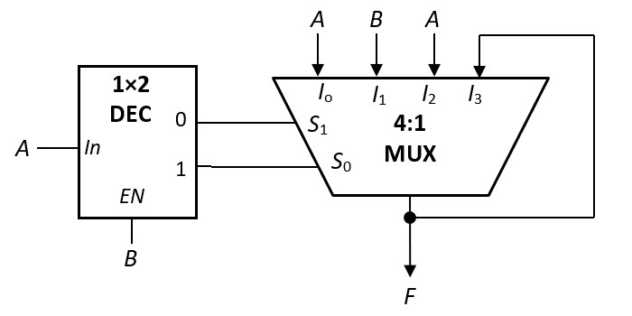
AY2017/18 Semester 2 Q3
(a) Given the following circuit, what is F?
A | B | F
0 | 0
0 | 1
1 | 0
1 | 1
0
0
1
1
F = A

Slide 25






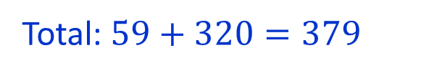
AY2017/18 Semester 2 Q4
(a) Suppose MIPS instructions in R-format must use the following 5 opcodes (in decimal): 0, 1, 16, 17 and 32, what is the maximum total number of instructions that can be supported in MIPS?
Answer: 379
6-bit
6-bit
opcode
funct
Non-R-format:
$${(2}^{6}−5)$$
$$=59$$
R-format:
$$5$$
$$×$$
$$2^{6}$$
$$=320$$
Total: $59+320=379$

Slide 26
AY2017/18 Semester 2 Q4
(b) Suppose due to a hardware defect in the datapath circuit, a stuck-at-0 fault occurs at bit 6 of every MIPS instruction. This means that bit 6 of a MIPS instruction is always 0 regardless of what the instruction is originally. Devise a simple test using a MIPS instruction to discover this error. Explain your test.
One possible test: addi $t0, $zero, 64
0
0 0 0 0 0 0 0 0 0 1 0 0 0 0 0 0
This is supposed to put 64 into $t0.
However, due to stuck-at-0 fault in bit 6, the final value in $t0 will be 0.
Other appropriate examples are accepted.

Slide 27
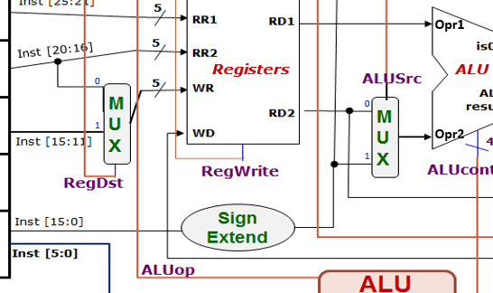
AY2017/18 Semester 2 Q4
(c) Suppose the stuck-at-0 fault occurs at the ALUSrc control signal.
Assuming that $t0 and $t1 contain 12 and 34 respectively, and we are to use the instruction lw $t1, 0($t0) to discover the error. Describe what other preparation work needs to be done. You may assume that we can write data into any location in the memory.
Note that ALUSrc chooses between RD2 and SignExt(Inst[15:0]).
12
If the instruction is correctly carried out, lw $t1, 0($t0) would have loaded the value at memory address 12 into $t1.
34
With stuck-at-0 fault at ALUSrc, the instruction would have loaded the value at memory address 46 into $t1 instead.
0
Hence, we could first load different values in addresses 12 and 46 before using the test.

Slide 28
AY2017/18 Semester 2 Q4
(d) You want to add the bne instruction into the datapath, which already includes the required hardware for the instruction. Write out the ALUop for bne and how you can determine whether the bne results in the branch to be taken.
Opcode | ALUop
lw | 00
sw | 00
beq | 01
R-type | 10
: | :
Since ALUop code 11 is not used, we may use it for bne.
Hence, branch taken = ALUop1 AND ALUop2 AND !(isZero) where (isZero) is the output from the ALU.
or
Use ALUop code 01 (same as beq).
Hence, branch taken = !ALUop1 AND ALUop2 AND !(isZero) where (isZero) is the output from the ALU, or
branch taken = Branch AND !(isZero) .

Slide 29
AY2017/18 Semester 2 Q7
$s0: base addr. of array A;
$s1: base addr. of array B.
$s2: n, #elements in array A (and B)
beq $s2, $zero, End # Inst1, Addr: 0x0040003c
addi $t8, $s2, -1 # Inst2
sll $t8, $t8, 2 # Inst3
Loop: add $t0, $s0, $t8 # Inst4
add $t1, $s1, $t8 # Inst5
lw $t2, 0($t0) # Inst6
lw $t3, 0($t1) # Inst7
andi $t4, $t3, 3 # Inst8
addi $t4, $t4, -3 # Inst9
beq $t4, $zero, A1 # Inst10
add $t2, $t2, $t3 # Inst11
j A2 # Inst12
A1: addi $t2, $t2, 1 # Inst13
A2: sw $t2, 0($t0) # Inst14
addi $t8, $t8, -8 # Inst15
slt $t7, $t8, $zero # Inst16
beq $t7, $zero, Loop # Inst17
End:
int i;
for (i=n-1; i>=0; i-=2) {
if (B[i]%4 == 3)
A[i]++;
else
A[i] += B[i];
}

Slide 30
AY2017/18 Semester 2 Q7
Assuming that arrays A and B now each contains 1024 positive integers. Given a direct-mapped data cache with 128 words in total, each block containing 4 words with each word being 4 bytes long, arrays A and B are stored starting at memory addresses 0x10001000 and 0x1003F100 respectively.
The data cache is involved when memory is accessed (i.e., when lw and sw are executed.)
(a) How many bits are there in the index field? In the byte offset field?
Number of blocks = 128/4 = 32 = $2^{5}$ → index field: 5 bits
Number of bytes per block = 16 = $2^{4}$ → byte offset field: 4 bits
(b) Which index is A[1023] mapped to? Which index is B[1023] mapped to?
A[0] at 0x10001000 → A[1024] at 0x10002000 → A[1023] at 0x10001FFC
10001FFC → … 1111 1111 1100 → Index 31
B[0] at 0x1003F100 → B[1024] at 0x10040100 → B[1023] at 0x100400FC
100400FC → … 0000 1111 1100 → Index 15

Slide 31
AY2017/18 Semester 2 Q7
(c) How many memory accesses in total are made for array A? For array B?
int i;
for (i=n-1; i>=0; i-=2) {
if (B[i]%4 == 3)
A[i]++;
else
A[i] += B[i];
}
512 elements for each array are accessed:
[1023], [1021], …, [3], [1].
A: 1024 accesses (1 read and 1 write per element);
B: 512 accesses.
(d) What is the cache hit rate for array A? For array B?
Since A[1023] and B[1023] are mapped to different indices, there will not be any cache thrashing.
Index
A: 256 misses, 768 hits, hit rate = 75%.
B: 256 misses, 256 hits, hit rate = 50%.
15
B[1020]
B[1021]
B[1022]
B[1023]
31
A[1020]
A[1021]
A[1022]
A[1023]

Slide 32
AY2017/18 Semester 2 Q7
(e) Given a direct-mapped instruction cache with 16 words in total, each block containing 2 instructions (words), and the first beq instruction is at memory address 0x0040003c. How many cache hits and misses are there in total during the execution of the code, assuming that the beq instruction at Inst10 always branches to A1? You may consider only the instructions in the given code segment, i.e., Inst1 – Inst17.
Total #instructions = 3 + 512×12 = 6147.
Index
Cache index field: 3 bits; byte offset: 3 bits.
0
I2
I3
First instruction at 0x0040003c →
… 0011 1100 → index 7, word 1 (second word)
1
I4
I5
2
I6
I7
3
I8
I9
Cache content in first iteration:
Misses: I1, I2, I4, I6, I8, I10, I13, I14 and I16.
4
I10
Subsequently, all instructions are in the cache.
5
I13
Therefore, 9 misses, 6138 hits.
6
I14
I15
7
I16
I1
I17

Slide 33
AY2016/17 Semester 2

Slide 34

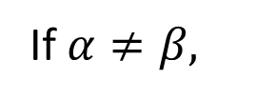

AY2016/17 Semester 2 Midterm Q4
Simplify the following expression of a 15-variable Boolean function.
m’s are the minterms and M’s the maxterms.
(m3125 ⋅ M987 ⋅ m1025) + m895 ⋅ (M2222 + M618)
0
1
Answer: m895
If $α≠β,$
$$mα∙mβ=0$$
$$Mα+Mβ=1$$

Slide 35
AY2016/17 Semester 2 Exam Q2
A | B | C | D | A | C | B | D | F=(AC<BD)
0 | 0 | 0 | 0 | 0 | 0 | 0 | 0 | 0
0 | 0 | 0 | 1 | 0 | 0 | 0 | 1 | 1
0 | 0 | 1 | 0 | 0 | 1 | 0 | 0 | 0
0 | 0 | 1 | 1 | 0 | 1 | 0 | 1 | 0
0 | 1 | 0 | 0 | 0 | 0 | 1 | 0 | 1
0 | 1 | 0 | 1 | 0 | 0 | 1 | 1 | 1
0 | 1 | 1 | 0 | 0 | 1 | 1 | 0 | 1
0 | 1 | 1 | 1 | 0 | 1 | 1 | 1 | 1
1 | 0 | 0 | 0 | 1 | 0 | 0 | 0 | 0
1 | 0 | 0 | 1 | 1 | 0 | 0 | 1 | 0
1 | 0 | 1 | 0 | 1 | 1 | 0 | 0 | 0
1 | 0 | 1 | 1 | 1 | 1 | 0 | 1 | 0
1 | 1 | 0 | 0 | 1 | 0 | 1 | 0 | 0
1 | 1 | 0 | 1 | 1 | 0 | 1 | 1 | 1
1 | 1 | 1 | 0 | 1 | 1 | 1 | 0 | 0
1 | 1 | 1 | 1 | 1 | 1 | 1 | 1 | 0
(a) F(A,B,C,D) = Σm(1,4,5,6,7,13 )
Implement using a 2-bit magnitude comparator with no logic gates.
2-bit
COMP
A
C
1
0
X
X<Y
X=Y
X>Y
F
B
D
1
0
Y

Slide 36
AY2016/17 Semester 2 Exam Q2
(b) G(A,B,C,D) = Σm(2,11 )
Implement using a 2×4 decoder and one XOR gate.
(A ⊕ D)'
Σm(2,11 ) = A'⋅B'⋅C⋅D' + A⋅B'⋅C⋅D = C⋅((A'⋅D' + A⋅D) ⋅B’)
2×4
DEC
0
1
2
3
G
A ⊕ D
B
S₁
S₀
EN
C

Slide 37
AY2016/17 Semester 2 Exam Q6
Cache access time = 5ns, main memory access time = 80ns.
(a) What is the memory access time when you have a cache hit?
5 ns
(b) What is the memory access time when you have a cache miss?
80 + 5 = 85 ns
(c) 10,000 accesses take 70 μs. What is the cache miss rate?
70 μs = 70,000 ns.
Average miss access time = 70,000/10,000 = 7 ns.
Average miss access time = miss_rate * 80 + 5
7 = miss_rate * 80 + 5
miss_rate = 2/80 = 2.5%

Slide 38
AY2016/17 Semester 2 Exam Q6
4-way set associative write-back cache.
Total 64KB. Each block = 8 words. Each word = 4 bytes. 32-bit addresses.
(d) How many bits per set do you require to store the tags?
32 bytes per block → byte offset = 5 bits.
Each set → 32 words = 128 bytes. #sets = 64KB/128 = 512 → set index = 9 bits.
Tag = 32 – 5 – 9 = 18 bits.
Therefore, #tag bits per set = 18×4 = 72 bits.

Slide 39
AY2016/17 Semester 2 Exam Q6
4-way set associative write-back cache.
Total 64KB. Each block = 8 words. Each word = 4 bytes. 32-bit addresses.
(e) What is the total amount of static RAM required to implement this cache?
Each block has 18 tag bits, 1 valid bit and 1 dirty bit → 20 bits.
In total, 512 (sets) × 4 (blocks/set) × 20 = 40,960 bits = 5120 bytes = 5 KB.
Therefore, 64KB + 5KB = 69KB.

Slide 40
AY2016/17 Semester 2 Q4
(a) Using the instruction set given, write the Zephyr assembly language equivalent of this program. Ensure that your code is properly commented.
for (i=0; i<5; i++)
if (x[i]<3)
x[i] = x[i]+5;
LDI $1, 0 ; Initialize index i to 0
LDI $2, 5 ; Loop limit of 5
LDI $3, x ; Base address of array x
LDI $4, 3 ; Our compare value
Label: LW $5, $3 ; Load array element
BGT $5, $4, Out ; Exit if bigger than 3
BEQ $5, $4, Out ; Exit if equal to 3
PUSH $5 ; Add 5 to array elt
PUSHI 5 ;
ADD ;
POP $5 ; Get result
SW $5, $3 ; Store it back to array
Out: INCW $3 ; Increment base by 4
INC $1 ; Increment index by 1
BLT $1, $2, Label ; Repeat if < 5
LDI $y, c: Load Immediate c into register y.
LW $y, $x: Load Word at address in $x into register y.
SW $y, $x: Store Word in register y into address in register x.
BEQ/BGT/BLT $x, $y, disp: Branch if register x equal/greater than/less than y.
INC/DEC $y: Increment/decrement register y by 1.
INCW/DECW $y: Increment/decrement register y by 4.

Slide 41
AY2016/17 Semester 2 Q4
(b) Sketch the instruction formats for all 6 classes, assuming that all 32 bits of a Zephyr instruction word are utilized fully, and that we maximize the number of opcode bits.
A: 32-bit operand
B: 29-bit operand, 3-bit register
C: 16-bit operand, 16-bit constant
D: 13-bit operand, 3-bit register, 16-bit constant
E: 26-bit operand, 3-bit register 1, 3-bit register 2
F: 10-bit operand, 3-bit register 1, 3-bit register 2, 16-bit displacement.

Slide 42
AY2016/17 Semester 2 Q4
(c) If we utilize an expanding opcode scheme for Zephyr, what is the maximum number of opcodes possible, assuming that there are at least one instruction in each class?
We want to maximize the number of Class A instructions but must leave one special opcode each for the remaining classes.
For these special opcodes, the remaining opcode bits cannot be used as they are part of “something else”, e.g. register numbers.
So # of unusable bits for each opcode class is:
B: (32 – 29) = 3 bits
C: (32 – 16) = 16 bits
D: (32 – 13) = 19 bits
E: (32 – 26) = 6 bits
F: (32 – 10) = 22 bits
So, total number of opcodes is: 2³² – 2³ – 2¹⁶ – 2¹⁹ – 2⁶ – 2²² + 5
The +5 is the one instruction each in the remaining 5 classes.

Slide 43
AY2016/17 Semester 2 Q4
(d) What is the minimum number of opcodes possible, assuming that there are at least one instruction in each class?
We maximize the most restrictive case but leave opcodes for the remaining 5 classes.
In this case Class F is the most restrictive class since it has only 10 opcode bits. We reserve 5 opcodes for the remaining classes.
So # of opcodes = 2¹⁰ – 5 + 5 = 2¹⁰ = 1024 opcodes.

Slide 44
AY2016/17 Semester 2 Q5
To support 2 new instructions: BLT (Branch on Less Than) and BGT (Branch on Greater Than).
BLT:
0x08
rs
rt
displacement
BGT:
0x12
rs
rt
displacement
The ALU is shown below. Show, by adding AT MOST ONE 32-input logic gate and any additional wires, how to generate the IsZero and IsNegative signals.
IsZero signal is 1 when ALUIn1 – ALUIn2 = 0
IsNegative signal is 1 when ALUIn1 – AluIn2 < 0.
32
ALUIn1
32
ALUOut
IsZero
32
ALUIn2
ALUControl
ALUOut[31]
IsNegative
4

Slide 45
AY2016/17 Semester 2 Q5
(b) The CONTROL unit in the datapath must now generate BranchLess and BranchGreater signals from the instruction bits. Sketch the combinational circuits to generate these signals.
BLT: 0x08 = 00 1000
BGT: 0x12 = 01 0010
Inst
Inst
[31]
[31]
[30]
[30]
[29]
BranchLess
[29]
BranchGreater
[28]
[28]
[27]
[27]
[26]
[26]
[25]
[25]
:
:
[0]
[0]

Slide 46
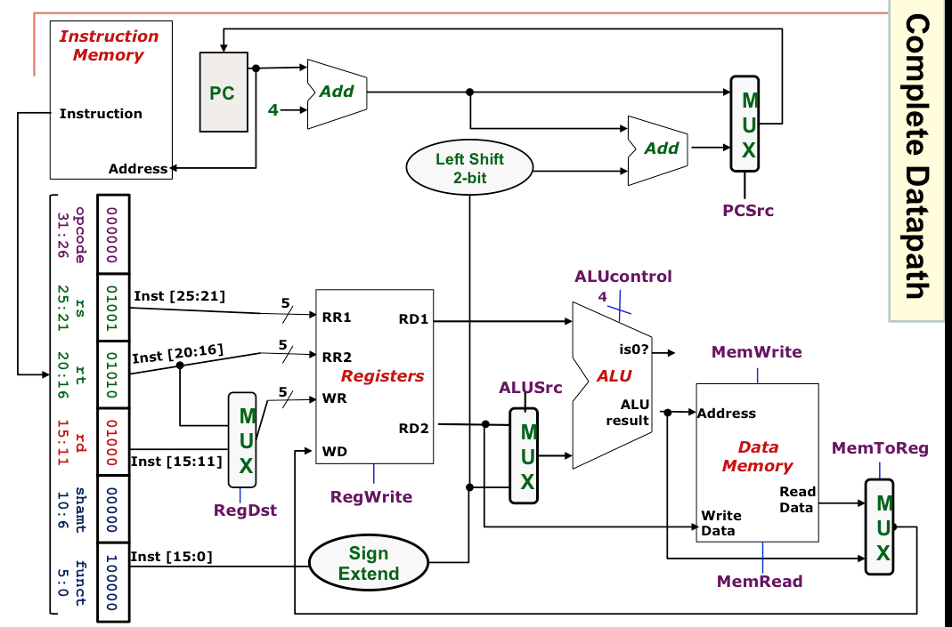
AY2016/17 Semester 2 Q5
(c) Sketch the combinational circuit needed to generate the PCSrc control signal to support the BEQ, BLT and BGT instructions.
IsZero
BEQ
Branch
GreaterThan
BGT
IsNegative
BranchGreater
BLT
BranchLess
PCSrc

Slide 47
AY2015/16 Semester 2

Slide 48
AY2015/16 Semester 1 Q11
addi $t1, $a0, 12 # I1
lw $t0, 12($a0) # I2
Loop: lw $t2, -4($t1) # I3
sw $t2, 0($t1) # I4
addi $t1, $t1, -4 # I5
bne $t1, $a0, Loop # I6
sw $t0, 0($t1) # I7
$a0 stores the base addr of integer array A. What does the code do?
Rotates A[0], A[1], A[2], A[3] one element to the right.
A[0]
A[1]
A[2]
A[3]
(b) If first instruction executed is I1, which is the seventh instruction executed?
Instruction I3.

Slide 49
AY2015/16 Semester 1 Q11
addi $t1, $a0, 12 # I1
lw $t0, 12($a0) # I2
Loop: lw $t2, -4($t1) # I3
sw $t2, 0($t1) # I4
addi $t1, $t1, -4 # I5
bne $t1, $a0, Loop # I6
sw $t0, 0($t1) # I7
(c) No data forwarding. Branch resolved at stage 4.
Total number of cycles:
3+(3×11)+5 = 41
 | 1 | 2 | 3 | 4 | 5 | 6 | 7 | 8 | 9 | 10 | 11 | 12 | 13 | 14 | 15 | 16 | 17 | 18 | 19 | 20 | 21
I1 | F | D | E | M | W
I2 |  | F | D | E | M | W
I3 |  |  | F | - | D | E | M | W
I4 |  |  |  | F | - | - | - | D | E | M | W
I5 |  |  |  |  | F | - | - | - | D | E | M | W
I6 |  |  |  |  |  | F | - | - | - | - | - | D | E | M | W
I3 |  |  |  |  |  |  |  |  |  |  |  |  |  |  | F | D | E | M | W

Slide 50
AY2015/16 Semester 1 Q11
addi $t1, $a0, 12 # I1
lw $t0, 12($a0) # I2
Loop: lw $t2, -4($t1) # I3
sw $t2, 0($t1) # I4
addi $t1, $t1, -4 # I5
bne $t1, $a0, Loop # I6
sw $t0, 0($t1) # I7
(d) With data forwarding. Branch resolved at stage 2, predicted taken.
Total number of cycles = 23
 | 1 | 2 | 3 | 4 | 5 | 6 | 7 | 8 | 9 | 10 | 11 | 12 | 13 | 14 | 15 | 16 | 17 | 18 | 19 | 20 | 21
I1 | F | D | E | M | W
I2 |  | F | D | E | M | W
I3 |  |  | F | D | E | M | W
I4 |  |  |  | F | D | E | M | W
I5 |  |  |  |  | F | D | E | M | W
I6 |  |  |  |  |  | F | - | D | E | M | W
I3 |  |  |  |  |  |  | F | - | D | E | M | W

Slide 51
AY2015/16 Semester 1 Q12
int sum = 0;
for (int i=0; i<32; i++) {
sum = sum + (A[i] * B[i]) – C[i];
}
Direct-mapped cache, 8 blocks. Each block 4 words.
(a) What is the cache hit rate of the code?
Addresses:
A: 0x00000080; B: 0xFFFF0040; C: 0x12345688
0x00000080 = … 0000 00001 000 0000
0xFFFF0040 = … 0000 00000 100 0000
0x12345688 = … 0101 01101 000 1000
First four iterations:
A[0]..A[3] mapped to block 0.
B[0]..B[3] mapped to block 4.
C[0], C[1] mapped to block 0,
C[2], C[3] mapped to block 1.
A[0] (miss), A[1] (miss), A[2] (miss), A[3] (hit).
B[0] (miss), B[1]..B[3] (hits)
C[0] (miss), C[1] (miss), C[2] (miss), C[3] (hit).
Hit rate = 5/12

Slide 52
AY2015/16 Semester 1 Q12
int sum = 0;
for (int i=0; i<32; i++) {
sum = sum + (A[i] * B[i]) – C[i];
}
(b) Fill in the content of the cache after executing the code.
A: … 0000 00001 000 0000
B: … 0000 00000 100 0000
C: … 0101 01101 000 1000
Block 0 | C[30] | C[31] | unknown | unknown
Block 1 | B[20] | B[21] | B[22] | B[23]
Block 2 | B[24] | B[25] | B[26] | B[27]
Block 3 | B[28] | B[29] | B[30] | B[31]
Block 4 | A[16] | A[17] | A[18] | A[19]
Block 5 | A[20] | A[21] | A[22] | A[23]
Block 6 | A[24] | A[25] | A[26] | A[27]
Block 7 | A[28] | A[29] | A[30] | A[31]
First four iterations:
A[0]..A[3] mapped to block 0.
B[0]..B[3] mapped to block 4.
C[0], C[1] mapped to block 0,
C[2], C[3] mapped to block 1.

Slide 53
AY2021/22 Semester 1
CS2100 Exam
Date: 20 November 2021, Saturday
Time: 9 – 11am (set aside 8 – 1pm)
Format
Q0: 3 marks
Part A: 6 MCQs (12 marks)
Part B: 5 MRQs (15 marks)
Part C: 5 long questions (70 marks)
3-page answer sheets provided (optional)
Submit a single pdf file

Slide 54
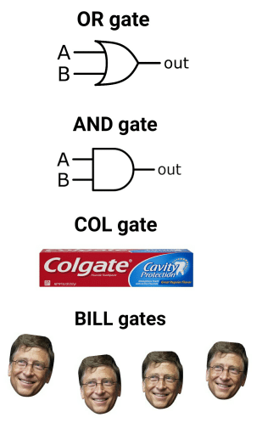
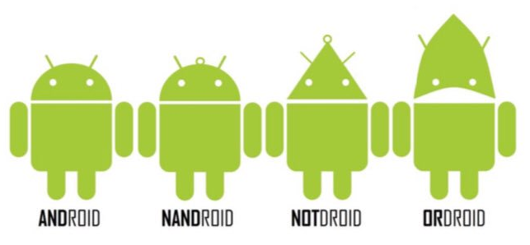
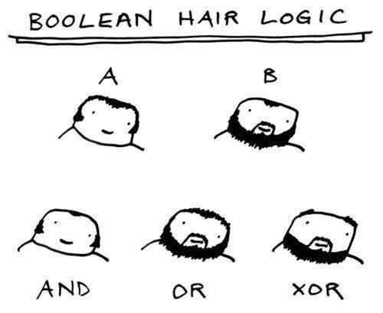


Slide 55
END OF FILE

