Slide 1

Capstone Project
Team
Algorithm Architects
Team Members:
Akshada Modak - 202301485
Maanav Gurubaxani - 202301438
Harita Rathod - 202301211
Jevik Rakholiya - 202301276

Slide 2

An entry queue manager for a stadium is to be made.
There are N entry gates.
As people keep coming in, they can line up in any of the queues or switch queues anytime if they think that will get them a quicker entry. The entry queue manager helps them in making that decision by suggesting:
The waiting time for the last person in the queue to enter through any gate (assume that it takes p mins for a single attendee to enter any gate),
The particular queue number(s) where one should be switching.
The queue manager must be designed to minimise the time for M people to enter the stadium. Each gate has an initial random assignment of M/2 people (a gate may not have anyone assigned).
“Initial random assignment of M/2 people”: Half of the total number of attendees (i.e., the capacity of the stadium) are already assigned to each of the gates randomly (may not be equally distributed).
Problem

Slide 3

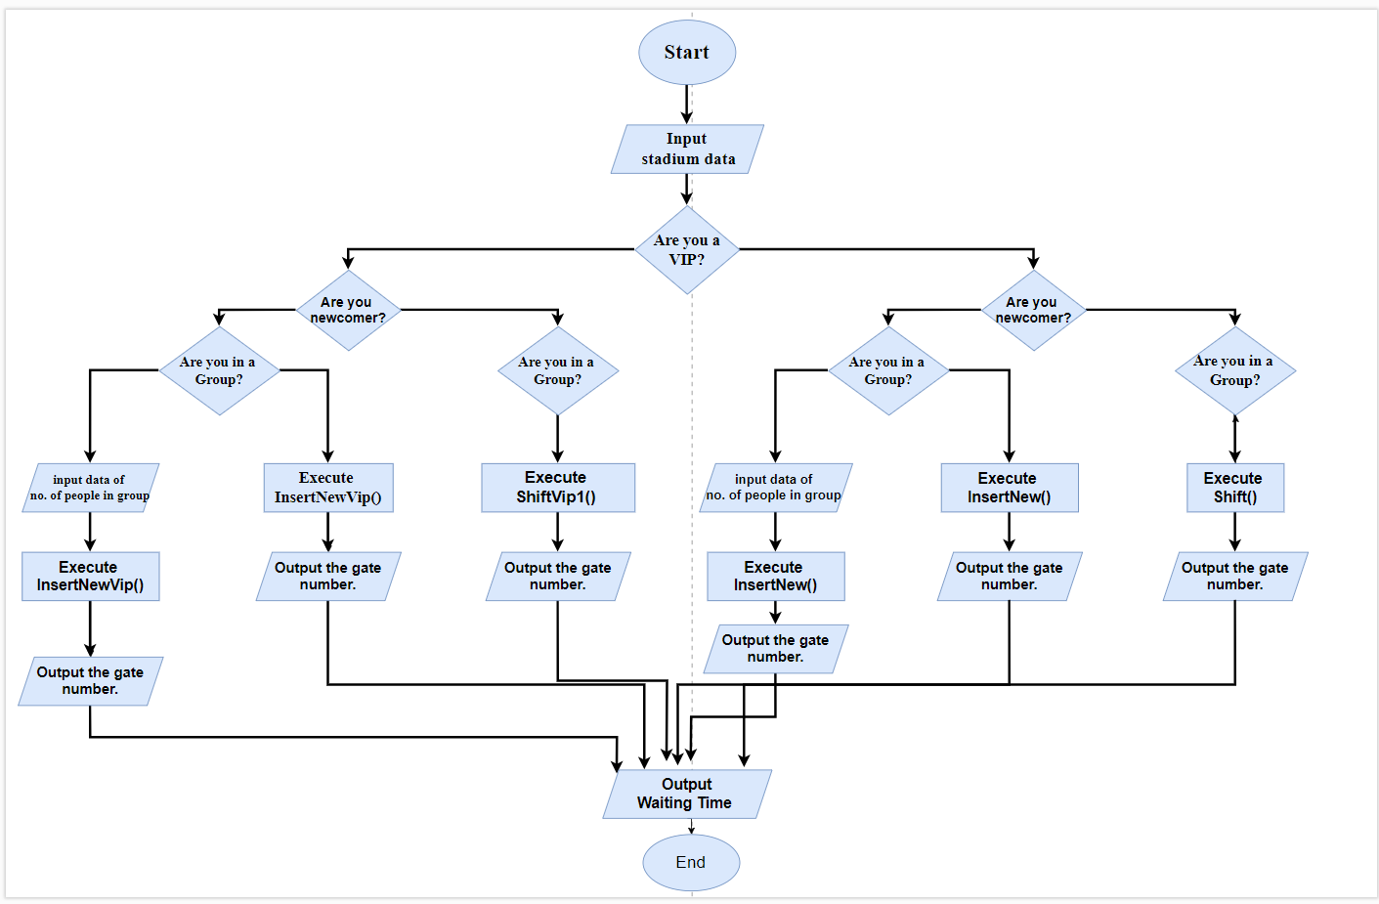
Algorithm

Slide 4
● The application uses a one dimensional array that stores the number of people on every gate .
● The size of the array is equal to the number of gates in the stadium .
● The initial choice for data structure was vector deque or a queue using stl .
● Vector deque was chosen as the application required pop from the front (at the gate entrance) .It required pop and push from the back for allowing shift and insertion of newcomers.
● However the vector deque increased space complexity .
● We realised that for the application to run we only required information of the number of people in every queue and this did not require a two dimensional vector deque.
● The pop function in the gates could be easily done by subtracting one from the value(people at a gate) at each index. The push and pop from the queue could be done similarly .
● The operations for shift and insert became relatively much easier, the space complexities reduced by far.
● The implementation of the VIP feature and Group/Family feature was easily done.
DATA STRUCTURE
1- Dimensional
Array

Slide 5

Time and Space Complexities
Function | Time Complexity | Space Complexity
InsertNew | O(people*gates) | O(1)
InsertNewVip | O(peopleVip*VipGates) | O(1)
shiftVip1 | O(VipGates) | O(1)
shift1 | O(Gates) | O(1)
shift | O(Gates^2) | O(1)
shiftV | O(VipGates^2) | O(1)

Slide 6
Let’s look at the pseudo codes

Slide 7

Inserting Newcomers Into The Queue:
InsertNew function:
Function InsertNew(people, group_t):
index_of_min = 0
counter = 0
min = arr_of_gates[0]
while (people != 0)
min = arr_of_gates[0]
for (counter = 0 to Gates - 1)
if arr_of_gates[counter] <= min:
min = arr_of_gates[counter]
index_of_min = counter
End if
if group_t == 0:
arr_of_gates[index_of_min] += 1
People -= 1
End if
else:
arr_of_gates[index_of_min] += group_t
people -= 1
End while
return index_of_min + 1
Time complexity: O(people*gates)
Space complexity: O(1)
b. InsertNewVip function:
Function InsertNewVip(peopleVip, groupVip_t):
index_of_min = 0
counter = 0
min = arr_of_vip[0]
while peopleVip != 0:
min = arr_of_vip[0]
for counter = 0 to VipGates - 1:
. if arr_of_vip[counter] <= min:
min = arr_of_vip[counter]
index_of_min = counter
End if
if groupVip_t == 0:
arr_of_vip[index_of_min] += 1
peopleVip -= 1
else:
arr_of_vip[index_of_min] += groupVip_t
peopleVip -= 1
End if
End while
return index_of_min + 1
TIme complexity: O(peopleVip*VipGates)
Space complexity: O(1)

Slide 8
2. Switching Queues
ShiftVip1 function:
Function shiftVip1(queue_person, standing, poptime, groupVip_t):
size = arr_of_vip[queue_person]
if size > standing:
if groupVip_t != 0:
Print "Your last group member is not the last member
in the queue. You cannot Shift."
Print "It will take", poptime * standing, "mins from
your current position for all members of the group
to reach the stadium."
else:
Print "You are not the last member in the queue. You
cannot Shift."
Print "It will take", poptime * standing, "mins from
your current position to reach the stadium."
End if
else if size == standing:
min = arr_of_vip[0]
a = -1
for (j = 0 to VipGates - 1):
if min >= arr_of_vip[j]:
a = j
min = arr_of_vip[j]
End if
End for
if a != -1 and (min + groupVip_t) < arr_of_vip[queue_person]:
Print "It will take", poptime * standing, "mins from your current
position to reach the stadium."
Print "You have to move to queue", a + 1
if groupVip_t != 0:
arr_of_vip[a] += groupVip_t
arr_of_vip[queue_person] -= groupVip_t
else:
arr_of_vip[a] += 1
arr_of_vip[queue_person] -= 1
End if
Print "It will take", poptime * arr_of_vip[a], "mins from your
new position to reach the stadium."
else:
if groupVip_t != 0:
Print "You and your group members are at the most optimised
place."
Print "It will take", poptime * standing, "mins from your
current position to reach the stadium."
else:
Print "You are at the most optimised place."
Print "It will take", poptime * standing, "mins from your
current position to reach the stadium."
End if
End if
else:
Print "Enter your accurate standing in your queue"
End if
End Function
TIme complexity: O(1)
Space complexity: O(VipGates)

Slide 9
b. Shift1 function
Function shift1(queue_person, standing, poptime, group_t):
size = arr_of_gates[queue_person]
if size > standing:
if group_t != 0:
Print "Your last group member is not the last member in the
queue. You cannot Shift."
Print "It will take", poptime * standing, "mins from your
current position for all members of the group to reach the
stadium."
else:
Print "You are not the last member in the queue. You cannot
Shift."
Print "It will take", poptime * standing, "mins from your
current position to reach the stadium."
End if
else if size == standing:
min = arr_of_gates[0]
a = -1
for (j = 0 to Gates - 1):
if min >= arr_of_gates[j]:
a = j
min = arr_of_gates[j]
End if
End for
if a != -1 and (min + group_t) < arr_of_gates[queue_person]:
Print "It will take", poptime * standing, "mins from your
current position to reach the stadium."
Print "You have to move to queue", a + 1
if group_t != 0:
arr_of_gates[a] += group_t
arr_of_gates[queue_person] -= group_t
else:
arr_of_gates[a] += 1
arr_of_gates[queue_person] -= 1
End if
Print "It will take", poptime * arr_of_gates[a],
"mins from your new position to reach the
stadium."
else:
if group_t != 0:
Print "You and your group members are at the
most optimized place."
Print "It will take", poptime * standing,
"mins from your current position to reach
the stadium."
else:
Print "You are at the most optimized place."
Print "It will take", poptime * standing,
"mins from your current position to reach
the stadium."
End if
End if
else:
Print "Enter your accurate standing in your queue"
End if
End Function
Space Complexity - O(1)
Time Complexity - O(Gates)

Slide 10
c. Shift function
Function shift():
For i = 0 to Gates - 1:
min = arr_of_gates[0]
a = -1
For j = 0 to Gates - 1:
If min >= arr_of_gates[j]:
a = j
min = arr_of_gates[j]
End If
End For
If a != -1 and min < arr_of_gates[i]:
Increment arr_of_gates[a] by 1
Decrement arr_of_gates[i] by 1
End If
End For
End Function
Space Complexity -O(1)
Time Complexity - O(Gates^2)
d. ShiftV function:
Function shiftV():
For i = 0 to VipGates - 1:
min = arr_of_vip[0]
a = -1
For j = 0 to VipGates - 1:
If min >= arr_of_vip[j]:
a = j
min = arr_of_vip[j]
End If
End For
If a != -1 and min < arr_of_vip[i]:
Increment arr_of_vip[a] by 1
Decrement arr_of_vip[i] by 1
End If
End For
End Function
Space Complexity -O(1)
Time Complexity - O(VipGates^2)

Slide 11
Insert New Function Flow Chart

Slide 12
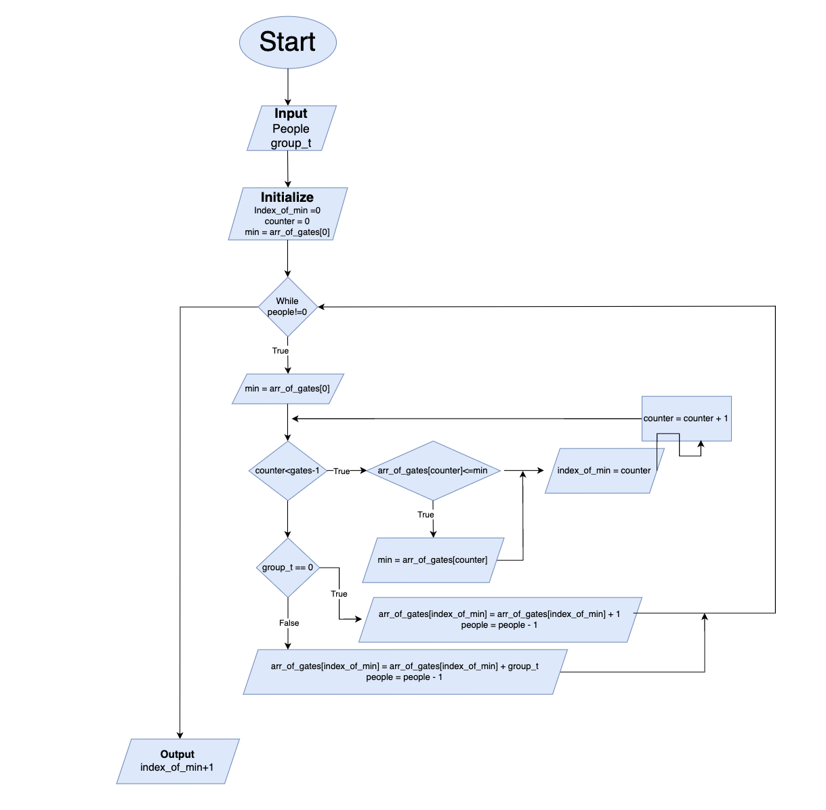

Slide 13
Insert New Vip Function Flow Chart

Slide 14
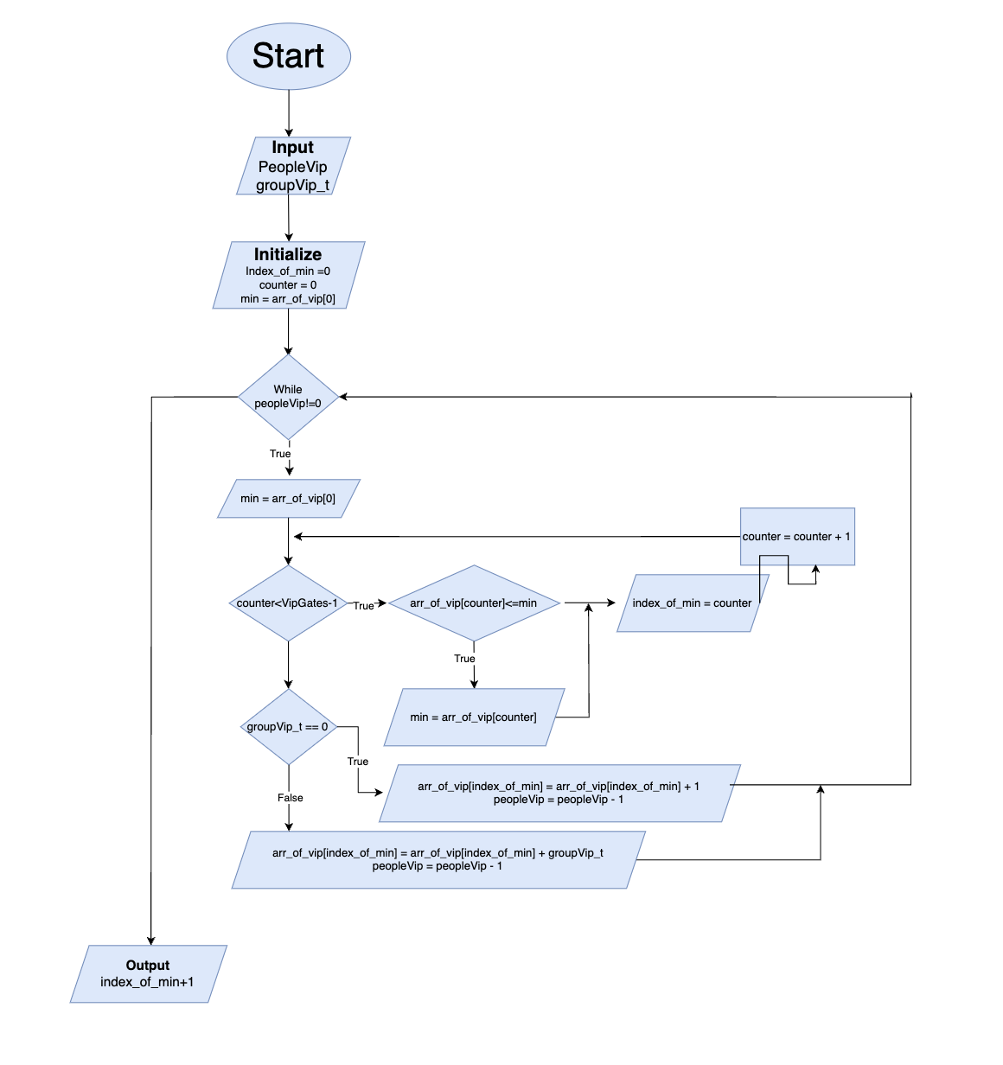

Slide 15
Shift Vip1 Function Flow Chart

Slide 16
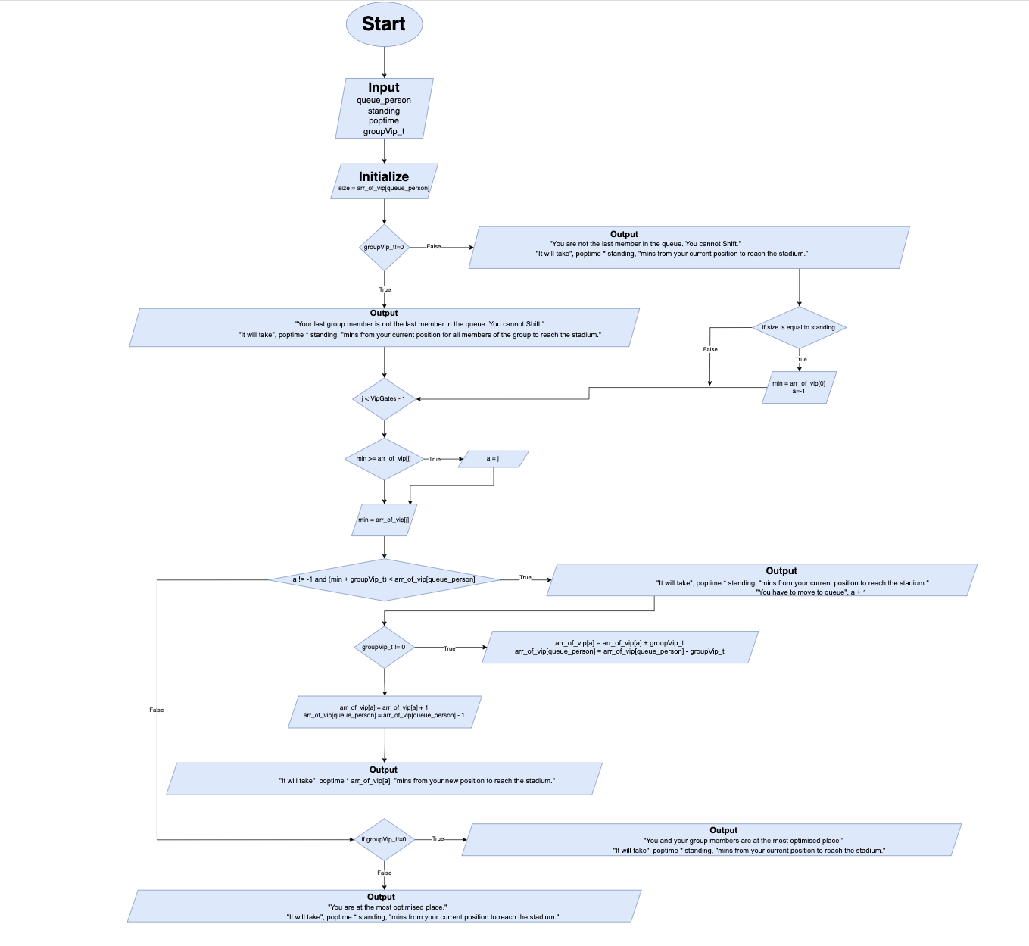

Slide 17
Shift1 Function Flow Chart

Slide 18
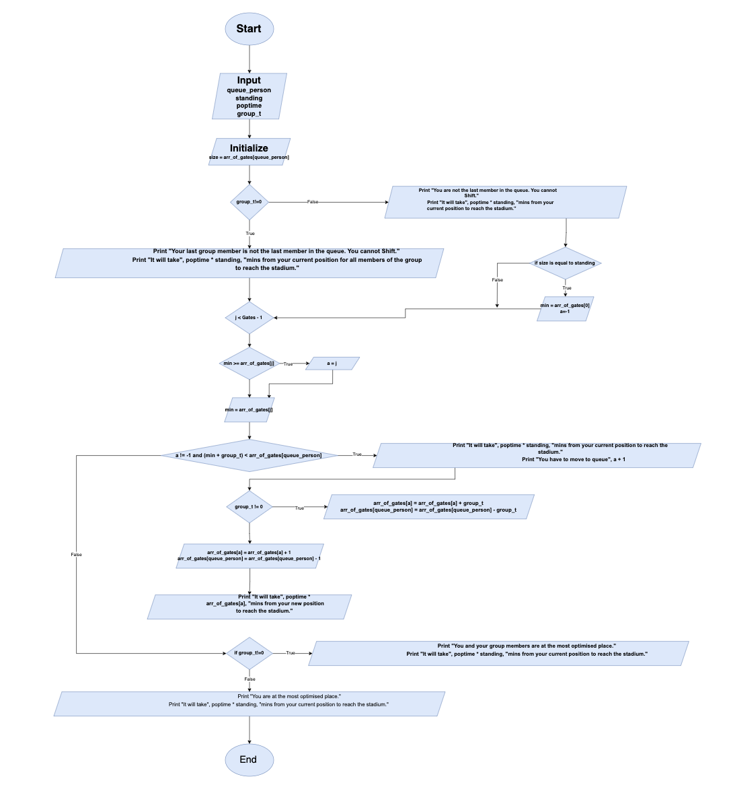

Slide 19
Video Link of our Project - https://drive.google.com/drive/folders/1C9REwmyucLr7yRY-BbGBsyd7x_ARYxSe?usp=sharing

Slide 20

THANK YOU

