Slide 1

Network Intrusions
By Judah Drelich
This Photo by Unknown Author is licensed under CC BY-SA-NC

Slide 2
Introduction
Global cyber crime costs are expected to grow 15% per year for the next 5 years reaching $10.5 trillion by 2025
I analyzed the 1998 DARPA Intrusion Detection Program’s dataset that was managed and prepared by MIT’s Lincoln Labs
Training data has ~5 million observations, 41 features
Test data has 300,000 observations, with the same features.
Problem Statement
and Data
Data was taken from the 1999 KDD Cup
KDD-CUP-99 Task Description (uci.edu)

Slide 3
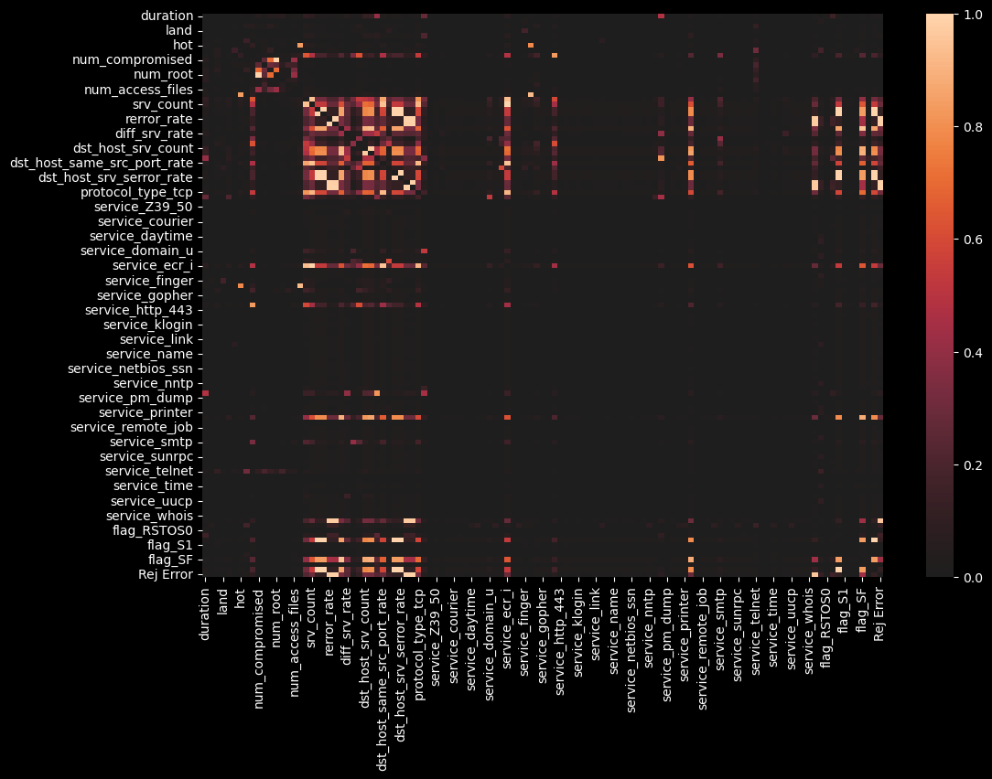
Data Wrangling
Multicollinearity
Initial heatmap for the correlations between the features

Slide 4
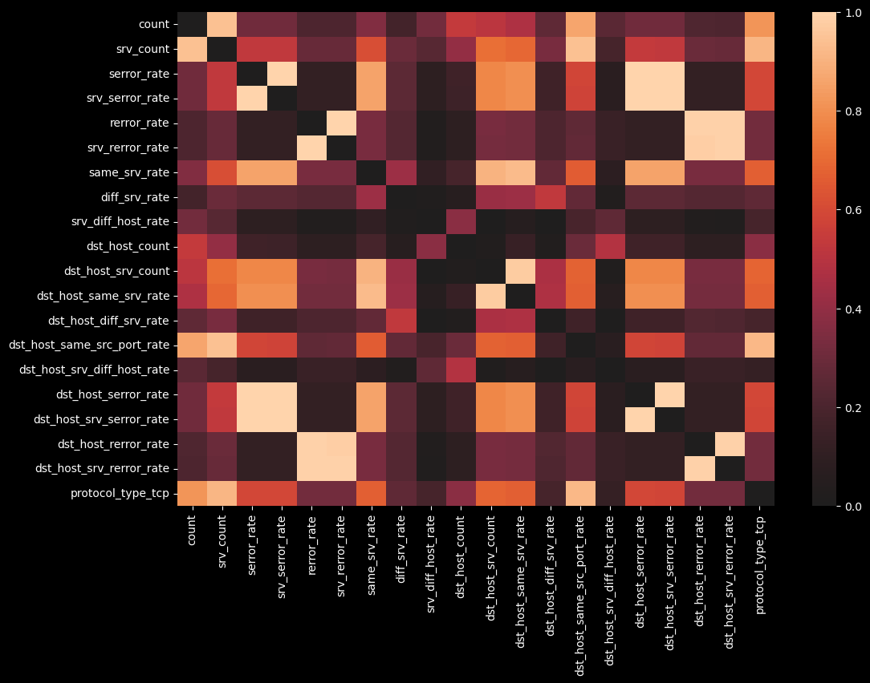
Data Wrangling
Multicollinearity
Heatmap that is focused on the most collinear features

Slide 5
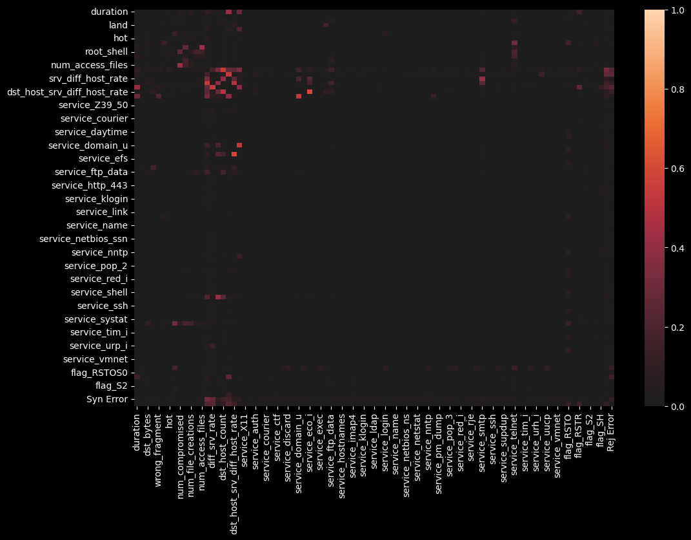
Data Wrangling
Multicollinearity
Final heatmap after all the collinear columns have been dropped or combined.

Slide 6

Data Wrangling
Lasso Regularization is a technique for variable selection that uses linear regression to evaluate the effect that each features has on a target variable.
$$Loss\left(β_{1},…β_{n}\right)=SSD+α\sum_{i=1}^{n}{\left|β_{i}\right|}$$
I used Lasso Regularization to create to datasets
Small: 12 features, binary intrusion or not
Big: 61 features, multi class model, determines intrusion types
Lasso Regularization
Feature Selection

Slide 7
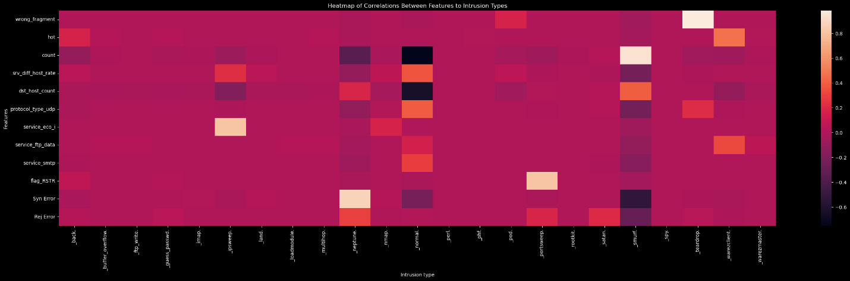
EDA
Correlation heatmap between features and intrusion types
Intrusion Frequency
Smurf. | 56.8378%
Neptune. | 21.6997%
Normal. | 19.6909%

Slide 8
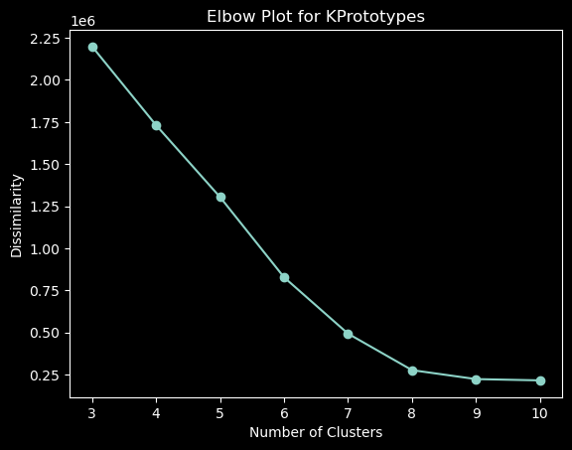
EDA
Clustering
Elbow Plot For
K-Prototypes

Slide 9
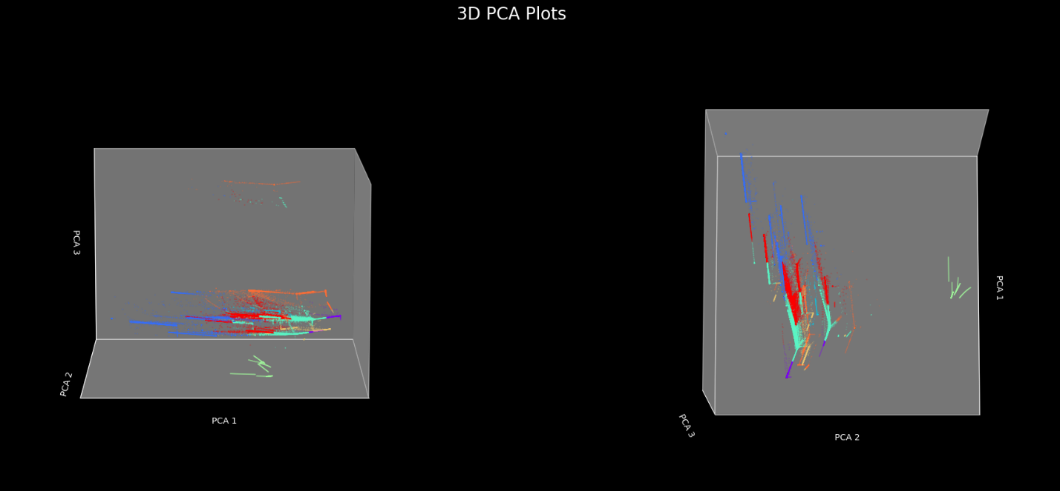
EDA
Principal Component Analysis (PCA)
3-D PCA for the dataset to try and visualize the structure of the data.

Slide 10
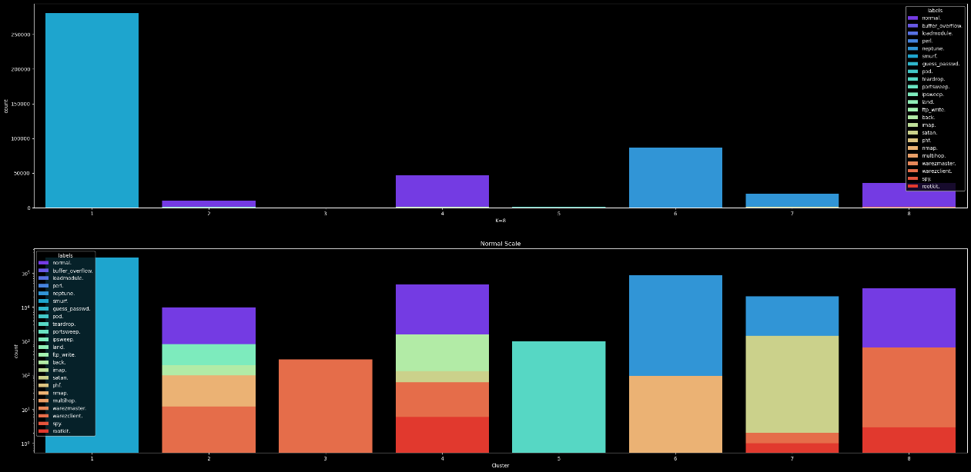
EDA
Cluster Analysis
Linear y-axis
Log y-axis
Histogram of the Clusters colored by intrusion type.

Slide 11
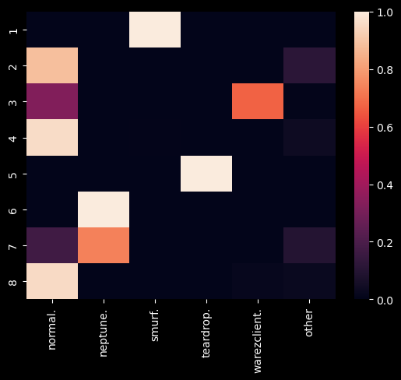
EDA
Cluster Analysis
Heatmap of the odds that a given intrusion will be found in each cluster. Rarer types are grouped as other.

Slide 12
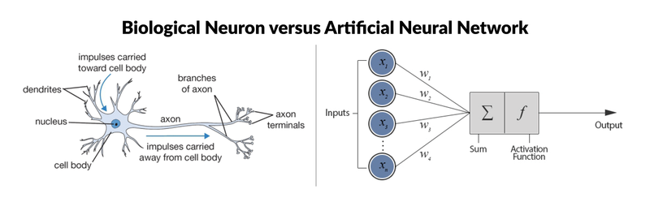
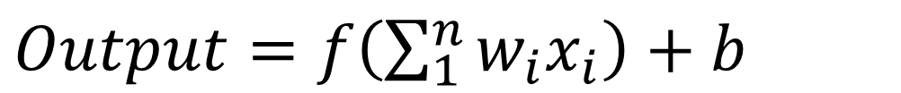
Modelling
Neural Networks
Diagram of the similarity between biological neuron and a node in a neural network
Formula for a node in a neural network
This Photo by Unknown Author is licensed under CC BY-SA
$Output=f\left(\sum_{1}^{n}{w_{i}x_{i}}\right)+b$

Slide 13
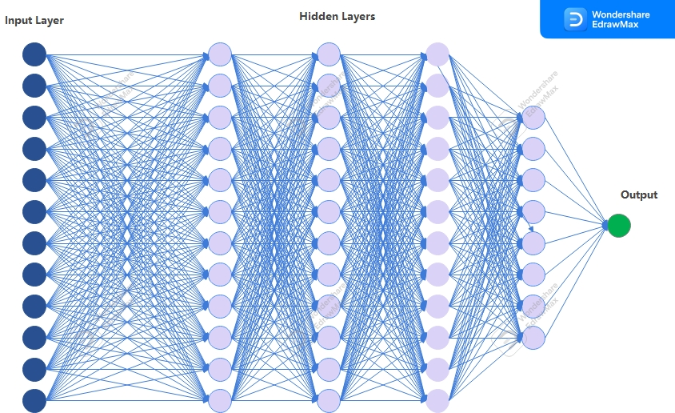
Modelling
Neural Network
Graphical representation of the model that I used

Slide 14
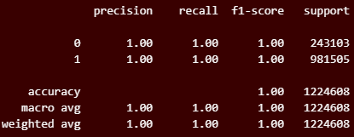
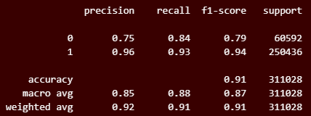
Modelling
Neural Network
Results for the smaller, binary model,
Cross Validational set
Official Test Set

Slide 15
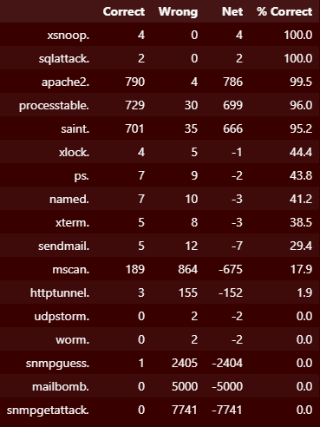
Modelling
Neural Network
Results for the smaller dataset with a binary model by new intrusion types.
No discernable features for the model to use

Slide 16
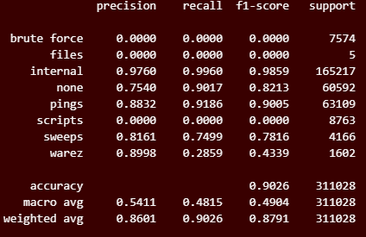
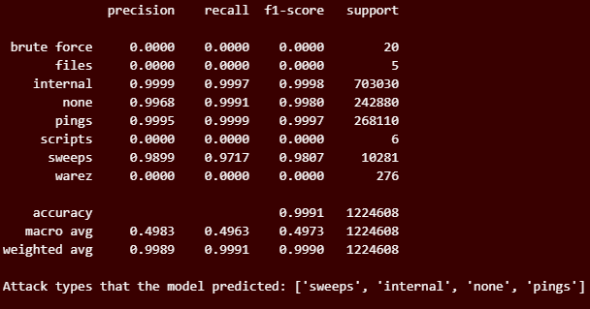
Modelling
Test Set
Cross Validation
Neural Network
Results for the bigger dataset using a multi class classifier

Slide 17
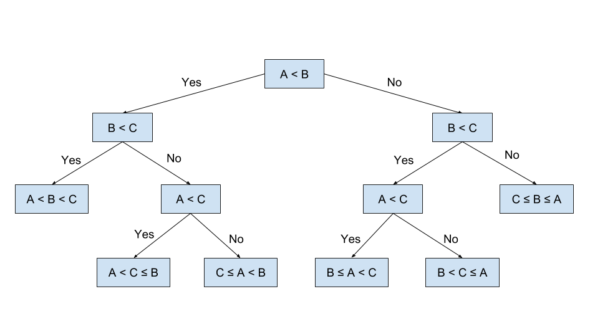
Modelling
Random Forest
Model of a single decision tree in a random forest
Purity measurement formula
This Photo by Unknown Author is licensed under CC BY
$Gini=1−\sum_{i=1}^{n}{{p_{i}}^{2}}$

Slide 18
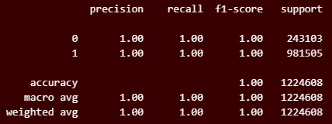
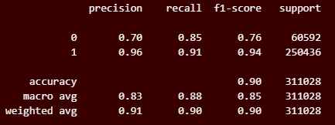
Modelling
Random Forest
Small data, binary model
Cross Validitional Test Set
Small data, binary model
Official Test Set

Slide 19
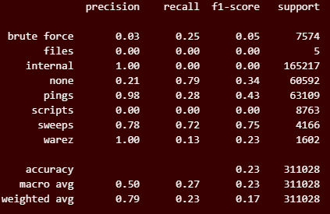
Modelling
Random Forest
Big Data, Multi Class Model
Official Test Set
Categories that were predicted

Slide 20
Conclusion
Important Insights:
The predictions that the Multi Class Neural Network Model gave were significantly better than a trivial classifier
Cluster Analysis gave a view into how features can affect different intrusion types.
Cons
“As a side note, the [Intrusion Detection Systems] IDS research community vehemently discourages the use the DARPA dataset (and the derived KDD Cup dataset) despite it’s appealing availability.”
The background traffic generator is not publicly available so there is no way to evaluate the background traffic in the dataset.
Pros
“the non-availability of any other dataset that includes the complete network traffic”
This dataset is the perfect training dataset. It gives me a chance to hone my skills and techniques on a large amount of data in an important field while getting clear and interesting results.

