Slide 1
An ENSEMBLE Technique for Linking Software Features to Code Components
PRESENTED BY
DIN MUHAMMAD
STUDENT ID: 190237
AZHARUDDIN
STUDENT ID: 190238
Computer Science and Engineering Discipline Khulna University, Khulna
1

Slide 2
OUTLINES
Introduction
Baseline Approach
Our proposed Method
Performance and Analysis
Conclusion
Future Work
References

Slide 3

INTRODUCTION

Slide 4
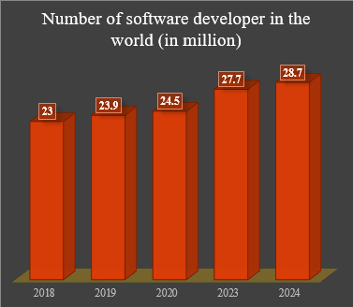
BACKGROUND
Usages of Software Service in daily life.
Recent Software Anomalies.
Bangladesh government website hacks.
ChatGPT bugs.
Software update on Rogers core IP network went catastrophically wrong.
Developers well being needs to be considered while reducing unwarranted mental pressure.
04

Slide 5
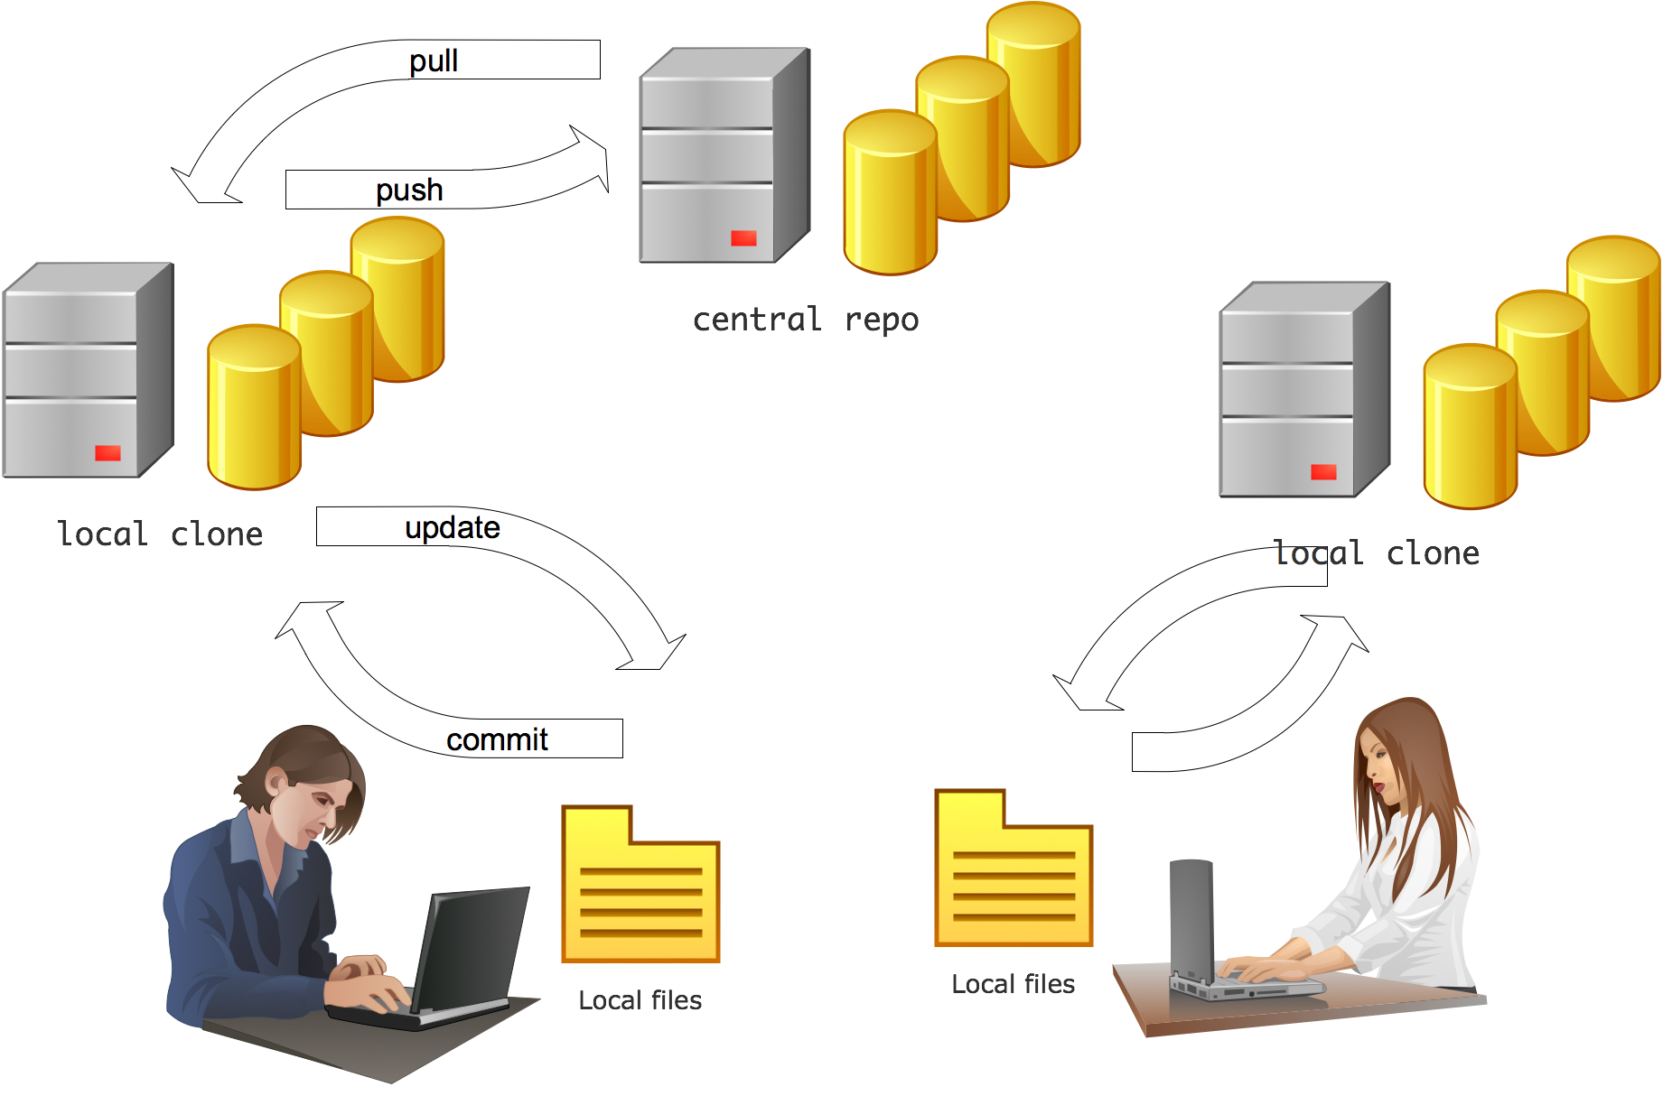
The significance for linking software features to source code component
Determine the location of the features in the code base.
Analyzing the change impact.
Modifying the existing code.
Inspecting the software by government or third party.
Testing.

Slide 6

MOTIVATION
Regular activities in software development maintenance.
Accuracy.
Cost.
Explainable Properties.
Support for finding feature location.
Create more accurate link.
06

Slide 7
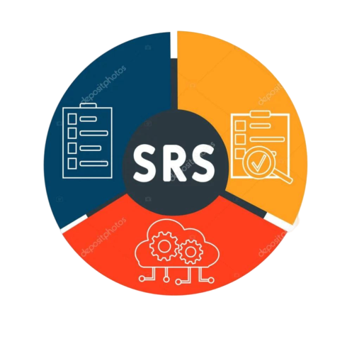
Software Requirement
A software requirement is a documented description of what a software system or application should do or how it should behave. It represents a specific need, constraint, or expectation that the software must meet.
For example
A requirement for an e-commerce website could be the ability for users to add products to a shopping cart.
07

Slide 8

Software Construction
Software construction refers to the process of translating software requirements to cede components. It designs specifications into a working software product. It involves writing code, integrating components, and building the software system.
Implementation using Hibernate: Package: com.example.webapp Module: User.java Class: User Method: login(username, password)
08

Slide 9
Code Components
Module: In Java, modules are a way to organize and encapsulate code.
import org.hibernate.Session;
Class
Method
Module
Class: Classes are the building blocks of our code base
package com.example.domain;.
public class User {
-----
}
Method: Methods contain the logic and operations that are performed on objects.
public User getById(Long id) {
-----
}
10

Slide 10
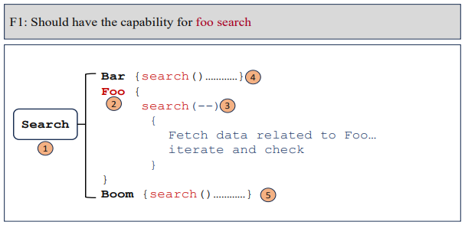
LINKING PROCESS:
Linking Software Feature to code Components

Slide 11

BASELINE APPEOACH

Slide 12
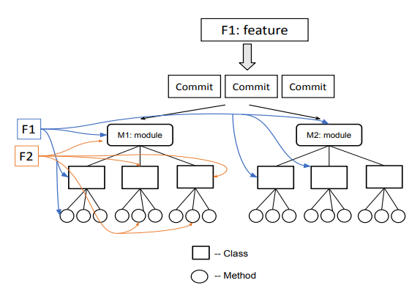
FSECAM :A Contextual Thematic Approach for Linking Feature to Multi-level Software Architectural Components
Performance:
Precision: 22.51%
Recall: 65.59%
F1 Score: 25.56%
Drawbacks:
When textual description are not details then it fail to generate proper theme extraction.

Slide 13
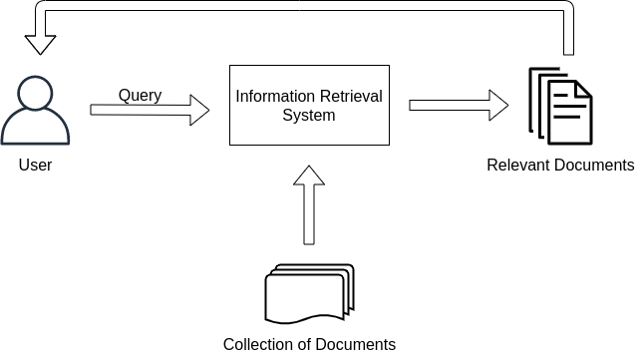
VSM : Vector Space Model
Performance:
Precision: 11.31%
Recall: 68.26%
F1 Score: 18.23%
Drawbacks:
Sparse Representation Problem.
Bag-of-word Model difficulty.
Data

Slide 14
LSI: Latent Semantic Indexing
Performance:
Precision: 8.75%
Recall: 63.27%
F1 Score: 14.55%
Latent Semantic Indexing
Raw Text data and features
Document Term Matrix
Singular
Value Decomposition
Topic Encoded Data
Drawbacks:
Interpretability and semantic understanding lacking.
Computational Intensity Problem.

Slide 15

OUR PROPOSED METHODS

Slide 16
OUR PROPOSED METHOD
Bootstrapping and
Aggregating
Combining Model
with
Ensemble Approach
Final Retrieved Code Components
Codebase
VSM
LSI
Features
FSECAM

Slide 17
Aggregating And Bootstrapping Mechanism
Model 1
Model 2
Model n
Output 1
Output 2
Output n
Data Entity | Frequency
DE₁ | 1
DE₂ | 2
DE_{n} | n
Aggregating

Slide 18




Score Calculation
Score calculation for the ENSEMBLE Approach.
$$\text{Score} \text{Percentage}=\frac{\text{Frequency} \text{of} \text{the} \text{output} \text{entities}}{\text{Total} \text{number} \text{of} \text{models} }$$
$$\text{Score} \text{Percentage} \text{for}\text{ 1}=\frac{1}{3}×100\%$$
=33%
$$\text{Score} \text{Percentage} \text{for} 2=\frac{2}{3}×100\%$$
= 67%
$$\text{Score} \text{Percentage} \text{for} 3=\frac{3}{3}×100\%$$
= 100%

Slide 19

PERFORMANCE ANALYSIS

Slide 20

Dataset
Project | Domain | Classes | Modules | Methods
Project 1 (P1) | Data Repository | 120 | 40 | 10000
Project 2 (P2) | Scientific Workflow System | 222 | 82 | 2126
Experimental Dataset
Project | Classes | Modules | Methods
P1 | 26 | 29 | 24
P2 | 11 | 46 | 138
Test Dataset

Slide 21

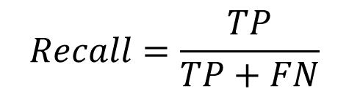
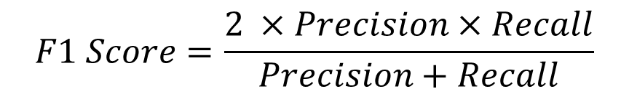
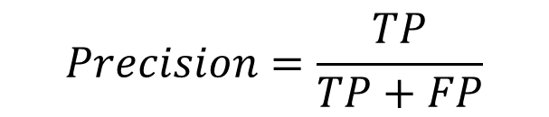
Testing
$$Precision=\frac{TP}{TP+FP}$$
$$Recall=\frac{TP}{TP+FN}$$
$$F1 Score=\frac{2 ×Precision×Recall}{Precision+Recall}$$
21

Slide 22

Example
A sample test set with model predictions
P$recesion=\frac{TP}{TP+FP}$
$=\frac{5}{5+0}×100\%$
$=100\%$
$Recall=\frac{TP}{TP+FN}$
$=\frac{5}{5+2}×100\%$
$=71.42\%$
F1 Score$=\frac{2×\text{p}recesion × Recall}{\text{p}recesion+ Recall}$
$=\frac{2×1×0.7142}{1+.7142}×100\%$
$=83.33\%$
ID | Target Class | Predicted Class | Outcome
1 | Search Managers | User Managers | FN
2 | Search Managers | User Managers | FN
3 | User Managers | User Managers | TN
4 | Search Managers | Search Managers | TP
5 | User Managers | User Managers | TN
6 | Search Managers | Search Managers | TP
7 | User Managers | User Managers | TN
8 | Search Managers | Search Managers | TP
9 | Search Managers | Search Managers | TP
10 | Search Managers | Search Managers | TP
22

Slide 23
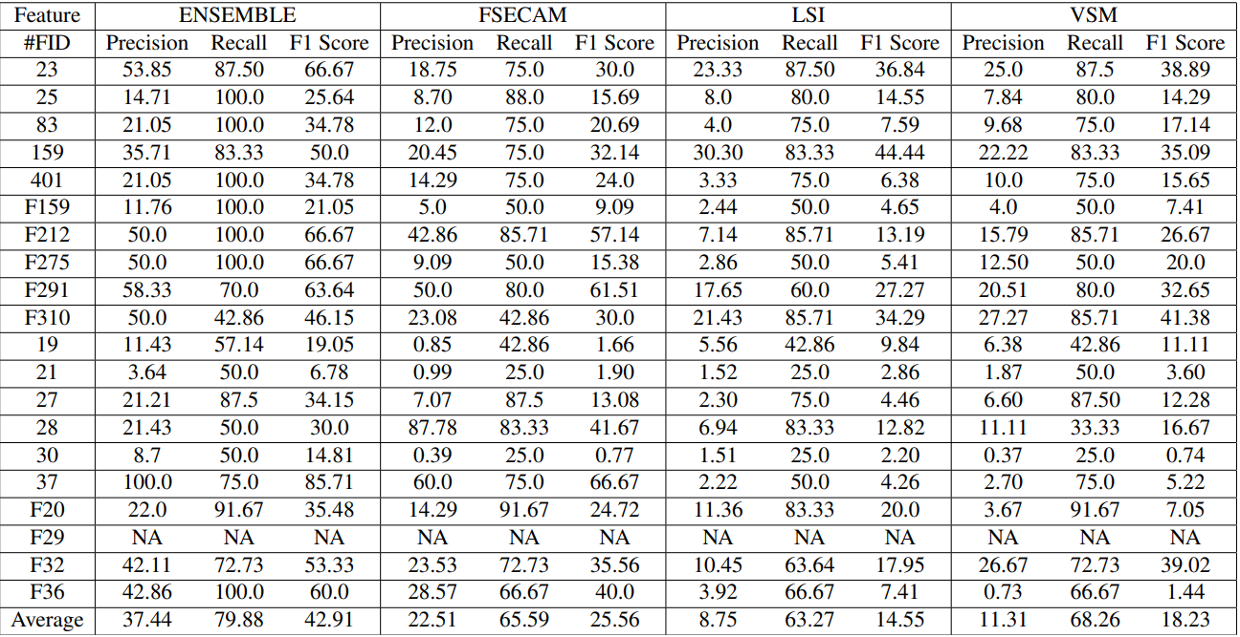
Performance Of Modules
Performance of Modules association with our proposed approach for Project 1 and 2

Slide 24
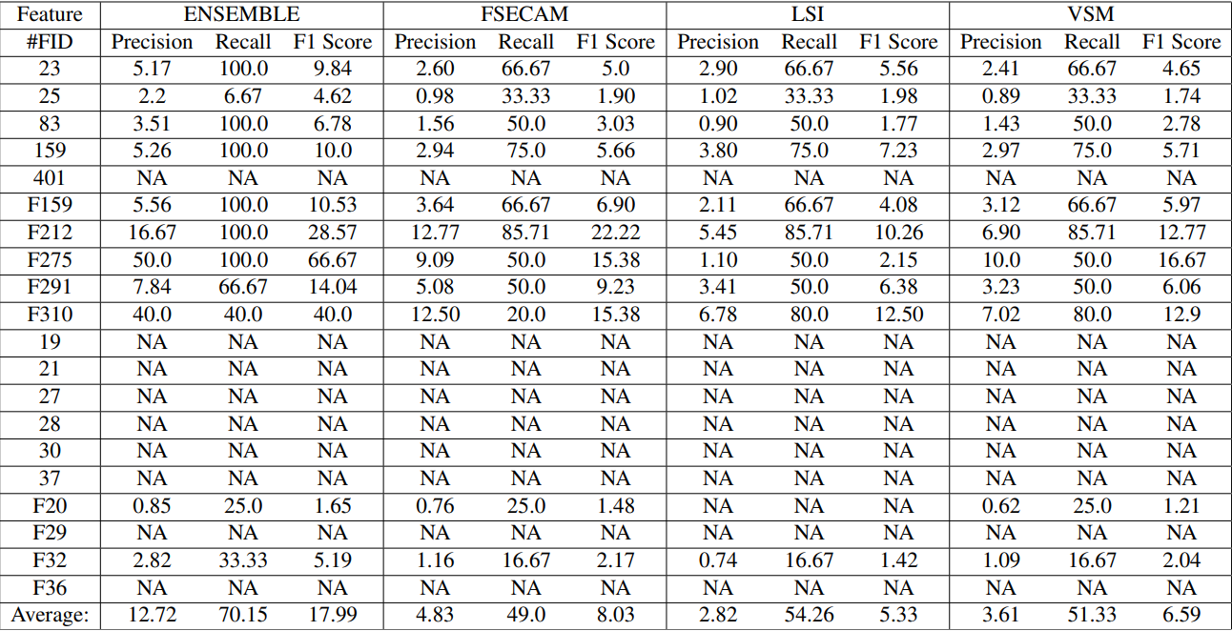
Performance Of Classes
Performance of Classes association with our proposed approach for Project 1 and 2

Slide 25
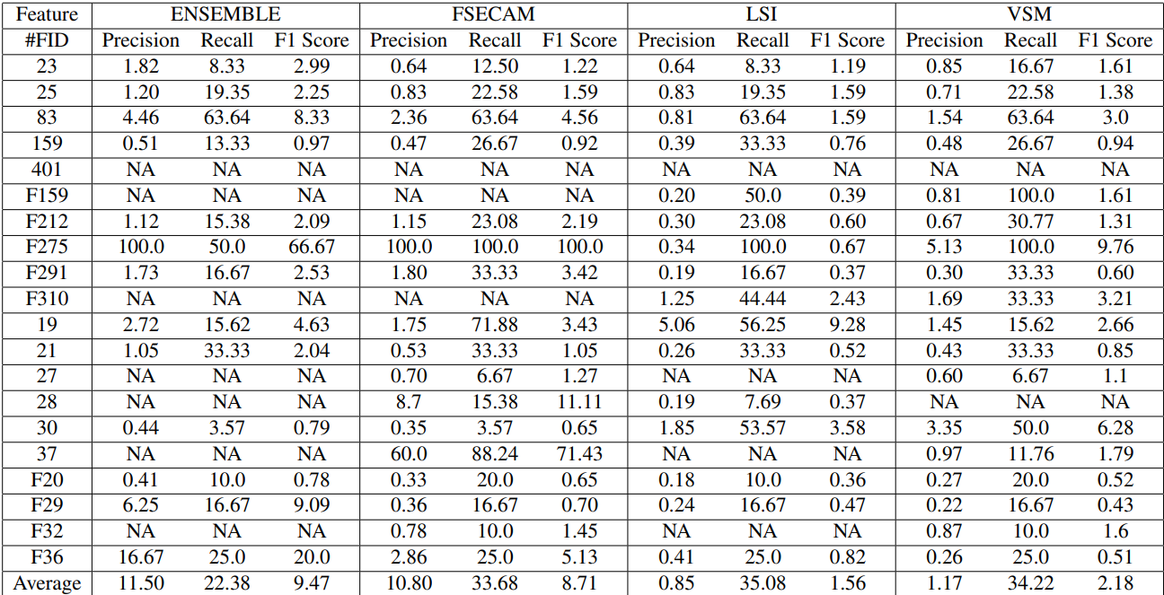
Performance Of Methods
Performance of Methods association with our proposed approach for Project 1 and 2
25

Slide 26
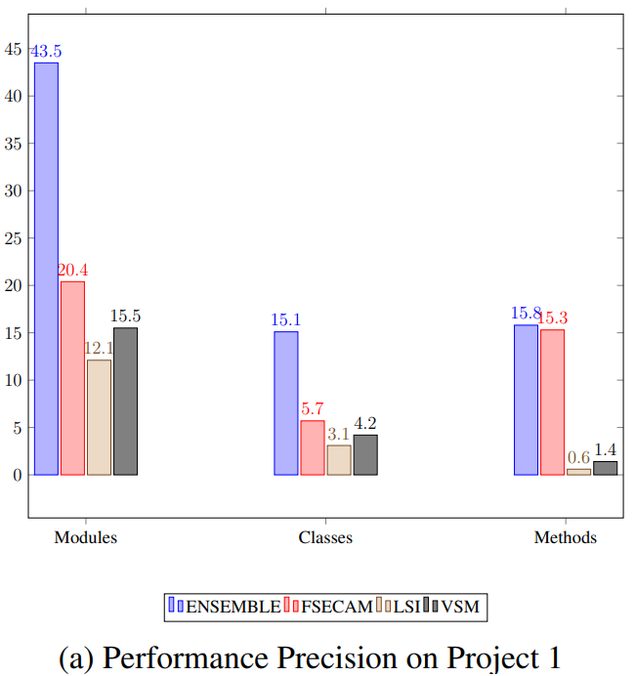
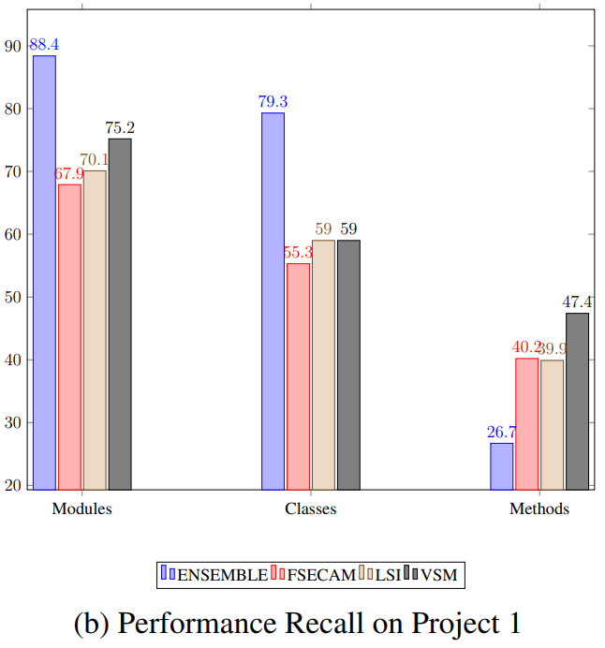
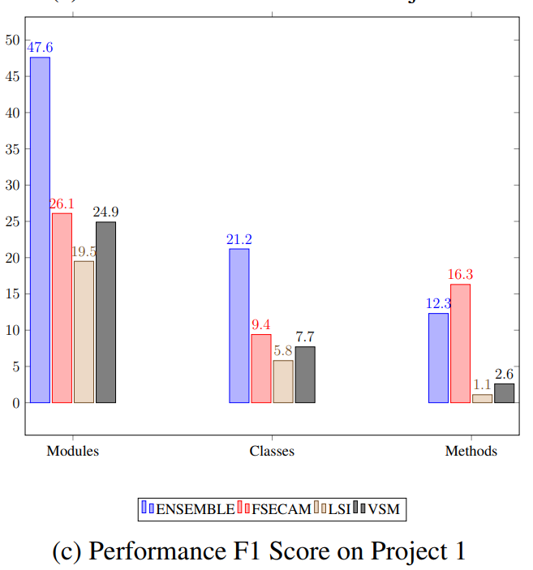
Performance Comparison Using Bar Plot
Performance Measurement on Project 1
Modules (23.1), Classes (9.4) and
Methods (0.5)
Modules (13.2), Classes (20.3) and Methods (-20.7)
Modules (21.5), Classes (11.8) and Methods (-4)
26

Slide 27
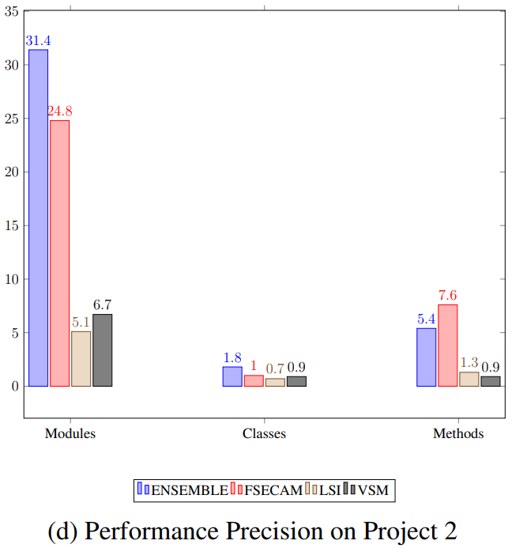
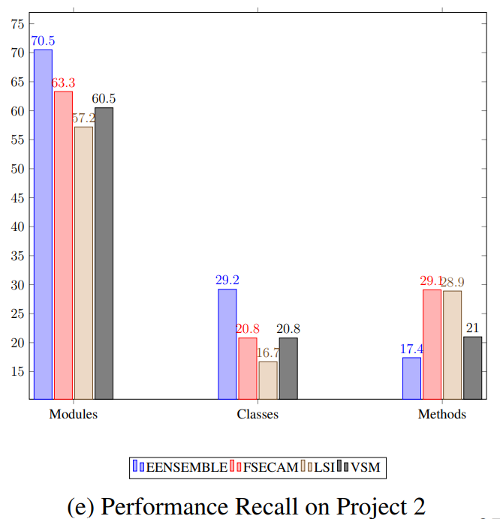
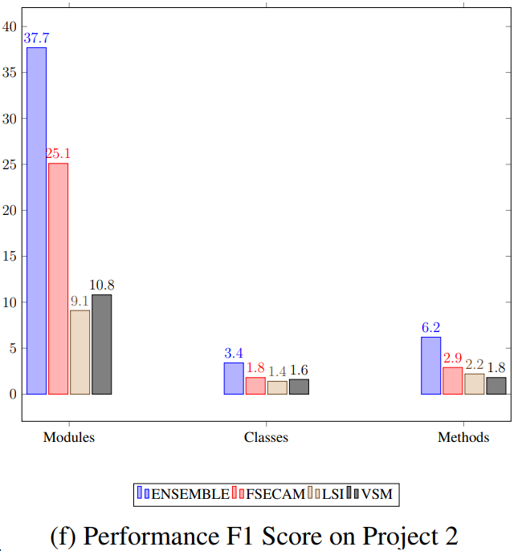
Performance Comparison Using Bar Plot
Performance Measurement on Project 2
Modules (6.6), Classes (0.8) and
Methods (-2.2)
Modules (7.2), Classes (8.4) and
Methods (-11.7)
Modules (12.6), Classes (1.6) and
Methods (3.3)
27

Slide 28
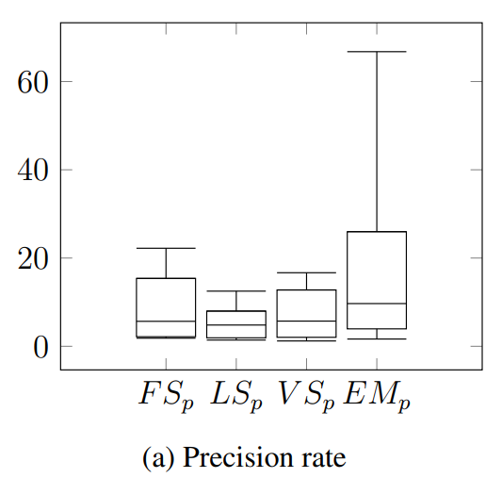
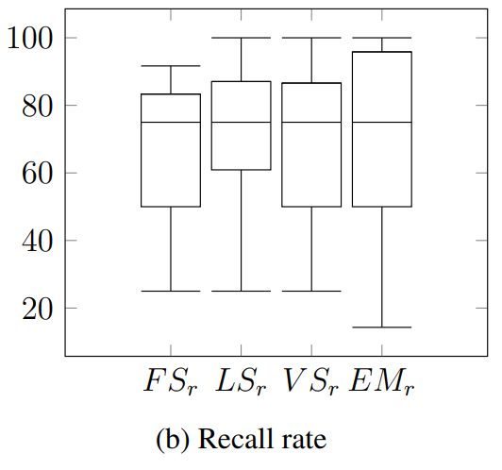
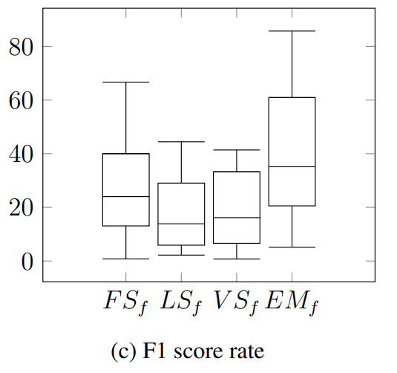
Box plot for Modules Performance
Range of Precision (p), Recall (r) and F1 score (f) of Modules on Project 1 and 2
80.58
45.83
65.11
40.36
85.71
22.02
28

Slide 29
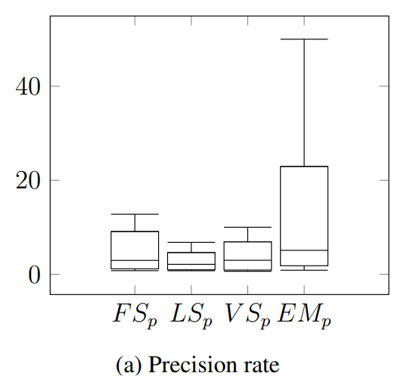
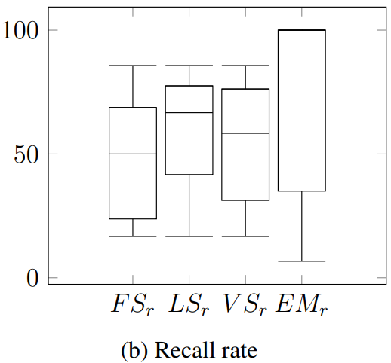
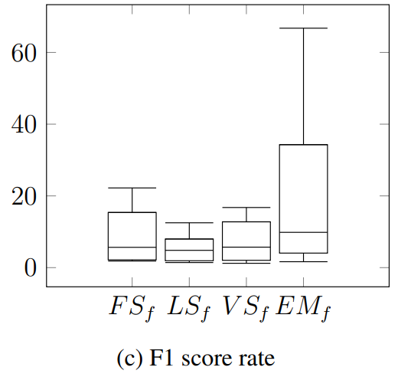
Box plot for Classes Performance
Range of Precision (p), Recall (r) and F1 score (f) of Classes on Project 1 and 2
65.01
65.11
49.15
21.10
30.23
93.33
29

Slide 30
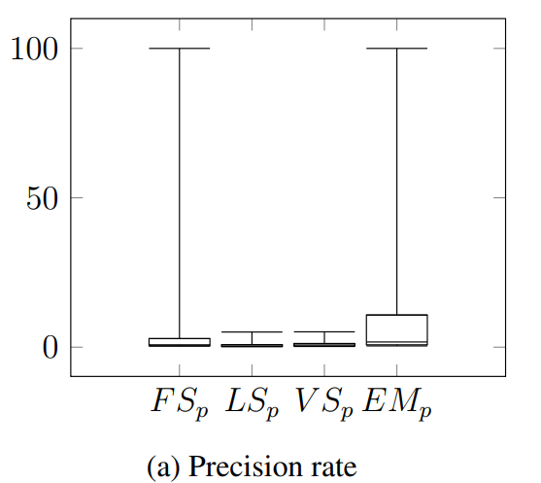
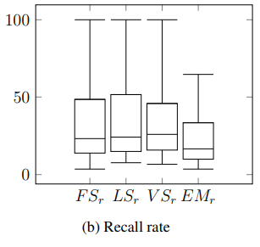
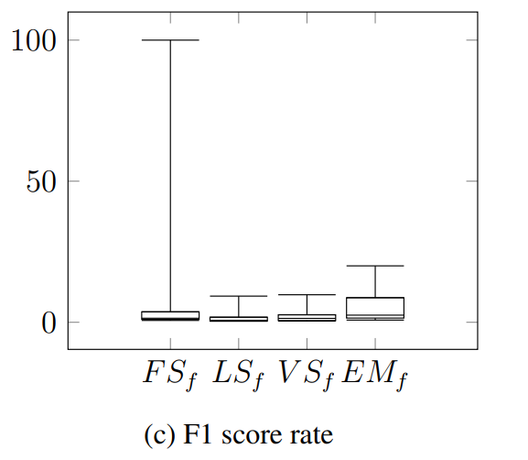
Box Plot for Methods Performance
Range of Precision (p), Recall (r) and F1 score (f) of Methods on Project 1 and 2
99.59
61.06
36.56
23.33
9.98
07.21
19.22
02.68
30

Slide 31
CONCLUSION
ENSEBMLING from VSM, LSI, and FSECAM approaches.
Overall result better than other approaches.
Help Software Developer.
Separately 2 projects then perform better 14 cases among 18 cases.
Combine 2 projects then perform better 8 cases among 9 cases.

Slide 32
FUTURE WORK
Apply on another programming Language based projects.
Apply Open source projects.
We will work on more explainable properties of the linking approach.

Slide 33
REFERENCES
K. Kelly, The inevitable: Understanding the 12 technological forces that will shape our future. Penguin, 2016.
N. L. S. Nuraini, P. S. Cholifah, A. P. Putra, E. Surahman, I. Gunawan, D. A. Dewantoro, and A. Prastiawan, “Social media in the classroom: A literature review,” in 6th International Conference on Education and Technology (ICET 2020), pp. 264–269, Atlantis Press, 2020.
K. A. S. Amit Kumar Mondal, Mainul Hossain Chanchal, “Fsecam: A contextual thematic approach for linking feature to muilti- level architectural components,” vol. 29, no. 3, pp. 1–55, 2023.
A. Olszak and B. N. Jørgensen, “A unified approach to feature-centric analysis of object-oriented software,” in IASTED Software Engineering and Applications (SEA 2010), ACTA Press, 2010.
O. Crameri, N. Knezevic, D. Kostic, R. Bianchini, and W. Zwaenepoel, “Staged de-ployment in mirage, an integrated software upgrade testing and distribution system,”ACM SIGOPS Operating Systems Review, vol. 41, no. 6, pp. 221–236, 2007.
K. H. Bennett and V. T. Rajlich, “Software maintenance and evolution: a roadmap,”in Proceedings of the Conference on the Future of Software Engineering, pp. 73–87,2000.

Slide 34
THANK YOU!

